Slide 1
Detectability of Anisotropic HII Bubbles using Matched Filter Technique
Suman Majumdar
Centre For Theoretical Studies
IIT Kharagpur

Slide 2
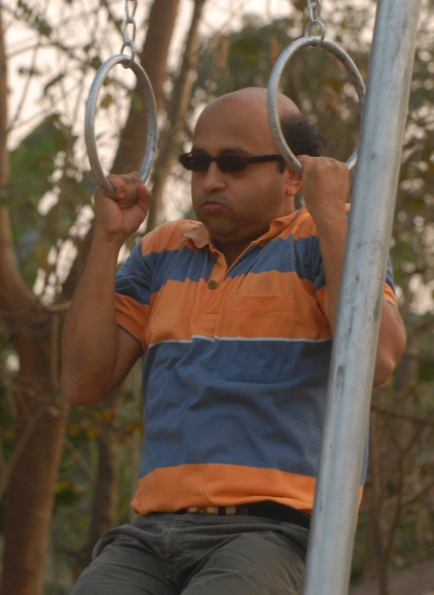
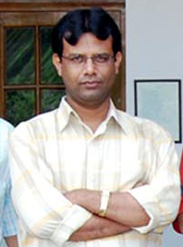
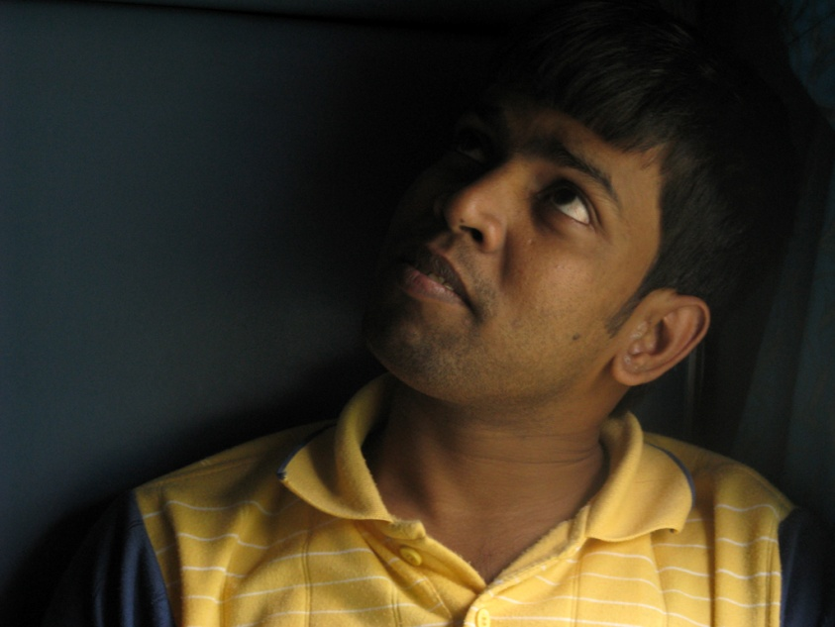
Somnath Bharadwaj
Tirthankar Roy Choudhury
Kanan Kumar Datta

Slide 3
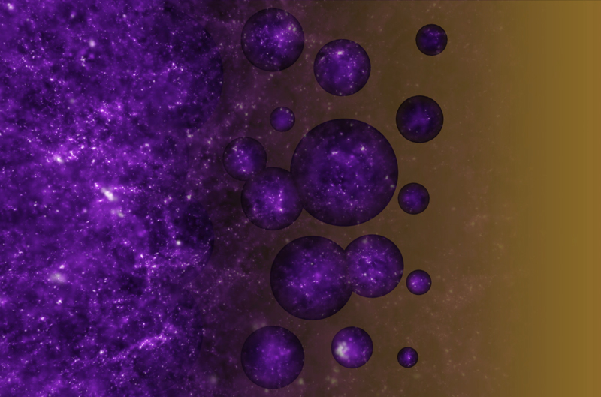
Image credit: NASA/STScI

Slide 4
A Simple Model
Uniform HI
Medium
Perfectly Spherical HII Bubble

Slide 5
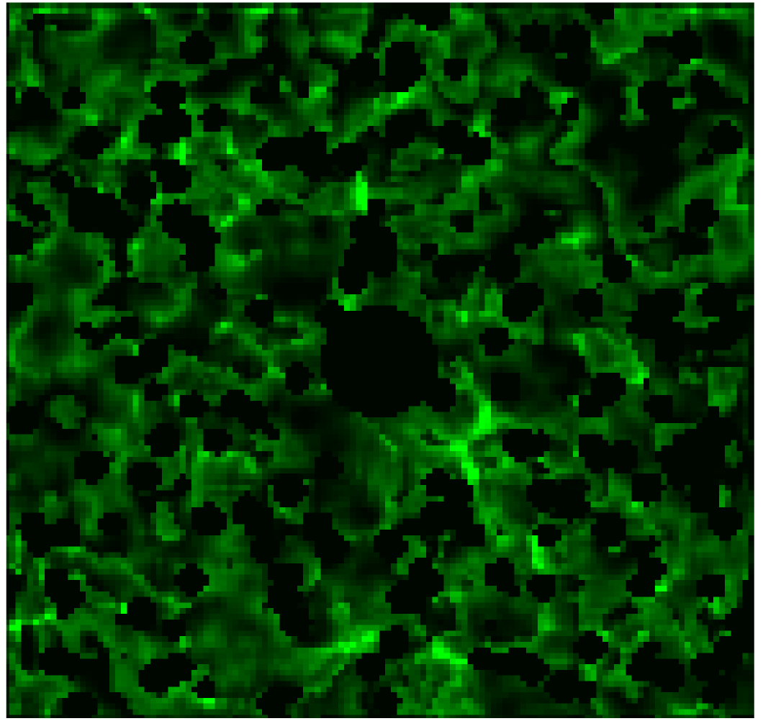
Realistic Model
HII bubble can be anisotropic in shape, due to ----
HI density fluctuation outside,
Anisotropic emission from QSO/source, ……
Non-uniform HI Distribution

Slide 6
OBSERVER

Slide 7
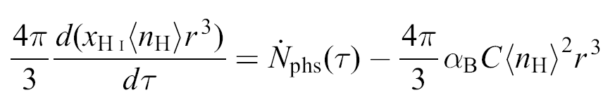
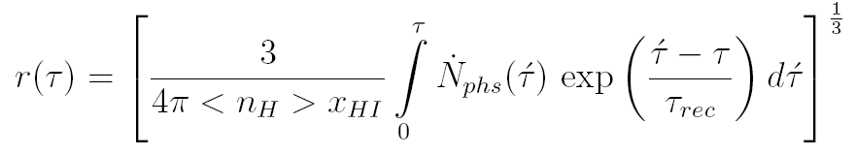
Growth Equation
Photon Emission Rate
Recombination Rate
Shapiro, P. R., & Giroux, M. L. 1987, ApJL, 321L, 107S

Slide 8
OBSERVER
QSO

Slide 9
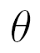
OBSERVER

Slide 10
OBSERVER

Slide 11
OBSERVER

Slide 12
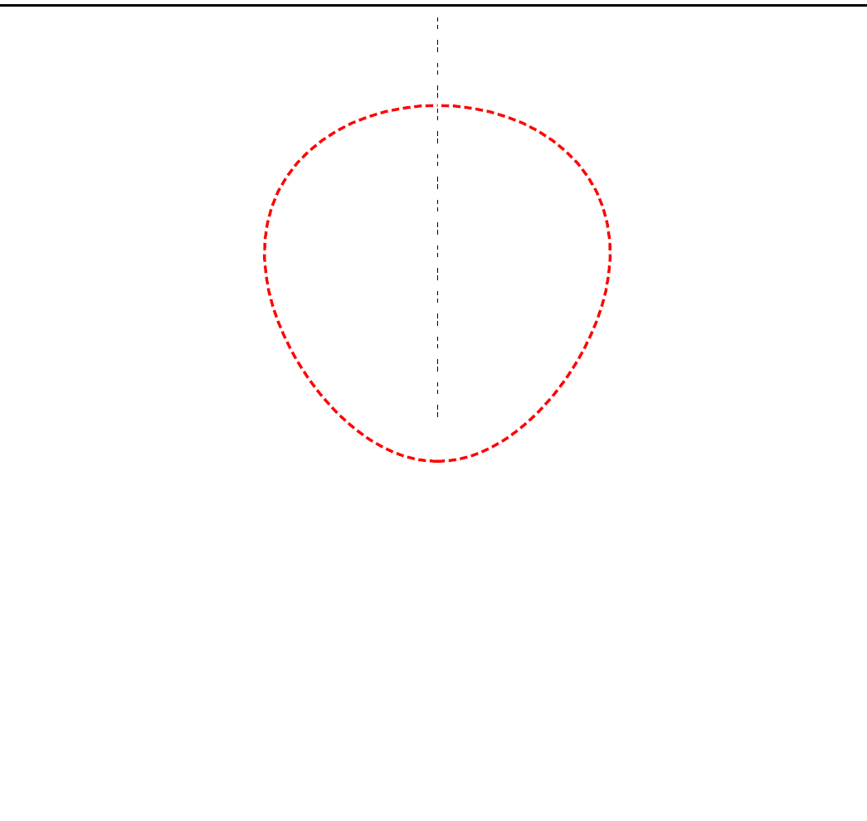
OBSERVER
OBSERVER

Slide 13
OBSERVER
OBSERVER

Slide 14
OBSERVER
OBSERVER
Yu, Q. 2005, ApJ, 623, 683

Slide 15
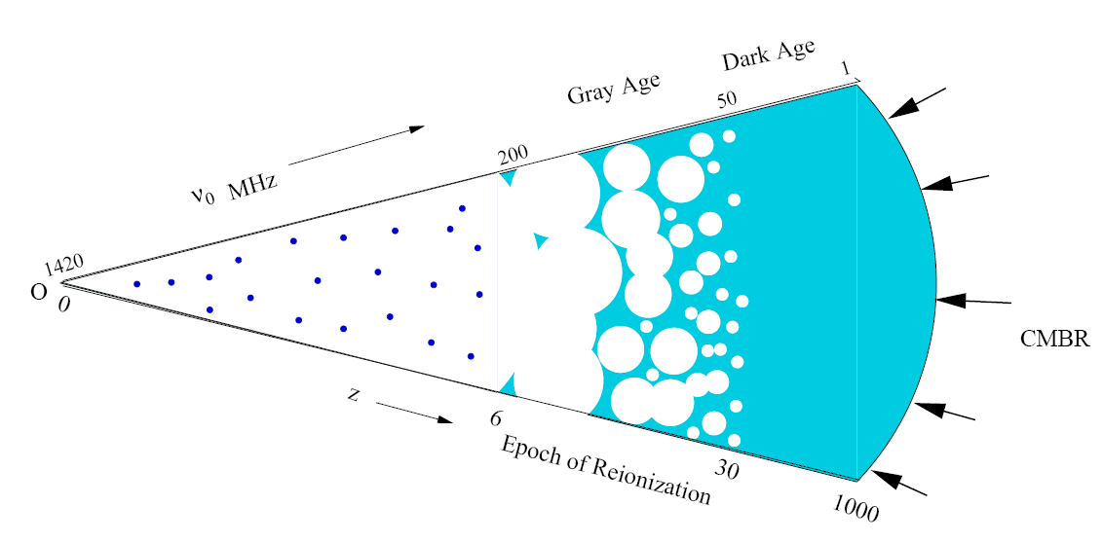
HI 21 cm
radiation

Slide 16
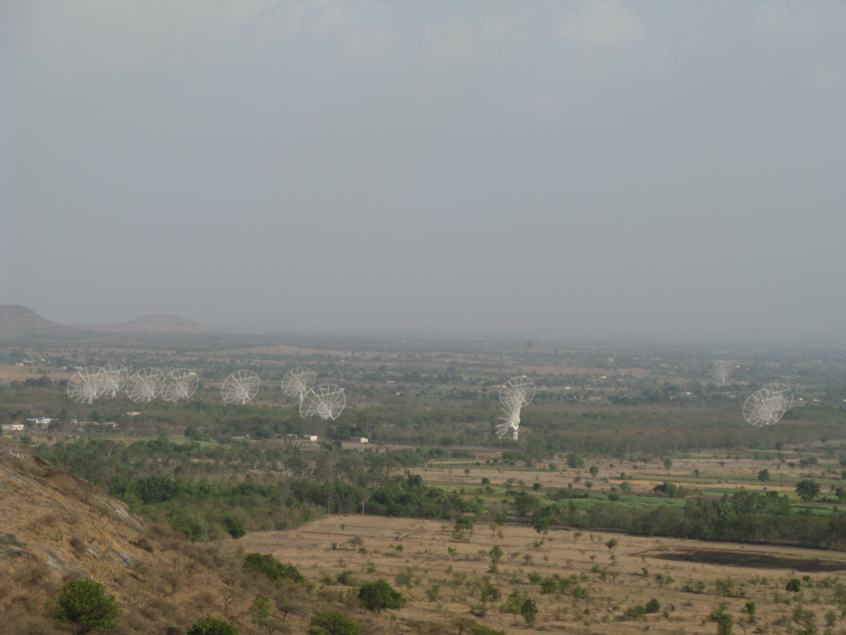

Slide 17
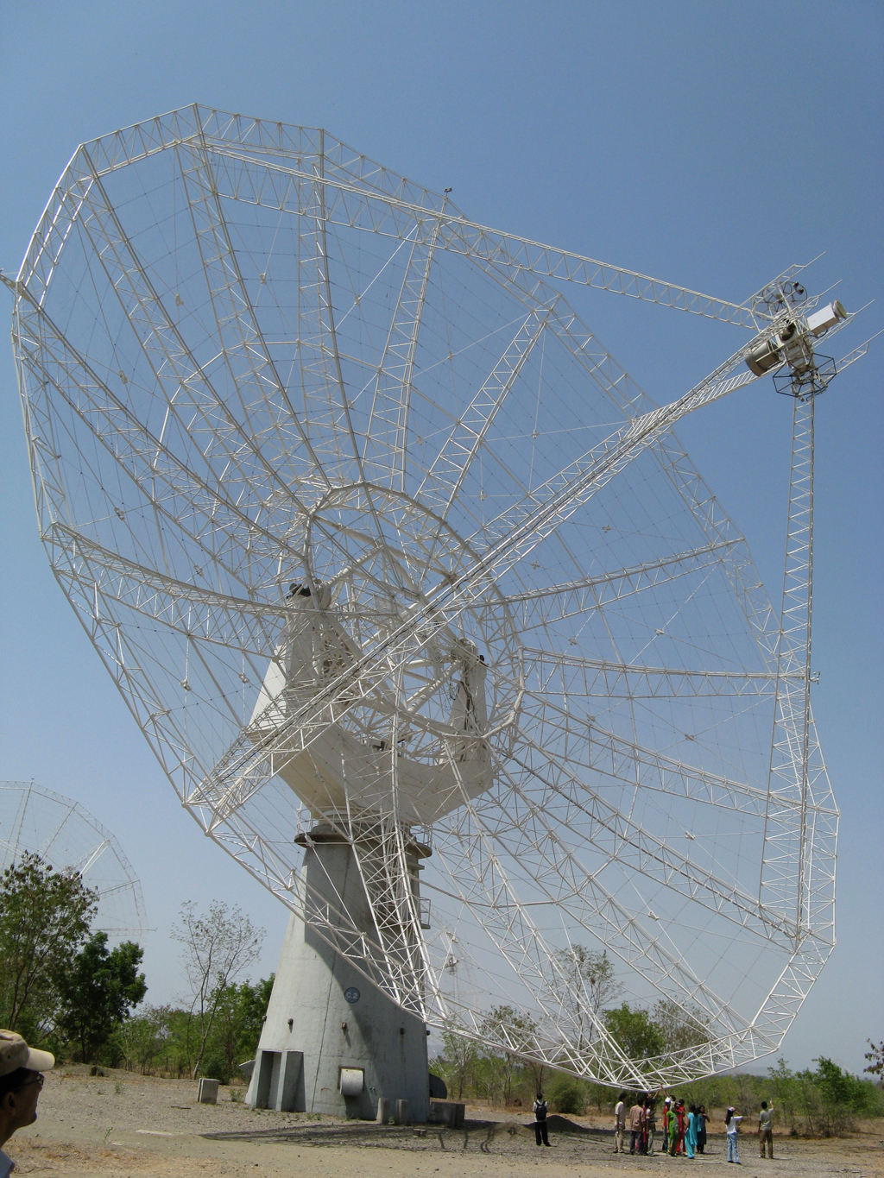

Slide 18
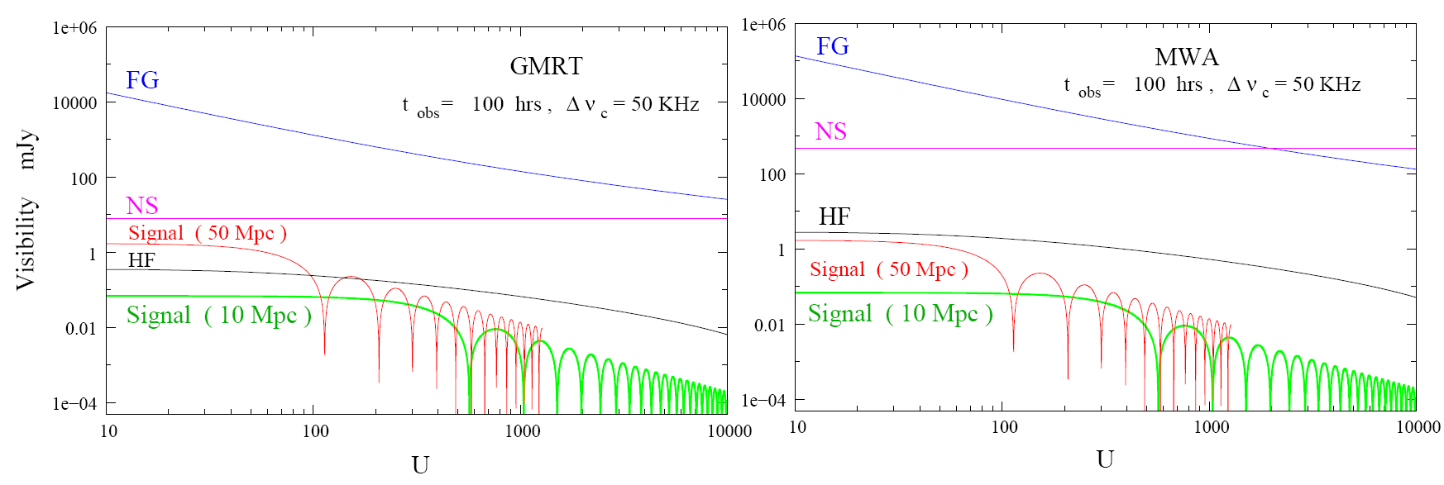
Radio Interferometry
“Visibility”
Signal is ~1,00,000 & ~100 times smaller than foregrounds & 100 hrs noise !!!

Slide 19
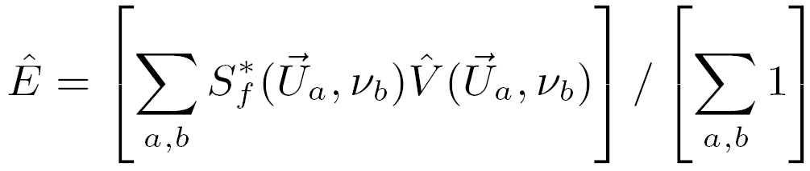


Matched Filter & Spherical HII Bubble
Ionized Hydrogen
(HII)
Spherical Filter
Neutral Hydrogen
(HI)
Datta, K. K., Bharadwaj, S., & Choudhury, T. R., 2007,MNRAS, 382, 109

Slide 20
Matched Filter & Spherical HII Bubble
Ionized Hydrogen
(HII)
Spherical Filter
Neutral Hydrogen
(HI)
Datta, K. K., Bharadwaj, S., & Choudhury, T. R., 2007,MNRAS, 382, 109

Slide 21
Matched Filter Technique & Finite Light Travel Time Effect on HII Bubble
To check the detectability of these apparently anisotropic shaped bubbles using matched filter technique .

Slide 22
Matched Filter Technique & Finite Light Travel Time Effect on HII Bubble
To check the detectability of these apparently anisotropic shaped bubbles using matched filter technique .
Effect is along the line of sight (LOS) of the observer

Slide 23
Matched Filter Technique & Finite Light Travel Time Effect on HII Bubble
To check the detectability of these apparently anisotropic shaped bubbles using matched filter technique .
Effect is along the line of sight (LOS) of the observer
Apparent shapes are symmetric about the LOS axis

Slide 24
Matched Filter Technique & Finite Light Travel Time Effect on HII Bubble
To check the detectability of these apparently anisotropic shaped bubbles using matched filter technique .
Effect is along the line of sight (LOS) of the observer
Apparent shapes are symmetric about the LOS axis
Cross section of these apparent shapes are circular

Slide 25
Matched Filter Technique & Finite Light Travel Time Effect on HII Bubble
To check the detectability of these apparently anisotropic shaped bubbles using matched filter technique .
Effect is along the line of sight (LOS) of the observer
Apparent shapes are symmetric about the LOS axis
Cross section of these apparent shapes are circular

Slide 26
Matched Filter Technique & Finite Light Travel Time Effect on HII Bubble
To check the detectability of these apparently anisotropic shaped bubbles using matched filter technique .
Effect is along the line of sight (LOS) of the observer
Apparent shapes are symmetric about the LOS axis
Cross section of these apparent shapes are circular
We will use spherical filters

Slide 27
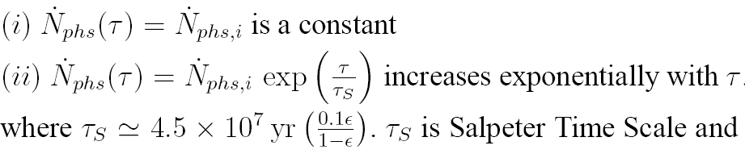
Growth of Bubbles & Shape Parameters
Two Models of Photon Emission Rate ----
Yu, Q. 2005, ApJ, 623, 683

Slide 28
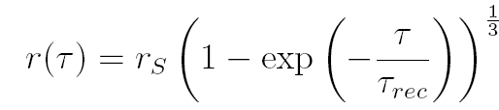
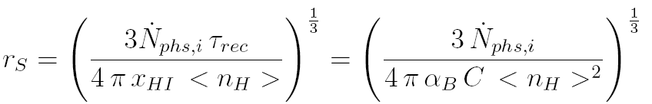
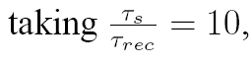
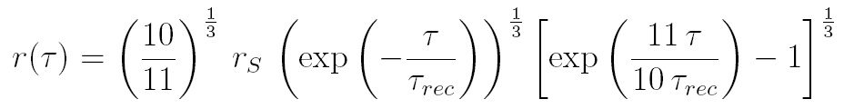
Growth of Bubbles & Shape Parameters
Solution for Model (i):-
Solution for Model (ii):-

Slide 29
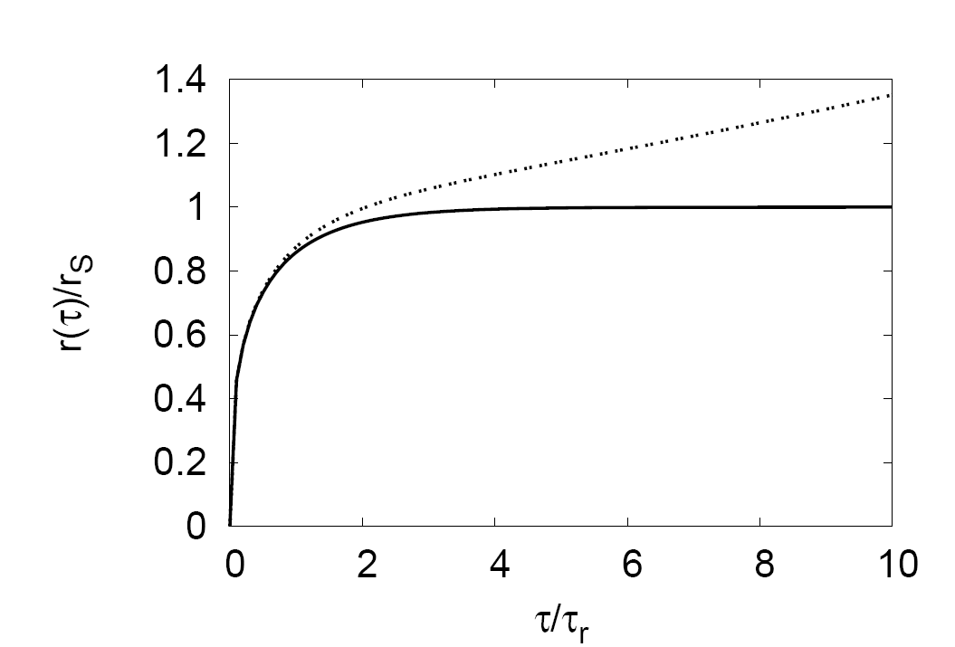
Model (ii)
Model (i)

Slide 30
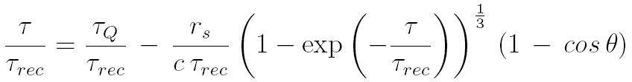
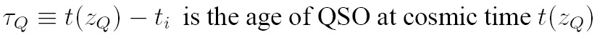
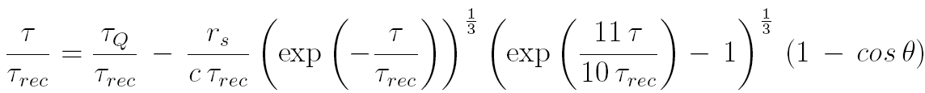
Growth of Bubbles & Shape Parameters
For Model (i)
For Model (ii)
Yu, Q. 2005, ApJ, 623, 683

Slide 31
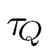
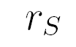
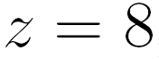
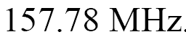
QSO & Bubble Parameters
We assume QSO is sitting at redshift
Corresponding HI 21cm redshifted frequency
This is the optimum redshift for bubble detection using GMRT
Datta, K. K., Bharadwaj, S., & Choudhury, T. R., 2009, MNRAS.tempL, 307D

Slide 32
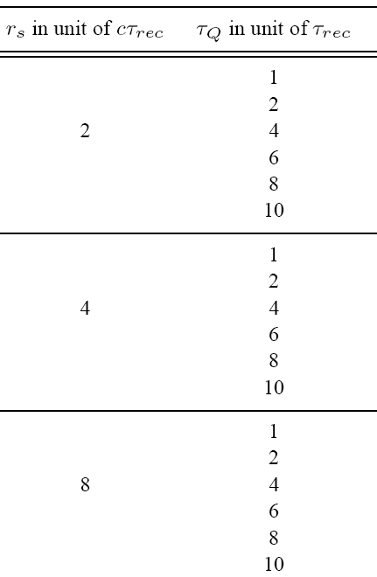
Bubble Parameters
For Models (i) & (ii)

Slide 33
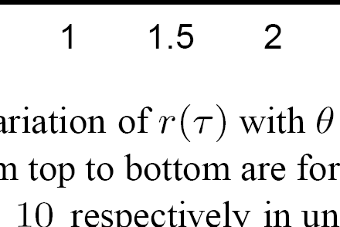
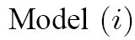
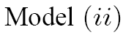
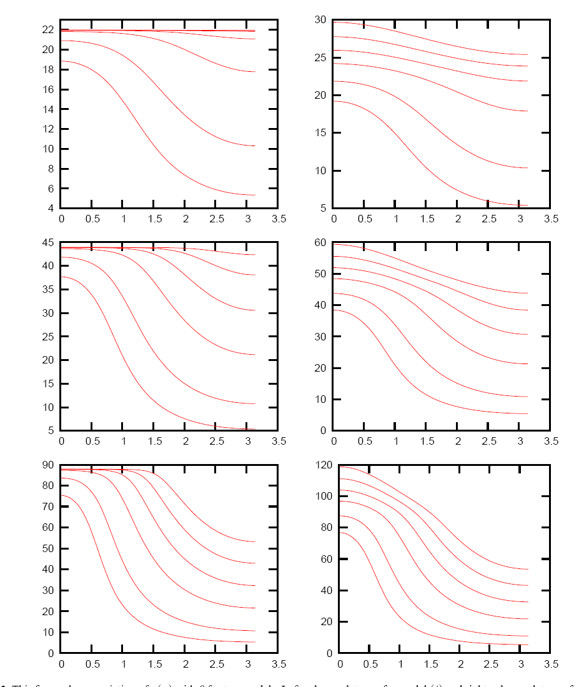
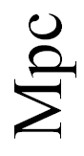
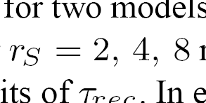


Slide 35
R_max
R_max

Slide 36
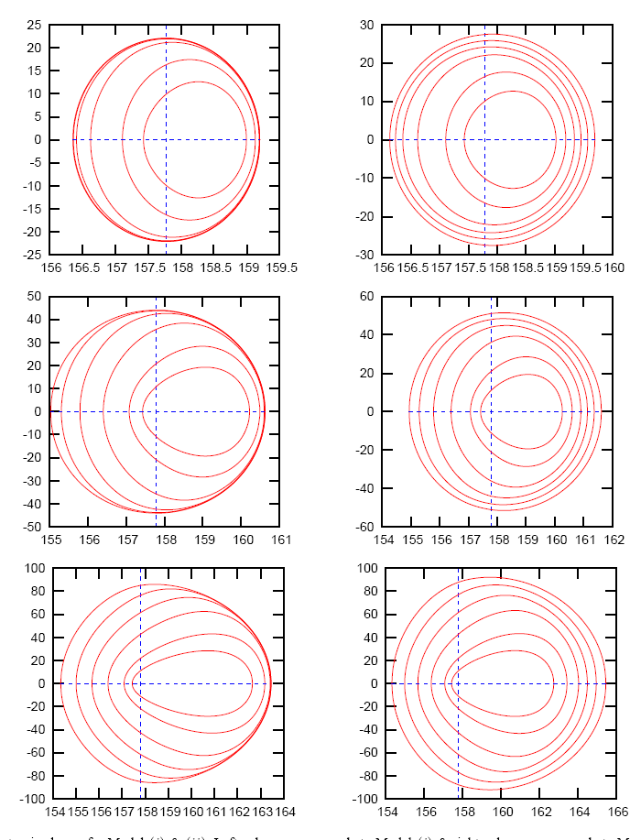


Slide 37
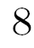

Slide 39
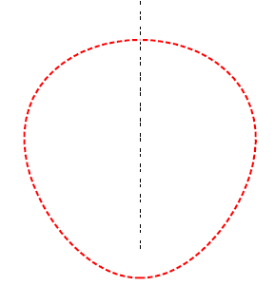
Search with Spherical Filters
Search Parameters:--
Radius of the filter

Slide 40
Search with Spherical Filters
Search Parameters:--
Radius of the filter

Slide 41
Search with Spherical Filters
Search Parameters:--
Radius of the filter

Slide 42
Search with Spherical Filters
Search Parameters:--
Radius of the filter
We assume sky plane position coordinates QSO is known, so we vary redshift or frequency of filter centre.

Slide 43
Search with Spherical Filters
Search Parameters:--
Radius of the filter
We assume sky plane position coordinates of QSO is known, so we vary redshift or frequency of filter centre.

Slide 44
Search with Spherical Filters
Search Parameters:--
Radius of the filter
We assume sky plane position coordinates of QSO is known, so we vary redshift or frequency of filter centre.

Slide 45
Search with Spherical Filters
Search Parameters:--
Radius of the filter
We assume sky plane position coordinates of QSO is known, so we vary redshift or frequency of filter centre.
SNR maximum => Best Match
&
Maximim SNR>3 => 3-sigma detection is possible

Slide 46
Search with Spherical Filters
Search Parameters:--
Radius of the filter
We assume sky plane position coordinates of QSO is known, so we vary redshift or frequency of filter centre.
SNR maximum => Best Match
&
Maximim SNR>3 => 3-sigma detection is possible
We consider 1000 hrs of observation with GMRT

Slide 47
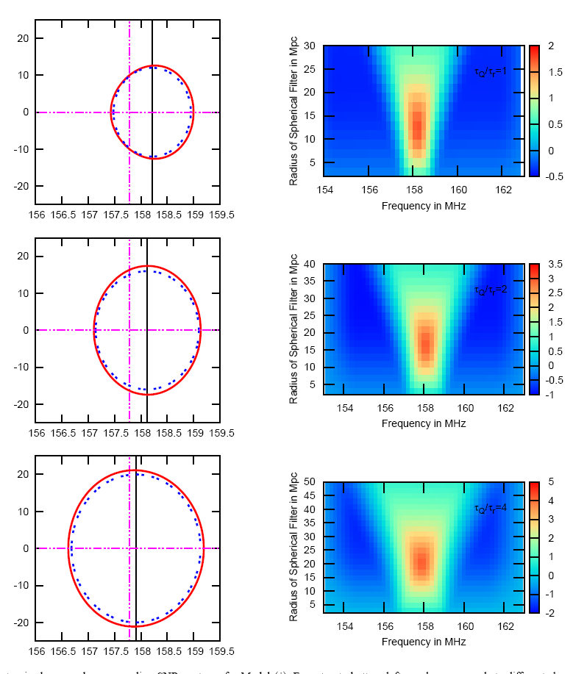
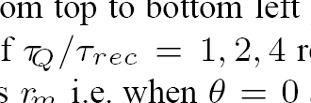
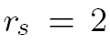
QSO
Filter

Slide 48
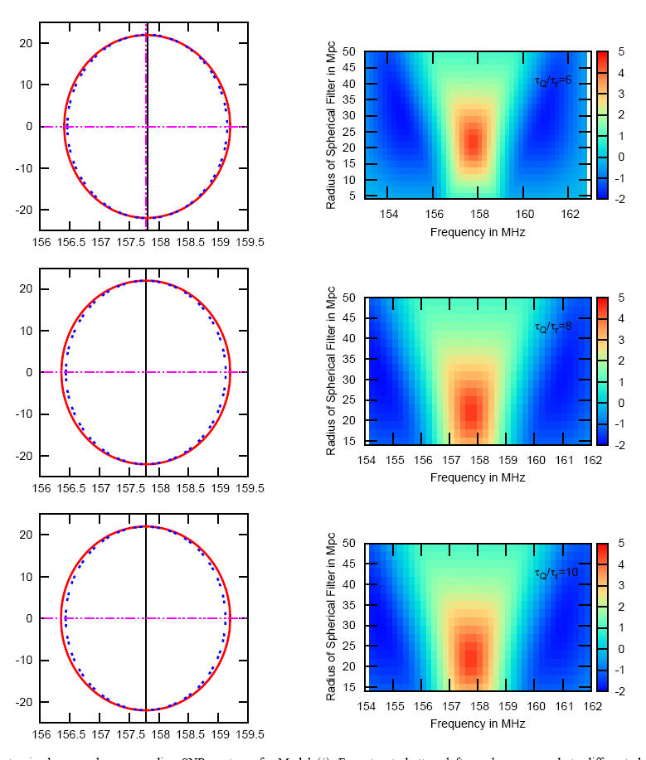
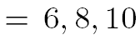

Slide 49
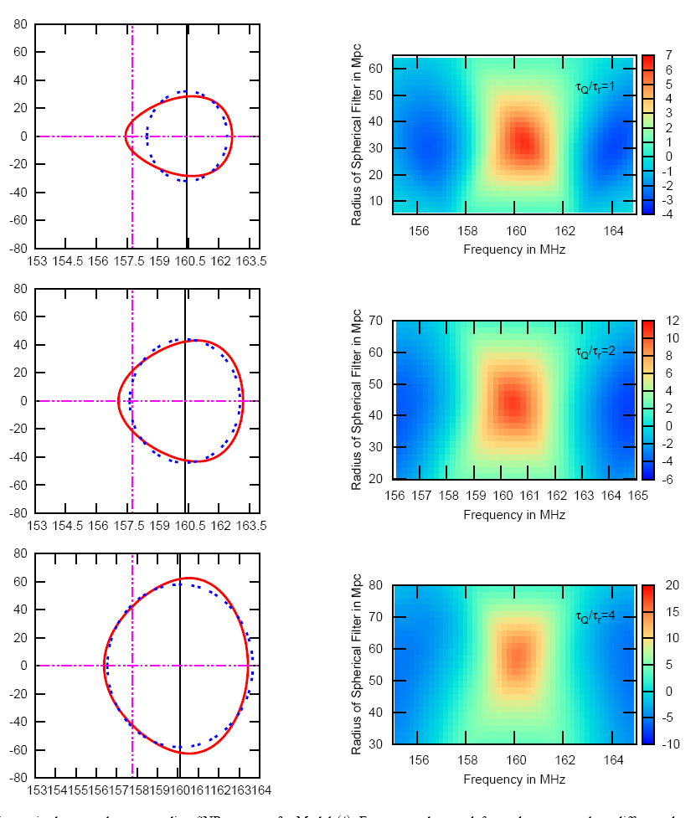
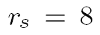

Slide 50
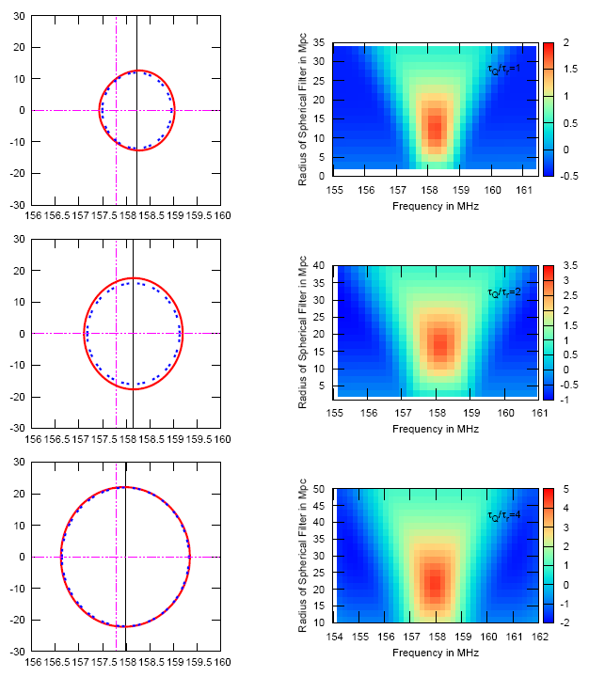

Slide 51
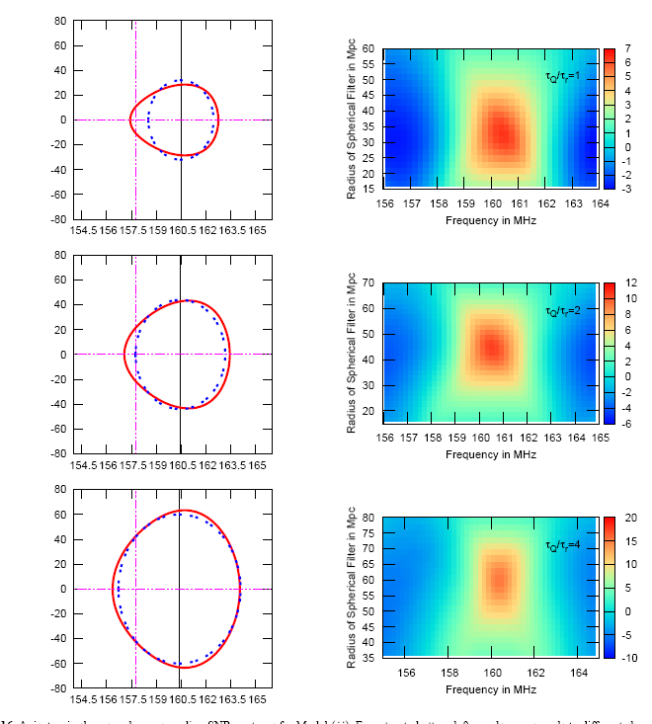

Slide 52
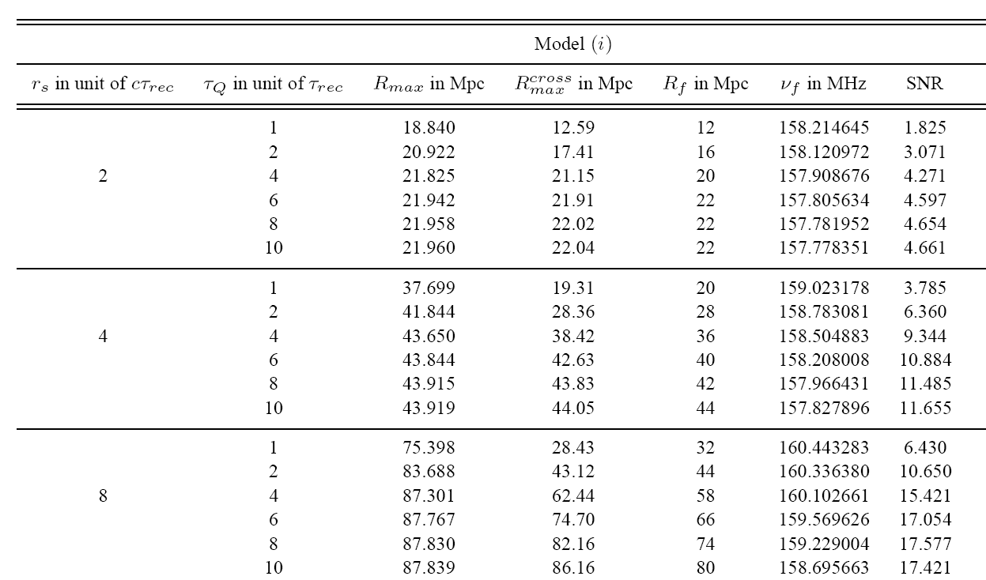

Slide 59
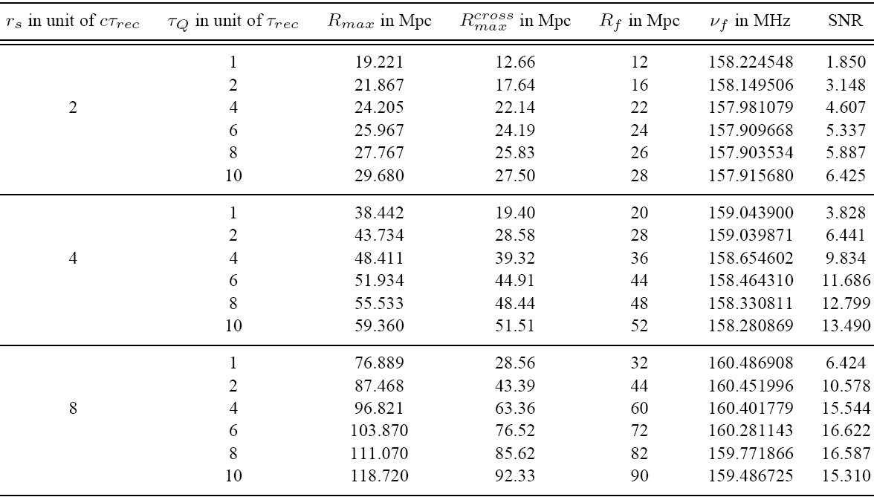

Slide 63
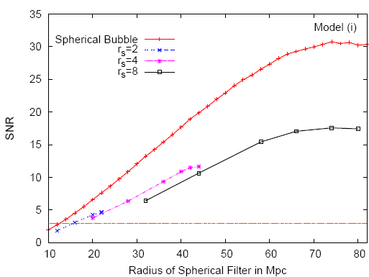
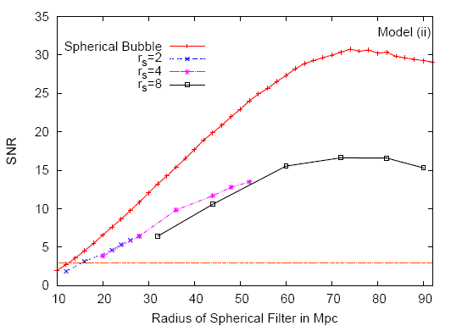
Comparison with Spherical Bubble
SNR

Slide 64
Conclusions
3-sigma detection of growing HII bubbles with apparent anisotropic shape is possible using matched filter technique, with spherical filters.
Magnitude of SNR for best matched filter is below than that of an exact spherical bubble.
Best matched filter radius is comparable with the max. cross sectional radius of the bubble.
There is a difference between the best matched filter centre’s frequency coordinate & QSO’s frequency coordinate, in almost all cases.

Slide 65


Slide 66

Thank You

Slide 67

Baseline Distribution Function

Slide 68

Baseline Distribution Function
Datta, K. K., Bharadwaj, S., & Choudhury, T. R., 2007,MNRAS, 382, 109

Slide 69


Comparison with Spherical Bubble
Estimator

