Slide 1
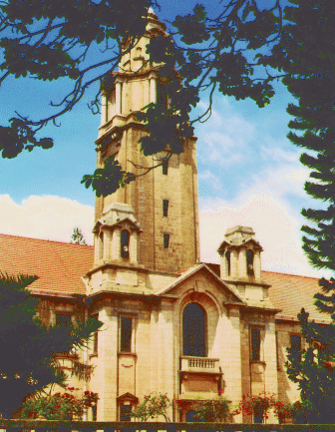
Recent Developments in Quantum Information Processing by NMR
Anil Kumar
Department of Physics and NMR Research Centre
Indian Institute of Science, Bangalore-560012
QIPA-15-HRI-December 2015

Slide 2
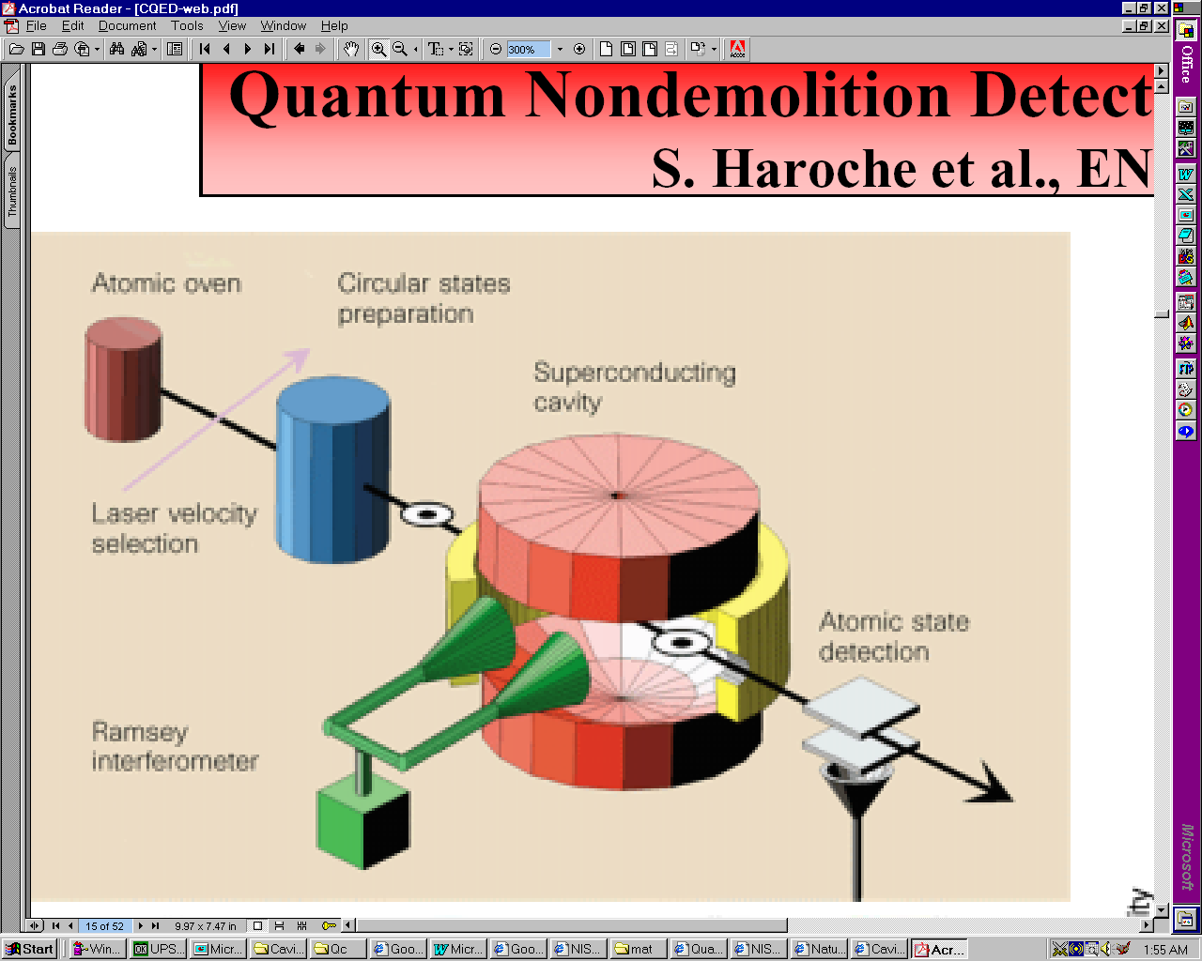
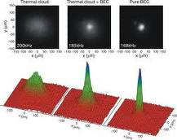
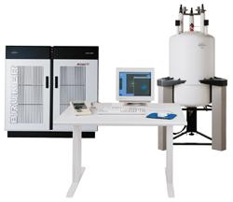
Experimental Techniques for Quantum Computation:
2. Polarized Photons Lasers
3. Cavity Quantum
Electrodynamics (QED)
1. Trapped Ions
4. Quantum Dots
5. Cold Atoms
6. NMR
7. Josephson junction qubits
8. Fullerence based ESR quantum computer

Slide 3
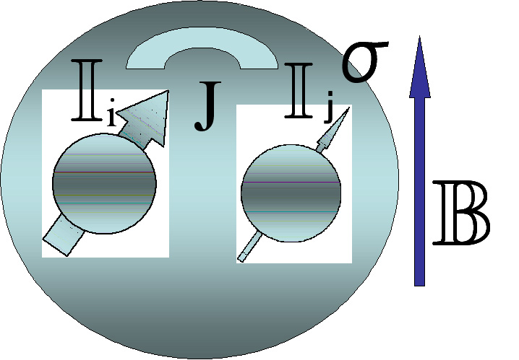
Nuclear Magnetic Resonance (NMR)
1. Nuclear spins have small magnetic moments and behave as tiny quantum magnets.
B₁
2. When placed in a magnetic field (B₀), spin ½ nuclei orient either along the field (|0⟩ state) or opposite to the field (|1⟩ state) .
0
3. A transverse radio-frequency field (B₁) tuned at the Larmor frequency of spins can cause transition from |0⟩ to |1⟩ (NOT Gate by a 180⁰ pulse). Or put them in coherent superposition (Hadamard Gate by a 90⁰ pulse). Single qubit gates.
4. Spins are coupled to other spins by indirect spin-spin (J) coupling, and controlled (C-NOT) operations can be performed using J-coupling. Multi-qubit gates
NUCLEAR SPINS ARE QUBITS

Slide 4
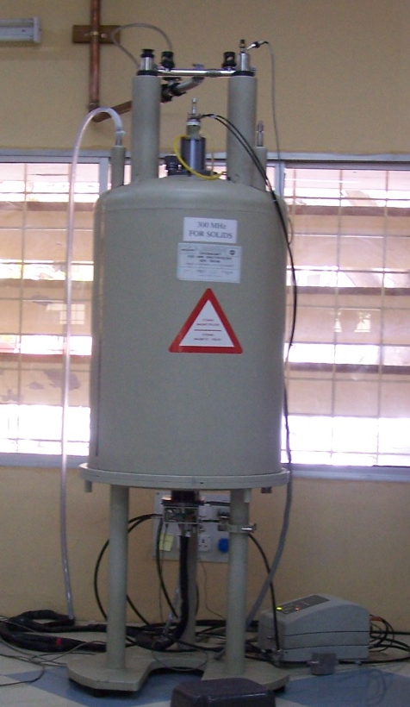
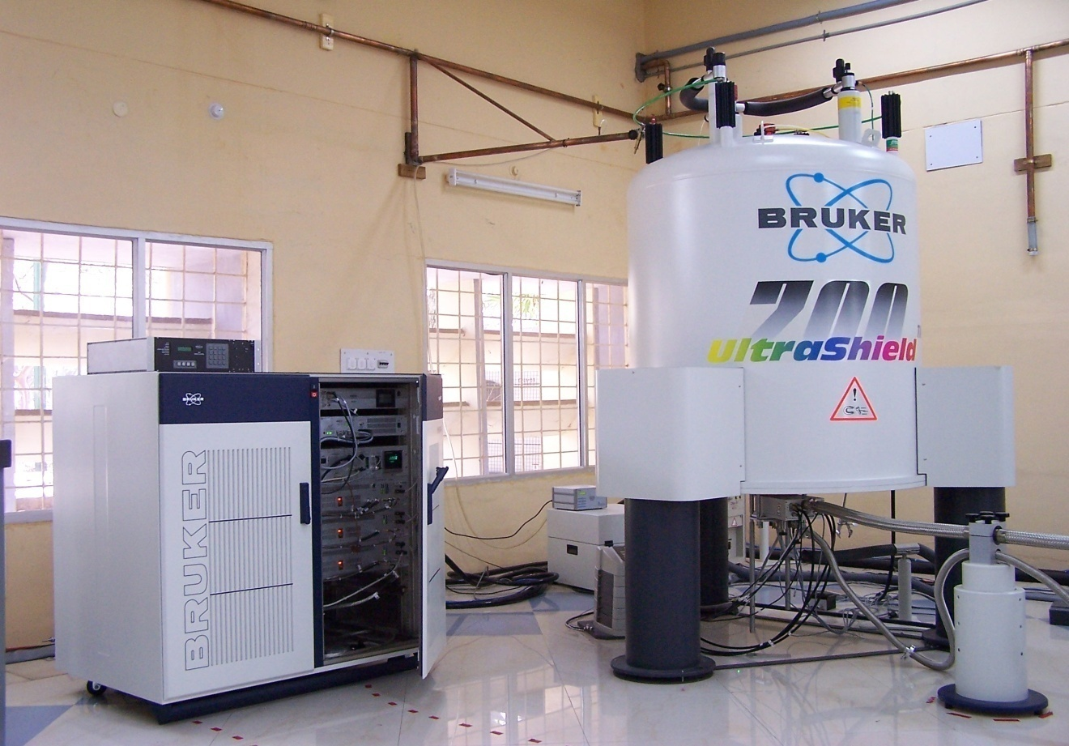
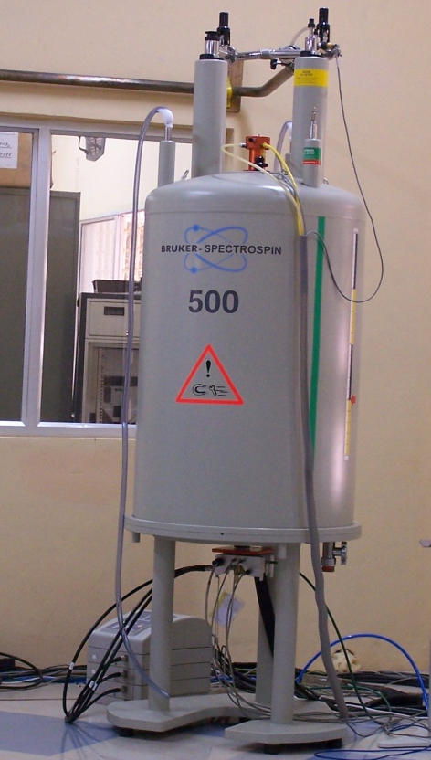
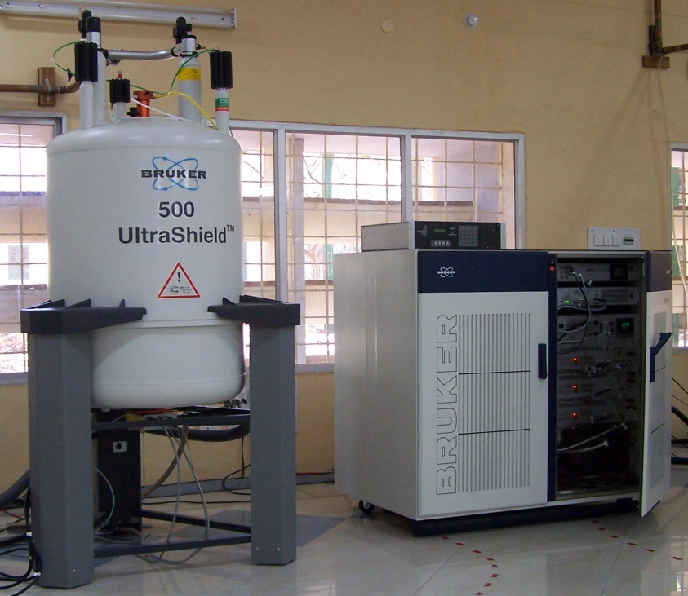
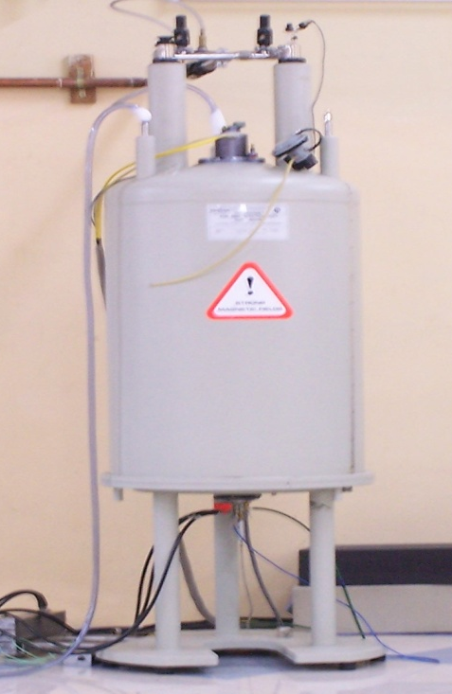
DSX 300
7.0 Tesla
Field/ Frequency stability = 1:10 ⁹
AV 700
16.5 Tesla
NMR Research Centre, IISc
1 PPB
DRX 500
11.7 Tesla
AV 500
11.7 Tesla
AMX 400
9.4 Tesla
Notes:
4

Slide 5
Why NMR?
> A major requirement of a quantum computer is that the coherence should last long.
> Nuclear spins in liquids retain coherence ~ 100’s millisec and their longitudinal state for several seconds.
> A system of N coupled spins (each spin 1/2) form an N qubit Quantum Computer.
> Unitary Transform can be applied using R.F. Pulses and J-evolution and various logical operations and quantum algorithms can be implemented.

Slide 6
Addressability in NMR
NMR sample has ~ 10¹⁸ spins.
Do we have 10¹⁸ qubits?
No - because, all the spins can’t be
individually addressed.
Progress so far
Spins having different Larmor frequencies can be addressed in the frequency domain resulting-in as many “qubits” as Larmor frequencies, each having ~10¹⁸ spins. (ensemble computing).
One needs un-equal couplings between the spins, yielding resolved
transitions in a multiplet, in order to encode information as qubits.

Slide 7
NMR Hamiltonian
H = H_{Zeeman} + H_{J-coupling}
= ∑ ω_{i} Ι_{zi} + ∑ J_{ij} I_{i} • I_{j}
Two Spin System (AM)
^{i}
^{i < j}
|ββ⟩ = |11⟩
Weak coupling Approximation
⏐ω_{i} − ω_{j}⏐>> J_{ij}
A₂= |1_{M}⟩
M₂= |1_{A}⟩
|αβ⟩ = |01⟩
|βα⟩ = |10⟩
H = ∑ ω_{i} Ι_{zi} + ∑ J_{ij} I_{zi} I_{zj}
M₁= |0_{A}⟩
A₁= |0_{M}⟩
^{i}
^{i < j}
|αα⟩ = |00⟩
Spin Product States are Eigenstates
A2
A1
M2
M1
Under this approximation spins having same Larmor Frequency can be treated as one Qubit
ω_{A}
ω_{M}

Slide 8
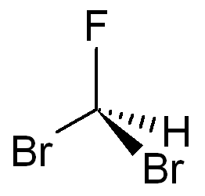
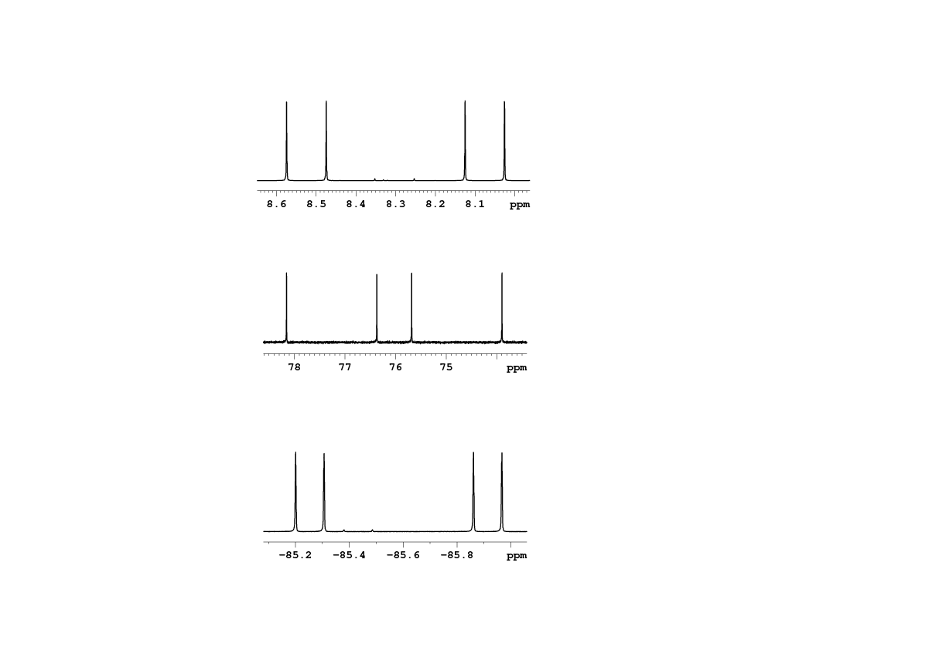
NMR Qubits
An example of a Hetero-nuclear three qubit system.
J_{CH} = 225 Hz
J_{CF} = -311 Hz
J_{HF} = 50 Hz
¹³CHFBr₂
¹³C
¹H = 500 MHz
¹³C = 125 MHz
¹⁹F = 470 MHz
Br (spin 3/2) is a quadrupolar nucleus, is decoupled from the rest of the spin system and can be ignored.

Slide 9
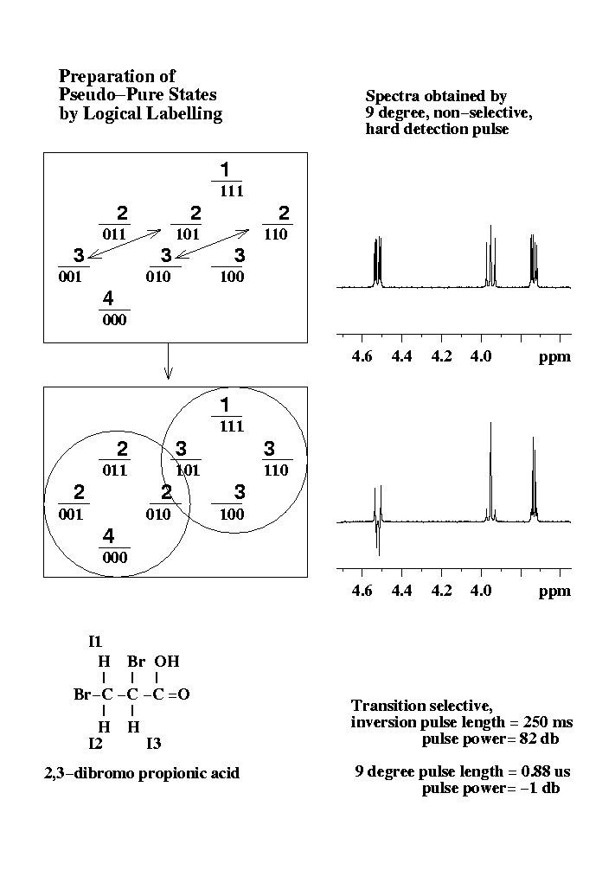
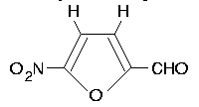
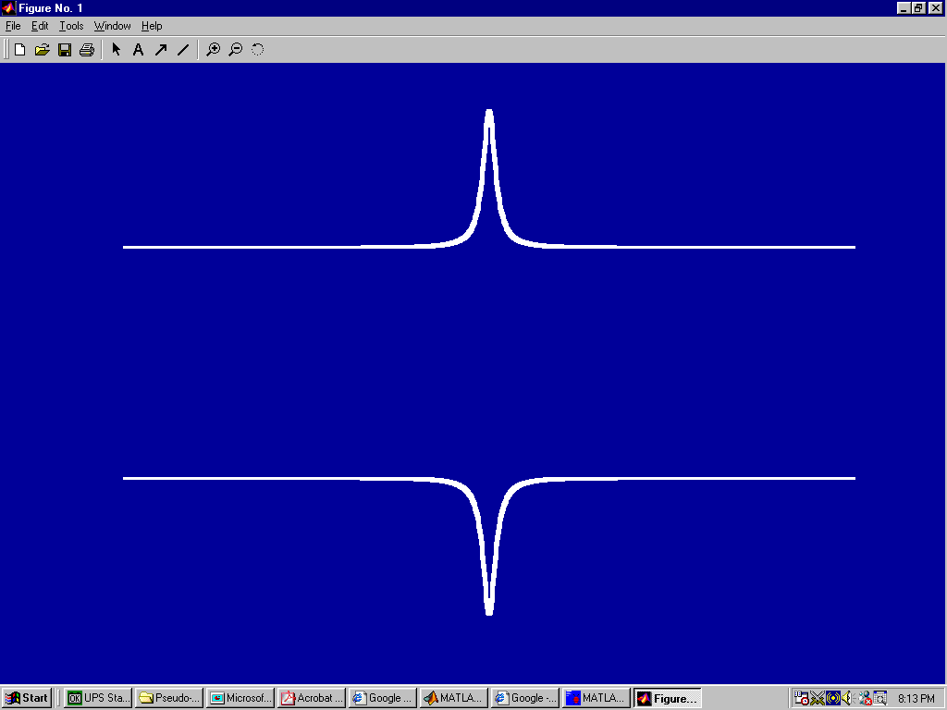
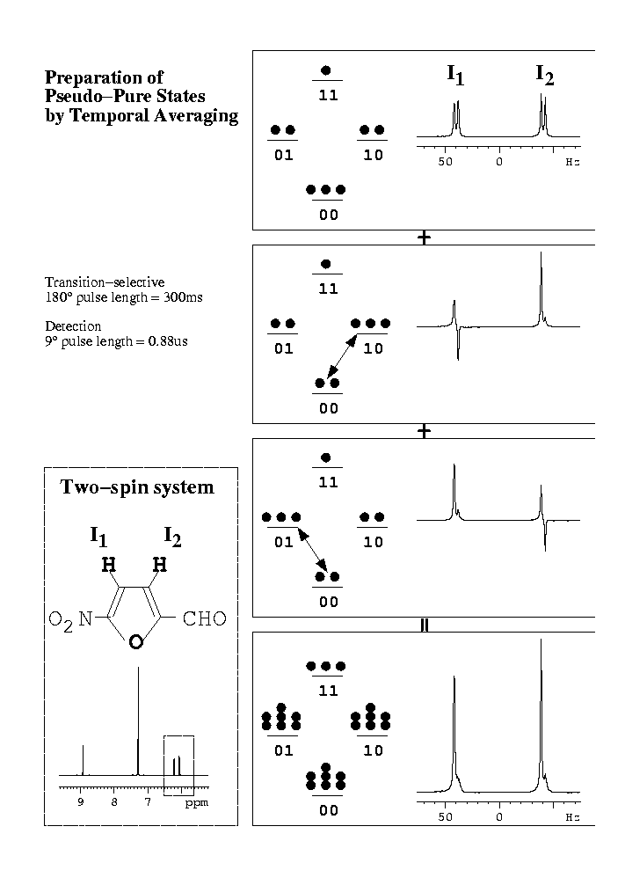
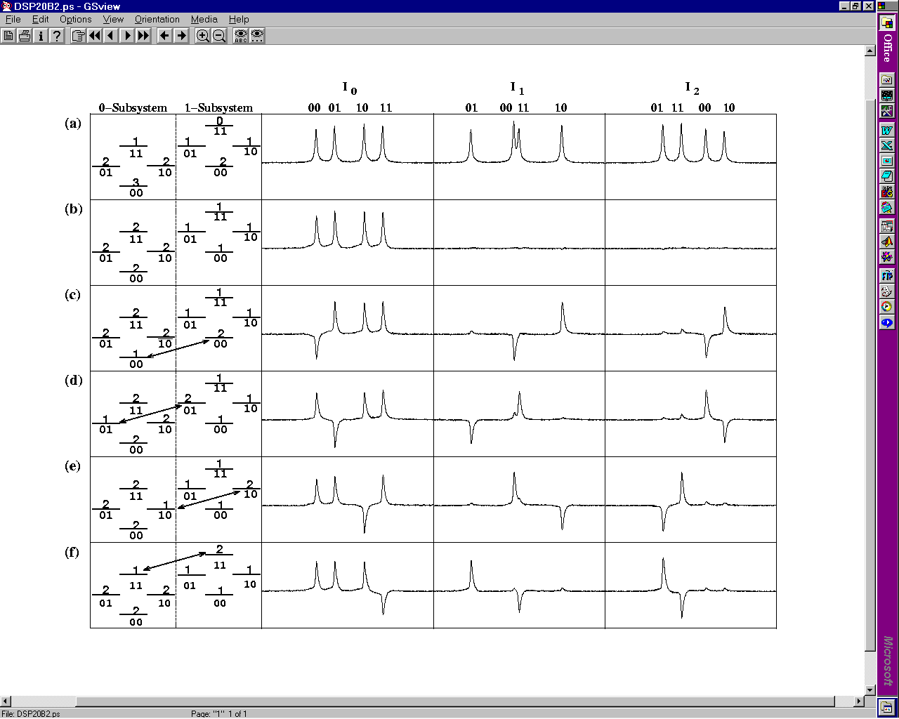
Homo-nuclear spins having different Chemical shifts (Larmor frequencies) also form multi-qubit systems
3 Qubits
2 Qubits
1 Qubit
CHCl₃
111
1
11
011
110
101
0
10
01
010
001
100
00
000

Slide 10
Pure States:
Tr(ρ ) = Tr ( ρ² ) = 1
For a diagonal density matrix, this condition requires that all energy levels except one have zero populations.
Such a state is difficult to create in NMR
Pseudo-Pure States
Under High Temperature Approximation
ρ = 1/N ( α1 + Δρ )
Here α = 10⁵ and U 1 U⁻¹ = 1
We create a state in which all levels except one have EQUAL populations. Such a state mimics a pure state.

Slide 11
Pseudo-Pure State
In a two-qubit Homo-nuclear system:
(Under High Field Approximation)
        Equilibrium:
ρ = 10⁵ + Δρ = {2, 1, 1, 0}
Δρ ~ I_{z1}+I_{z2} = { 1, 0, 0, -1}
(ii) Pseudo-Pure
Δρ = {4, 0, 0, 0}
0
| 11⟩
1
1
| 01⟩
| 10⟩
2
| 00⟩
0
| 11⟩
0
0
| 01⟩
| 10⟩
Δρ ~ I_{z1}+I_{z2} + 2 I_{z1}I_{z2}
= { 3/2, -1/2, -1/2, -1/2}
4
| 00⟩

Slide 12
Preparation of Pseudo-Pure States
Spatial Averaging
Logical Labeling
Temporal Averaging
Pairs of Pure States (POPS)
Spatially Averaged Logical Labeling Technique (SALLT)
Cory, Price, Havel, PNAS, 94, 1634 (1997)
N. Gershenfeld et al, Science, 275, 350 (1997)
Kavita, Arvind, Anil Kumar, Phy. Rev. A 61, 042306 (2000)
E. Knill et al., Phy. Rev. A57, 3348 (1998)
B.M. Fung, Phys. Rev. A 63, 022304 (2001)
T. S. Mahesh and Anil Kumar, Phys. Rev. A 64, 012307 (2001)
Using long lived Singlet States
S.S. Roy and T.S. Mahesh, Phys. Rev. A 82, 052302 (2010).

Slide 13
Spatial Averaging: Cory, Price, Havel, PNAS, 94, 1634 (1997)
1 0 0 0
0 1 0 0
0 0 -1 0
0 0 0 -1
1 0 0 0
0 -1 0 0
0 0 1 0
0 0 0 -1
1 0 0 0
0 -1 0 0
0 0 -1 0
0 0 0 1
I_{1z} = 1/2
I_{2z} = 1/2
2I_{1z} I_{2z} = 1/2
3 0 0 0
0 -1 0 0
0 0 -1 0
0 0 0 -1
Pseudo-pure
state
I_{1z} + I_{2z} + 2I_{1z}I_{2z} = 1/2
(π/3)_{X}⁽²⁾
(π/4)_{X}⁽¹⁾
(π/4)_{Y}⁽¹⁾
π
Eq.= I_{1z}+I_{2z}
I_{1z} + I_{2z} + 2I_{1z}I_{2z}
1
2
3
4
5
6
1/2J
G_{x}

Slide 14
Achievements of NMR - QIP
√
10. Quantum State Tomography
11. Geometric Phase in QC
12. Adiabatic Algorithms
13. Bell-State discrimination
14. Error correction
15. Teleportation
16. Quantum Simulation
17. Quantum Cloning
18. Shor’s Algorithm
19. No-Hiding Theorem
1. Preparation of
Pseudo-Pure States
2. Quantum Logic Gates
3. Deutsch-Jozsa Algorithm
4. Grover’s Algorithm
5. Hogg’s algorithm
6. Berstein-Vazirani parity algorithm
7. Quantum Games
8. Creation of EPR and GHZ states
9. Entanglement transfer
√
√
√
√
√
√
√
√
√
√
√
√
√
√
Also performed in our Lab.
Maximum number of qubits achieved in our lab: 8
In other labs.: 12 qubits;
Negrevergne, Mahesh, Cory, Laflamme et al., Phys. Rev. Letters, 96, 170501 (2006).

Slide 15
Recent Developments in our Laboratory
(i) Multipartite quantum correlations reveal frustration in quantum Ising spin systems: Experimental demonstration.
K. Rama Koteswara Rao, Hemant Katiyar, T. S. Mahesh, Aditi Sen(De), Ujjwal Sen and Anil Kumar; Phys. Rev. A 88, 022312 (2013).
(ii) An NMR simulation of Mirror inversion propagator of an XY spin Chain.
K. R. Koteswara Rao, T.S. Mahesh and Anil Kumar, Phys. Rev. A 90, 012306 (2014).
(ii) Quantum simulation of 3-spin Heisenberg XY Hamiltonian in presence of DM interaction- entanglement preservation using initialization operator.
V.S. Manu and Anil Kumar, Phys. Rev. A 89, 052331 (2014).
(iii) Efficient creation of NOON states in NMR.
V.S. Manu and Anil Kumar (Communicated)

Slide 16
Quantum simulation of frustrated Ising spins by NMR
K. Rama Koteswara Rao¹, Hemant Katiyar³, T.S. Mahesh³, Aditi Sen (De)², Ujjwal Sen² and Anil Kumar¹:
Phys. Rev A 88 , 022312 (2013).
¹ Indian Institute of Science, Bangalore
² Harish-Chandra Research Institute, Allahabad
³ Indian Institute of Science Education and Research, Pune

Slide 17

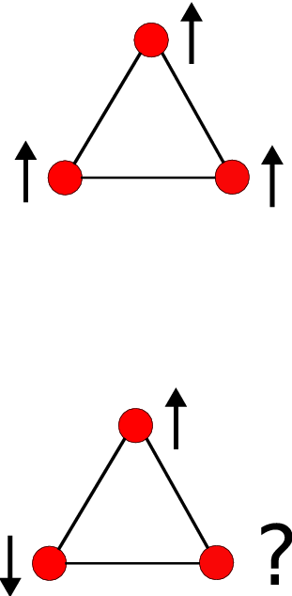
A spin system is frustrated when the minimum of the system energy does not correspond to the minimum of all local interactions. Frustration in electronic spin systems leads to exotic materials such as spin glasses and spin ice materials.
3-spin transverse Ising system
If J is negative Ferromagnetic
The system is non-frustrated
If J is positive Anti-ferromagnetic
The system is frustrated

Slide 18
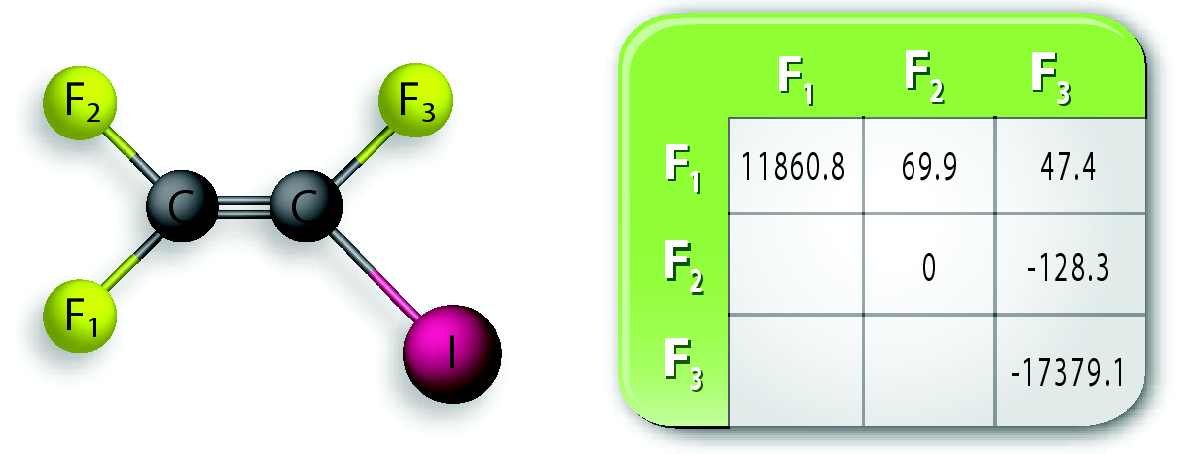
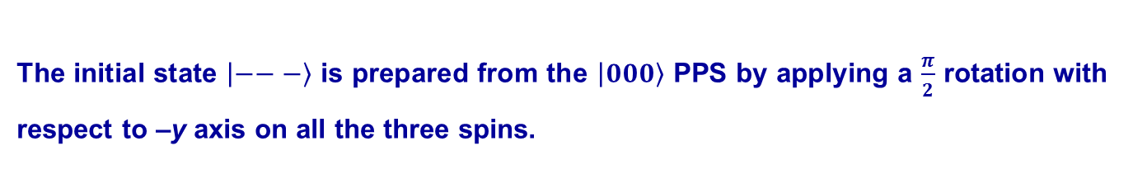
Here, we simulate experimentally the ground state of a 3-spin system in both the frustrated and non-frustrated regimes using NMR.
Experiments at 290 K in a 500 MHz NMR Spectrometer of IISER-Pune
Diagonal elements are chemical shifts and off-diagonal elements are couplings.
This rotation was realized by a numerically optimized amplitude and phase modulated radio frequency (RF) pulse using GRadient Ascent Pulse Engineering (GRAPE) technique¹.
¹N. Khaneja and S. J. Glaser et al., J. Magn. Reson. 172, 296 (2005).

Slide 19
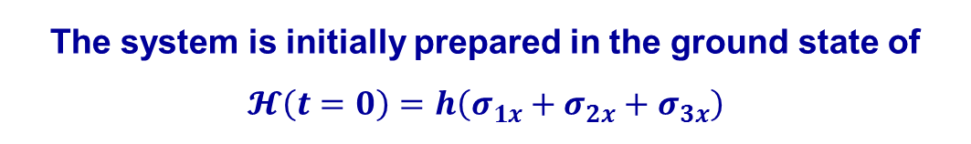
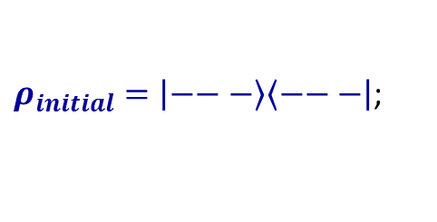
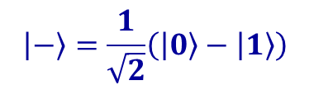







Non-frustrated
Frustrated

Slide 20
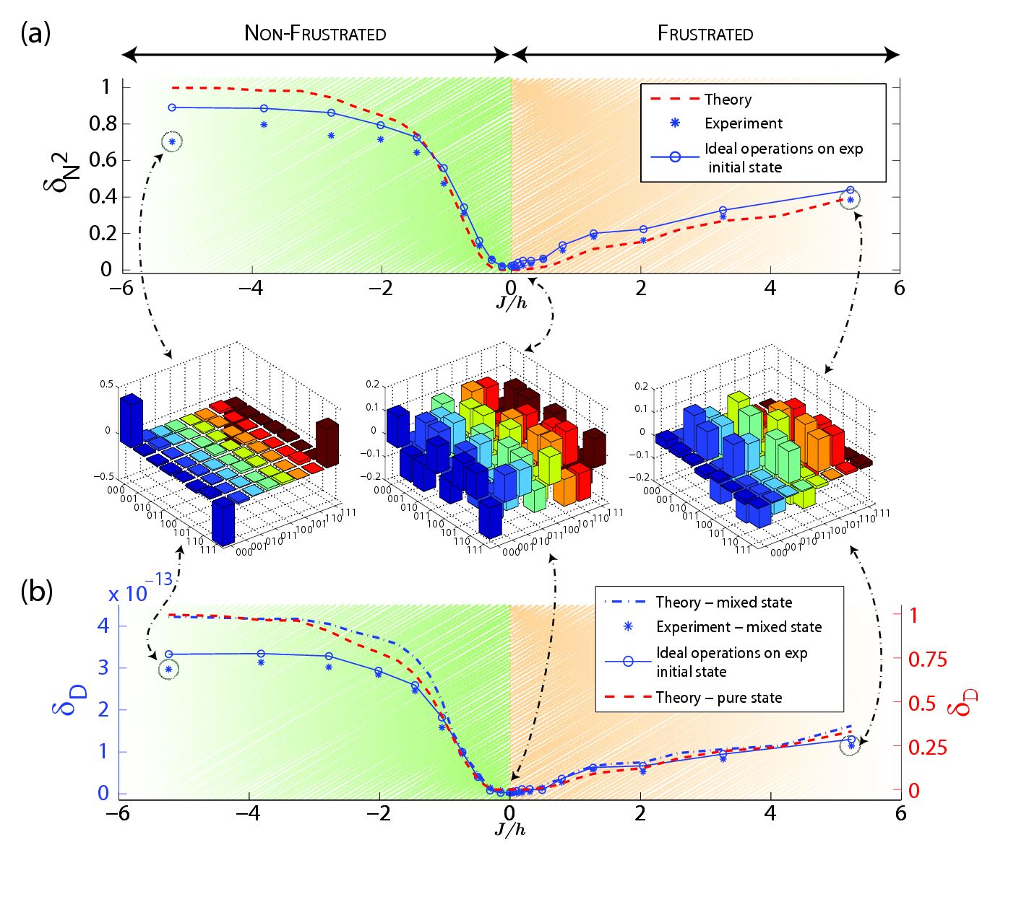
Multipartite quantum correlations
Entanglement Score using deviation Density matrix
Initial State:
Equal Coherent Superposition State.
Fidelity = .99
Non-frustrated regime: Higher correlations
Frustrated regime:
Lower correlations
Ground State
GHZ State (J >> h) (׀000> - ׀111>)/√2
Fidelity = .984
Quantum Discord Score using full density matrix
Koteswara Rao et al. Phys. Rev A 88 , 022312 (2013).

Slide 21
Conclusion
The ground state of the 3-spin transverse Ising spin system has been simulated experimentally in both the frustrated and non-frustrated regimes using Nuclear Magnetic Resonance.
To analyze the experimental ground state of this spin system, we used two different multipartite quantum correlation measures which are defined through the monogamy considerations of (i) negativity and of (ii) quantum discord. These two measures have similar behavior in both the regimes although the corresponding bipartite quantum correlations are defined through widely different approaches.
The frustrated regime exhibits higher multipartite quantum correlations compared to the non-frustrated regime and the experimental data agrees with the theoretically predicted ones.

Slide 22
An NMR simulation of Mirror inversion propagator of an XY spin Chain.
K. R. Koteswara Rao, T.S. Mahesh and Anil Kumar, Phys. Rev. A 90, 012306 (2014).
---------------------------------------------------------------------
In the last decade, there have been many interesting proposals in using spin chains to efficiently transfer quantum information between different parts of a quantum information processor.
Albanese et al have shown that mirror inversion of quantum states with respect to the center of an XY spin chain can be achieved by modulating its coupling strengths along the length of the chain. The advantage of this protocol is that non-trivial entangled states of multiple qubits can be transferred from one end of the chain to the other end.

Slide 23
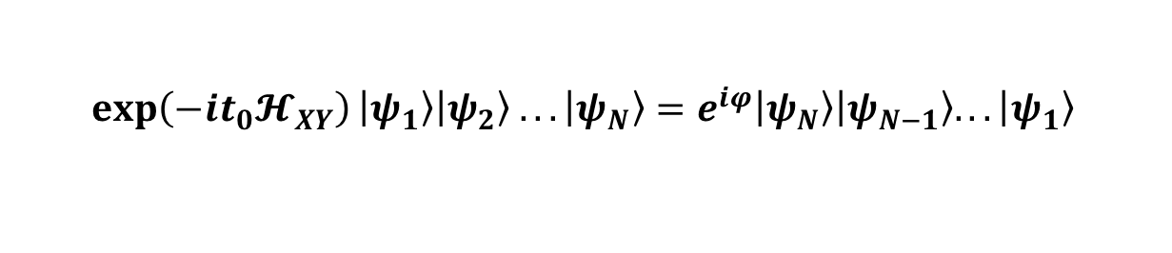
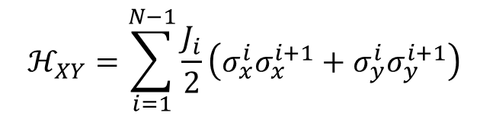

Mirror Inversion of quantum states in an XY spin chain*
J₁
J₂
J_{N-1}
1
2
3
N-1
N
The above XY spin chain Hamiltonian generates the mirror image of any input state up to a phase difference.
Entangled states of multiple qubits can be transferred from one end of the chain to the other end
*Albanese et al., Phys. Rev. Lett. 93, 230502 (2004)
*P Karbach, and J Stolze et al., Phys. Rev. A 72, 030301(R) (2005)

Slide 24
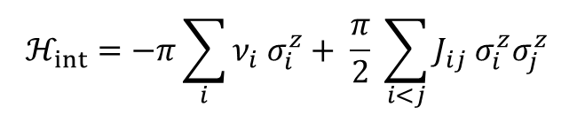
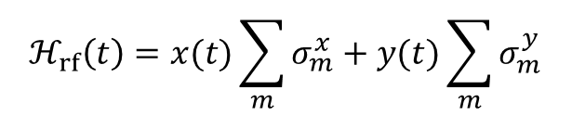
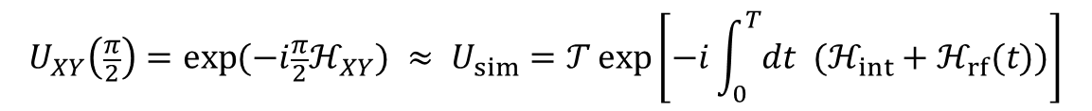



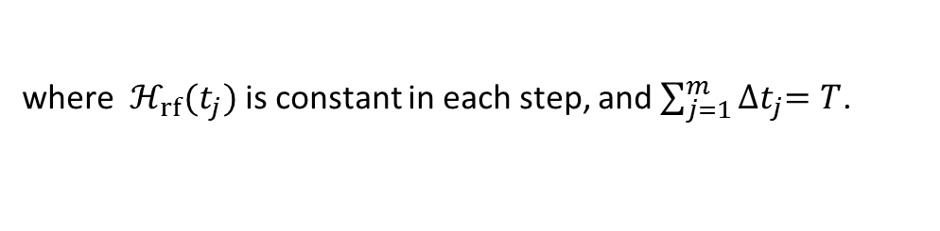
NMR Hamiltonian of a weakly coupled spin system
Control Hamiltonian
Simulation
In practice

Slide 25

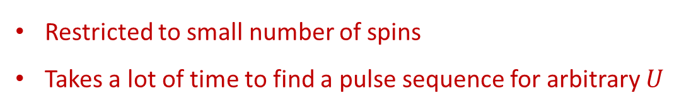
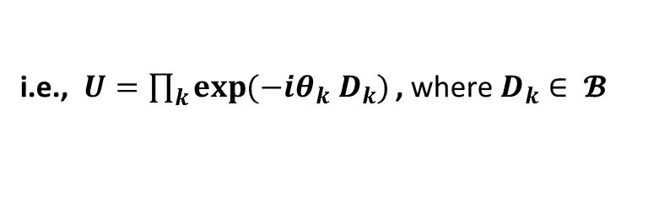
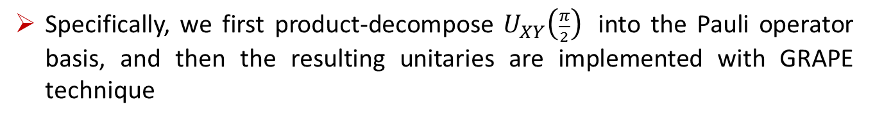
Simulation
GRAPE algorithm
2) An algorithm by A Ajoy et al. Phys. Rev. A 85, 030303(R) (2012)
Here, we use a combination of these two algorithms to simulate the unitary evolution of the XY spin chain

Slide 26
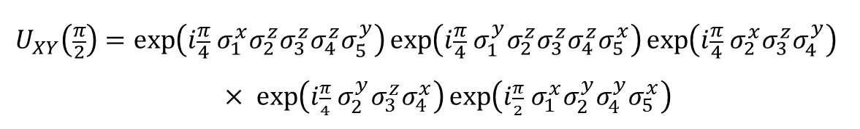
4-spin chain
5-spin chain
In the experiments, each of these decomposed operators are simulated using GRAPE technique
The number of operators in the decomposition increases only linearly with the number of spins (N).

Slide 27
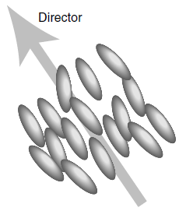
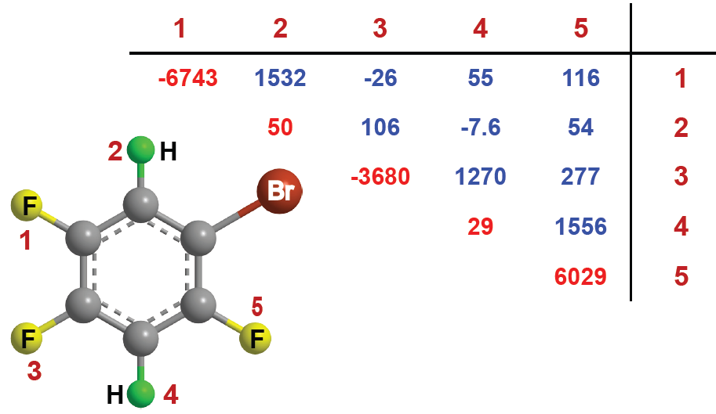
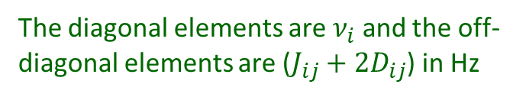
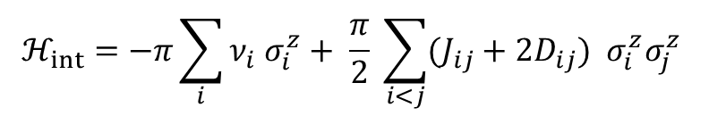
Experiment
Molecular structure and Hamiltonian parameters
5-spin system
The dipolar couplings of the spin system get scaled down by the order parameter (~ 0.1) of the liquid-crystal medium.
The sample 1-bromo-2,4,5-trifluorobenzene is partially oriented in a liquid-crystal medium MBBA
The Hamiltonian of the spin system in the doubly rotating frame:

Slide 28

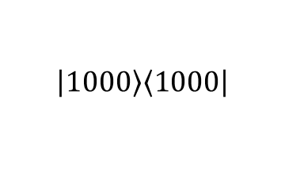
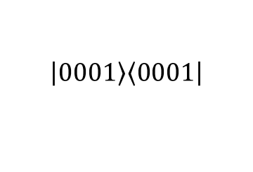
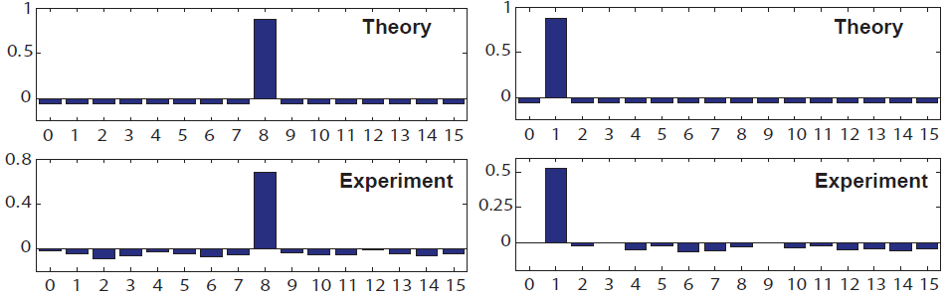

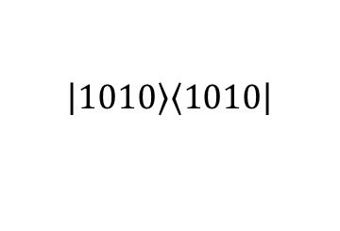
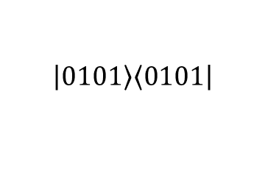
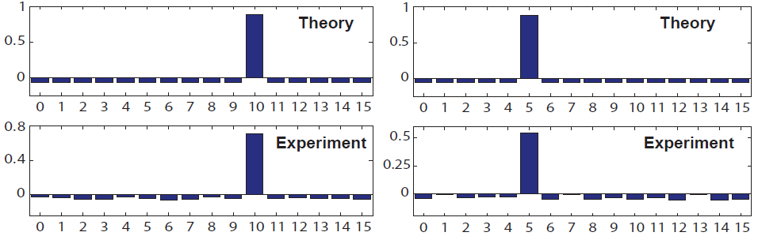
Quantum State Transfer:
Mirror Inversion of a 4-spin pseudo-pure initial states
Diagonal part of the deviation density matrices (traceless)
The x-axis represents the standard computational basis in decimal form
Notes:
28

Slide 29



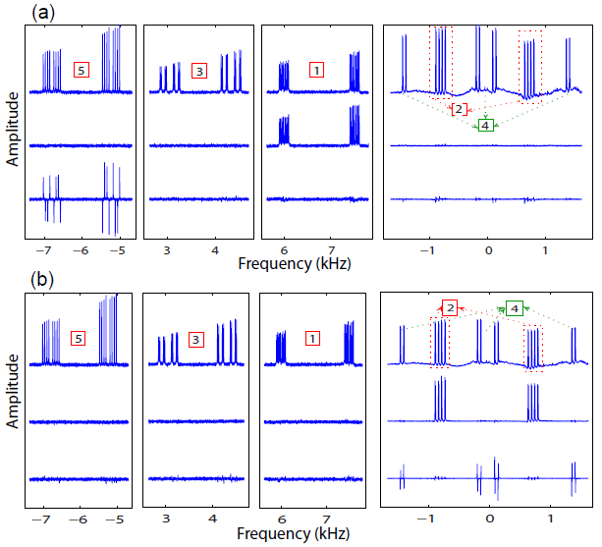


Coherence Transfer:
Mirror Inversion of a 5-spin initial state
σ₅^{x}
Anti-phase w.r.t. other spins
Spectra of Fluorine spins
Proton spins
Eq.
σ₁^{x}
σ₅^{x}
Anti-phase w.r.t. other spins
K R K Rao, T S Mahesh, and A Kumar, Phys. Rev. A , 90, 012306 (2014).

Slide 30





Coherence Transfer:
Spin 2 (in- phase) magnetization transferred to spin 4 (anti-phase w.r.t. other spins)
Spectra of Fluorine spins
Proton spins

Slide 31

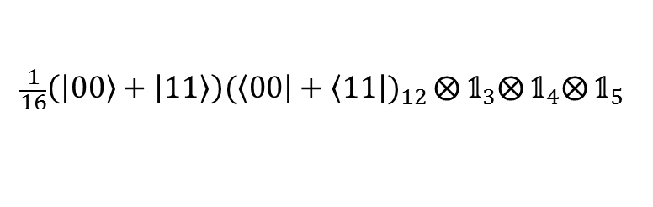
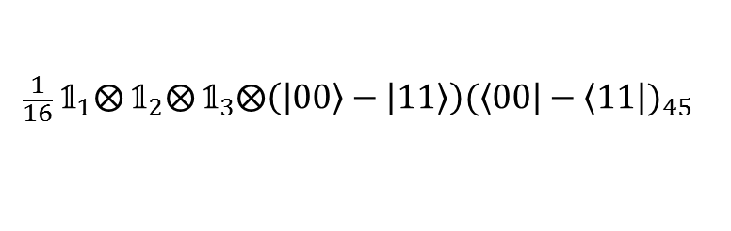
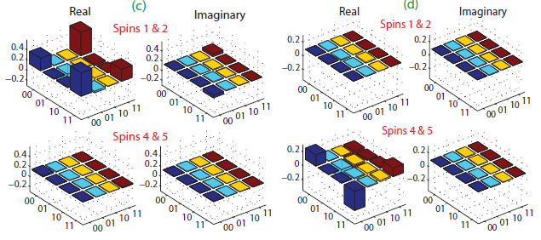
Entanglement Transfer
Bell State between spins 1and 2 transferred to spins 4 and 5
Initial States
Final States
Experimentally reconstructed deviation density matrices (trace less) of spins 1 and 2, and spins 4 and 5.

Slide 32

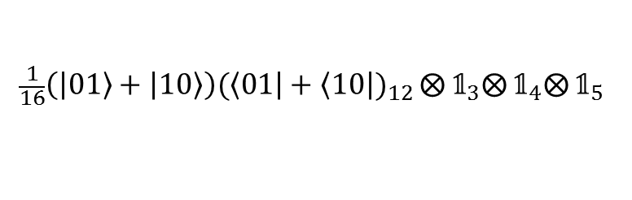
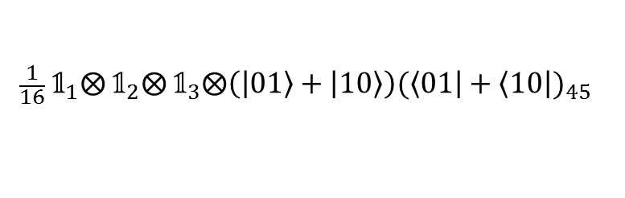

Entanglement Transfer
Another Bell State between spins 1and 2 transferred to spins 4 and 5
Initial States
Final States
Experimentally reconstructed deviation density matrices (trace less) of spins 1 and 2, and spins 4 and 5.
K R K Rao, T S Mahesh, and A Kumar, Phys. Rev. A , 90, 012306 (2014).

Slide 33


The Genetic Algorithm
John Holland
Charles Darwin 1866
1809-1882
Directed search algorithms based on the mechanics of biological evolution
Developed by John Holland, University of Michigan (1970’s)
Notes:
33

Slide 34
Genetic Algorithm
“Genetic Algorithms are good at taking large, potentially huge, search spaces and navigating them, looking for optimal combinations of things, solutions one might not otherwise find in a lifetime”
Here we apply Genetic Algorithm to Quantum Information Processing
We have used GA for
(1) Quantum Logic Gates (operator optimization)
and
(2) Quantum State preparation (state-to-state optimization)
V.S. Manu et al. Phys. Rev. A 86, 022324 (2012)

Slide 35
Representation Scheme
Representation scheme is the method used for encoding the solution of the problem to individual genetic evolution. Designing a good genetic representation is a hard problem in evolutionary computation. Defining proper representation scheme is the first step in GA Optimization*.
In our representation scheme we have selected the gene as a combination of
(i) an array of pulses, which are applied to each channel with amplitude (θ) and phase (φ),
(ii) An arbitrary delay (d).
It can be shown that the repeated application of above gene forms the most general pulse sequence in NMR
* Whitley, Stat. Compt. 4, 65 (1994)

Slide 36
The Individual, which represents a valid solution can be represented as a matrix of size (n+1)x2m. Here ‘m’ is the number of genes in each individual and ‘n’ is the number of channels (or spins/qubits).
So the problem is to find an optimized matrix, in which the optimality condition is imposed by a “Fitness Function”

Slide 37
Fitness function
In operator optimization
GA tries to reach a preferred target Unitary Operator (U_{tar}) from an initial random guess pulse sequence operator (U_{pul}).
Maximizing the Fitness function
F_{pul} = Trace (U_{pul} Χ U_{tar} )
In State-to-State optimization
F_{pul} = Trace { U _{pul} (ρ_{in}) U_{pul} ⁽⁻¹⁾ ρ_{tar} † }

Slide 38
(iii) Quantum simulation of 3-spin Heisenberg XY Hamiltonian in presence of DM interaction.
and
Entanglement preservation using initialization operator.
V.S. Manu and Anil Kumar, Phys. Rev. A 89, 052331 (2014).

Slide 39
Manu et al. Phys. Rev. A 89, 0523331 (2014)
Using Genetic Algorithm, Quantum Simulation of Dzyaloshinsky-Moriya (DM) interaction (H_{DM}) in presence of Heisenberg XY interaction (H_{XY}) for study of Entanglement Dynamics and Entanglement preservation.
Hou et al. ¹ demonstrated a mechanism for entanglement preservation using H(J,D). They showed that preservation of initial entanglement is performed by free evolution interrupted with a certain operator O, which makes the state to go back to its initial state.
Similar to Quantum Zeno Effect
¹Hou et al. Annals of Physics, 327 292 (2012)

Slide 40

DM Interaction^{1,2}
Anisotropic antisymmetric exchange interaction arising from spin-orbit coupling.
Proposed by Dzyaloshinski to explain the weak ferromagnetism of antiferromagnetic crystals (Fe₂O₃, MnCO₃).
Quantum simulation of a Hamiltonian H requires unitary operator decomposition (UOD) of its evolution operator, (U = e^{-iHt}) in terms of experimentally preferable unitaries.
Using Genetic Algorithm optimization, we numerically evaluate the most generic UOD for DM interaction in the presence of Heisenberg XY interaction.
1. I. Dzyaloshinsky, J. Phys & Chem of Solids, 4, 241 (1958).
2. T. Moriya, Phys. Rev. Letters, 4, 228 (1960).

Slide 41



The Hamiltonian
Heisenberg XY interaction
DM interaction
Evolution Operator:
Decomposing the U in terms of Single Qubit Rotations (SQR) and ZZ- evolutions.
SQR by Hard pulse
ZZ evolutions by Delays

Slide 42






Entanglement Preservation
Hou et al. ¹ demonstrated a mechanism for entanglement preservation using H(J,D). They showed that preservation of initial entanglement is performed by free evolution interrupted with a certain operator O, which makes the state to go back to its initial state.
concurrence
µ_{i} are eigen values of the operator ρSρ*S, where S= σ_{1y ⊗} σ_{2y}
Without Operator O
With Operator O
Equivalent to Quantum Zeno Effect
Entanglement (concurrence) oscillates during Evolution.
Entanglement (concurrence) is preserved during Evolution. This confirms the Entanglement preservation method of Hou et al.¹
Manu et al. Phys. Rev. A 89, 052331 (2014).
¹Hou et al. Annals of Physics, 327 292 (2012)

Slide 43

(iii) Efficient creation of NOON states in NMR.
V.S. Manu and Anil Kumar (Communicated)
---------------------------------------------------------------
NOON states is an important concept in quantum metrology¹ and quantum sensing for their ability to make precision phase measurements.
N O O N
Equivalent to multiple quantum in NMR
Two qubit NOON state is Bell state = (|00> + |11>)/√2
is a GHZ State
¹Quantum metrology is the study of making high-resolution and highly sensitive measurements of physical parameters using quantum theory to describe the physical systems, particularly exploiting quantum entanglement

Slide 44



NOON state creation in NMR,
N spin pps
NOON state
This NOON state creation quantum circuit uses N-1 number of CNOT gates
Each CNOT gate requires 6 pulses and one evolution delay as shown
Hence total number of pulses in NOON state creation :
N=2, N_{r} = 8
N=3, N_{r} = 14
H gate
CNOT gates

Slide 45



Using GA, Efficient creation of NOON state in NMR
Using GA, we have optimized the NOON state creation quantum circuit, to perform the state creation with minimum number of operators (pulses or delays).
We addressed the problem in following spin system configurations,

Slide 46



Minimum operator decomposition for NOON state creation obtained using GA optimization
Spin chain with NN equal couplings
Spin chain with NN non-equal couplings :
Spin star topology

Slide 47





In pulse sequence language ….
Spin chain with NN equal couplings in pulse sequence language

Slide 48




Three Qubit case:
Initial state
Pulse sequence
Final state

Slide 49
NOON state creation with minimum number of pulses or delays are shown in previous slides ….
Now we have to make it robust.
Robust means, efficient operation in presence of experimental errors ….
Here we consider experimental situation with two simultaneous errors, which are pulse length error or flip angle error and error in interaction strength.
These errors are selected by considering an engineered interacting qubit system (in a possible future quantum computer). Qubit can be manufactured with individual control (shown by DWAVE). The possible errors in that case will be error in individual spin controls and error in interaction strength.

Slide 50




Addressing pulse length errors,
The optimized decompositions for NOON state creation in all three different spin configurations are , (shown before)

Slide 51




Using GA optimization, we have generated robust 90 and 180 pulses.
The details of GA optimization used in this case are discussed in PRA, 86 022324 (2012)
90 pulse
Rotation Angle(Phase)
180 pulse
Φ is the phase of the pulse to be added to each phase

Slide 52


Where,

Slide 53

The fidelity profile of Uzz operation.
Simultaneous errors in flip angle and coupling strength are shown.
Robust performance (fidelity greater than 99%) are observed for up to 50% error in both coupling strength and flip angle.

Slide 54






Experimental Implementation
Three qubit NOON state (GHZ state)
Fidelity : 96.4 %
This demonstrates our ability to create NOON States with high Fidelity.

Slide 55
Summary
NMR is continuing to provide a test bed for many quantum Phenomenon and Quantum Algorithms.

Slide 56
Acknowledgements
Former QC- IISc-Associates/Students
Recent QC IISc - Students
Prof. Arvind
Prof. Kavita Dorai
Prof. T.S. Mahesh
Dr. Neeraj Sinha
Dr. K.V.R.M.Murali
Dr. Ranabir Das
Dr. Rangeet Bhattacharyya
- IISER Mohali
IISER Mohali
IISER Pune
- CBMR Lucknow
IBM, Bangalore
NCIF/NIH USA
IISER Kolkata
Dr. R. Koteswara Rao - Dortmund
Dr. V.S. Manu - Univ. Minnesota
Other IISc Collaborators
Prof. Apoorva Patel
Prof. K.V. Ramanathan
Prof. N. Suryaprakash
Dr.Arindam Ghosh - NISER Bhubaneswar
Dr. Avik Mitra - Philips Bangalore
Dr. T. Gopinath - Univ. Minnesota
Dr. Pranaw Rungta - IISER Mohali
Dr. Tathagat Tulsi – IIT Bombay
Other Collaborators
Prof. Malcolm H. Levitt - UK
Prof. P.Panigrahi IISER Kolkata
Prof. Arun K. Pati HRI-Allahabad
Prof. Aditi Sen HRI-Allahabad
Prof. Ujjwal Sen HRI-Allahabad
Mr. Ashok Ajoy BITS-Goa-MIT
This lecture is dedicated
to the memory of
Ms. Jharana Rani Samal*
(*Deceased, Nov., 12, 2009)
Funding: DST/DAE/DBT
Thanks: NMR Research Centres at IISc, Bangalore
and IISER-Pune for spectrometer time

Slide 57
Thank You

Slide 58
(i) Multipartite quantum correlations reveal frustration in quantum Ising spin systems: Experimental demonstration.
K. Rama Koteswara Rao¹*, Hemant Katiyar², T. S. Mahesh², Aditi Sen(De)³, Ujjwal Sen³ and Anil Kumar¹;
Phys. Rev. A 88, 022312 (2013).
¹ Indian Institute of Science, Bangalore
² Harish-Chandra Research Institute, Allahabad
³ Indian Institute of Science Education and Research, Pune

Slide 59
A spin system is frustrated when the minimum of the system energy does not correspond to the minimum of all local interactions. Frustration in electronic spin systems leads to exotic materials such as spin glasses and spin ice materials.
3-spin transverse Ising system
If J is negative Ferromagnetic
The system is non-frustrated
If J is positive Anti-ferromagnetic
The system is frustrated

Slide 60
Here, we simulate experimentally the ground state of this spin system in both the frustrated and non-frustrated regimes using NMR.
We use two different multipartite quantum correlation measures to distinguish these phases.
These multipartite quantum correlation measures are defined through the monogamy of bipartite quantum correlations (Negativity and Quantum discord).
Let A, B and C be the three parts of a system. Monogamy of quantum correlations implies that if A and B are strongly correlated then they can have only a restricted amount of correlations with C.
Notes:
60

Slide 61


(i) Negativity
Negativity is an important bipartite quantum correlation measure, defined through the entanglement-separability paradigm.
The corresponding multipartite quantum correlation measure is given by

Slide 62




(ii) Quantum discord
Quantum discord is defined as the difference between two classically equivalent formulations of mutual information, when the systems involved are quantum, and is given by
The corresponding multipartite quantum correlation is given by

Slide 63


Ground State Preparation using adiabatic evolution
Quantum adiabatic theorem states that: ‘if a system is initially in the ground state and if its Hamiltonian evolves slowly with time, it will be found at any later time in the ground state of the instantaneous Hamiltonian.’
The Hamiltonian evolution rate is governed by the expression,
A. Messiah, Quantum Mechanics, vol. II (Wiley, New York (1976)); E. Farhi, J. Goldstone, S. Guttmann, M. Sipser, quantph/0001106

Slide 64
Non-frustrated
Frustrated

Slide 65

E₀ and E₁ represent the energy levels corresponding to the ground state and the excited one which is relevant in the calculation of the adiabatic evolution rate.
Energy level diagram
Though there are energy levels in between E0 and E1, there are no possible transitions from the ground state to these excited states as the transition amplitudes are zero in these cases.
Considering the energy gap between E₀ and E₁, we varied J as a sine hyperbolic function of t.

Slide 66





In the experiment J is varied in 21 steps. The rate of change is slow in the centre and faster at the ends in a hyperbolic sine function.
¹M. Steffen, W. van Dam, T. Hogg, G. Bryeta, I. Chuang, Phys. Rev. Lett. 90, 067903 (2003)

Slide 67




Experiment
Chemical Structure of trifluoroiodoethylene and Hamiltonian parameters
A three qubit system
This rotation was realized by a numerically optimized amplitude and phase modulated radio frequency (RF) pulse using GRadient Ascent Pulse Engineering (GRAPE) technique¹.
The experiments have been carried out at a temperature of 290 K on Bruker AV 500 MHz liquid state NMR spectrometers.
¹N. Khaneja and S. J. Glaser et al., J. Magn. Reson. 172, 296 (2005).

Slide 68




All the unitary operators corresponding to the adiabatic evolution are also implemented by using GRAPE pulses.
The length of these pulses ranges between 2ms to 30 ms.
Robust against RF field inhomogeneity.
The average Hilbert-Schmidt fidelity is greater than 0.995
(a)
(b)
(c)

Slide 69

Quantum state tomography of the full density matrix is performed after every second step in both the regimes.
The density matrix of NMR systems is given by
In liquid state NMR quantum information processing, in general we consider only the deviation part of the density matrix and ignore identity.
But, for calculating the quantum discord from the experimental density matrices, we considered the full mixed state NMR density matrix. Although the discord is very small, it’s behavior is very much similar to that of the pure states.

Slide 70


Bipartite quantum correlations
The fidelity of the experimental initial state is 0.99 and that of all other final density matrices is greater than 0.984
Negativity of spins 1 and 2 (N₁₂)
Quantum discord of spins 1 and 2 (D₁₂)
Non-frustrated
Frustrated
Non-frustrated
Frustrated
Negativity as well as Discord between any pair of qubits in non-frustrated regime decays to zero and in frustrated regime goes to a finite value; verified experimentally

Slide 71
Multipartite quantum correlations
Non-frustrated regime:
Higher correlations
Frustrated regime:
Lower correlations

Slide 72



Fidelity is defined as.
A. The Decomposition for ϒ = 0 -1:
1
Period of U(ϒ,τ)
This has a maximum value of 12.59. Optimization is performed for τ -> 0-15, which includes one complete period.
Fidelity > 99.99 %
Manu et al. Phys. Rev. A 89, 052331 (2014).

Slide 73


ϒ’ = 1/ ϒ
When ϒ > 1 -> ϒ’ < 1
2
Using above decomposition, we studied entanglement preservation in a two qubit system.

