Slide 1


Hierarchical Joint Remote State Preparation
Chitra Shukla
JSPS Postdoctoral Research Fellow
Graduate School of Information Science Nagoya University, JAPAN
Email: chitrashukla07@gmail.com
08th December, 2015 QIPA 2015, HRI, Allahabad, India

Slide 2
Outline
Introduction
Recent ideas on hierarchical quantum communication (HQC)
Hierarchical joint remote state preparation (HJRSP)
Effect of a set of noise models on HJRSP scheme
Applications
Amplitude damping
Phase damping
Collective dephasing
Collective rotation

Slide 3


Teleportation
Alice’s port
Bob’s port
At time t=0
Ψ(x)
Entangled qubits
x₀
Unknown qubit
to be teleported
Alice (Sender)
Bob (Receiver)
At time t=T
Ψ(x+x₀)
Teleported qubit

Slide 4
Remote State Preparation (RSP)
Teleportation of a known qubit with reduced resources
Alice’s port
Bob’s port
At time t=0
Encoding of
a known state
Ψ(x)
Entangled qubits
x₀
Alice (Sender)
Bob (Receiver)
At time t=T
Remotely prepared qubit
Ψ(x+x₀)
A. K. Pati, Phys. Rev. A 63, 014302 (2000)

Slide 5

Joint Remote State Preparation (JRSP)
RSP of a qubit from two senders
Alice1’s port
Bob’s port
Encoding of
amplitude
GHZ state
Alice1 (Sender1)
Alice2’s port
Entangled qubits
Bob (Receiver)
Encoding
of phase
At time t=0
Alice2 (Sender2)

Slide 6
Joint Remote State Preparation (JRSP)
RSP of a qubit from two senders
Alice1’s port
Bob’s port
Alice1 (Sender1)
Alice2’s port
Jointly
prepared state
Bob (Receiver)
At time t
Alice2 (Sender2)

Slide 7
Recent ideas on remote state preparation (RSP)
Proposed generalized schemes:
Probabilistic CBRSP,
Deterministic CBRSP and
Deterministic CJBRSP
V. Sharma, C. Shukla, S. Banerjee, A. Pathak: Controlled bidirectional remote state preparation in noisy environment: a generalized view, Quantum Inf Process 14, 3441–3464 (2015)

Slide 8
Quantum Communication
Alice (Sender)
Bob (Receiver)
Hierarchy exists everywhere!

Slide 9


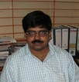
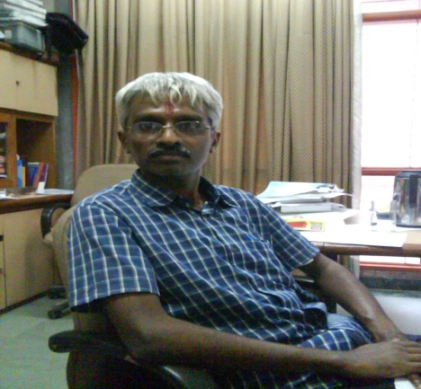
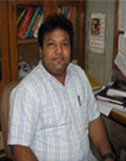
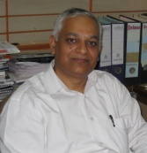
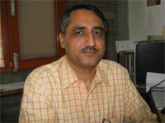

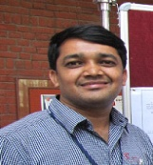
Hierarchical Quantum Communication
Hierarchical QIS
3-4 Model
Classical communication when
Bob₁ recovers ( )
Bob₇ recovers ( )
Quantum communication when
Alice shares secret ( )
Joint measurement of Bobs
Alice
Bob₁ (High power agent)
Bob₂
Bob₃
Bob₄
Bob₅
Bob₆
Bob₇ (Low power agent)

Slide 10
Recent ideas on hierarchical quantum communication (HQC)
HQIS (Hierarchical QIS)
PHQIS (Probabilistic Hierarchical QIS)
HQSS (Hierarchical QSS)
HDQSS (Hierarchical Dynamic QSS)
C. Shukla, A.Pathak: Hierarchical quantum communication. Phys. Lett. A 377, 1337 (2013)
S. Mishra, C. Shukla, A. Pathak, R. Srikanth, A. Venugopalan: An Integrated Hierarchical Dynamic Quantum Secret Sharing Protocol. Int J Theor Phys DOI 10.1007/s10773-015-2552-z (2015)

Slide 11

Classical communication (CC)
Alice1 CC ( )
Quantum Channel ( )
Shared by all the Participants
Prime Minister
Alice1
Bob₂ (High power agent)
Defence Minister
Bob₁ (Low power agent)
Bob₃ (Low power agent)
Defence Secratery
Chief of Armed Forces

Slide 12
Teleportation based Quantum Communication
Teleportation based Hierarchical Quantum Communication
RSP (Remote State Preparation)
JRSP (Joint Remote State Preparation)
CBRSP (Controlled Bidirectional Remote State Preparation)
CJBRSP (Controlled Joint Bidirectional Remote State Preparation)
HQIS (Hierarchical QIS)
HQSS (Hierarchical QSS)
HDQSS (Hierarchical Dynamic QSS)
Hierarchical Joint Remote State Preparation (HJRSP)

Slide 13

Classical communication (CC)
Alice1 CC ( )
Alice2 CC ( )
Quantum Channel ( )
Shared by all the Participants
Alice1
Alice2
Bob₂ (High power agent)
Bob₁ (Low power agent)
Bob₃ (Low power agent)
5-qubit Cluster state shared by the participants:

Slide 14
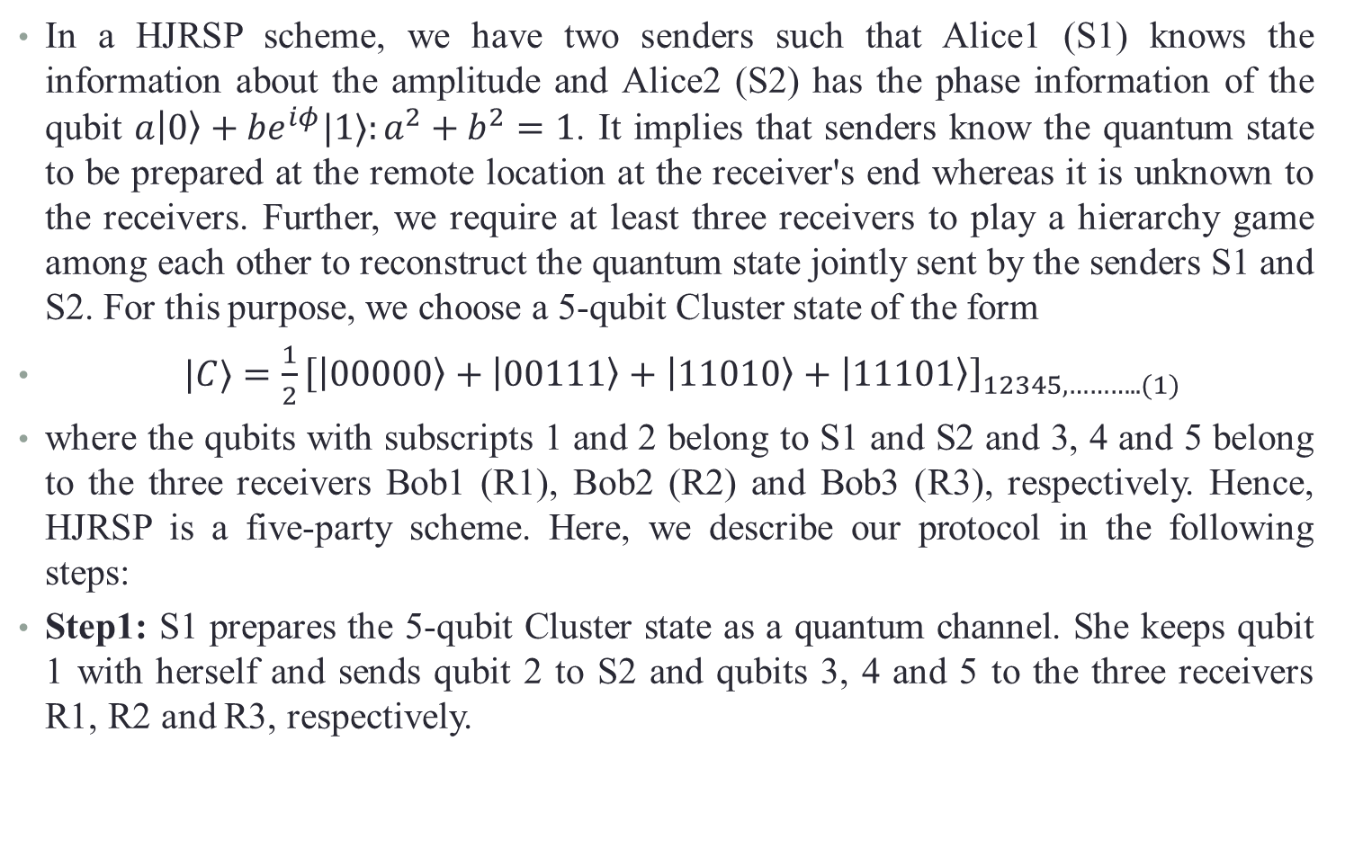
Hierarchical JRSP (HJRSP) using 5qubit Cluster State
In a HJRSP scheme, we have two senders such that Alice1 (S1) knows the information about the amplitude and Alice2 (S2) has the phase information of the qubit $a|0〉+be^{iφ}|1〉:a^{2}+b^{2}=1$. It implies that senders know the quantum state to be prepared at the remote location at the receiver's end whereas it is unknown to the receivers. Further, we require at least three receivers to play a hierarchy game among each other to reconstruct the quantum state jointly sent by the senders S1 and S2. For this purpose, we choose a 5-qubit Cluster state of the form
$|C〉=\frac{1}{2}{\left[|00000〉+|00111〉+|11010〉+|11101〉\right]}_{12345,………..(1)}$
where the qubits with subscripts 1 and 2 belong to S1 and S2 and 3, 4 and 5 belong to the three receivers Bob1 (R1), Bob2 (R2) and Bob3 (R3), respectively. Hence, HJRSP is a five-party scheme. Here, we describe our protocol in the following steps:
Step1: S1 prepares the 5-qubit Cluster state as a quantum channel. She keeps qubit 1 with herself and sends qubit 2 to S2 and qubits 3, 4 and 5 to the three receivers R1, R2 and R3, respectively.

Slide 15
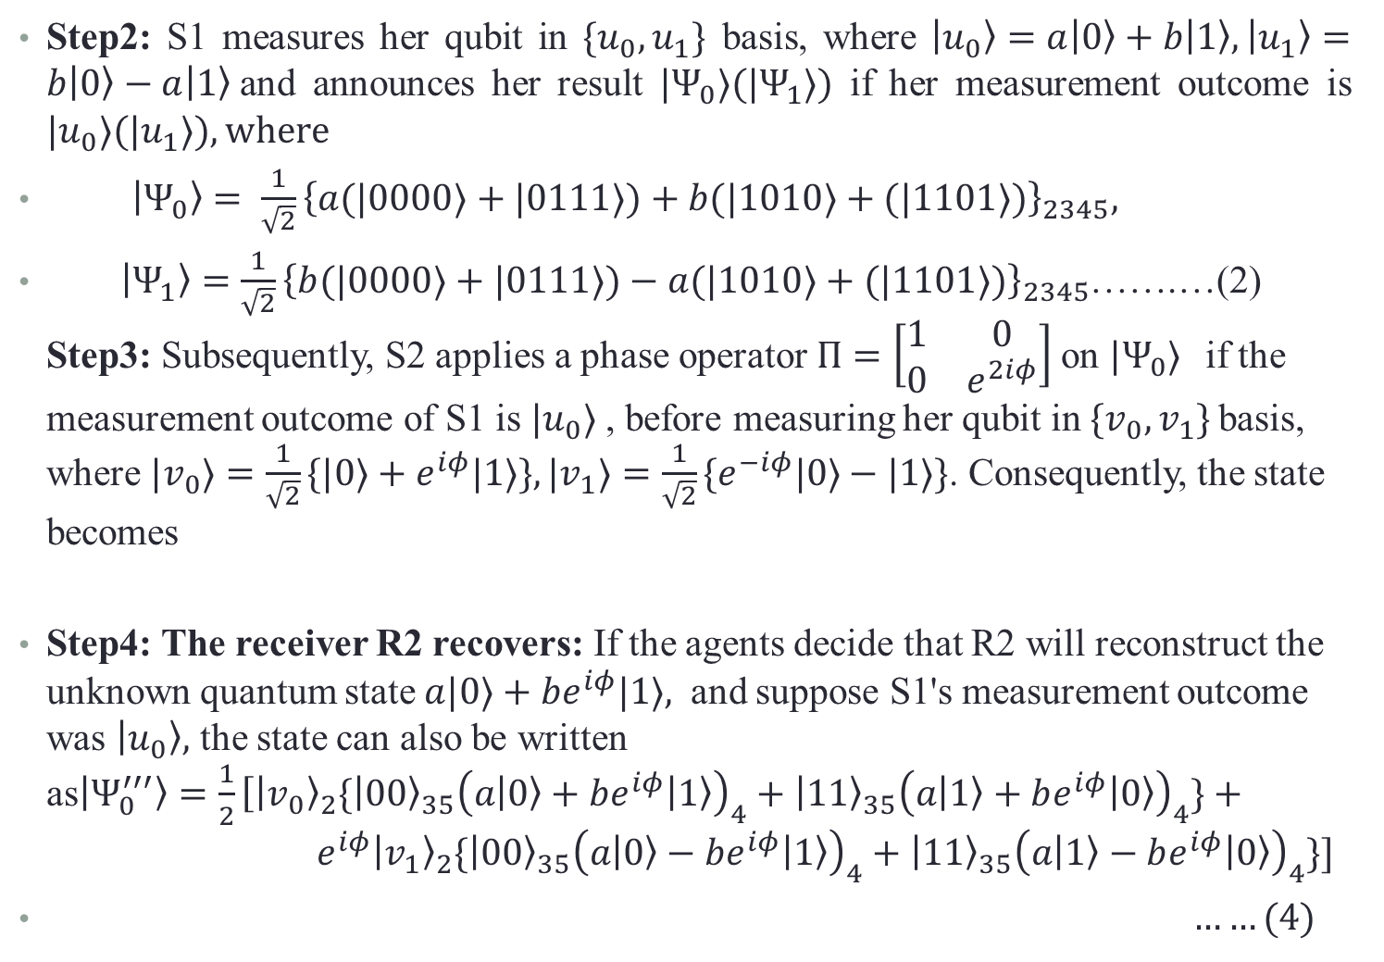
Hierarchical JRSP (HJRSP) using 5qubit Cluster State
Step2: S1 measures her qubit in $\{u_{0},u_{1}\}$ basis, where $|u_{0}〉=a|0〉+b|1〉,|u_{1}〉=b|0〉−a|1〉$and announces her result $|Ψ_{0}〉(|Ψ_{1}〉)$ if her measurement outcome is $|u_{0}〉(|u_{1}〉), where$
$|Ψ_{0}〉= \frac{1}{\sqrt{2}}{\left\{a(|0000〉+|0111〉)+b(|1010〉+(|1101〉)\right\}}_{2345},$
$|Ψ_{1}〉=\frac{1}{\sqrt{2}}{\left\{b(|0000〉+|0111〉)−a(|1010〉+(|1101〉)\right\}}_{2345}$…….…(2)
Step3: Subsequently, S2 applies a phase operator $Π=\left[\begin{matrix}1 & 0 \\ 0 & e^{2iφ}\end{matrix}\right]$on $|Ψ_{0}〉$if the measurement outcome of S1 is $|u_{0}〉$, before measuring her qubit in ${\{v}_{0},v_{1}\}$basis, where $|v_{0}〉=\frac{1}{\sqrt{2}}\{|0〉+e^{iφ}|1〉\},|v_{1}〉=\frac{1}{\sqrt{2}}\{e^{−iφ}|0〉−|1〉\}$. Consequently, the state becomes
Step4: The receiver R2 recovers: If the agents decide that R2 will reconstruct the unknown quantum state $a|0〉+be^{iφ}|1〉,$ and suppose S1's measurement outcome was $|u_{0}〉,$ the state can also be written as$|Ψ_{0}^{′′′}〉=\frac{1}{2}\left[{|v_{0}〉}_{2}\right.\{{|00〉}_{35}{\left(a|0〉+be^{iφ}|1〉\right)}_{4}+{|11〉}_{35}{\left(a|1〉+be^{iφ}|0〉\right)}_{4}\}+{ e}^{iφ}{|v_{1}〉}_{2}\{{|00〉}_{35}{\left(a|0〉−be^{iφ}|1〉\right)}_{4}+{|11〉}_{35}{\left(a|1〉−be^{iφ}|0〉\right)}_{4}\}]$
$……(4)$
Notes:
There are the assumptions that

Slide 16
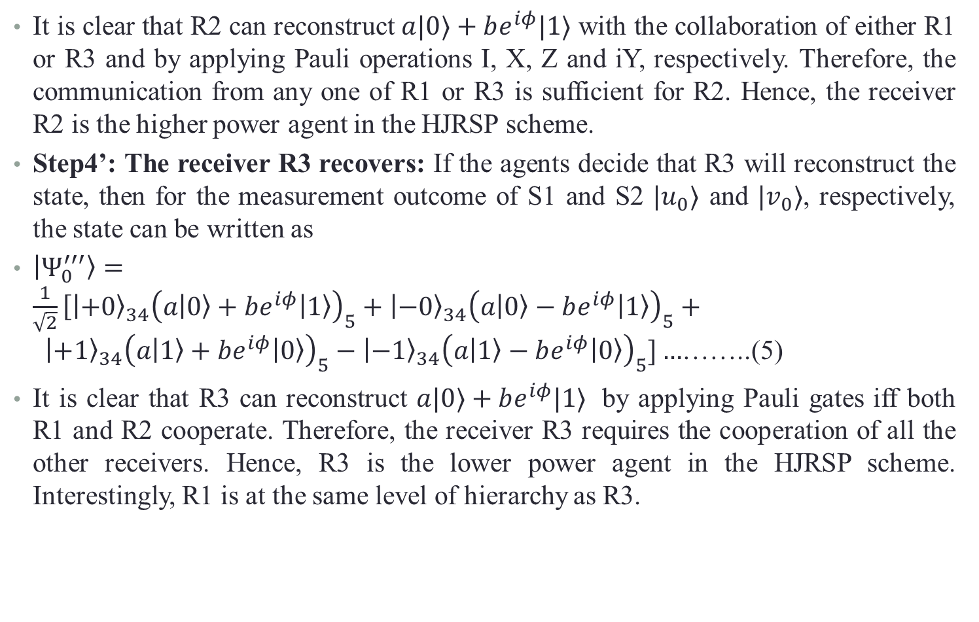
Hierarchical JRSP (HJRSP) using 5qubit Cluster State
It is clear that R2 can reconstruct $a|0〉+be^{iφ}|1〉$ with the collaboration of either R1 or R3 and by applying Pauli operations I, X, Z and iY, respectively. Therefore, the communication from any one of R1 or R3 is sufficient for R2. Hence, the receiver R2 is the higher power agent in the HJRSP scheme.
Step4’: The receiver R3 recovers: If the agents decide that R3 will reconstruct the state, then for the measurement outcome of S1 and S2 $|u_{0}〉$ and $|v_{0}〉$, respectively, the state can be written as
$|Ψ_{0}^{′′′}〉=\frac{1}{\sqrt{2}}\left[{|+0〉}_{34}\right.{\left(a|0〉+be^{iφ}|1〉\right)}_{5}+{|−0〉}_{34}{\left(a|0〉−be^{iφ}|1〉\right)}_{5}+{ |+1〉}_{34}{\left(a|1〉+be^{iφ}|0〉\right)}_{5}−{|−1〉}_{34}{\left(a|1〉−be^{iφ}|0〉\right)}_{5}]…$……..(5)
It is clear that R3 can reconstruct $a|0〉+be^{iφ}|1〉$ by applying Pauli gates iff both R1 and R2 cooperate. Therefore, the receiver R3 requires the cooperation of all the other receivers. Hence, R3 is the lower power agent in the HJRSP scheme. Interestingly, R1 is at the same level of hierarchy as R3.

Slide 17
Effect of noise on the HJRSP scheme
Amplitude damping (AD) noise
Phase damping (PD) noise
Collective dephasing (CD) noise
Collective rotation (CR) noise
Kraus operators for the noise models:
(AD)
(PD)
where, describes the probability of error/decoherence rate due to AD/PD noisy environment when a travel qubit passing through it.
(CD) where is the noise parameter that fluctuates with time, but remains the same at an instant for all the qubits traveling simultaneously through a noisy channel.
(CR) where is the noise parameter, and have the same effect as

Slide 18
5-qubit Cluster State for HJRSP
Density Matrix
Effect of Noise
To see the effect of noise we calculate Fidelity

Slide 19
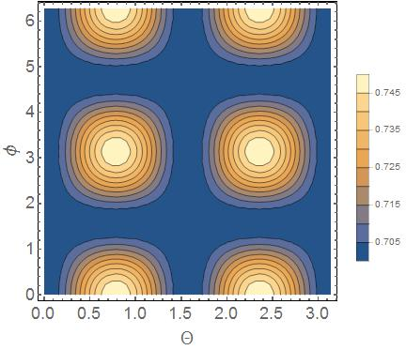
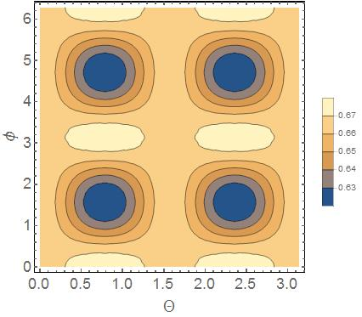
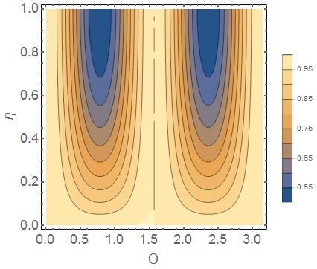
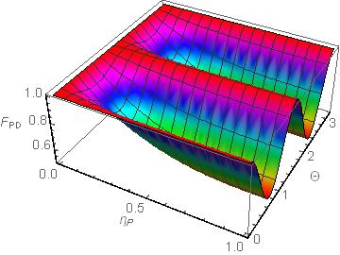
Fidelity of quantum state under AD and PD noise:
For R2 (higher power agent)
For R3 (lower power agent)

Slide 20
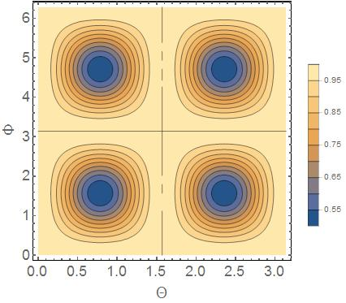
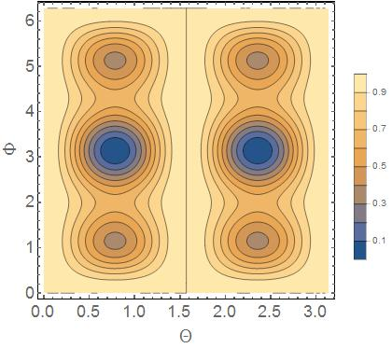
Fidelity of quantum state under CD and CR noise:

Slide 21
Collaborators
Prof. Anirban Pathak
Mr. Kishore Thapliyal
Acknowledgements
CS thanks Japan Society for the Promotion of Science (JSPS), Grant-in-Aid for JSPS Fellows no. 15F15015.

Slide 22
Thank you!

