Slide 1



Bounds on Entanglement Distillation & Secret Key Agreement Capacities for Quantum Broadcast Channels
Kaushik P. Seshadreesan
Joint work with
Masahiro Takeoka & Mark M. Wilde
arXiv:1503.08139 [quant-ph]
QIPA, HRI,
12/12/2015

Slide 2
Motivation

Slide 3
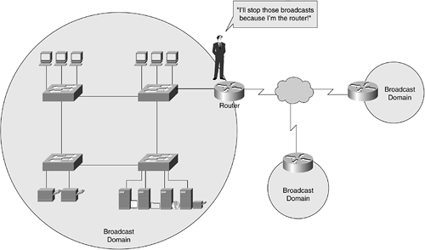
Quantum Networks
Secure Classical
Communication
  Secure Classical Communication
  Distributed Quantum Information Processing (QIP)
One-Time Pad
  Secret Key Agreement (SKA)
  Entanglement Distillation (ED)
Teleportation
Point-to-point
Links
Quantum
Communication
End-user
domain
Trusted Relay nodes
End-user
domain
End-user
domain

Slide 4
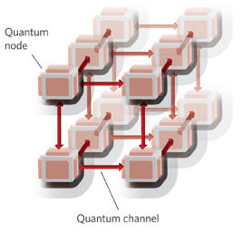



Quantum Networks
Our Focus →
  Multiuser Secret Key Agreement
  Multipartite Entanglement Distillation
End-User Domain
Quantum Internet
Alice
Bob
Charlie

Slide 5
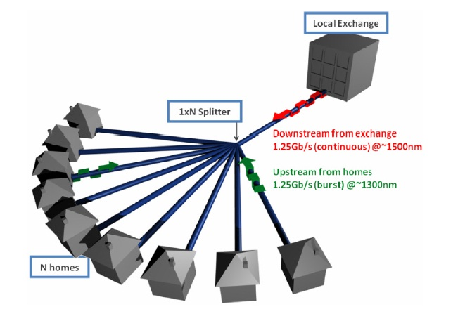
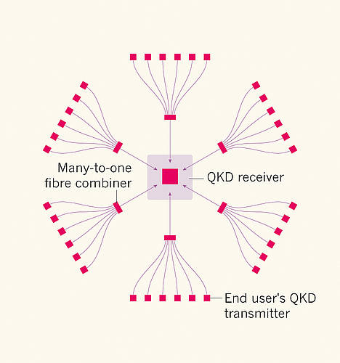
End-User Domain: Possible Architectures
1) Point-to-Point Links between each
pair of users.
Prohibitively Expensive!!
3) A Quantum Access Network.
Bernd Frohlich et al.
Nature 501, 69–72 (2013)
2) A Quantum Broadcast Network.
Townsend Nature 385, 47–49 (1997)

Slide 6
Background

Slide 7
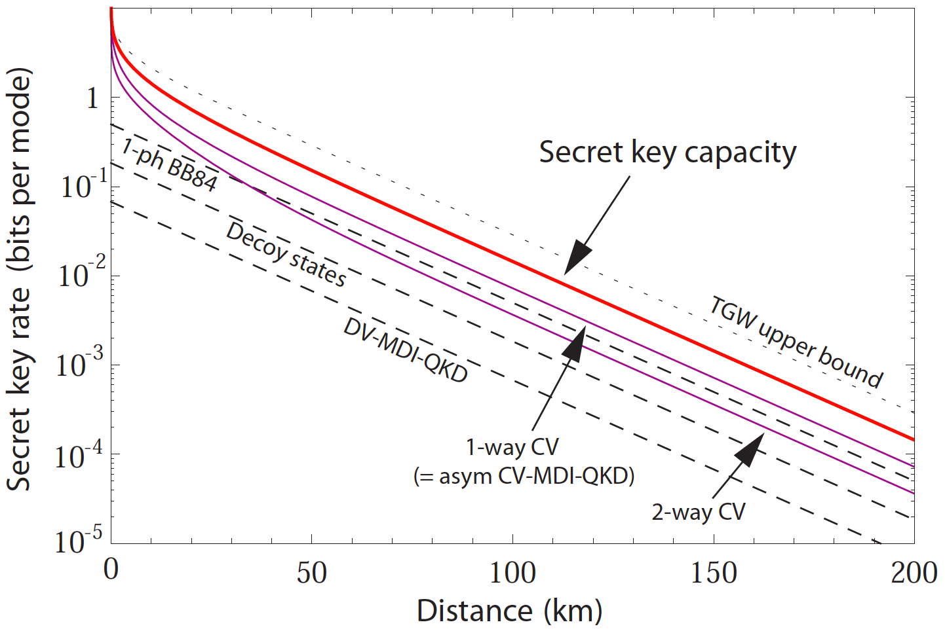
SKA and ED over point-to-point links
Rate-loss tradeoff
→ A fundamental limitation of the optical
comm. channel.
Pirandola et al.,
arXiv:1510.08863
Reverse
Coherent Information
Lower Bound
Takeoka, Guha & Wilde
Nature Comm. (2014)
Main tool used:
Squashed Entanglement

Slide 8
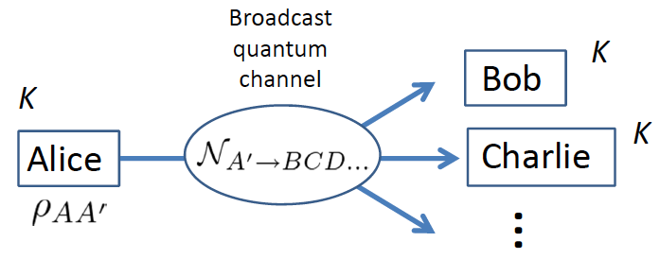
Our Contribution
Rate-loss tradeoffs for SKA and ED over quantum broadcast channels
Main tool:
  Multipartite Squashed Entanglement
Yang et al. (2009)

Slide 9
Outline
Setting up the Arena
  Entanglement Distillation and Secret Key Agreement over a Quantum Broadcast Channel
Protocol:
  One-sender two-receiver case
Tool
  Multipartite Squashed Entanglement
Bounds for ED and SKA over a QBC
Open Questions and Conclusions

Slide 10
Setting up the Arena:
Entanglement Distillation & Secret Key Agreement over a Quantum Broadcast Channel

Slide 11
A Quantum Broadcast Channel
QBC as a resource to generate shared entanglement and shared secret key
Other available resources:
  Local Operations and Classical Communication (LOCC) for ED
  Local Operations and Public Class. Comm. (LOPC) for SKA

Slide 12
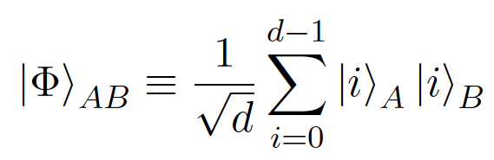
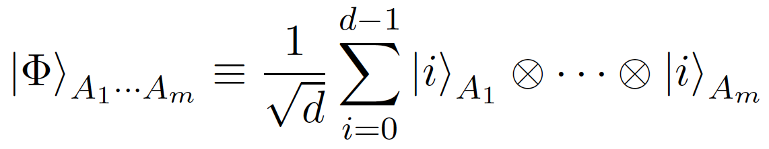
Entanglement Distillation
Distilling generalized “GHZ states” under unlimited LOCC
A bipartite maximally entangled state:
Entanglement Distillation Capacity of a Channel:
Largest achievable rate of distilling maximally entangled states using the channel along with unlimited two-way LOCC.
An m-partite GHZ state:

Slide 13
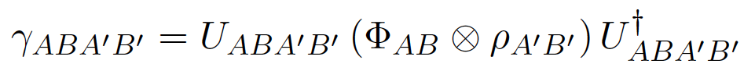
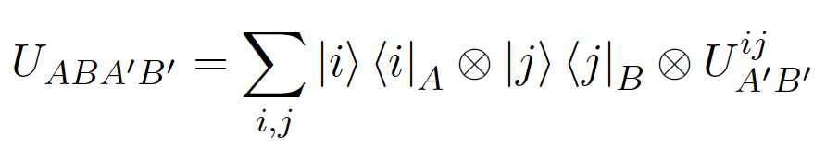
Secret Key Agreement
Horodecki et al. , IEEE Trans. Inf. Theory 55, 1898 (2009)
Key Distillation under LOPC
→ “Private State” Distillation under LOCC
A bipartite Private State:
Explicit form:
Shared Secret Key
Measurement Maps. (In general, POVMs)
A purification of the state
Shield Systems
Twisting Unitary

Slide 14
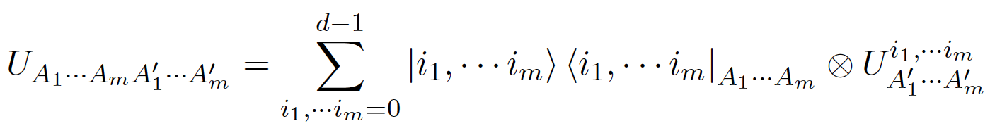
Secret Key Agreement
Augusiak & P Horodecki,
Phys. Rev. A 80, 042307 (2009)
Key Distillation under LOPC
→ “Private State” Distillation under LOCC
An m-partite Private State:
Secret-Key Agreement Capacity of a Channel:
Largest achievable rate of distilling private states using the channel along with unlimited two-way LOCC.
Shield Systems
Twisting Unitary

Slide 15





ED and SKA over a QBC
E.g., consider a one-sender two-receiver QBC
Power Set of S (sans null
and singleton elements)
Ideal State of Interest:
Alice
where
, etc.
Charlie
Bob

Slide 16
Protocol:
One-sender two-receiver case

Slide 17
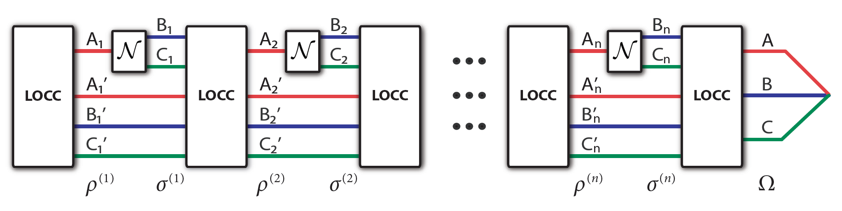
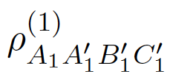
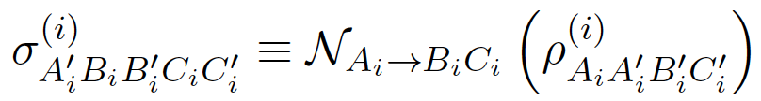
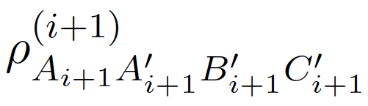

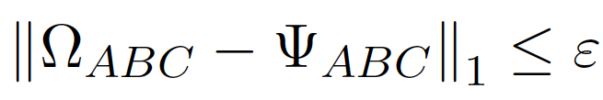
Protocol
We define a (n, E_{AB}, E_{AC}, E_{BC}, E_{ABC}, K_{AB}, K_{AC}, protocol as follows:
  Initial state → Separable:
  State after i^{th} channel use:
  State after (i+1)^{th} round of LOCC:
  State after n channel uses:
  such that
Ideal state

Slide 18
Capacity Region
Achievable Rate:
A tuple
is achievable is for all ε≥ 0 and sufficiently large n, there exists a protocol of the above type.
Capacity Region: Closure of all achievable rates.

Slide 19
Tool:
Multipartite Squashed Entanglement

Slide 20
Squashed Entanglement (Bipartite)
Definition: Christandl & Winter (2004)
For a bipartite state
Eve tries her best to “squash down” the correlations between Alice and Bob.
Upper bounds on ED and SKA rates for point-to-point channels.
Takeoka, Guha and Wilde (2014)

Slide 21
Properties
Monotone non-increasing under LOCC
Normalized on maximally entangled states
Asymptotically Continuous
Additive on tensor-product states

Slide 22

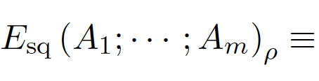

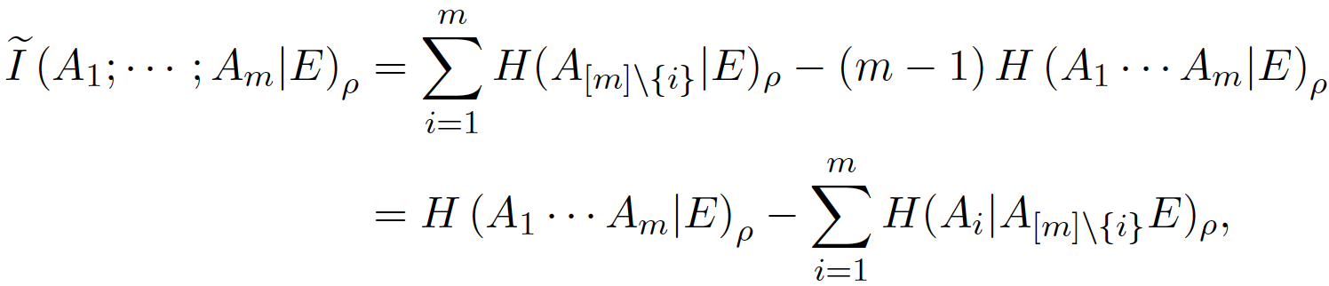
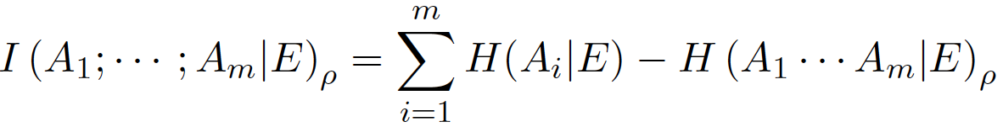
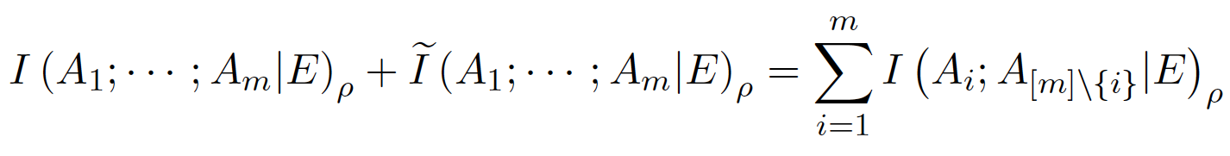
Squashed Entanglement(s) (Multipartite)
Definition(s): Yang et al. (2009)
For an m-partite state
Incomparable

Slide 23
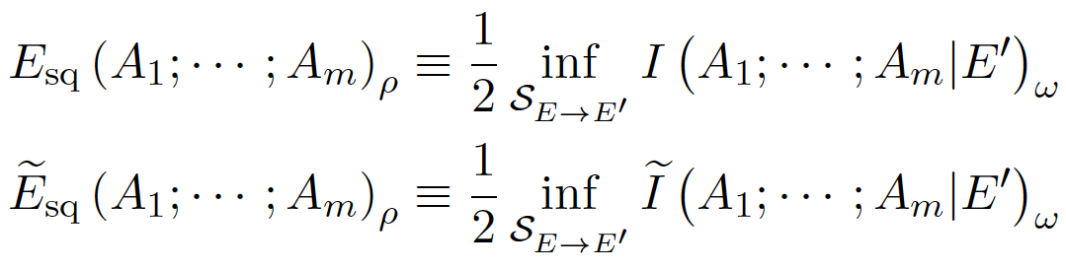
Squashed Entanglement(s) (Multipartite)
Definition(s): Yang et al. (2009)
For an m-partite state
Eve tries her best to “squash down” the correlations between the m parties.
Upper bounds on ED and SKA rates for Quantum Broadcast Channels.
Seshadreesan, Takeoka and Wilde (2015)

Slide 24
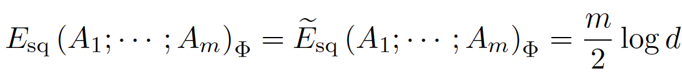
Properties and some notation
LOCC monotone, Continuous and Additive on tensor-product states
Normalization on MES and Private States

Slide 25
Bounds for ED and SKA over a Quantum Broadcast Channel

Slide 26
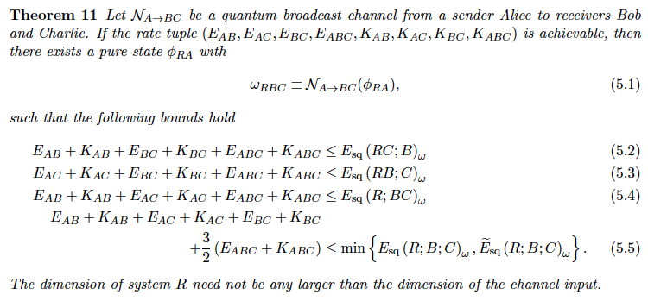
Bounds for a one-sender two-receiver QBC

Slide 27

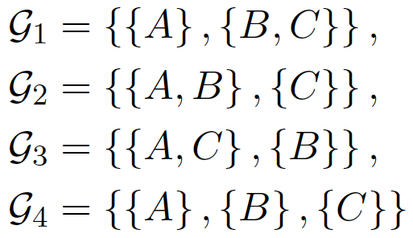
Proof Sketch
Consider and its different partitions:
Consider the ideal state
1
Additivity of SqE. on tensor product states
2
Normalization of SqE. on MES and
Private states
1
2

Slide 28


Proof Sketch
Well, actually, rate defined as “per channel use”. So,
Continuity of Squashed Entanglement
  If
Monotonicity under LOCC
then

Slide 29
Proof Sketch
A TGW-type subadditivity inequality
Consider a pure state . Then,

Slide 30
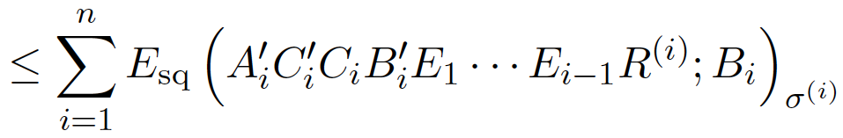
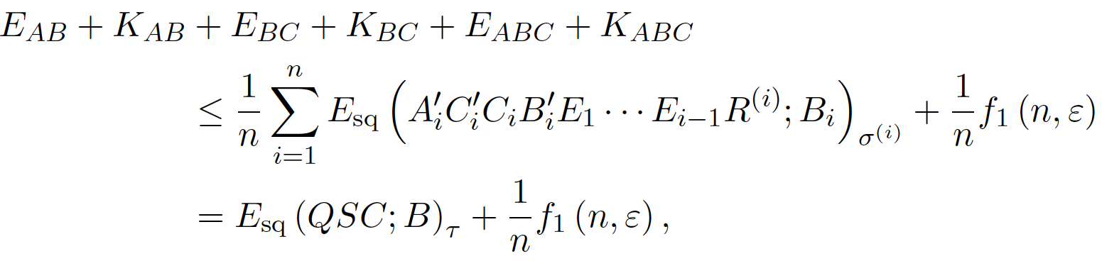
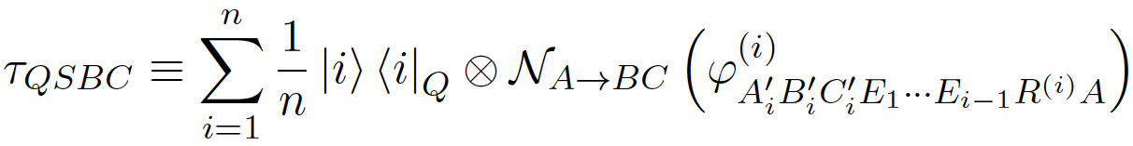
Proof Sketch
Repeated application of the TGW-type subadditivity and monotonicity under LOCC gives
Therefore,
Time sharing
Register
Single Letter bound!
where

Slide 31
Open Questions and Conclusions

Slide 32
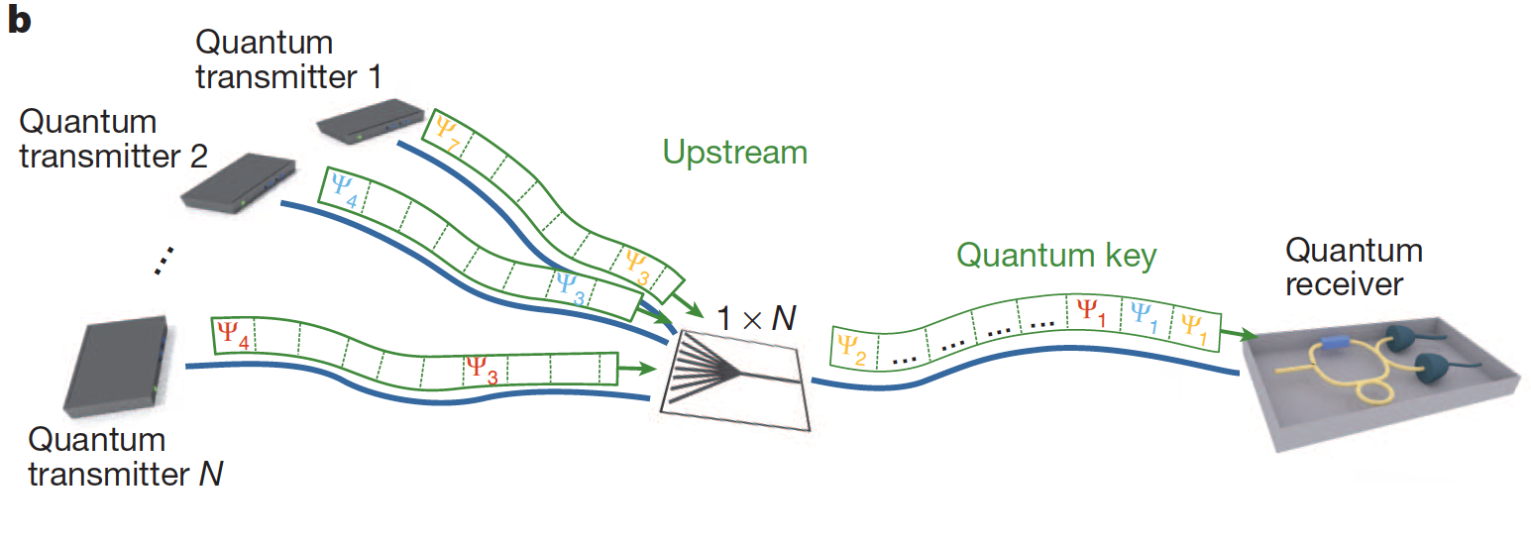
Open Questions
Similar bounds for a Multiple Access Channel (MAC)
Bounds for a QBC and a MAC in the presence of quantum repeaters
Protocols for ED and SKA over QBC and MAC

Slide 33
Conclusions
Considered ED and SKA over a QBC
Described a LOCC protocol for the above task
Studied a multipartite squashed entanglement
Used it to upper bound rates for ED and SKA over QBC
The bounds are single-letter

Slide 34
Thank you for your attention!
Notes:
1.

Slide 35



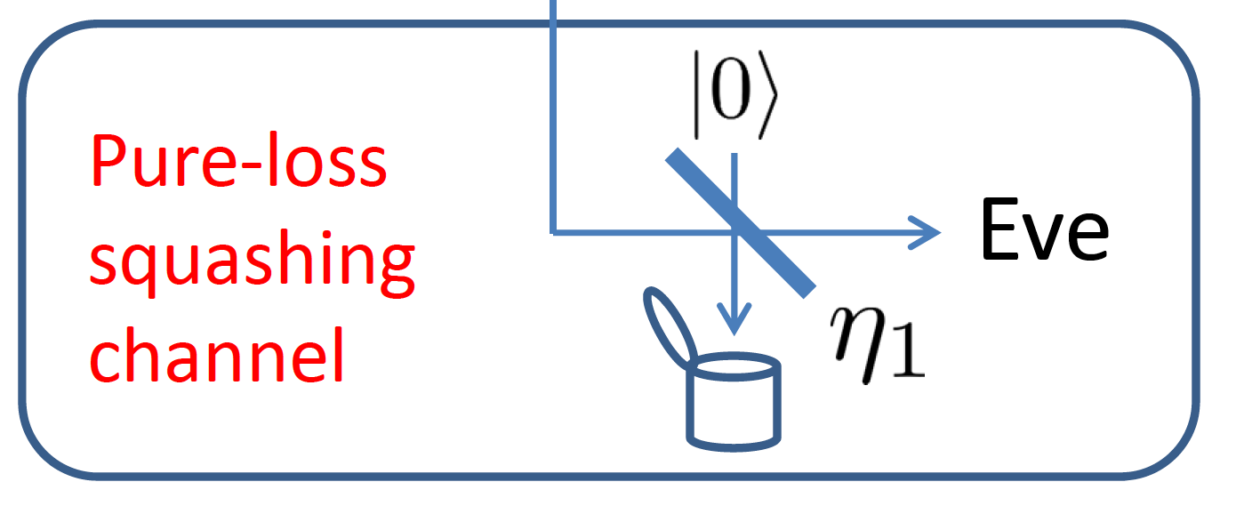



Pure-Loss Bosonic Broadcast Channel
E.g., consider a three-way beamsplitter
Mean photon number Constraint

Slide 36
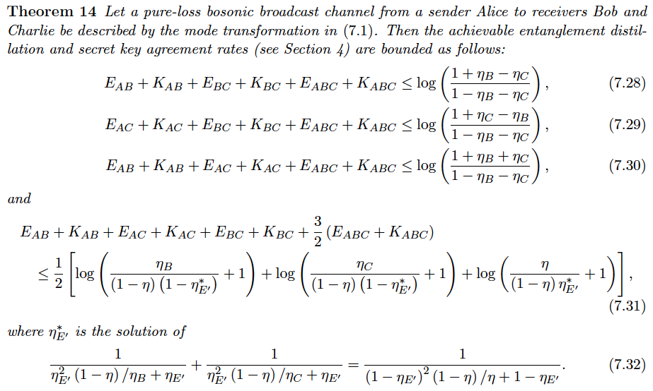
Bounds on ED and SKA for a Pure-Loss Bosonic Broadcast Channel

Slide 37
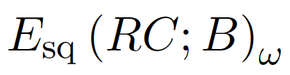
Bounds on ED and SKA for a Pure-Loss Bosonic Broadcast Channel

Slide 38
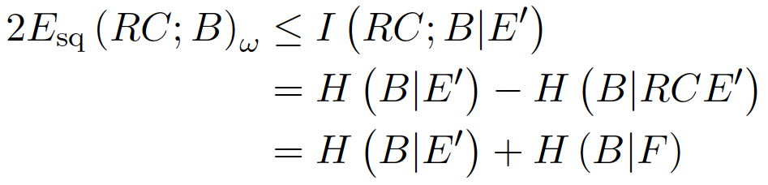

Proof Sketch
Consider that
Due to the extremality of Gaussian states for conditional entropy, we have the optimal entropies
where
Correspond to
thermal states of
mean photon
number x
, etc.

Slide 39


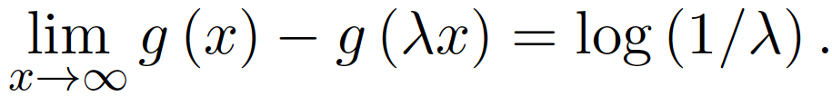

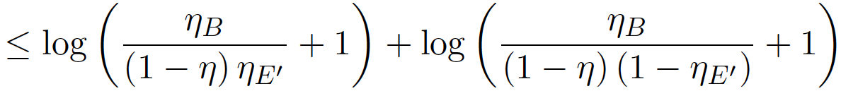
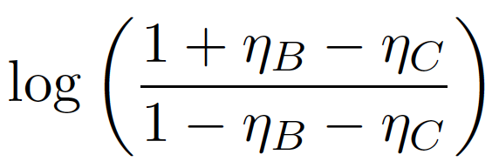


Proof Sketch
Further, for
monotonically increasing
Also,
Therefore,
By picking
Because the function is convex
And similarly, the other bounds…

