Slide 1
Entanglement generation in periodically driven integrable quantum systems
K. Sengupta
Theoretical Physics Department, IACS, Kolkata
Collaborator: Arnab Sen, IACS, Kolkata.
arXiv: 1511.03668

Slide 2
Outline
A class of integrable models: Spin systems and Dirac fermions
Entanglement: Basic facts relevant to the present study.
Periodic drive and entanglement generation
Hasting’s theorem: states generated out-of-equilibrium
5. Approach to steady state: A dynamic phase transition
6. Floquet Hamiltonian: Explaining the transition.
Steady state entanglement
8 Conclusion and future directions.

Slide 3


A class of integrable models
Free fermionic models in d dimensions with matrix structure of the Hamiltonian
Two component fermion
creation operator
Tuning parameter: chosen
to be a periodic function
of time according to a
chosen protocol
Pauli matrices in
Particle-hole space
H represents, for different realizations of g(t), Δ_{k} and b_{k}, Ising model in d=1, Kitaev
model in d=2 , and Dirac fermions describing quasiparticles of Graphene and
topological insulators (also in d=2).
Subject of this talk: Behavior of entanglement entropy of H when subjected to a periodic
drive characterized by number of periods n and frequency ω.

Slide 4
Specific Example: Ising model in transverse field
Spin Hamiltonian
Jordan-Wigner transformation:
Hamiltonian in term of the fermions: [J=1]

Slide 5
Impulse region
ε_{k}
2∆(k)
Adiabatic
region
g
Defect formation occurs mostly between a finite interval near the
quantum critical point.
x

Slide 6
Kitaev Model in d=2
Jordan-Wigner
transformation
a and b represents Majorana
Fermions living at the end
sites of the vertical bonds
of the lattice.
D_{n} is independent of a
and b and hence
commutes with H_{F}:
Special property of
the Kitaev model
Ground state
corresponds to
D_{n}=1 on all links.

Slide 7
Solution in momentum space
Off-diagonal
element
Diagonal
element
z
z

Slide 8
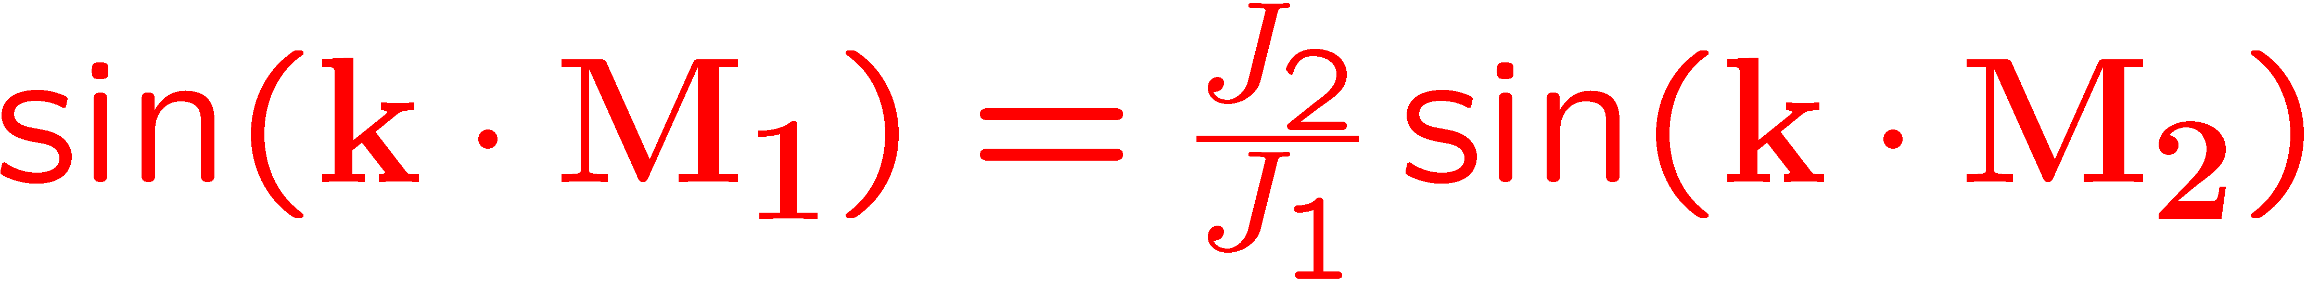
Gapless phase when J₃ lies
between(J₁+J₂) and |J₁-J₂|. The
bands touch each other at
special points in the Brillouin
zone whose location depend
on values of J_{i} s.
J₁
J₂
J₃
Quenching J₃ linearly
takes the system
through a critical line in
parameter space and
hence through the line
in momentum space.
In general a quench of d dimensional
system can take the system through a
d-m dimensional gapless surface in
momentum space.
For Kitaev model: d=2, m=1
For quench through critical point: m=d

Slide 9
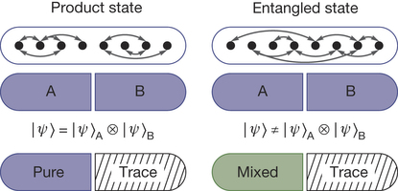




Entanglement: A few basic facts
Focus: Entanglement entropy of ground
states of many-body Hamiltonian.
Reason: May lead to classification of states
or phase transition which eludes the standard
methods (such as Landau-Ginzburg paradigm
for phase transitions)
R. Islam et al. Nature 2015.
Several measures of entanglement:
m^{th} Renyi entropy
Von-Neuman
Entanglement entropy for ground states of
local Hamiltonian obeys area law
Hasting’s theorem
The possible violation of this occurs for gapless
ground states and are usually logarithmic
For d=1, the coefficient of the log term is the central charge of the associated CFT
The sub-leading term Γ in the entanglement entropy for gapped systems, if non-zero,
indicates additional long-range component and is a signature of the ground state topology.
2D

Slide 10
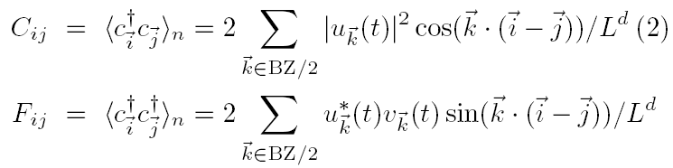
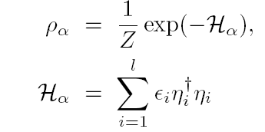


Calculation of integrable models
Divide the system of linear dimension L into a subsystem of dimension l and the rest (bath).
We intend to compute the density matrix ρ(l) by tracing out the bath degrees of freedom.
For integrable models, the answer can be expressed in terms two-point correlation functions
The density matrix can be written
in terms of these matrix elements
(Peschel et al. 2001)
The entanglement spectrum ε_{i} and the functions g and h can be determined from the
correlation functions C and F. Thus the correlation matrix determines ρ(l) and hence S(l).
The eigenvalues p_{i} of the density matrix as computed from the above procedure yields
Numerical computation of entanglement after n-cycles of the periodic drive.

Slide 11
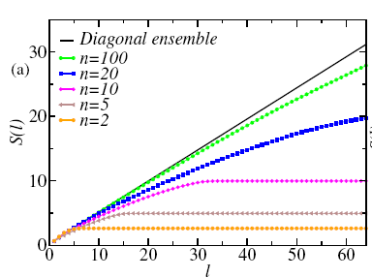




Entanglement generation after n drive cycles
Ising model in transverse field in d=1
Periodic drive of the transverse field for n
cycles with frequency ω
Protocol followed: Square pulse
S_{n}(l) satisfies area-law for small n in accordance with expected behavior.
However, the minimum l beyond which S_{n}(l) satisfies area-law diverges with n.
Periodic drive provides a route to realization of states with non area-law entanglement
entropies.
Consequence of finite weight of the final state in a major fraction of states in the
Hilbert space of the initial Hamiltonian.
Qualitatively similar to linear spread of S after quench (Huse et al)

Slide 12
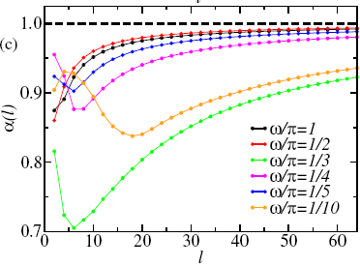

How fast one approach volume law
We define an estimator α
For d=1 α=0 indicates area law
α=1 indicates volume law
For large ω, there is a rapid convergence of α to 1 indicating approach to volume law
For small ω, α is a non-monotonic function of frequency.
The approach of α to unity may be quite slow for small ω
It may require a very large subsystem size
Thus periodic drive may be used to realize states with non-area and non-volume law
enatnglement entropy for any finite subsystem.

Slide 13


Qualitative Criteria for a non-area law: Analog of Hasting’s theorem
Hastings theorem states that ground state
of any local Hamiltonian must have an
area-law entanglement entropy
Not directly applicable to driven systems
since the final state is not the ground
state of the driven Hamiltonian for any t
Idea: Turn the problem around. Is it possible to obtain an Hamiltonian for which the final
State after the drive is the ground state?
The state of the system after n drive periods is
We seek the solution of
The two component structure of
the wavefunction allows us to write
Obtain solution for ε_{kt} and Δ_{kt} subject to the condition that
H_{kt} approaches the system Hamiltonian in the adiabatic limit

Slide 14



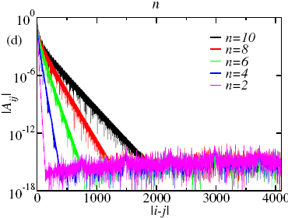
The solutions are
where u and v are the two components
of the final wavefucntion.
Thus in real space one obtains
From the plot of |A_{ij}| as a function of
distance between the sites, we find that
A_{ij} decays exponentially with |i-j|.
A_{ij} ~ Exp[ -|i-j|/R(n,ω)]
The length-scale R increases rapidly with n for
any ω and crosses l for some finite n=n’
T=1
For n >> n’, the system may have non-area
law behavior since the state after n drive cycles
is the ground state of an effectively long-ranged
Hamiltonian H_{t}
Application of Hasting’s theorem
to driven systems .

Slide 15



Approach to the steady state: dynamic transition
In the limit of infinite n, the system is known
to reach a steady state which is given by
the diagonal ensemble ( which is same as
GGE for periodically driven integrable models)
One can drop cross terms
while calculating any fermioinc
Correlator:
We denote the correlation function thus computed as fermionic steady state correlators.
The corresponding steady state value of the correlation matrix is
One can then define a distance measure D which measures how close C_{n} is
to its steady state value.
Numerically one finds that there are two distinct dynamical regimes in these driven systems
which are separated by a transition.
Regime 1
Regime 2
Dynamical transition and
reentrance at d=1

Slide 16
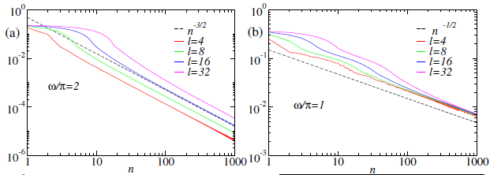

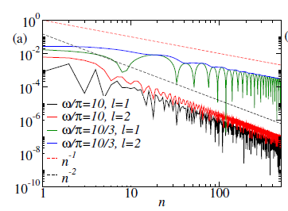
Dynamical transition and Reentrance
1D
Ising
2D
Kitaev

Slide 17

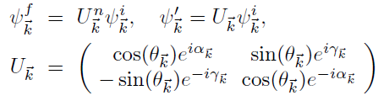
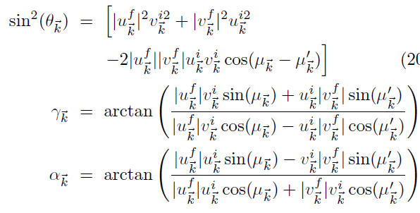
Interpretation of the transition: Evolution matrix
The unitary evolution in the presence of a periodic drive after n drive cycles leads to
The parametrization of U_{k} follows
from its unitary nature: θ, α, and γ
are real quantities
One can find U_{k} as a function of
initial and final values of the
wavefunctions.
For an initial state (0,1), this yields
the simple result

Slide 18


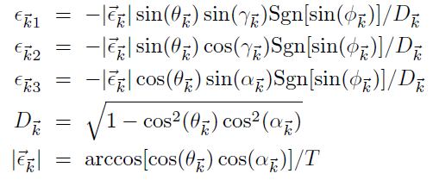
Interpretation of the transition: Floquet Hamiltonian
For stroboscopic measurements at
the end of n drive periods, the system
Is descrbed by the Floquet Hamiltonian
For the present class of integrable models U_{k} is 2 by 2 matrix. Thus one may write
One can express the Floquet Hamiltonian in terms of the parameters of U and
hence in terms of the initial and final wavefunctions for each k
Exact expression
For the Floquet
Hamiltonian

Slide 19
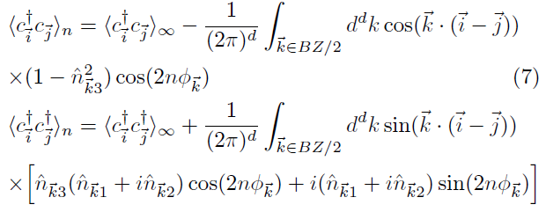
Relation of Floquet Hamiltonian with elements of correlation matrix
The elements of the correlation matrix depend on the final wavefunction
It can be expressed in terms of the initial wavefunction and the elements of the
Floquet Hamiltonian after n drive cycles
All elements of the correlation matrix can be expressed in terms of elements of H_{F}

Slide 20

For large n, the contribution to the frequency dependent part of the correlation function
comes from saddle point of φ and hence |ε|
Such saddle points at occurs at k=k0 for which d|ε|/dk_{i}=0
This occurs for k for which
n_{1k}=n_{2k}=0.This in turn implies
that U is diagonal or the
off-diagonal term in H vanishes
This happens at BZ edge or center
This condition may be satisfied for
a specific k₀ not necessarily at the BZ
edge or center,

Slide 21
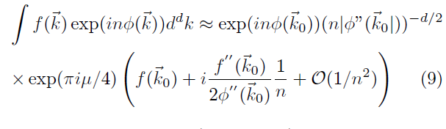
Saddle point evaluation of correlators
Within saddle point approximation appropriate for large n one may express these integrals as
μ=Sgn[φ”] and f(k)
Is a smooth function
of k around k₀
The function f(k) can be read off from the expression of correlation functions.
Key point: f(k₀) vanishes if k₀ happens to be at the
edge or center of the Brillouin zone where n_{3k}=1
In this case, the correlation functions show a (ω/n)^{(d+2)/2} decay to its steady state value
For any other position of k₀, f(k₀) is finite
In this case, the correlation functions show a (ω/n)^{d/2} decay to its steady state value
The position of the saddle point
depends on the drive frequency
Drive frequency induced dynamic
transition between two regimes

Slide 22
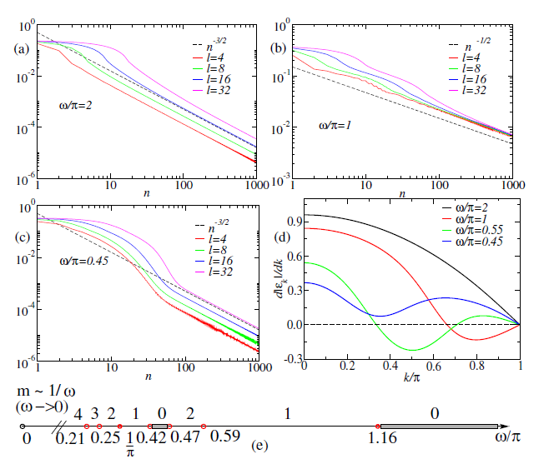
1D Ising model
For large ω, H_{F} is well approximated by time average of H and has its saddle point at k=0,π
As ω is decreased additional zero of d|ε|/dk occurs at k=k₀ at ω= 1.16 π leading to
a transition
Upon further decrease of ω, the number of such zeroes between k=0,π may
revert back to zero leding to re-entrant behavior of the phases
For small ω, the number of zeroes proliferate as 1/ω. --- no transition occurs in this regime.

Slide 23
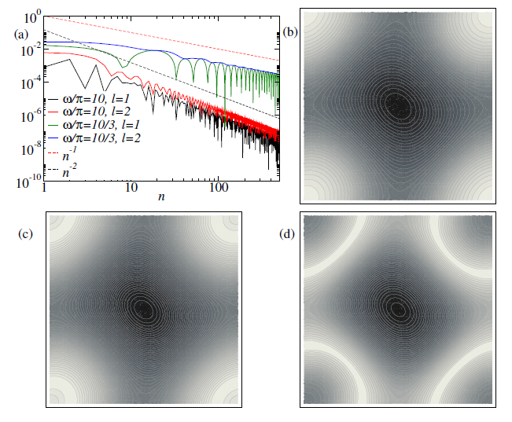
2D Kitaev model
ω=10 π
ω=4π
ω=3.3 π
A single transition between the two phases at ω_{c}= 4π with J₁=J2=1
Appearance of a line of zero rather than a single point in the BZ ruling out reentrance

Slide 24



Reason for line of zeros: Models with special symmetry
Additional symmetry of a class of 2D model
where the time dependent term is independent of k and the functional form of kx
and ky are similar
For the Kitaev model
For such Hamiltonians, since β(t) is independent
of kx and ky, dynamics does not change this
symmetry.
U, H_{F} and |ε| shares the
same symmetry
Such a functional form guarantees that if
so is
Thus one has a line of zeroes
in the 2D BZ
Such models do not show re-entrant behavior since an entire line of
zeroes do not generically vanish due to change in ω

Slide 25




Diagonal ensemble
To obtain the correlation function in the steady state one needs to compute ψ_{f}
In the limit when n approaches infinity.
Thus if |1_{k}> and |2_{k}> be the eigenstates of Floquet Hamiltonian, one can write
In doing this we have omitted all cross terms due to rapid oscillation of phase factors
that originates from the difference in Floquet energy of the two states
Thus for appropriate choice of O, one may compute the correlation matrix C and
hence S for the steady state.

Slide 26
Conclusion and Future Directions
There exist two dynamical regime for relaxation of correlation functions
in periodically driven many-body systems,
2. These two regimes are separated by a dynamic transition; they shall show
up in any local correlations such as magnetization of the Ising model.
Periodically drive integrable models provide route to generation of states
with non area-law entanglement entropy.
Recent experiments have measured second Renyi entropy for ultracold
bosons; similar experiments, suitably modified, may verify some of the
theoretical predictions.
Can these be generalized to non-integrable models?
Can one see effects of integrability breaking on these transitions by suitably
tuning model Hamiltonian parameters?

