Slide 1
Interplay of classical and quantum dynamics in hot atoms
Saikat Ghosh
Arif Warsi, Niharika Singh, Arunabh Mukherjee
Indian Institute of Technology - Kanpur

Slide 2

Qubits: Superposed atomic states as a resource
Hammerer K, Sorensen A S and Polzik E S, Rev. Mod. Phys. 82 1041 (2010)
Reiserer A and Rempe G, Rev. Mod. Phys. 87 1379 (2015)

Slide 3
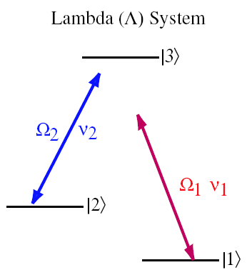
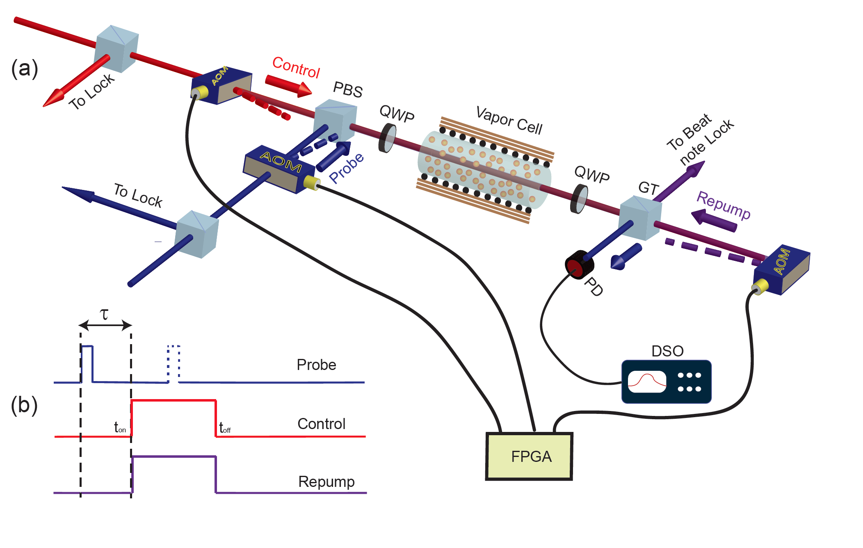
How such states are created in practice?
First demonstration in hot atomic vapor, followed by cold atom, single atoms, ions,
quantum dots , dye molecules and many more

Slide 4
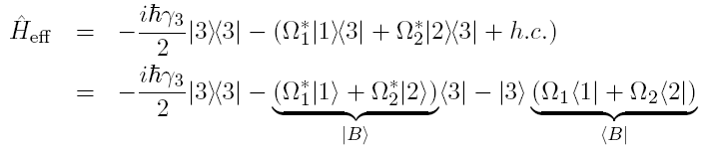
Experimental signature of superposition:
Electromagnetically Induced Transparency (EIT)

Slide 5


Electromagnetically Induced Transparency (EIT)
The “Dark State” is completely decoupled from the excited state:
No spontaneously scattered photons

Slide 6
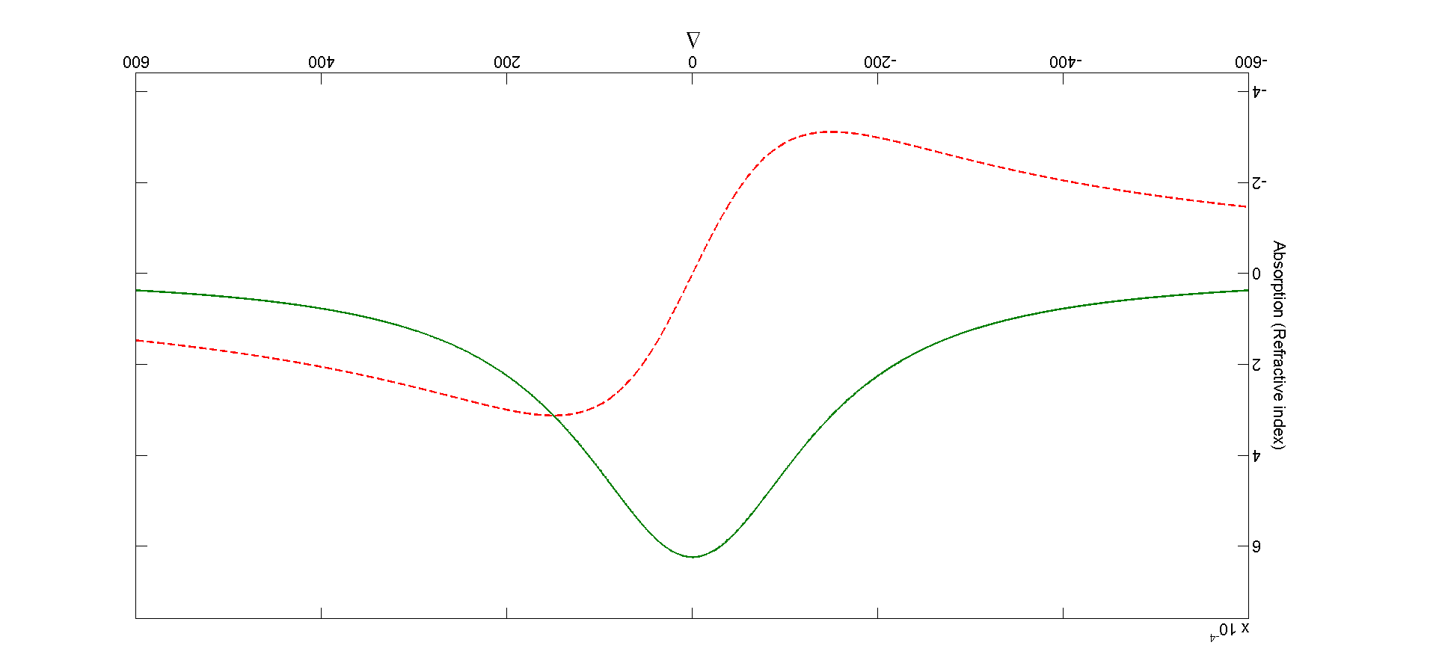
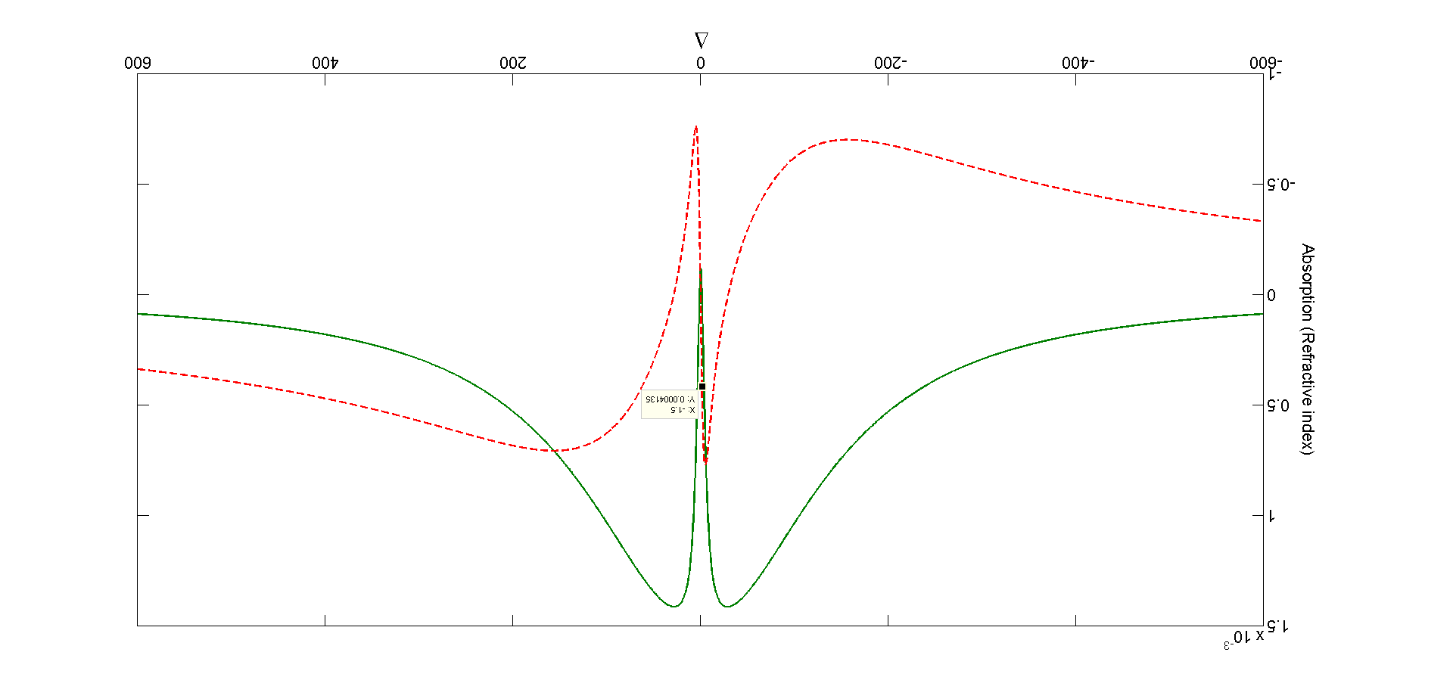
Standard experimental signature of superpostion
For more complicated systems, it is usually not possible to probe the system from various directions

Slide 7
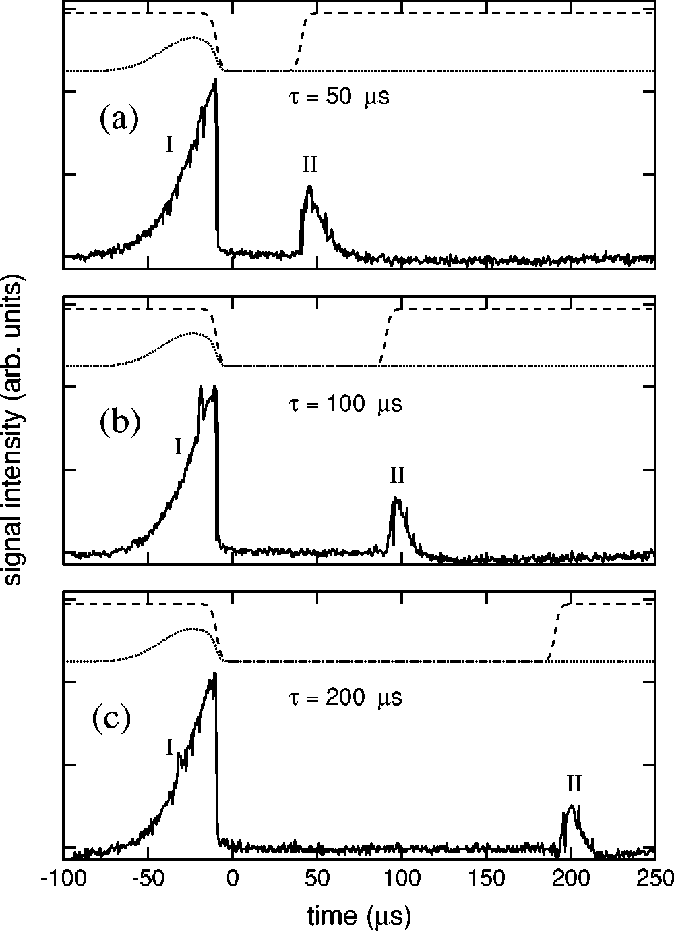
Slow and Stopped Light
A classical pulse interacting with an atomic ensemble
Light travelling at 17 m/s !
L. V. Hau, et al., Nature 397, 594, (1999);
C. Liu et al., Nature, 409, 490, (2001) D. Philips et al., Phys. Rev. Lett. 86, 783, (2001)

Slide 8



Heralded single photon generation
To Single Photon
Detector
time
State preparation
The write process is inherently random, but is conditioned on the detection of a single scattering event.

Slide 9
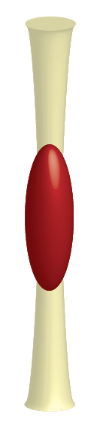
Heralded single photon generation
Conditioned on detecting a write photon, an on-resonant , classical beam reads out the excitation.
Highly directional, collective emission
Duan L M, Lukin M D, Cirac J I and Zoller P , Nature 414 413, 2001
McKeever J et. al., Science 303 1992, (2004 )

Slide 10



Mapping photons to atoms, entanglement, teleportation etc.
Ions: Jurgen’s talk, today morning
Mucke M, Figueroa E, Bochmann J, Hahn C, Murr K, Ritter S, Villas-Boas C J and
Rempe G Nature 465 755 2010
Haruka Tanji, Saikat Ghosh, Jon Simon, and Vladan Vuletic, Phys. Rev.Lett.,103,043601(2009).
Jon Simon, Haruka Tanji, Saikat Ghosh and Vladan Vulteic, Nature Physics, 3, 765, (2007).

Slide 11
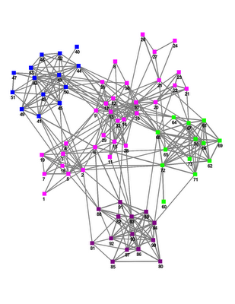

Superposition as a resource:
Towards a quantum network
Material systems form nodes
Single photon channels connect the nodes
For Quantum cryptography, computation and simulations
"The quantum internet" H. J. Kimble, Nature, 453, 1023 (2008).

Slide 12
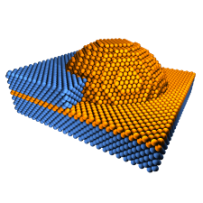
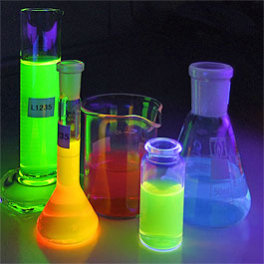

Towards a quantum network
A myriad of materials:
Engineering bandwidth of photons and therefore matching emission of one system to the other
Quantum Dots
Dye Molecules
Cold Atoms
Photo Source: wikipedia.org

Slide 13
Experimental signature of EIT in more complex systems
For more complicated systems, it is usually not possible to probe the system from various directions

Slide 14
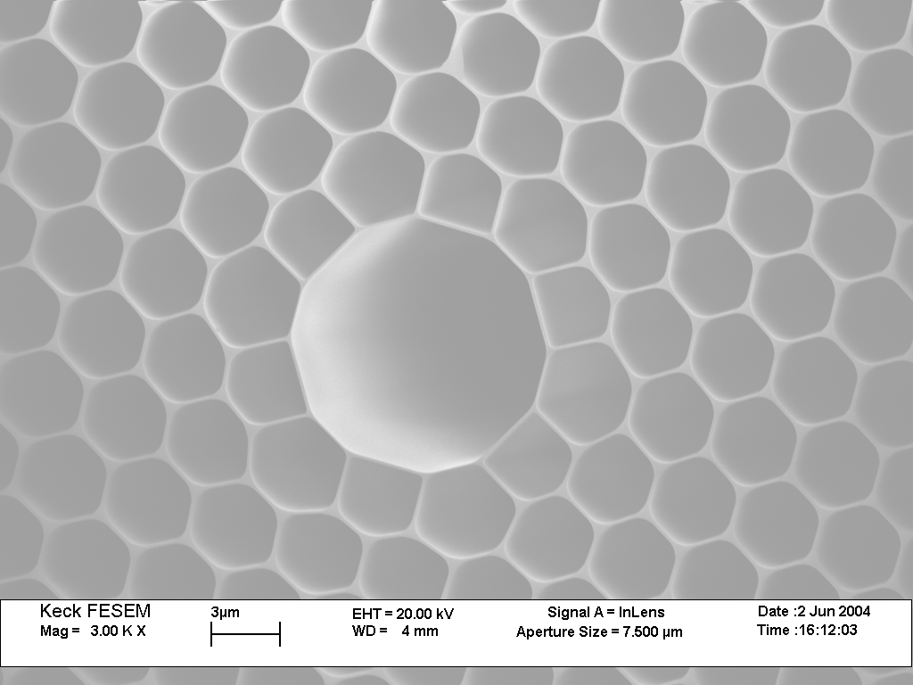
Two examples: EIT in more complex systems
Molecules in hollow core fiber:
A pathological case:
EIT(?) in Er doped fiber: superpostion of
gain and loss(!)
Saikat Ghosh, Jay Sharping, Alex Gaeta Phys.Rev. Lett. 94, 093902 (2005)
Saikat Ghosh et. al., Phys. Rev. Lett. 97, 023603 (2006).

Slide 15
How much quantum superposition do one really have?
Bad Modes
(Unsuperposed)
Driving system
Quantum
System
In an ensemble of atoms/molecules how many atoms are truly in a superpostion of states?
How such a superpostion is formed ? How does it compete with decay?
Can one differentiate classical and the quantum
dynamics?

Slide 16
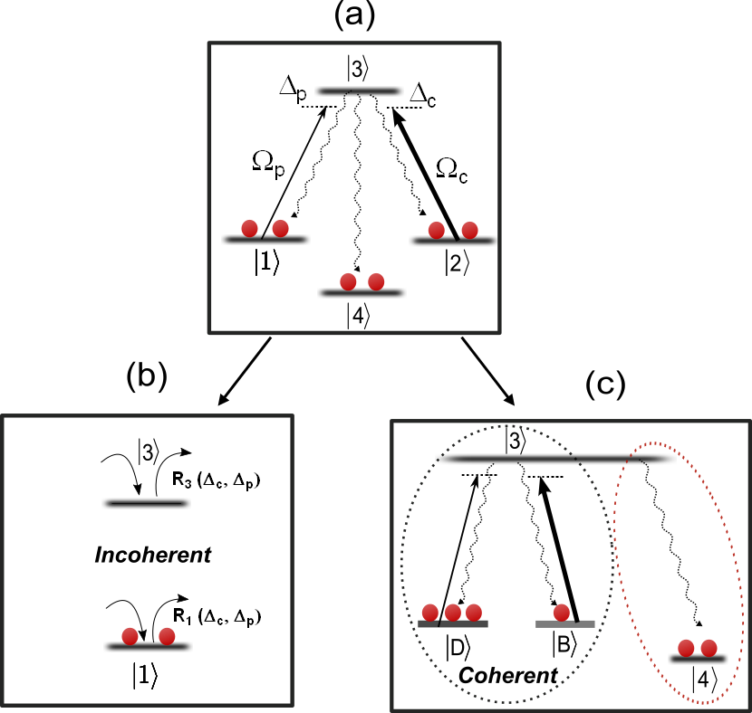
How much quantum superposition do one really have? Case study with hot atoms

Slide 17
Outline
In an ensemble of atoms/molecules how many atoms are truly in a superpostion of states?
How such a superpostion is formed ? How does it compete with decay?
Can one differentiate classical and the quantum dynamics?
Case A
Closed quantum system
Case B
Open quantum system
Case C
Incoherent dynamics

Slide 18
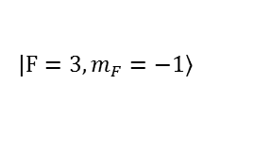
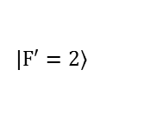
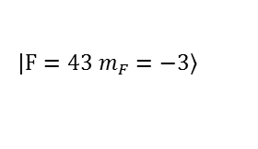
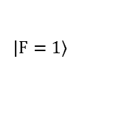
Experimental Method
$$\left.|F′=2\right\rangle$$
$$\left.|F=43 m_{F}=−3\right\rangle$$
$$\left.|F=3, m_{F}=−1\right\rangle$$
$$\left.|F=1\right\rangle$$

Slide 19
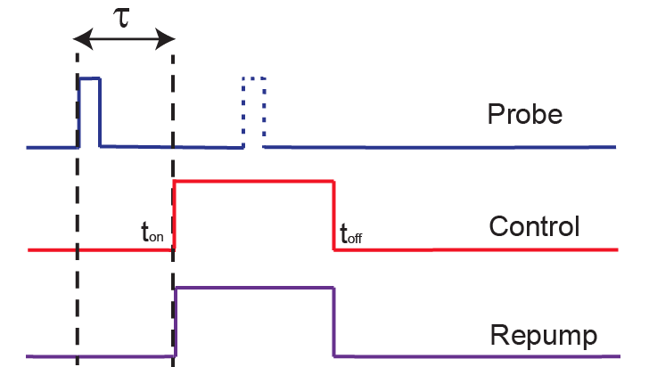
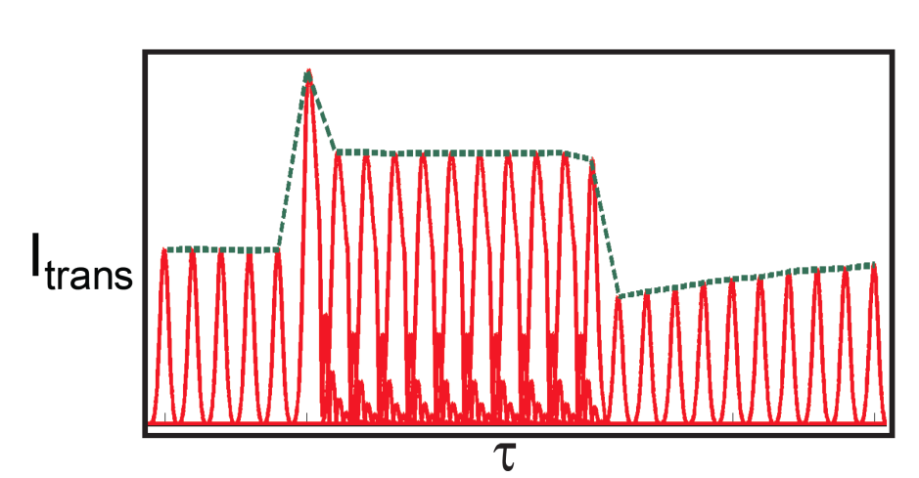
Stroboscopic Probing

Slide 20
Experimental Method
$$\left.|F′=2\right\rangle$$
$$\left.|F=43 m_{F}=−3\right\rangle$$
$$\left.|F=3, m_{F}=−1\right\rangle$$
$$\left.|F=1\right\rangle$$

Slide 21
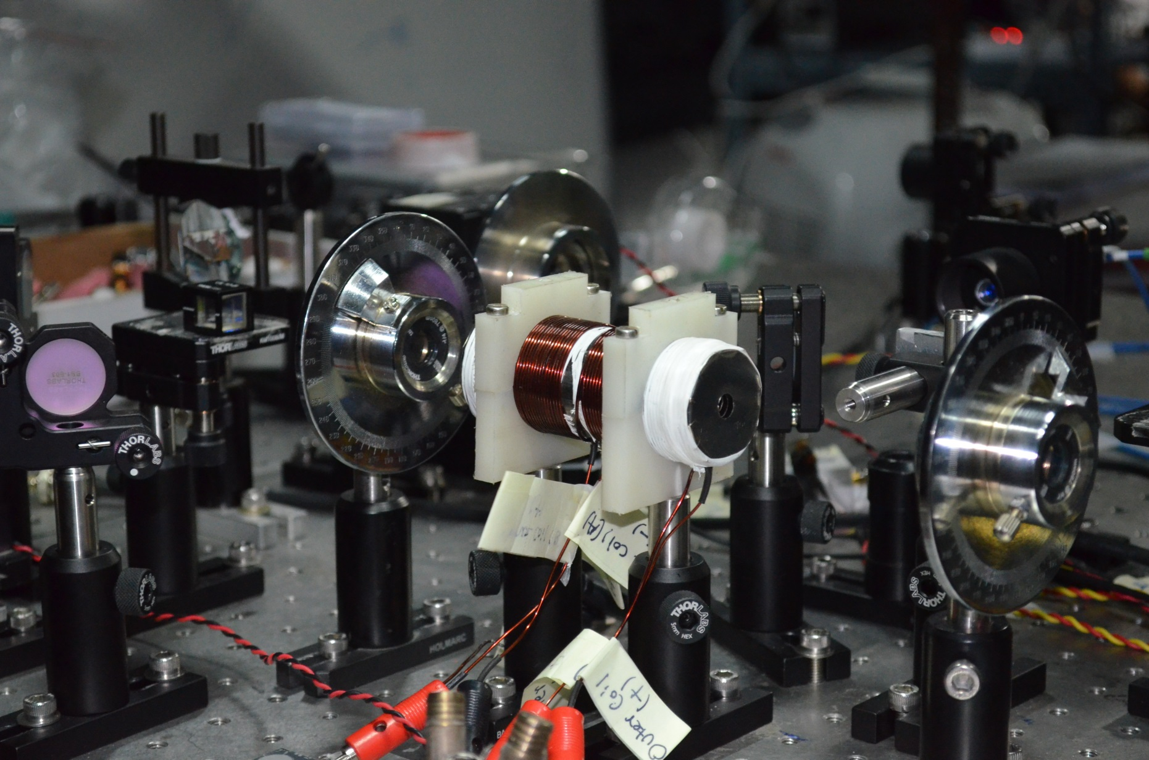
Experiments

Slide 22
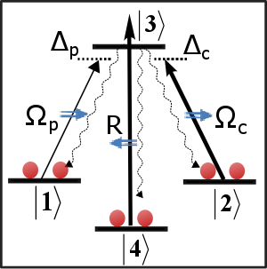
Case A: Closed system

Slide 23
Closed system: What do we expect ?
I
II
III
IV
Ideal EIT response

Slide 24
Observation: Closed system
I
II
III
IV

Slide 25
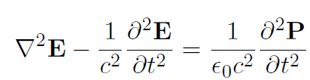

Closed system: Simulations
Coupled Maxwell-Bloch equations

Slide 26
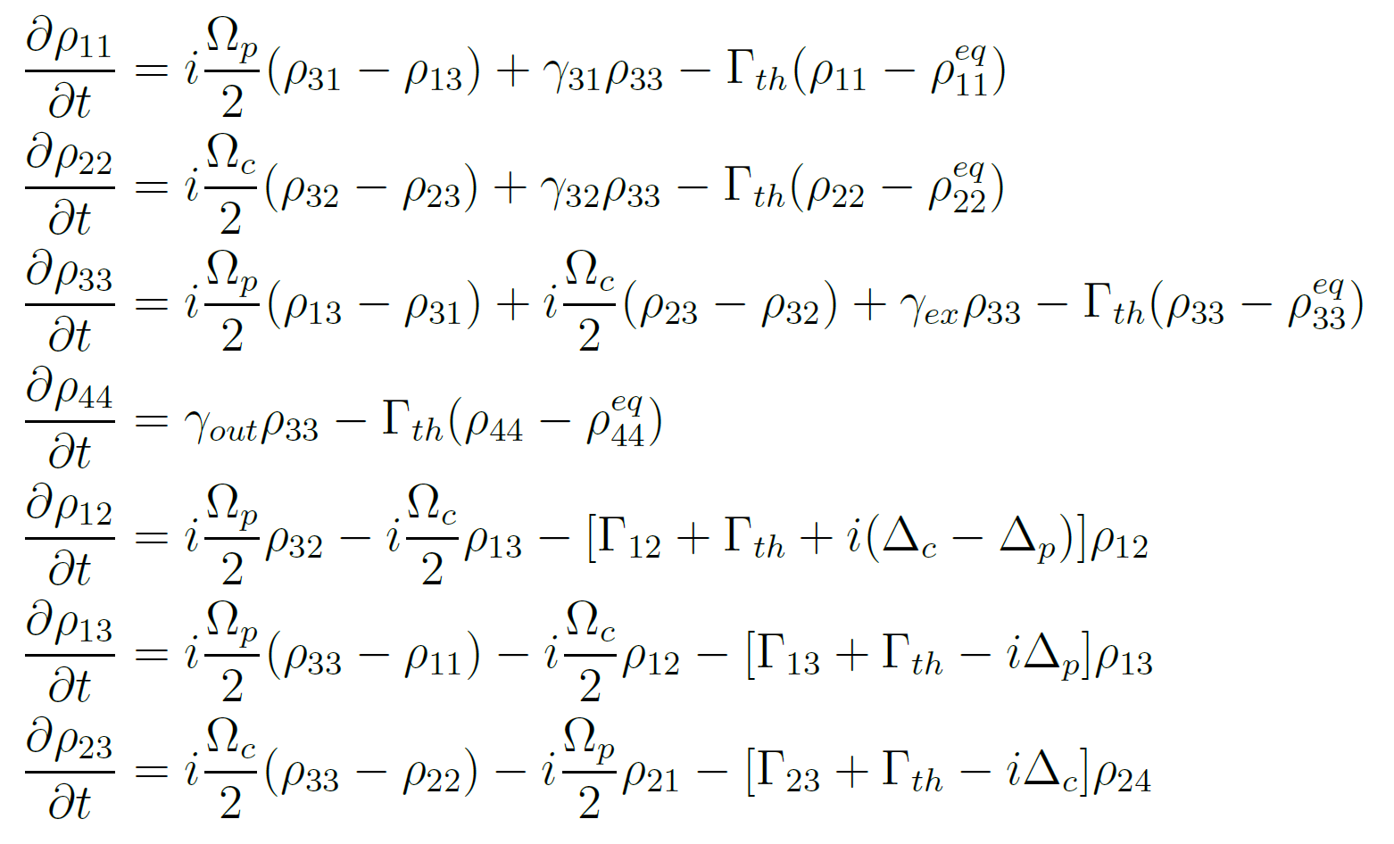
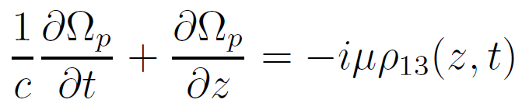
Closed system: Simulations
Maxwell-Bloch equations:

Slide 27
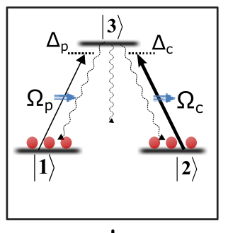
Closed system: Numerical experiments
I
II
III
IV
Expt.

Slide 28
Region I: Where is the peak coming from?

Slide 29

Region I: Lasing Without Inversion!
A thermal population in leads to gain.
One would not see any such peak in a optically pumped, pure sample.

Slide 30

Observation of Lasing Without Inversion: an artifact of thermal ensemble
Phenomenological bound:
“Quantum Optics”, Scully (2003)

Slide 31
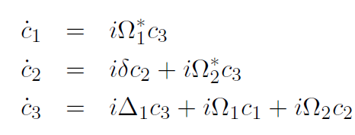
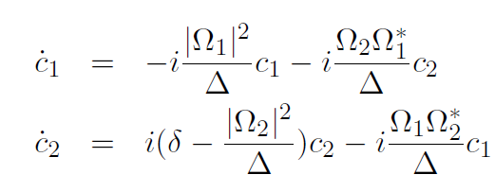
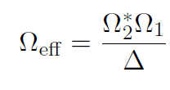
Region I: What sets the rise-time?
After adiabatic elimination of the excited state:
(which is simply a spectator for large detuning)

Slide 32
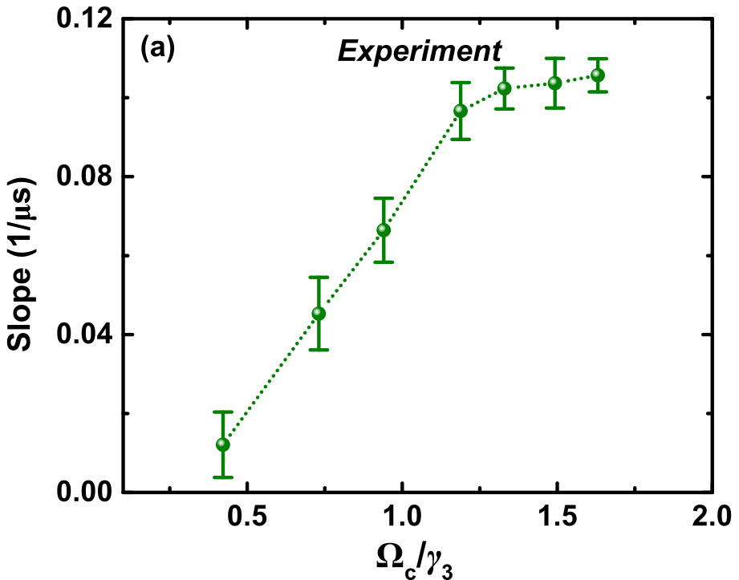
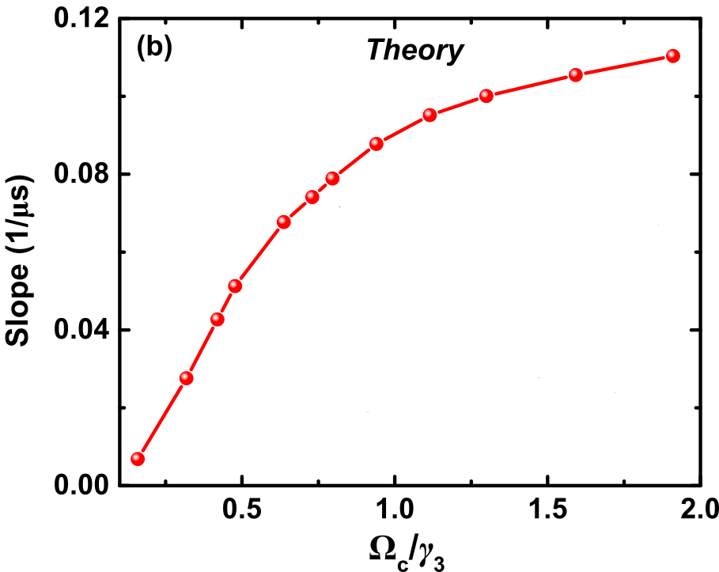
Region I: Observation of Rabi flop!
Why this is interesting?
Atoms in the vapor are all moving fast (on average 300 m/s)., each having their
Doppler shifted resonances. One therefore expects any coherent flops to completely
wash out.

Slide 33
Region II: How does the system approach steady state?
I
II
III
IV

Slide 34
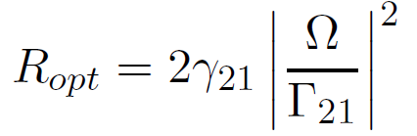

Region II: How does it approach steady state?

Slide 35
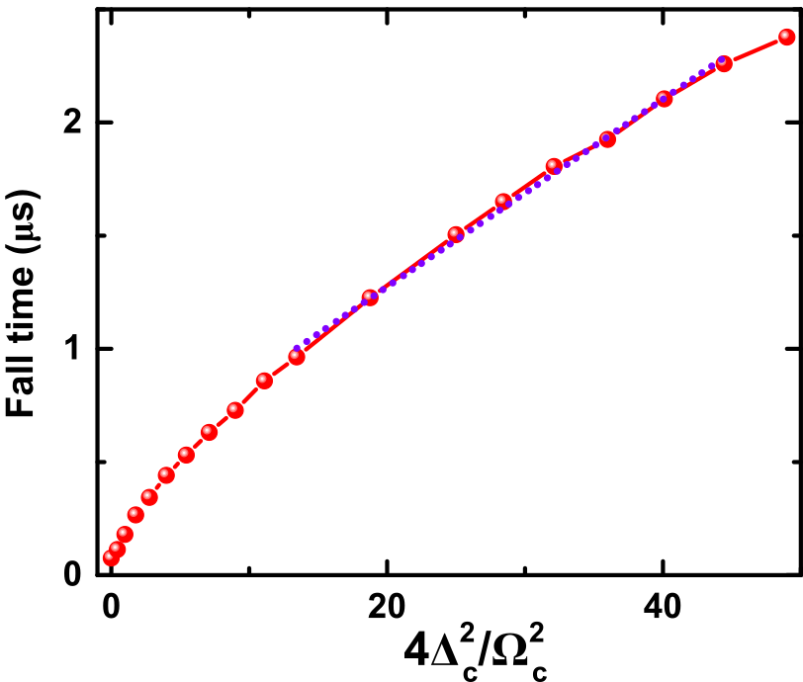
Region II: Optical pumping to Steady state EIT
Incoherent process

Slide 36
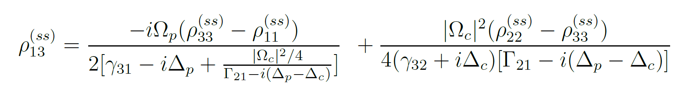
Region II: Steady state EIT
I
II
III
IV
Quantum superposition (EIT)
Incoherent process(Op. Pump.)

Slide 37
Region III: Fall at turn-off
Quantum coherence
Sustaining transparency
I
II
III
IV

Slide 38
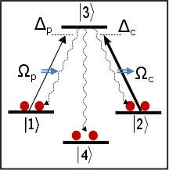
Case B: Open System dynamics
I
II
III
IV

Slide 39
Open System dynamics
There is again two time-scales for approach to steady state
The sharp rise corresponds to onset of Rabi-flop
The continuing steady-increase is due to optical pumping of atoms out of
the system

Slide 40
Open System dynamics
A direct signature of quantum
coherence sustaining
transparency

Slide 41
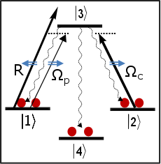
Case C: Incoherent pumping
Coherence is destroyed.
However, one expects to see a transparency due to
reduced number of atoms in probe state

Slide 42
Case C: Incoherent pumping
Incoherent pumping:
Proportional to the square of Rabi frequency
Thermalizaton:Time of flight of atoms
through the beam path, moving at 300 m/s

Slide 43
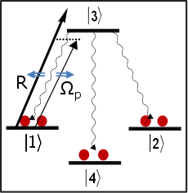
Case C: Incoherent pumping

Slide 44
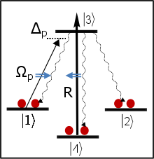
Case C:Incoherent dynamics (induced absorption)

Slide 45
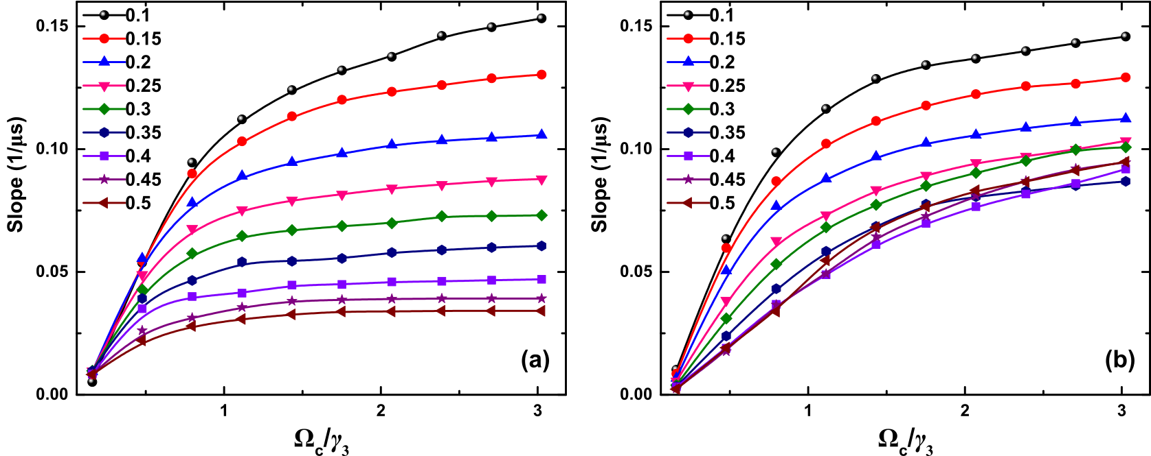
Adiabacity: Probe pulse width and control ramp time
Probe pulse width
Control ramp time
Region I

Slide 46
Summary
Testing competing hypothesis:
Proposed:
A master equation for error - probability
K. Molmer, Phys. Rev. Lett. 114 040401 (2015)

Slide 47
Summary
Testing competing hypothesis:
Closed, coherent
Open, coherent
Open, in-coherent
Observation of half-cycle Rabi flop in open quantum systems
Observation of Lasing without Inversion(LWI)
“Interplay of classical and quantum dynamics in atomic vapor”
Arif Warsi, Niharika Singh, Arunabh Mukherjee, Saikat Ghosh (to be submitted)

Slide 48


Experiments at IIT-K
How to detect an extremely “weak” scatterer?
Measurement of higher order correlations?
State discrimination problem: signal state vs thermal state
How to improve signal-to-noise ratio?

Slide 49
Experiments at IIT-K
System
Measurement
Probe

Slide 50
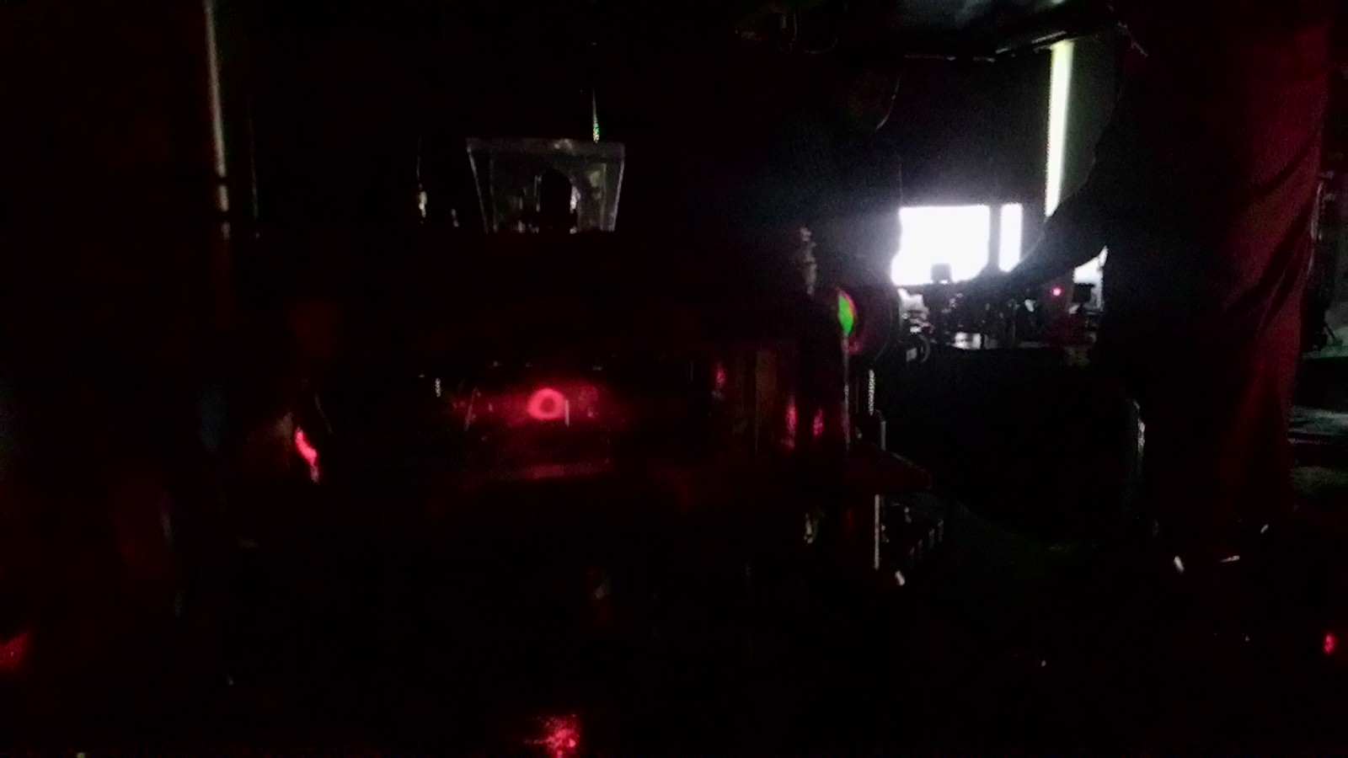
Experiments at IIT-K
System
Measurement
Probe
Probe: Correlated photons from cold atoms

Slide 51
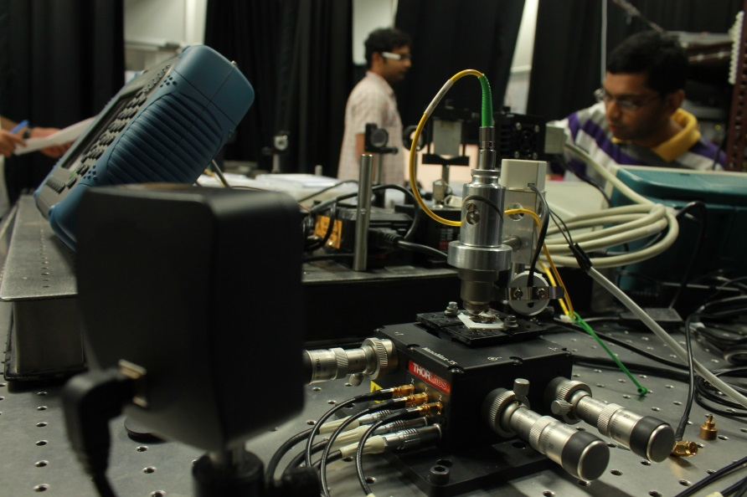
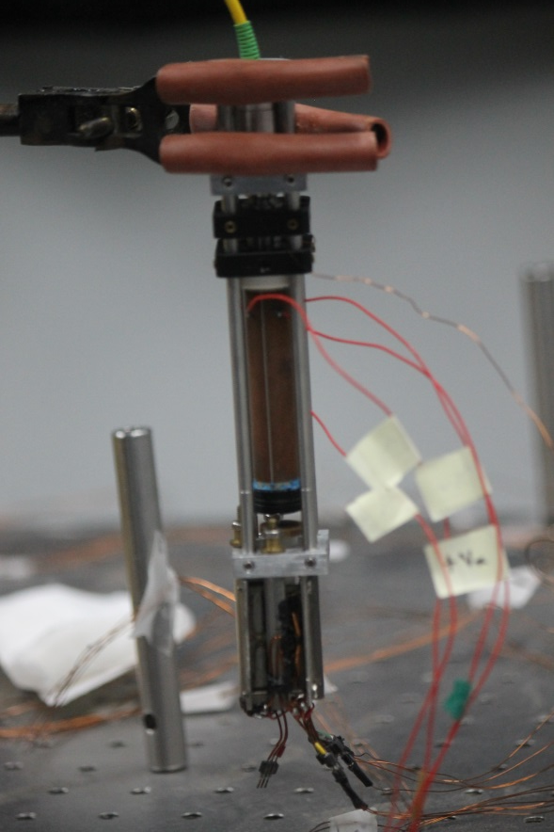
Experiments at IIT-K
System
Measurement
Probe
Confocal microscope (diffraction limited imaging)

Slide 52
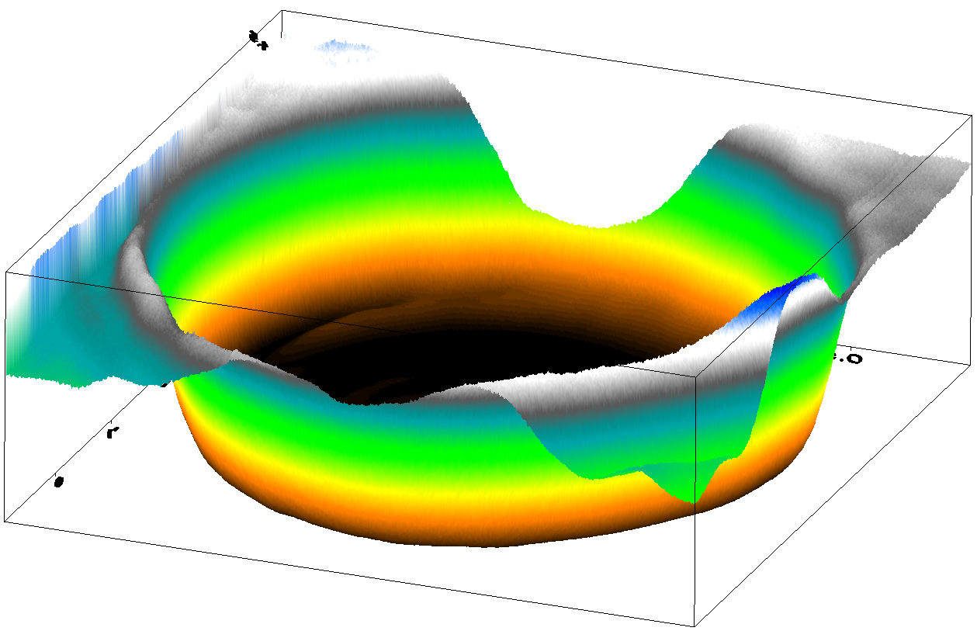
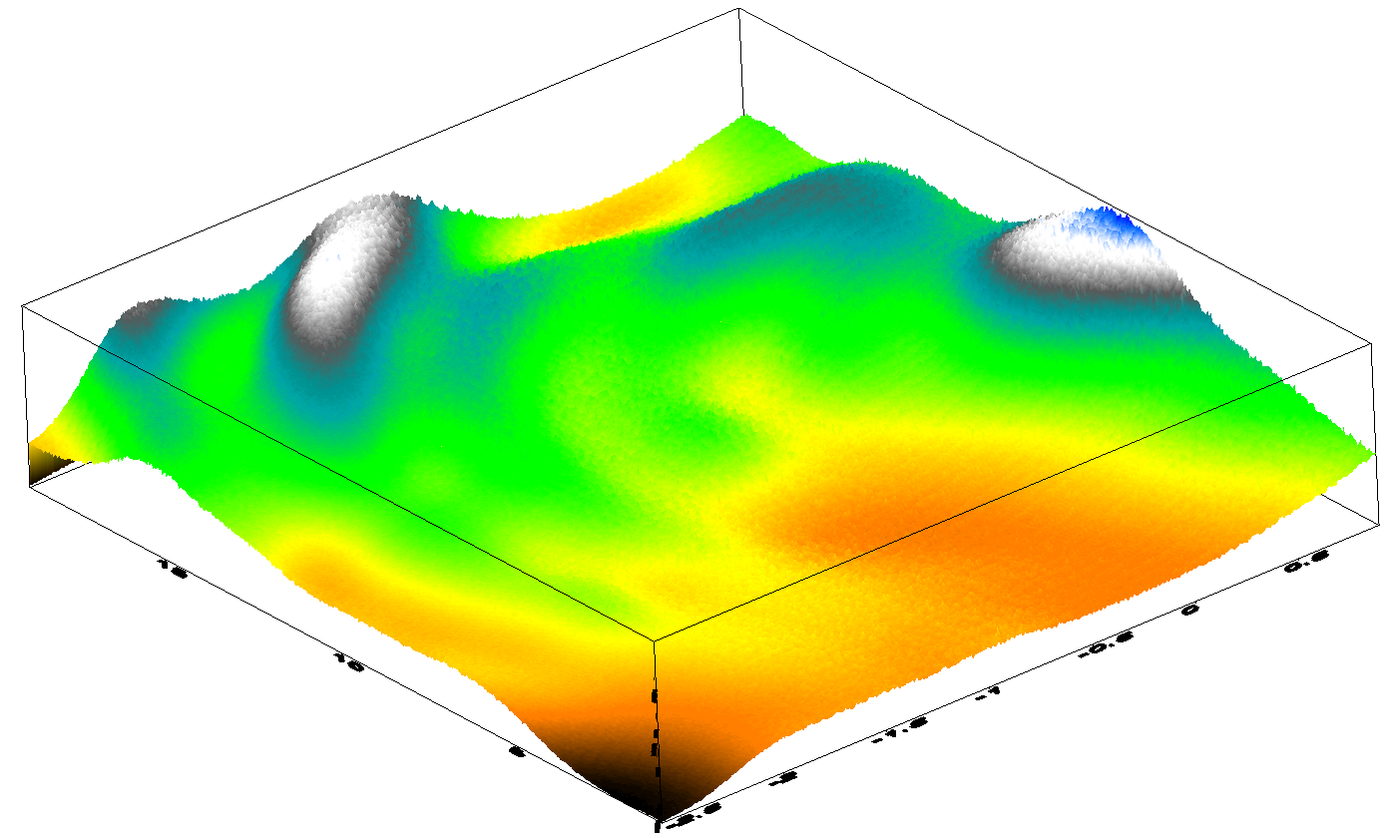
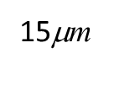
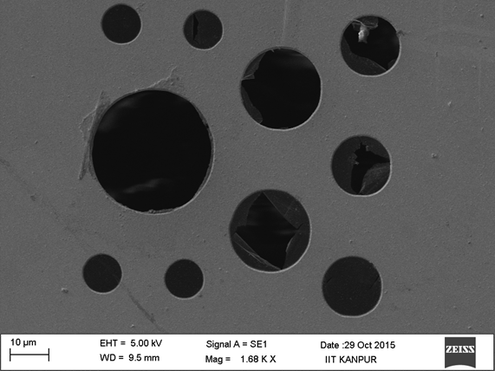
Experiments at IIT-K
System
Measurement
Probe
Folds of graphene
In collaboration with:
Kirill Bolotin(Max Planck) Amit Agarwal(IITK)

Slide 53
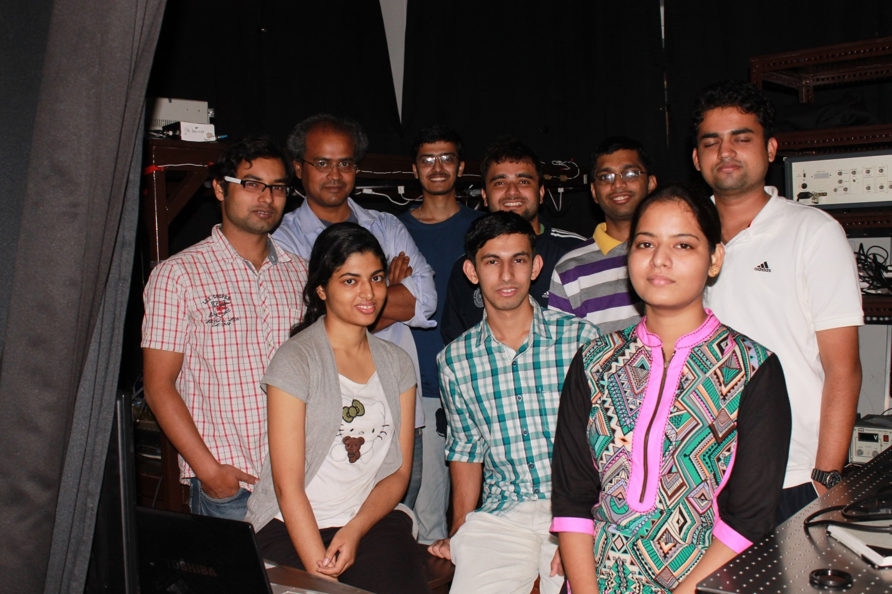
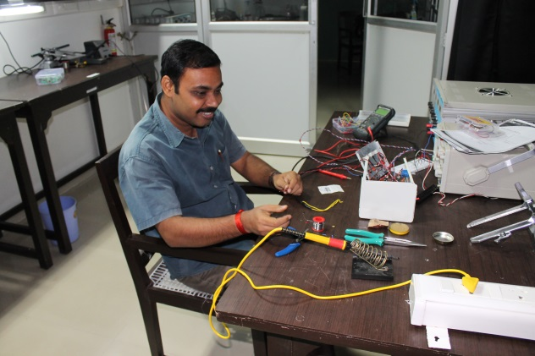
Quantum measurements lab @ Kanpur
Inspire Faculty Fellow: Dr. Niharika Singh
PhD Students: Arif, Rajan, Jagannath, Sanjukta
UG Students: Saheb, Arunabh, Abu Musha, Kevin, Chitesh, Harish
Lab Technician: Amar Nath Koener
Thank you

