Slide 1
Experimenting with entangled photons produced in spontaneous parametric down conversion process
R. P. Singh
Laser Physics & Quantum Optics Lab
Physical Research Laboratory, Ahmedabad

Slide 2
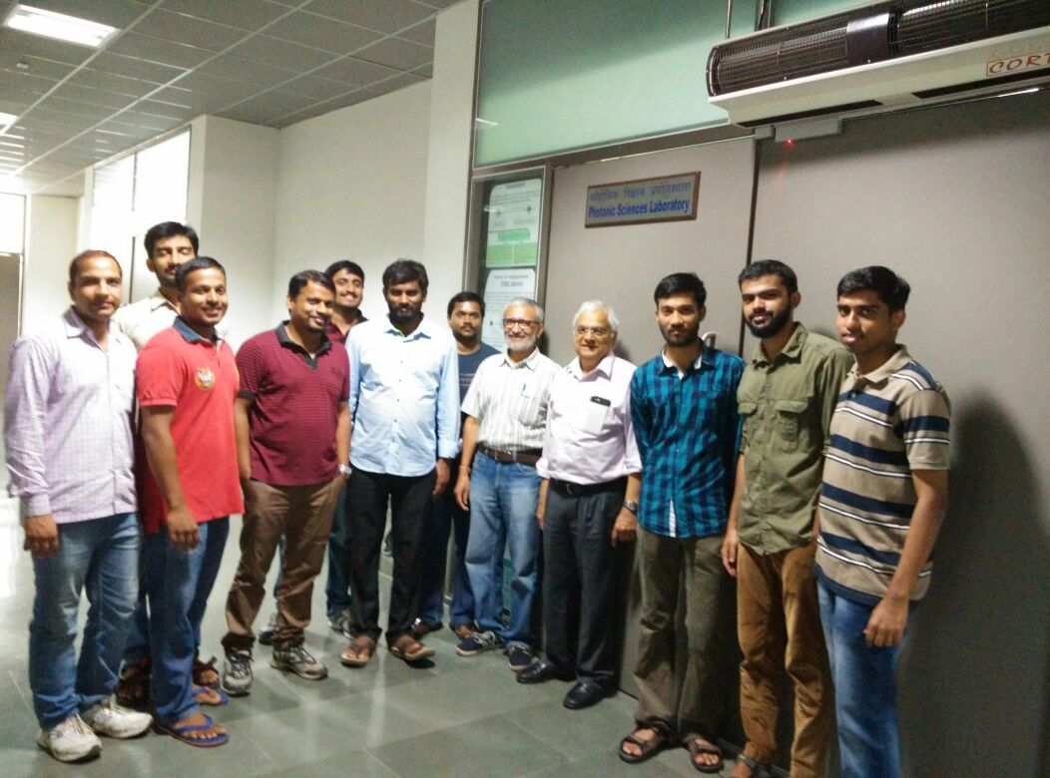
Our group
J. Banarjee
G. Samanta
Ali Anwar
M V Jabir
S G Reddy
A Aadhi
Nijil
P Chithrabhanu
Apurv Chaitanya
Vijay Kumar
Avesh Kumar
Shashi Prabhakar, Ashok Kumar, Pravin Vaity, Sanjoy Roychowdhury, Jitendra Bhatt

Slide 3
Outline
Entanglement
Spontaneous Parametric Down Conversion
SPDC with vortices
Perfect vortices and SPDC
Effect of pump focussing on SPDC output
Conclusion

Slide 4
Entanglement
While generation of entangled particles
Total energy is conserved
Total (spin/orbital/linear) momentum is conserved
Annihilation happens
Generated simultaneously from the source
Preserve non-classical correlation with propagation
The most common method to generate entangled photons in lab is Spontaneous parametric down conversion (SPDC).

Slide 5
Spontaneous Parametric Down-Conversion
k_{s}
k_{i}
Momentum conservation
Signal(s)
k_{pump} = k_{s} + k_{i}
k_{pump}
Pump
Idler(i)
ω_{s}
Energy conservation
Non-linear
χ⁽²⁾ Crystal
ω_{pump}
ω_{pump} = ω_{s} + ω_{i}
ω_{i}
Notes:
Spontaneous parametric down-conversion (SPDC) is a second order non-linear optical process in which one pump photon is destroyed and two photons with lower energies are created. It is governed by conservation laws of energy and momentum. The conservation of momentum is apparently called as phase-matching condition. The process is spontaneous because the daughter photons are generated from quantum vacuum fluctuations. It is parametric due to a definite phase relationship between input and output fields. The term down-conversion refers to the fact that the energies of generated signal and idler photons are lower than that of the pump photon.
•“Spontaneous”: no final states in initial configuration ( ~ 1 in 10^9 photons down-converted)
•“Parametric”: crystal does not add/subtract energy/momentum from process (elastic scattering)
•“Down-Conversion”: frequency of pump photon lowered

Slide 6
Birefringent Phase Matching
Optics axis
e-ray
(polarized)
Incident light
(Unpolarized)
o-ray
(polarized)
Birefringence, Δn = n_{e} – n_{o}
Notes:
Birefringence: dependence of the refractive index on the direction of polarization of the optical rotation.
In order to achieve Phase-matching through the use of birefringent crystals, the highest frequency wave is polarized in the direction that it is the lower of the two possible refractive indices. For a negative uniaxial crystal (n_e < n_o), this choice corresponds to the extraordinary polarization.
The optic axis of a crystal is the direction in which a ray of transmitted light suffers no birefringence(double refraction). Light polarized perpendicular to the plane containing propagation vector and the optic axis is said to have the ordinary polarization. Light polarized in the plane containing propagation vector and the optic axis is said to have the extraordinary polarization

Slide 7

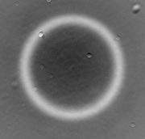
Type-I SPDC
e → o + o type interaction
Produces single cone
The two output photons (signal and idler) generated will be non-collinear
|H>
o-ray
2λ
λ
pump
|V>
o-ray
2λ
|H>
BBO crystal
Notes:
Based on the polarization of the down converted photons, there are two types of phase matching.

Slide 8
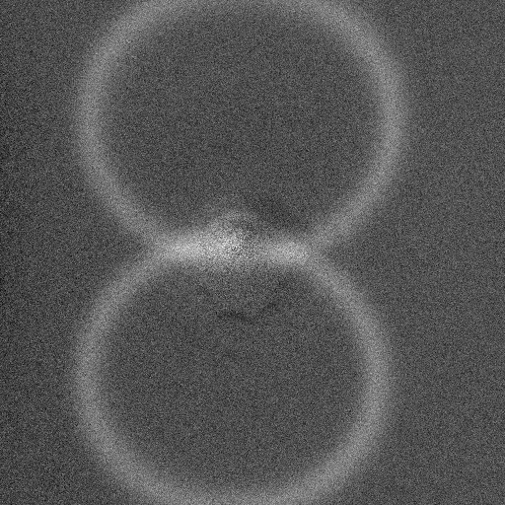
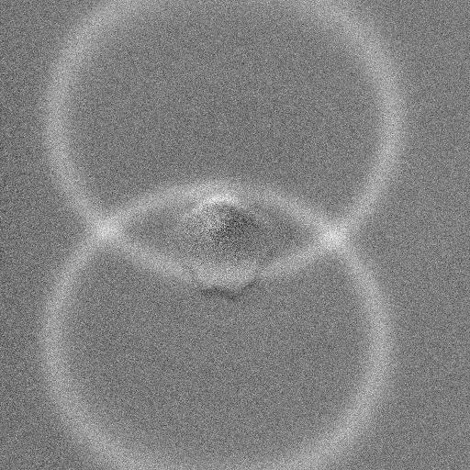
Type-II SPDC
|V>
2λ
λ
e → o + e type interaction
Produces double cone
The two output photons (signal and idler) generated can be both non-collinear and collinear
|V>
2λ
|H>
BBO crystal
e-ray
e-ray
pump
o-ray
o-ray

Slide 9
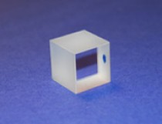
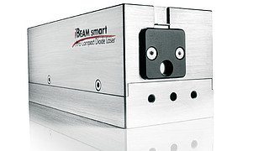
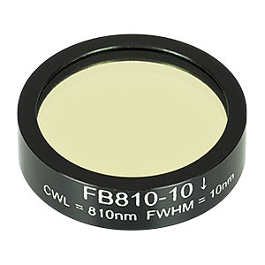
Components used
BBO Crystal
Size: 8×4×5 mm³
θ = 26˚ (cut for 532 nm)
Cut for type-1 SPDC
Optical transparency: ~190–3300 nm
n_{e} = 1.5534, n_{o} = 1.6776
Diode Laser
Wavelength: 405 nm
Output Power: 300 mW
Interference filter
Wavelength range 810 ± 5 nm

Slide 10
Basic experiments with SPDC
Imaging SPDC ring
Coincidence detection
Angular autocorrelation

Slide 11
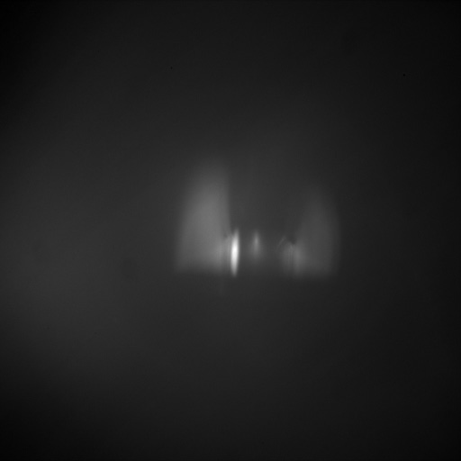
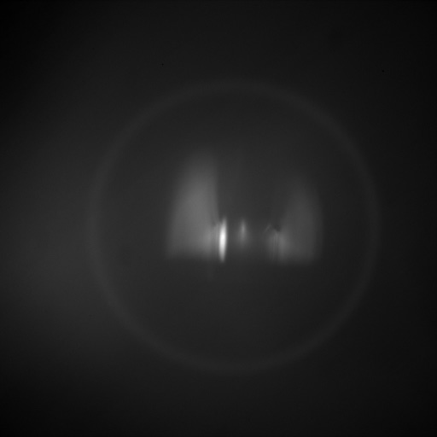
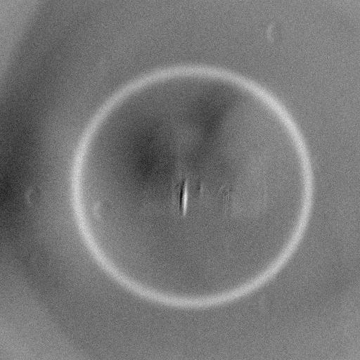
Imaging SPDC ring
λ/2
plate
Lens
f = 5 cm
EMCCD: Electron Multiplying CCD
Blue Laser
EMCCD
405 nm & 50 mW
BBO
crystal
IF
Angle(λ/2) = 45˚ Angle(λ/2) = 0˚ Background subtracted

Slide 12
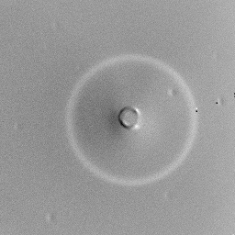
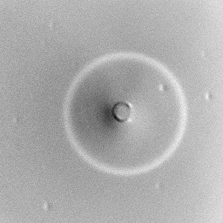
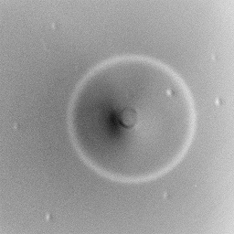
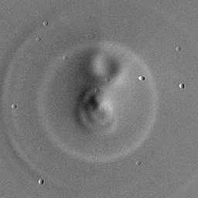

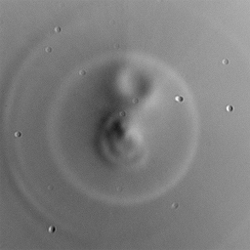
Observing SPDC ring at varying pump intensity
Width of the SPDC ring is
independent of the intensity
of the light beam.
3mW 5mW 8mW
Width of the SPDC ring is
independent of number of accumulations taken by EMCCD camera.
50 100 150

Slide 13
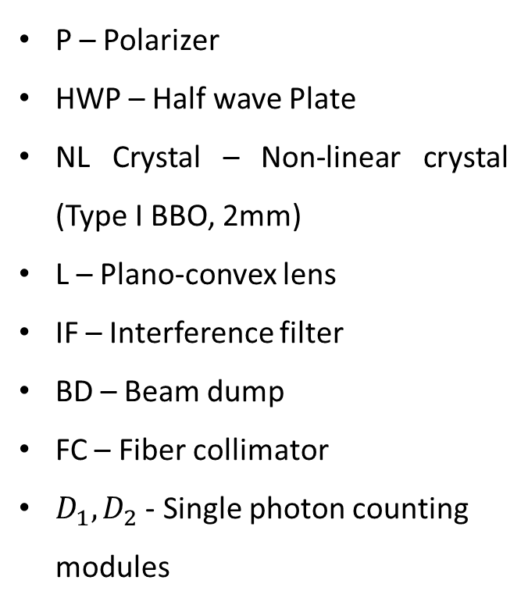
Coincidence counting: Experimental setup
P – Polarizer
HWP – Half wave Plate
NL Crystal – Non-linear crystal (Type I BBO, 2mm)
L – Plano-convex lens
IF – Interference filter
BD – Beam dump
FC – Fiber collimator
$D_{1}, D_{2}$ - Single photon counting modules
Notes:
SPCM:
Photon detection efficiency > 70%
Dark count = 25 cnts/sec
Single photon timing resolution ~ 350 ps
Dead time = 20 ns
IDQ(coincidence counter):
Minimum timing resolution = 81 ps

Slide 14
Variation of coincidence counts with pump polarization

Slide 15
Angular autocorrelation
θ
SPDC photon pair
Noise events
Noise events
Measured using EMCCD (averaged over 2000 images).

Slide 16
Numerical modelling of SPDC

Slide 17
Numerical modelling of SPDC
Step 1: Defining spatial coordinates
x-y plane
z
Optic Axis

Slide 18
Numerical modelling of SPDC (contd..)
Step 2: Defining angles

Slide 19
Numerical modelling of SPDC (contd..)
Step 3: Solving Phase-matching equations with the parameters defined
Energy conservation:
Phase-matching conditions:
∆k → phase-mismatch, Θ → crystal optic angle

Slide 20
Numerical modelling of SPDC (contd..)
Step 4A: Geometric mapping of ring due to signal photons

Slide 21
Numerical modelling of SPDC (contd..)
Step 4B: Geometric mapping of ring due to idler photons

Slide 22
Further experiments…
Spatial distribution of down-converted photons by pumping
  Gaussian beam
  Optical vortex beam
  Perfect vortex beam
  Effect of pump focusing on biphoton modes

Slide 23
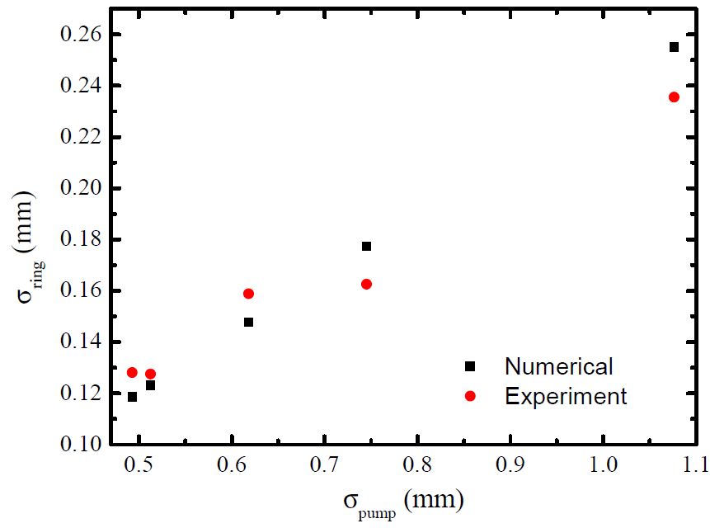
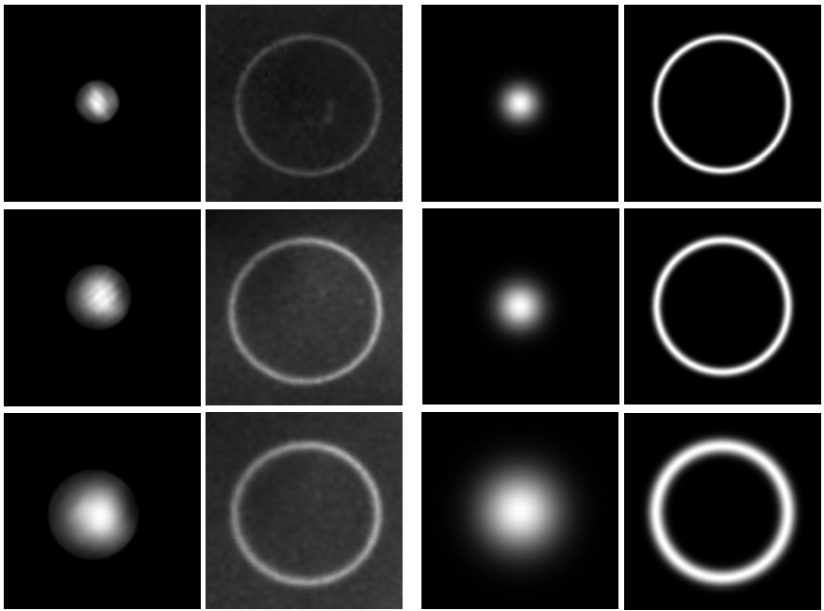
SPDC with Gaussian pump beam
Experimental
Numerical
The width of the ring increases linearly with the beam radius of the Gaussian pump beam

Slide 24
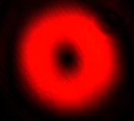
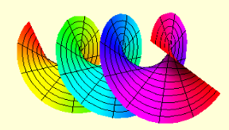
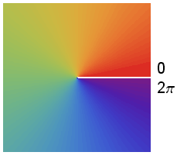
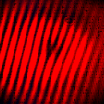
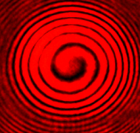
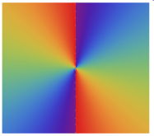
Optical Vortices
Optical vortex is a light beam with helical wave-front and phase singularity.
m=1
m=2
Intensity profile Helical wavefront
Fork and spiral interference fringes
Phase profile
At the center - Phase undefined Phase Singularity
Electric field
l = topological charge or order of the optical vortex (OV)

Slide 25
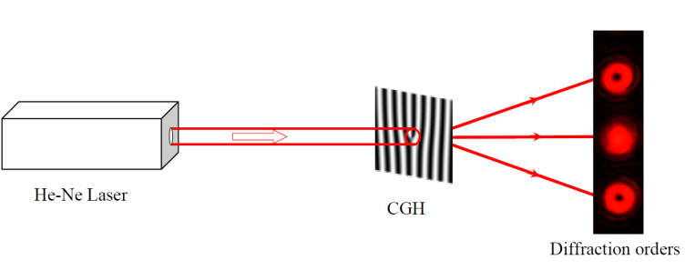
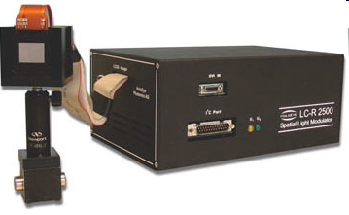



Generation of Optical Vortices
Computer Generated Hologram (CGH)
Number of data points used in the program to
make a CGH is termed as resolution.
Spatial Light Modulator (SLM)
Liquid crystal based device
Spiral Phase Plate
Astigmatic Mode Converter
Vortex beam
Plane beam

Slide 26
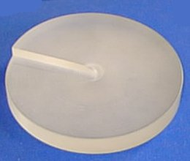
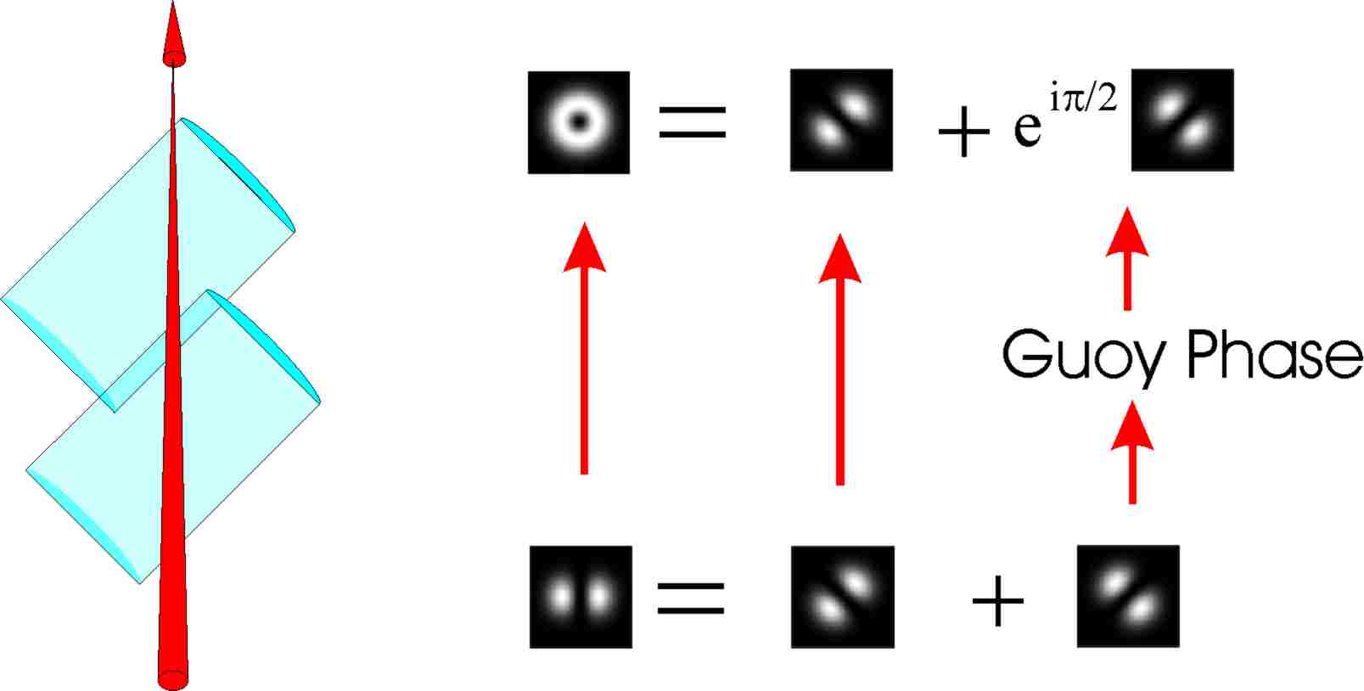

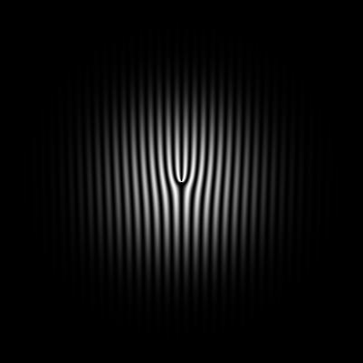

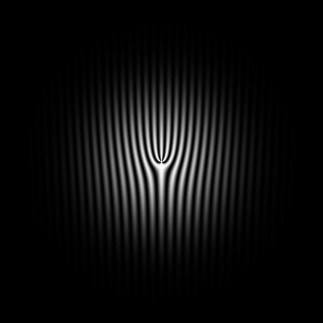
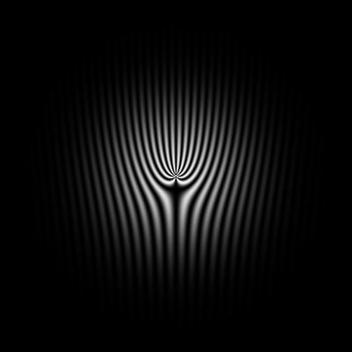
Generation of OV
Experimentally OVs can be generated through several techniques
Spiral Phase Plate
Astigmatic mode converters
Opt. Comm. 112, 321 (1994)
Phy.Rev.A 45, 8185 (1992), Opt. Comm 96, 123 (1993)
1
2
3
4
10
Computer generated holograms

Slide 27
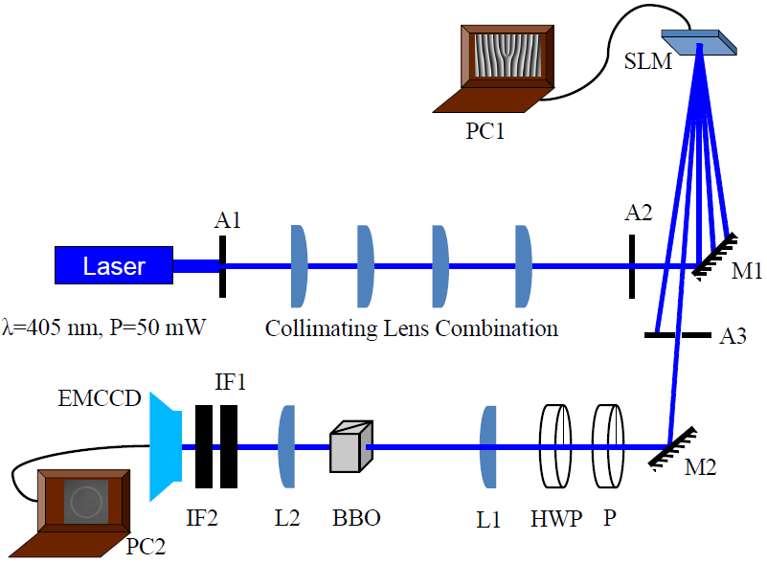
SPDC with vortex pump beam

Slide 28
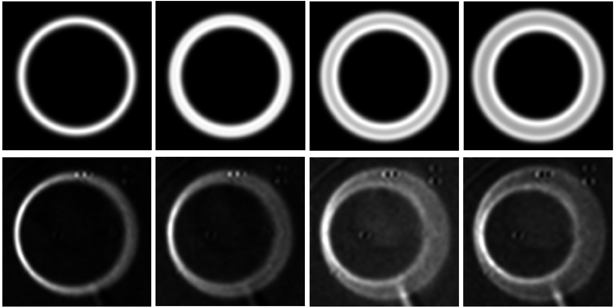
SPDC with vortex pump beam (contd..)
l=0
l=1
l=3
l=5

Slide 29
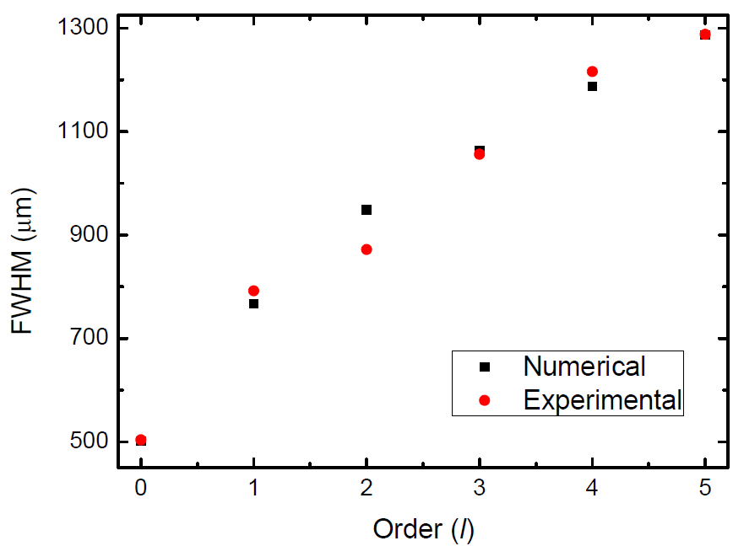
SPDC with vortex pump beam (contd..)
Shashi Prabhakar et.al.,
Opt. Commun 326, 64 (2014)

Slide 30
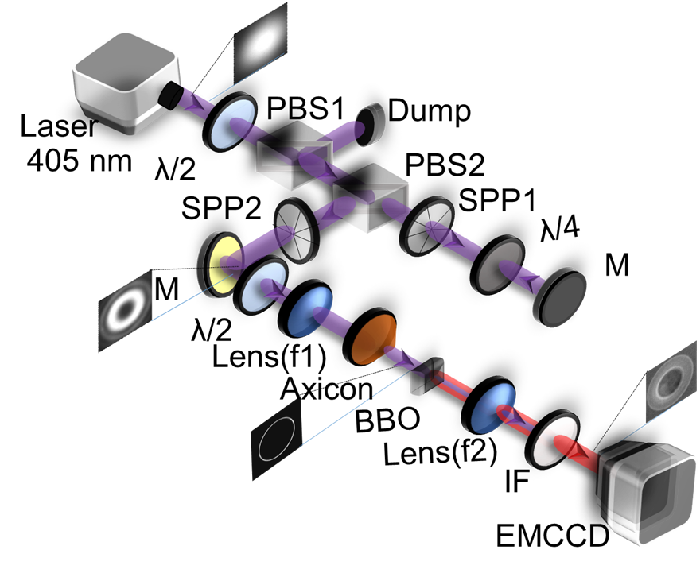
SPDC with perfect vortex pump beam
M. V. Jabir, N. Apurv Chaitanya, A. Aadhi, G. K. Samanta (Submitted)

Slide 31
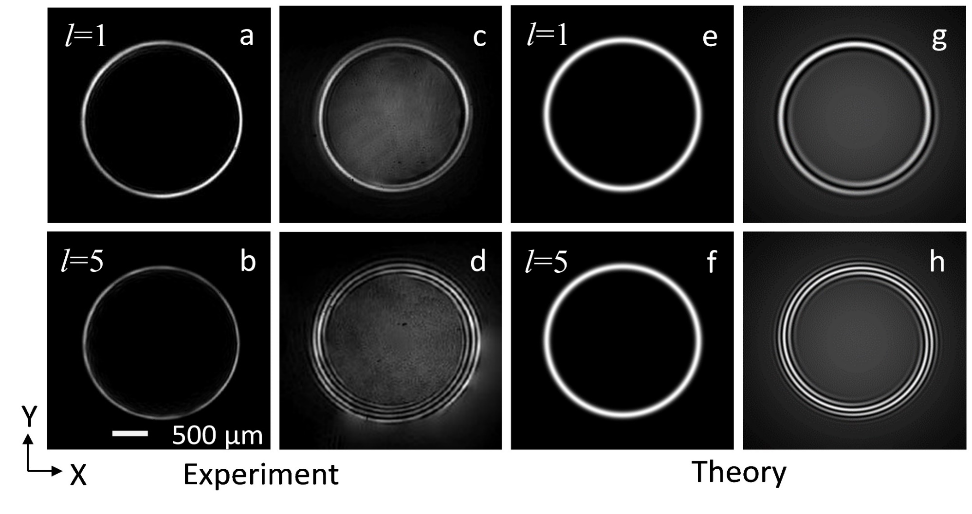
Perfect vortices and confirmation of its vorticity.

Slide 32
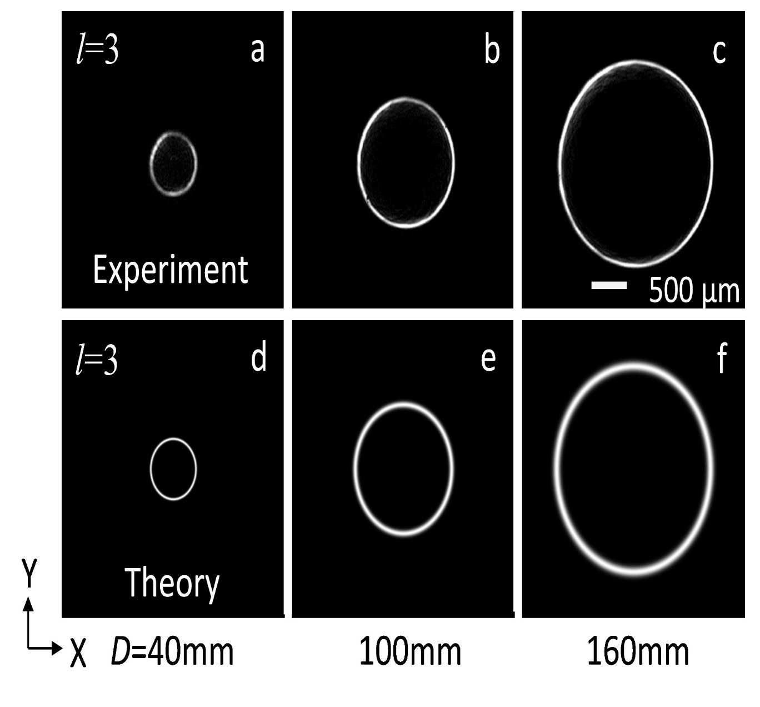
Varying the size of Perfect vortex.

Slide 33
Variation of perfect vortex radius with distance D
Apex angle measured to be 178.4⁰

Slide 34
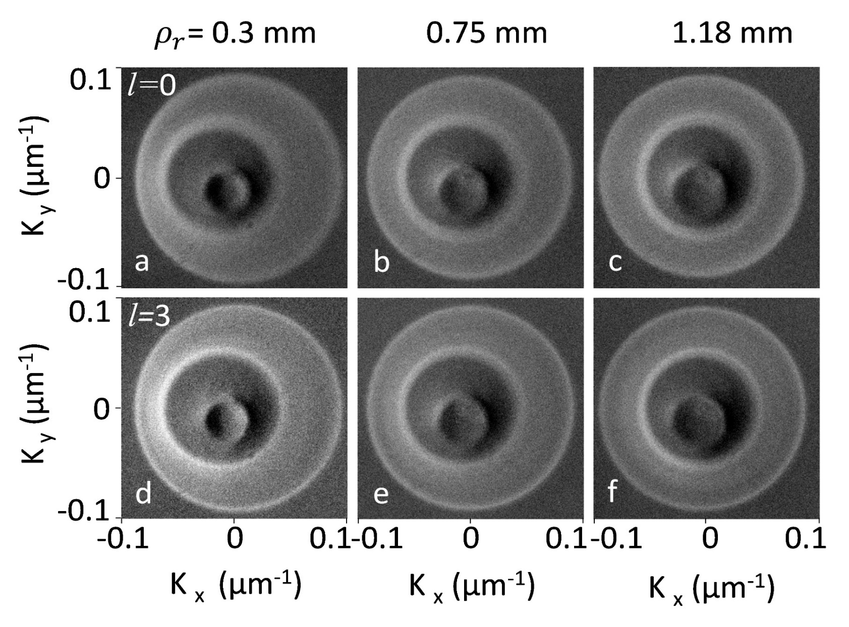
Angular spectrum of the down converted photons

Slide 35
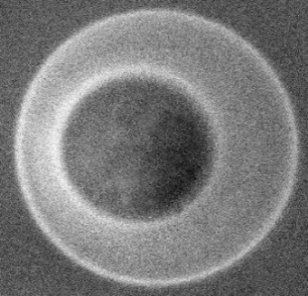
Dependence of asymmetry of the angular spectrum on the radius of pump vortex beam
a
b

Slide 36
Effect of pump focussing on biphoton modes
Single and Mutimode fibers are used for coupling down-converted output modes.
We show theoretically and experimentally the effect of pump focusing on photon mode coupling.

Slide 37
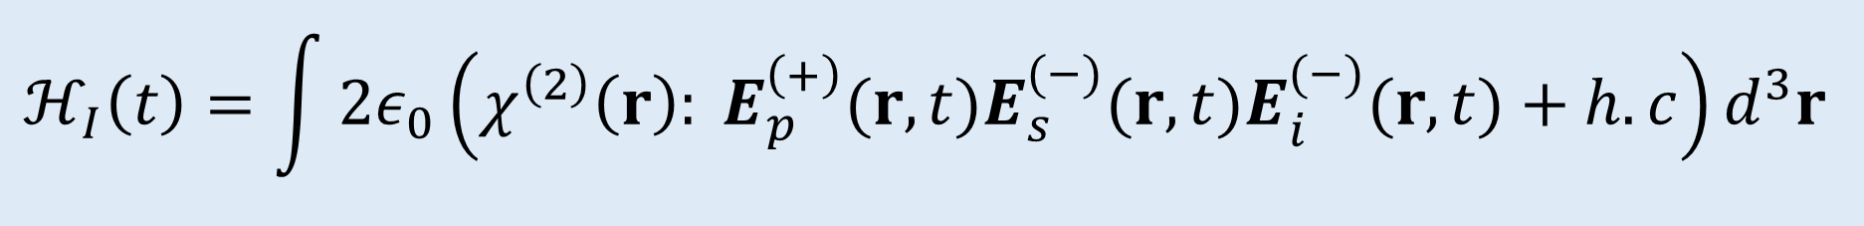

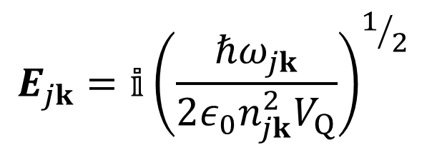
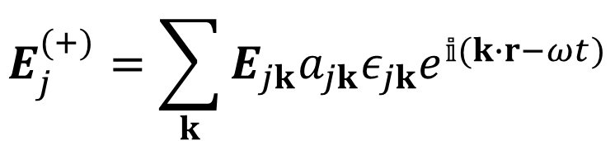
Interaction Hamiltonian for SPDC
$$ℋ_{I}\left(t\right)=\int{2ε_{0}\left(χ^{\left(2\right)}\left(r\right): E_{p}^{\left(+\right)}(r,t)E_{s}^{(−)}(r,t)E_{i}^{(−)}(r,t)+h.c\right)d^{3}r }$$
$$E_{jk}=𝕚{\left(\frac{ℏω_{jk}}{2ε_{0}n_{jk}^{2}V_{Q}}\right)}^{1/2}$$
$$E_{j}^{(+)}=\sum_{k}{E_{jk}a_{jk}ε_{jk}e^{𝕚(k∙r−ωt)}}$$
$$j=p,s,i$$
M. H. Rubin, D. N. Klyshko, Y. H. Shih, A. V. Sergienko, PRA 50, 6 (1994)
Notes:
Although the ‘Full-quantum’ approach (where we consider pump, signal and idler as operators) describes some features of the down conversion process, it fails in other cases, because the down converted light can be broadband and far from monochromatic. Even if the sum of signal and idler frequencies has a sharp value, each signal photon and idler photon can have a wide band width so that it behaves more like a short wave packet than a monochromatic wave. So we consider a semi-classical approach where pump is considered to be classical and down converted photons as quantum.
a_jk -> Annihilation operator, omega_jk -> angular frequency of photon, n_jk -> Refractive index of light inside crystal, V_Q -> Quantization volume, epsilon_jk -> polarization index(have values +1 or -1 based on each have same or orthogonal polarizations)
Interaction Hamiltonian is basically a volume integral. We consider the interaction medium (crystal) as infinitely long such that the integral along x and y directions will become dirac delta function. What remains is the longitudinal(z-axis) integral, which contribute to the longitudinal phase mismatch

Slide 38
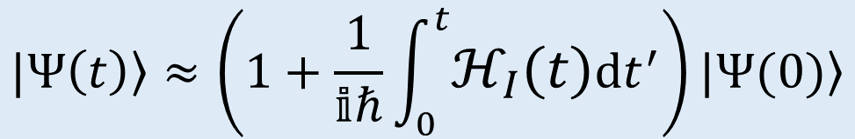
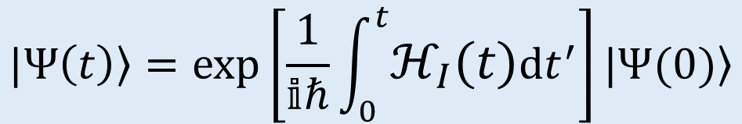
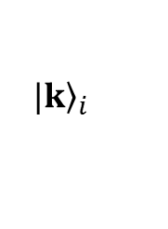
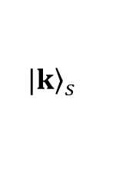
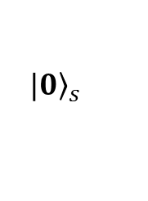
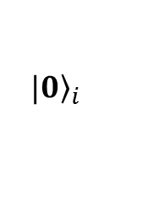
Output biphoton state
$$|\left.Ψ\left(t\right)\right\rangle =exp\left[\frac{1}{𝕚ℏ}\int_{0}^{t}{ℋ_{I}\left(t\right)dt^{′}}\right]|\left.Ψ(0)\right\rangle$$
Interaction
Medium
$${|\left.k\right\rangle }_{i}$$
$${|\left.0\right\rangle }_{s}$$
$$′$$
Output
Input
Taking upto first order terms,
$${|\left.k\right\rangle }_{s}$$
$${|\left.0\right\rangle }_{i}$$
$$|\left.Ψ\left(t\right)\right\rangle ≈\left(1+\frac{1}{𝕚ℏ}\int_{0}^{t}{ℋ_{I}\left(t\right)dt^{′}}\right)|{}Ψ(0)$$
SPDC: Four port model
Notes:
In four port model of SPDC process, we have two input modes and two output modes. The interaction medium(non-linear crystal) transforms the input mode to output mode. Since the down-conversion process is spontaneous, we have vacuum modes in the inputs. In Stimulated PDC, there will be non-vacuum modes at the input.

Slide 39
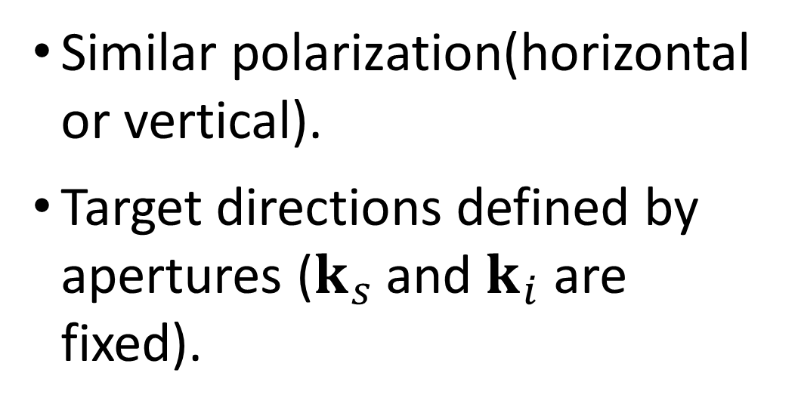


Assumptions
Similar polarization(horizontal or vertical).
Target directions defined by apertures ($k_{s}$ and $k_{i}$ are fixed).
$$k_{s}$$
H orV
H orV
$$k_{i}$$
Notes:
Based on our experimental constraints, we may simplify the expression for the output state by taking some assumptions. In Type I SPDC, we have same polarization for both signal and idler photon, so the polarization indices for them will be +1 each. Next, we select two diametrically opposite points of the SPDC cone and fix the directions of signal and idler using apertures, such that the k-summation can be removed. In the expression.

Slide 40
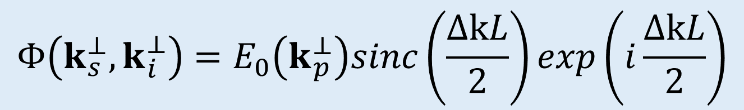

Biphoton mode function
$$Φ\left(k_{s}^{⊥},k_{i}^{⊥}\right)=E_{0}\left(k_{p}^{⊥}\right)sinc\left(\frac{ΔkL}{2}\right)exp\left(i\frac{ΔkL}{2}\right)$$
$E_{0}\left(k_{p}^{⊥}\right)→$ Amplitude distribution of pump beam
$Δk→$ Phase mismatch
$L→$ Length of the crystal
Notes:
The biphoton mode function includes every details about the process such as the pump distribution, crystal parameters, phase-matching conditions etc. This mode function is very useful in the photon correlation studies with effect of pump profile, crystal thickness.

Slide 41


Mode coupling
For biphoton source
Signal
Correlator
Biphoton
mode
Idler
±
Notes:
Mode coupling techniques
For maximum single photon output through a fiber in heralded single photon source, we match the input and output modes of the photons. For maximizing biphoton output, we match the individual (signal and idler) modes with the biphoton mode obtained by correlation measurements. The method to obtain biphoton mode is by measuring conditional angular spectrum of down converted photons.

Slide 42


Mode profiling: methods (contd…)
Idler photon projected to Gaussian – “Conditioning”
$$u\left(k_{i}^{⊥}\right)=N_{i}exp\left[−\frac{w_{i}^{2}}{4}\left(k_{sx}^{2}+k_{ix}^{2}\right)\right]$$
Spatial distribution of signal photon after ‘conditioning’
$$Φ_{s}\left(k_{s}^{⊥} \right)=\int{Φ\left(k_{s}^{⊥},k_{i}^{⊥}\right) u\left(k_{i}^{⊥}\right)dk_{i}^{⊥}}$$
Conditioned Profile!
Experiment → Measure coincidence profile by scanning the signal detector along x and y directions with idler photon coupled to a single mode fiber
Notes:
For biphoton modes, we project one of the individual modes to Gaussian and obtain the spatial distribution of signal mode with the condition being “IDLER IN GAUSSIAN”. What we plot is basically a conditioned profile. Experimentally, this can be obtained by measuring the coincidence profile through scanning of signal detector along x and y directions with the idler photon coupled to a single mode fiber attached to the idler detector. If we keep a lens at a distance equal to its focal length from both the crystal and the detector, then the coincidence profile we measure is a profile in transverse momentum space (ks,ki), which is also known as ‘Conditional Angular Spectrum’.

Slide 43


Mode profiling: methods (contd…)
Conditioned Profile of biphoton mode (idler fixed, signal vary)
Theory
Experiment
Notes:
The conditioned profile of a biphoton mode is in general elliptic Gaussian in nature. Pump distribution, crystal thickness, phase matching etc affects the ellipticity of the profile.

Slide 44


Effect of pump focussing on SPDC cone
$I\left(r_{s},r_{i}\right)$ $I(k_{s}^{⊥},k_{i}^{⊥})$
FT
EMCCD
Camera
λ=405 nm
HWP
IF
UV Laser
Pump focusing increases the asymmetry of the SPDC ring
P
L1
NL
Crystal
L2
Notes:
By keeping a lens of focal length f in the middle of the crystal and EMCCD camera that are separated at a distance 2f, we are Fourier transforming the spatial distribution of down converted photons from coordinate space(x, y) to momentum space(k_x, k_y). From the EMCCD images, it is clear that the asymmetry of SPDC cone increases as the pump focusing increases.

Slide 45




Biphoton mode coupling efficiency
The focusing parameter of pump beam
$L →$ Length of the crystal
$k →$ Magnitude of pump beam wave vector
$w_{p} →$ Pump beam waist
$w_{o} →$ Signal or idler mode waist
$C_{s}, C_{i} →$ Signal & idler counts
$C_{si} →$ Coincidence counts
$$ξ_{p}=\frac{L}{kw_{p}^{2}}$$
Biphoton mode coupling efficiency
$χ_{si}=\frac{4w_{p}^{2}\left(w_{o}^{2}+w_{p}^{2}\right)}{{\left(w_{o}^{2}+2w_{p}^{2}\right)}^{2}}$ (Theoretical)
$χ_{si}=\frac{C_{si}}{\sqrt{C_{s}C_{i}}}$ (Experimental)
S. Castelletto, I. P. Degiovanni, A. Migdall and M. Ware, New J. Phys. 6, 87 (2004).
Notes:
Physically C_si means the overlap of biphoton mode on both signal and idler modes. C_s means the overlap of biphoton mode on signal mode and C_i means the overlap of biphoton mode on idler mode. Maximum coupling of biphoton mode occurs when these three mode overlaps are equal. Theoretically(in literature), it is shown that the biphoton mode coupling efficiency explicitly depends on pump beam waist, crystal thickness and mode diameter of the coupling fiber.

Slide 46


Biphoton modes for focused pump
Loose focusing
Tight focusing
Pump focusing increases the ellipticity of biphoton mode
Notes:
As pump focusing increases, SPDC cone becomes asymmetric and the biphoton mode becomes more elliptic. Due to this, the mode-matching becomes difficult. Here we have numerically plotted the Conditional Angular Spectrum (called by this name in momentum space)

Slide 47


Variation of biphoton mode coupling efficiency ($χ_{si}$) with pump beam focusing parameter ($ξ_{p}$)
The coupling efficiency decreases asymptotically with pump beam focusing.
Notes:
The numerical plot generated from earlier expression fits with the experimental points. Here, in the plot the efficiency is very low (~3.5%). This is because of the overall degradation in the number of photons coupled into single mode fiber due to the mismatch of Numerical Aperture(NA) of the single mode fiber(0.13) and the attached fiber collimator(0.5)

Slide 48

Effect of mode field diameter (w) on biphoton mode coupling efficiency
Changing the mode field diameter has less significant effect on the mode coupling efficiency
Notes:
Changing the mode field diameter has less significant effect on the mode coupling efficiency

Slide 49

Effect of crystal thickness (L) on biphoton mode coupling efficiency
Changing the thickness of the crystal also has less significant effect on the mode coupling efficiency.
Notes:
Changing the thickness of the crystal also has less significant effect on the mode coupling efficiency.

Slide 50
Conclusions
Characterization of down converted photons generated with Gaussian and vortex pump beams was carried out.
Asymmetry of the perfect vortex SPDC ring decreases with increase in the radius of the pump vortex beam.
The coupling efficiency of correlated photon pairs generated in SPDC process decreases asymptotically with pump beam focusing, due to mode mismatch between biphoton mode and individual signal & idler modes.
Notes:
Best choice for good biphoton source is a thin crystal with large pump beam waist

Slide 51
Thank You!

