Slide 1
The Fractional Quantum Hall Effect and Gravity:
A Copernican View
C. S. Unnikrishnan
Gravitation Lab,
Tata Institute of Fundamental Research,
Homi Bhabha Road, Mumbai 400005, India
E-mail address: unni@tifr.res.in
Website: www.tifr.res.in/~filab

Slide 2
Core Idea and Plan
All Physical phenomena happens in the gravitational presence of the entire matter-energy of the universe.
Mass-energy being the charge of gravity and spin its current ALL physical phenomena that directly involves mass and spin are in fact causally gravitational, without exception .
In particular, several quantum phenomena of microscopic physics are affected and often controlled by cosmic gravity. I seek to solve the mysteries of fractional quantum Hall effect within this paradigm (Cosmic Relativity).
The Quantum Hall Effect and its explanation
The Fractional Quantum Hall Effect and attempts for its explanation
Key Experimental results relevant for this talk
Composite Fermions, a mysterious gauge field and FQHE
The Cosmic Relativity Paradigm
Some established results
Spin-gravity interactions
The cosmic gravitational potentials and a real ‘gauge’ field
FQHE as a QM phenomena in the combined vector potentials of electrodynamics and Cosmic gravity!

Slide 3


Hall Effects

Slide 4
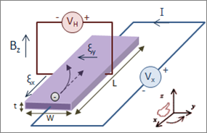
Hall Effects (EN LABO)

Slide 5
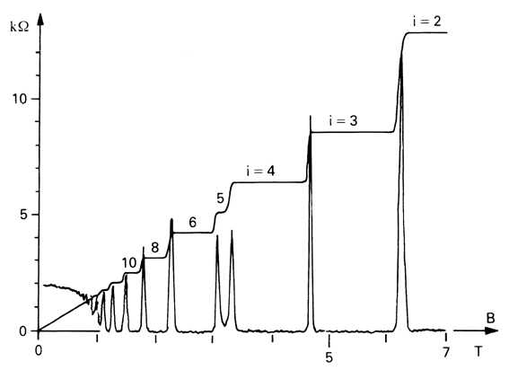
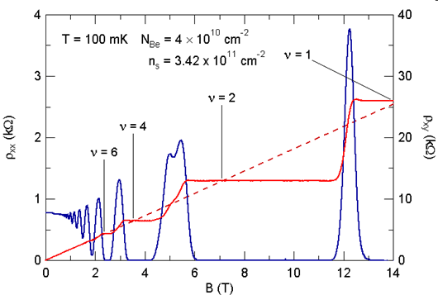
One electron per flux quantum fills the LL
(Single free particle description)

Slide 6
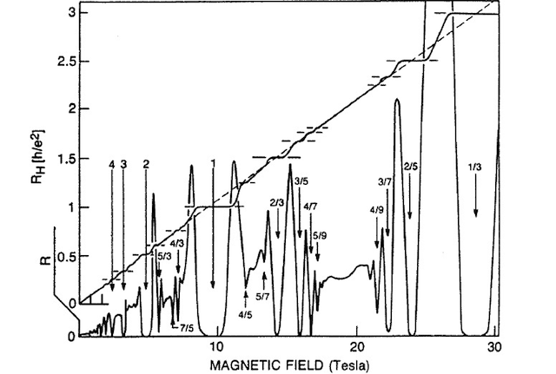

Slide 7
Fractional Quantum Hall Effect
Understood partially as a complex phenomena in a strongly interacting and strongly correlated system! Coulomb interaction dominate, collective effects are invoked, multi-particle relative phases are crucial…, and iteartive and heirarchical application of these effects are required.
Also, fractional charges...

Slide 9
Quantum Hall Effect
The entire phenomena can be measured in a single sample by varying the magnetic field or carrier density (hence varying filling factor smoothly)
The QHE is understood as a singe particle effect and interactions can be ignored…Then why does one need a complex description with interactions and multiparticle effects for FQHE?
Need a Copernican view!

Slide 10
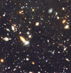
The necessary paradigm change

Slide 11
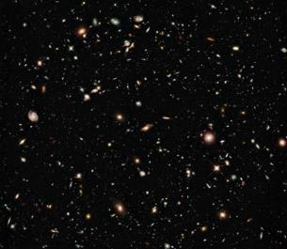
300 Million
Light years
(up to Coma)
10 Billion
Light years

Slide 12
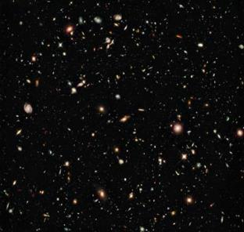
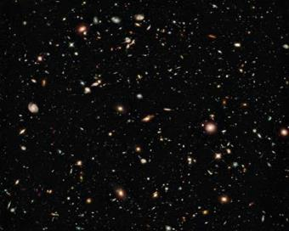

Slide 13
The universe is filled with gravitational charge at critical density. Just as an electrically charged matter density in the universe would have completely changed electrodynamics and Maxwell’s equations for moving particles (in comparison with an electrically neutral universe), Gravitationally Charged Universe hugely affects dynamics, relativity and all of physics, including the the theoretical description of gravity itself.

Slide 14
If the distant universe were electrically charged, with homogeneity and isotropy, Maxwell’s equations will still be similar, without any experimental trace for uniformly moving charges…
But wil give drastically different eperiment experimental results for accelerating and rotating charges.
‘Maxwell’ would have invoked some electro-inertial pseudo-force (depends on e/m) to keep his equations and some Mach would have objected and asked look for a material source…

Slide 15
Universe is gravitationally charged…and will hugely affect dynamics of anything with mass or energy, and spin, which is the current of the charge of gravity.
All physicall effects should be traced to physical interactions of real charges and currents of one of four fundamental interactions we have identified. In other words, there cannot be a real physical effect (change in energy, momentum, angular momentum etc.) without a real physical interaction.

Slide 16
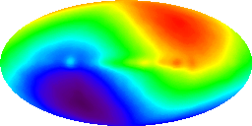

Moving through the Universe and its CMB marker
Absolute velocity
Absolute (universal) time
Same as average T
(1/10⁵)
Every observer can decide whether he is moving or not, and all clocks in the universe can be synchronized to this temperature.

Slide 17
Universe with matter and radiation
There is ONE special frame in which V=0
In all other frames,
SPACE is anisotropic in the frame of a moving observer. There is a large current of matter (the charge of gravity)

Slide 18
Isotropic space remains isotropic after Lorentz transformations on coordinates
Clear conflict with real anisotropic space from matter current
A physical and logically consistent boost transformation should have returned an anisotropic homogenous metric, reflecting the symmetry of the transformed space.

Slide 19
In a frame moving through this matter filled universe, there is a large matter-current and space is ANISOTROPIC
Galilean boost gives the physically consistent metric – flat and anisotropic

Slide 20
300 Million
Light years
(up to Coma)
10 Billion
Light years

Slide 21
Dynamics and Relativity from Cosmic Gravity (Cosmic Relativity)
Principle of Relativity as unobservability of this ‘gauge’ potential.
Same as statement of Lorentz/Galileo Invariance or invariance under boosts.
NEWTON’S LAW FROM COSMIC GRAVITY
It is already relativistic and ‘gravito-magnetic’

Slide 22
NEWTON’S LAW FROM COSMIC GRAVITY
It is relativistic and ‘gravito-magnetic’
EQUIVALENCE PRINCIPLE FROM COSMIC GRAVITY
If dynamics respects Newton’s law it respects Equivalence principle as well!
C. S. Unnikrishnan, Int. Jl. Mod. Phys. (2014).

Slide 23
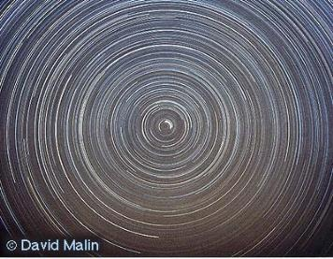
Cosmic Gravito-magnetic Effects
Universe in rotating frame
Currents of mass generate large vector potential
And its ‘curl’ is a strong gravito-magnetic field

Slide 24
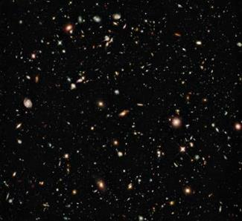
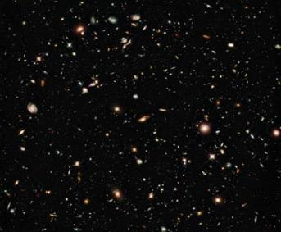

Slide 25

In the interferometer frame: Mass current with curl → Gravitomagnetic field

Slide 26
Atom Interferometer Gyroscope and Cosmic Gravity

Slide 27
Current-current interaction (Ampere) in gravity

Slide 28
Cosmic Gravity and Spin Physics
SPIN (both classical and quantum) will couple to this because spin and angular momentum are currents of the charge of gravity – mass currents
So, ALL spin-orbit effects (including second order effects) on neutral particles are due to gravitational interaction, coupled to the gravitational mass of the particle – there is no exception.
Unnikrishnan: Relativity and Dynamics in the once-given Universe (in prep.)

Slide 29
An Ampere Experiment in Electromagnetism
Current-Current Interaction
The flip of the magnetic moment is due to a reversed current-current interaction or reversed magnetic field, now written as

Slide 30
An ‘Ampere Experiment’ in Gravity

Slide 31
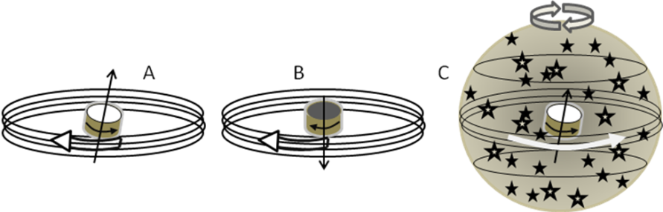
Unnikrishnan, General Theory of Relativity: The Universe between Beauty and Truth
(ResearchGate)

Slide 32
Several applications, insights and solutions…
Geometric phase on photon in helical fiber
Fine structure of atoms and Thomas precession
Spin-orbit energy splitting in chiral motion
Spin-transport in helical (bio) molecules
The spin-statistics connection
Fractional quantum Hall effect

Slide 33
Spin-dependent geometric phase
A. Tomita and R. Y. Chiao, PRL 1986

Slide 34
R. Naaman, D. W. Waldeck, Ann. Rev. Phys. Chem. 2015
Gravity-controlled spin valve!

Slide 35
Gravitational Vector potential as one moves around…

Slide 36
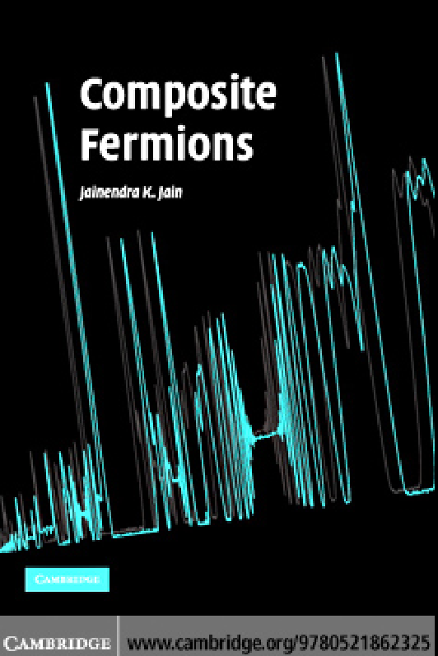

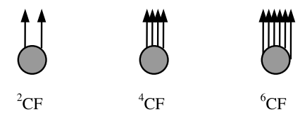

Slide 37
Description in terms of a ‘composite fermion”
(Jainendra Jain)
CF=electron+ even number of flux quanta/vortices of a mysterious gauge field
The FQHE is the IQHE of CF!

Slide 38

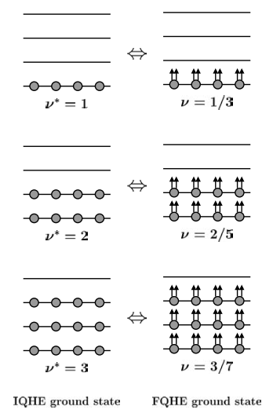
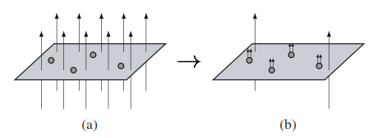
The ‘flux’ associated with the electron cancels part of the applied magnetic field and reduced the degeneracy to the integer QHE level.

Slide 39




Slide 41
Quantum Hall Effect
The entire phenomena can be measured in a single sample by varying the magnetic field or carrier density (hence varying filling factor smoothly)
The QHE is understood as a singe particle effect and interactions can be ignored…Then why does one need a complex description with interactions and multiparticle effects for FQHE?
Need a Copernican view!

Slide 42
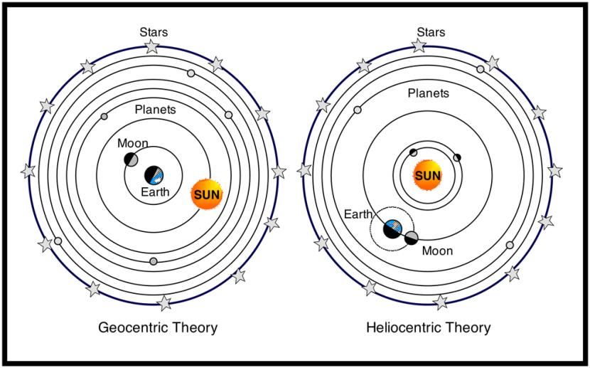

Slide 43
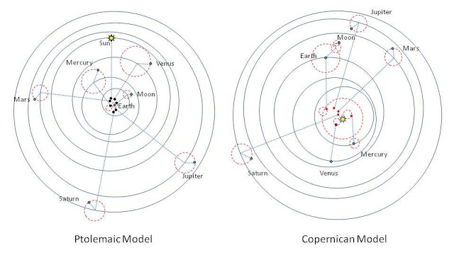
1473-1543)

Slide 44
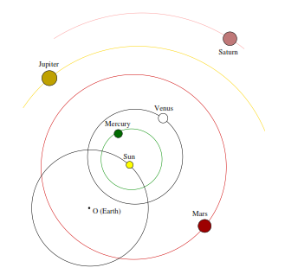
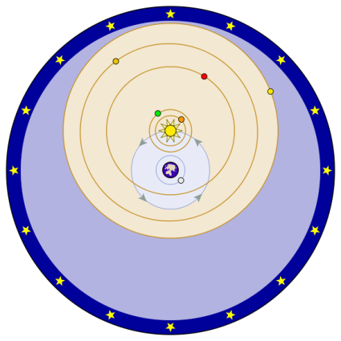
Nilakantha Somayaji 1444-1545
(Tantrasangraha)
Tycho Brahe (1546-1601)

Slide 45
Gravitational Vector potential as one moves around…

Slide 46
The extra ‘gauge field’ in FQHE is possibly gravity!

Slide 47
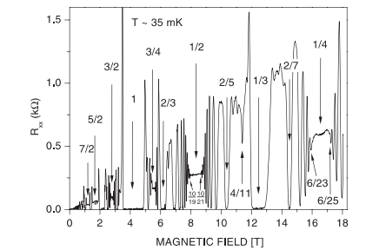
We then need to establish the same coherent picture for the entire sequence

Slide 48
Several remaining issues (in all theories of FQHE)…

Slide 49
Summary:
Cosmic Relativity, in which gravity of the matter-energy in the universe determines dynamics and relativistic effects, is the essential gravitational ingredient in classical and quantum dynamics.
Several quantum phases conventionally described as spin-orbit phases are in fact cosmic gravitational phases (G,m etc.). This is confirmed in Thomas precession and the behaviour of photons and electrons in helical transport.
The fractional quantum Hall effect has several features that indicate that cosmic gravity is indeed the extra field required for its single particle description. The pseudo composite-fermion is just a projected view, successful yet missing the true physics. However, several details need to be checked and matched and hopefully a more complete picture will emerge soon.

Slide 51
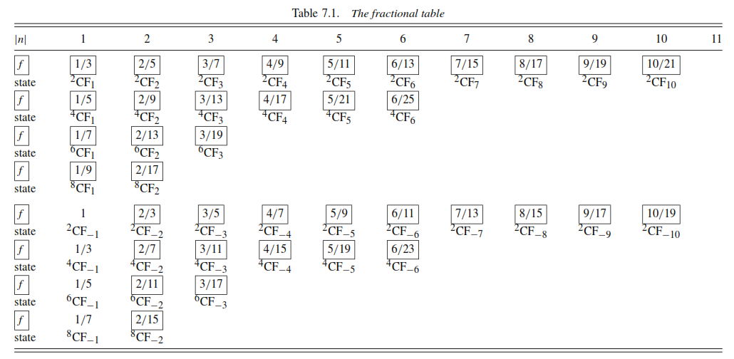
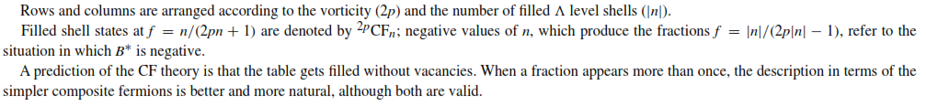

Slide 52
