Slide 1
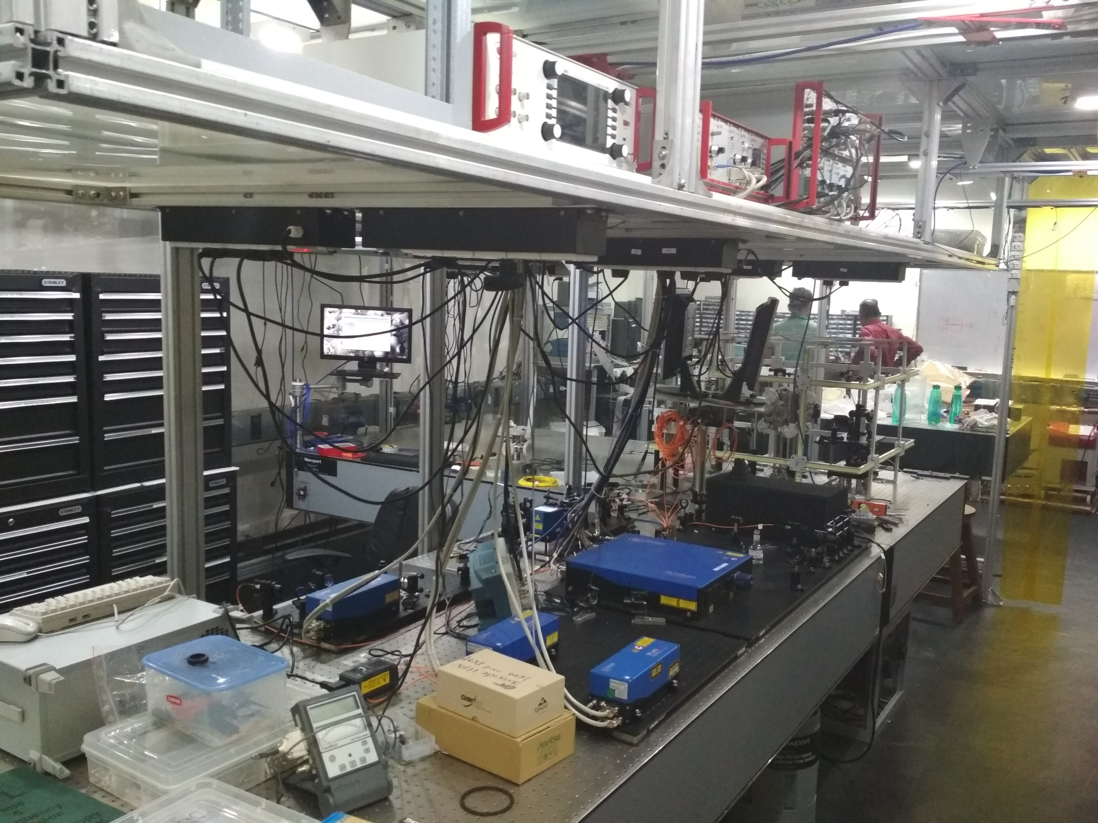


Progress Towards Developing
Single Trapped Ion Optical Atomic Clock
Subhadeep De
CSIR-National Physical Laboratory, New Delhi
QIPA-2018, 02-08 December 2018, HRI, Allahabad

Slide 2
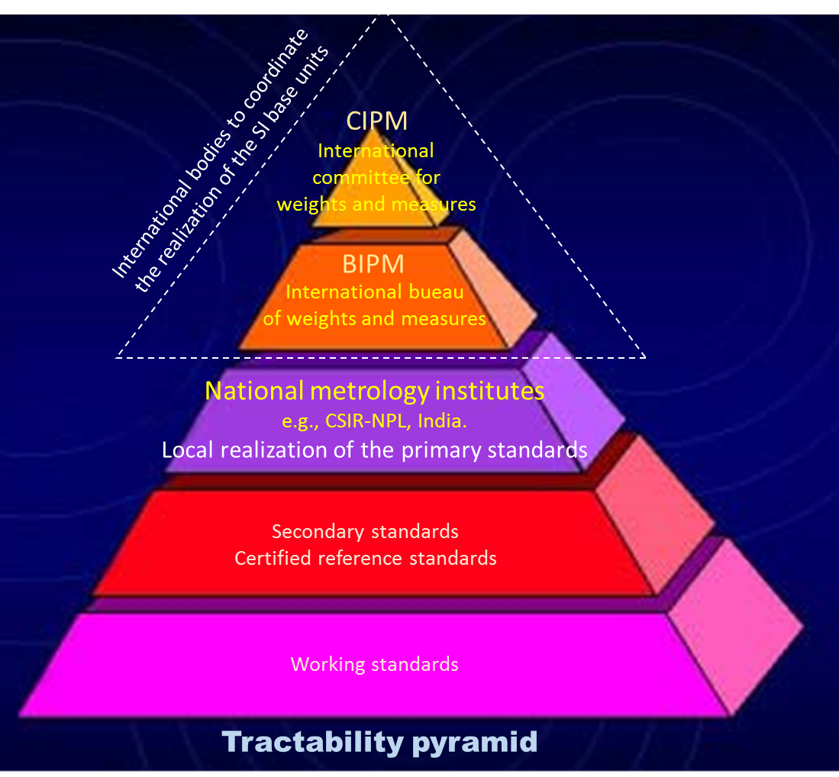
SI definition
“Standard” follows an unbroken chain of tractability to the SI unit
International realization
National realization
CSIR-NPL is the National Metrology Institute in India
It has the mandate of
establishing and maintaining the SI standards through the Act of Parliament

Slide 3
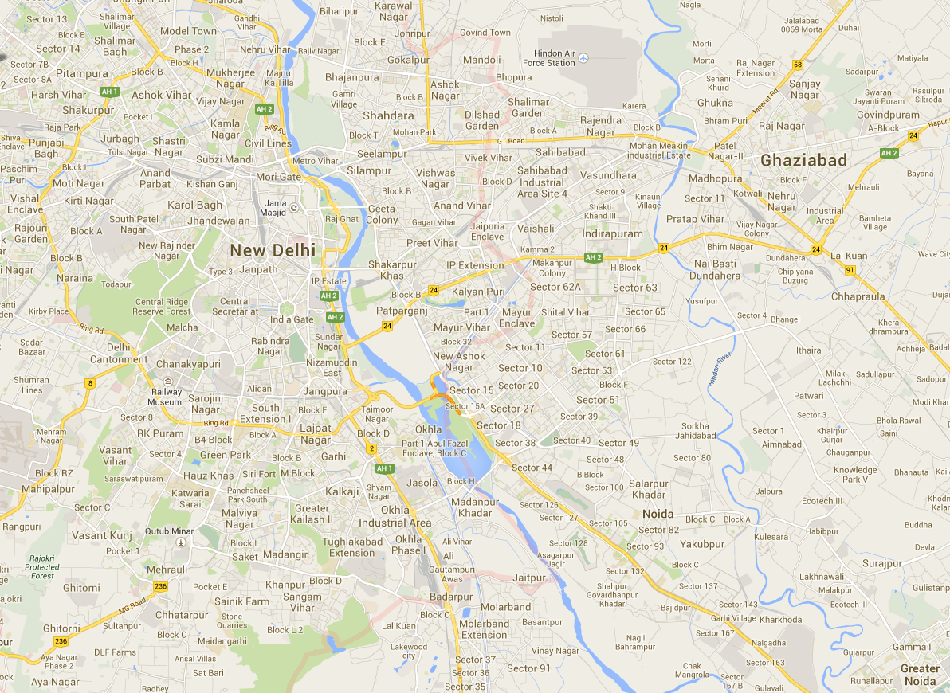


Navigation
Let us start with

Slide 4

Transmitter - I
Position
P1
d₁ km
t₁
Receiver
Transmitter sends the signal at time t_{s} with a “time stamp” on it
Receiver receives the signal at time t_{e} with another “time stamp” on it
- Transmitter and receiver “clocks are synchronized”
Distance between transmitter and the receiver is calculated as d₁ = c × (t_{e} – t_{s})
  velocity of light “c” is a constant

Slide 5
Transmitter - I
d₁ km
Position
P1
t₁
Position
P2
Receiver
d₂ km
t₂
Transmitter - II

Slide 6
Transmitter - I
d₁ km
Position
P1
t₁
Position
P2
Receiver
d₂ km
t₂
Transmitter - II
d₃ km
t₃
Transmitter III
Position
P3
Accuracy of 1 meter requires to synchronize clocks within
1/c ~ 3 ns precision

Slide 7
Transmitter - I
d₁ km
Position
P1
t₁
Position
P2
Transmitter - II
Receiver
d₂ km
t₂
d₃ km
t₃
Transmitter III
Position
P3

Slide 8
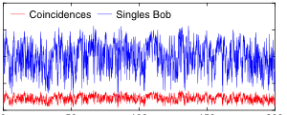
Transmission & Detection in
Long Distance (Free Space) Quantum Communication
Correlated photons
From the transmitter: pulse train of laser light
Time
Example: 1.2-km-long free-space transmission
F. Steinlechner et. al. Nat. Comm. 8, 15971 (2017)
At the receiver: Average detection rate
Counts [s⁻¹]
Time
Accurate “time stamping” to the transmitter & receiver and “time synchronization” between them with respect to a common stable reference is required for the correlation measurement.
High attenuation due to the free space transmission and low detector efficiency requires longer integration to get the desired S/N.

Slide 9
With efficient & fast detectors → low integration time
Allowed pulse rate from the transmitter will be limited by the Time stamping / Time synchronization accuracies
Correlated photons
Search range
Time [s]
Time [s]
Counts [s⁻¹]
Timing accuracy
Time [s]
Pulse rates can be faster
with more accurate timing devices

Slide 10
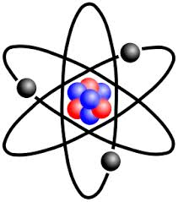
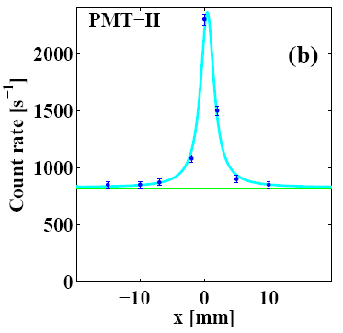



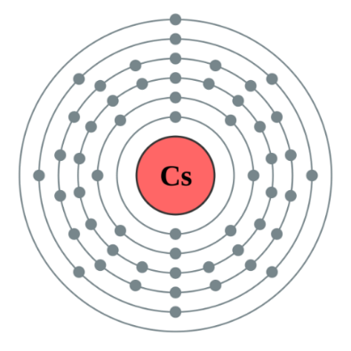
Principle of the Atomic Clocks
τ
|e>
Excitation
de-excitation
|g>
fluorescence
SERVOed to
detection
stabilize at
SI definition may change in 2026 to an optical transition
Fine
structure
Hyperfine
structure
in SI unit
4
1s is the duration for
6S_{1/2}
3
9 192 631 770 Hz
oscillations
Caesium
Accuracy: beam clock 10⁻¹⁴ & fountain 10⁻¹⁶

Slide 11
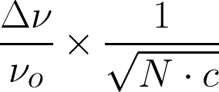
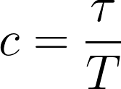
Accuracy of an Atomic Clock
Allan Deviation =
Theoretical
Statistical
Quality factor
Signal-to-noise⁻¹
Signal = number of events
Noise = (number of events)^{1/2}
Number of species, N
Number of measurements,
τ is total measurement time
T duration for each measurement
Ref: http://tf.nist.gov/general/glossary.htm

Slide 12
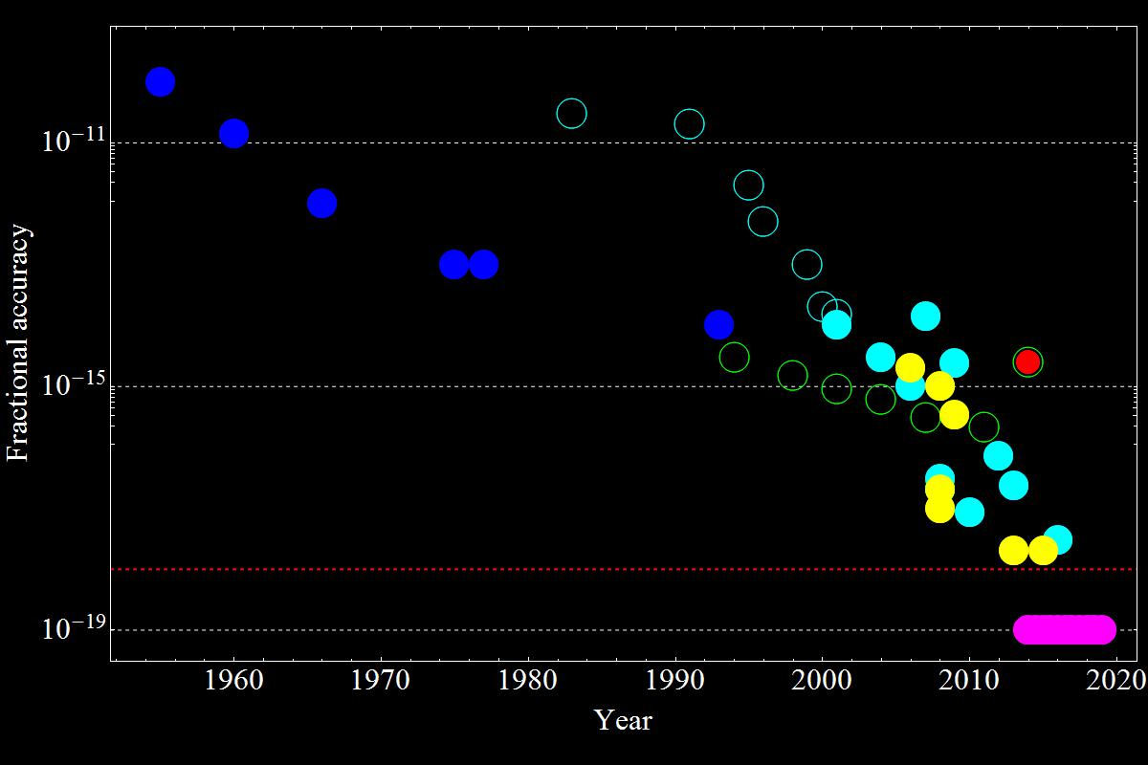
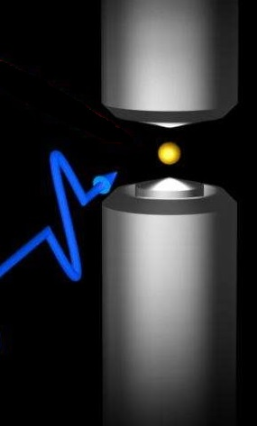
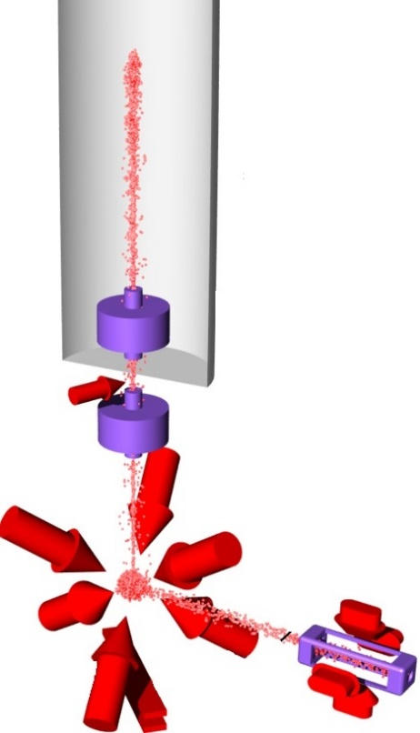
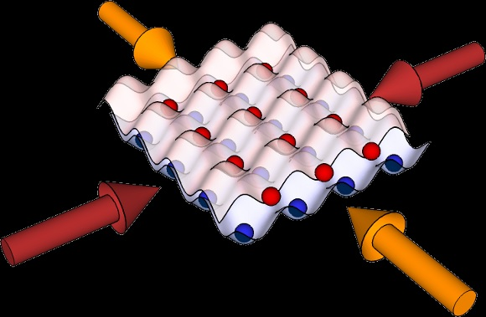
3×10⁻¹⁸ : Yb-ion
N. Huntemann et. al.,
Phys. Rev. Lett. 116, 063001 (2016)
Cs-fountain-I
CSIR-NPL
Cs-fountain
NPL-UK
1.4×10⁻¹⁸ : Yb-atom
W. F. McGrew et. al., Nature (2018)
10⁻¹⁸
2×10⁻¹⁸ : Sr-atom
Ushijima et. al.,
Nature Photonics 9, 185 (2015)

Slide 13
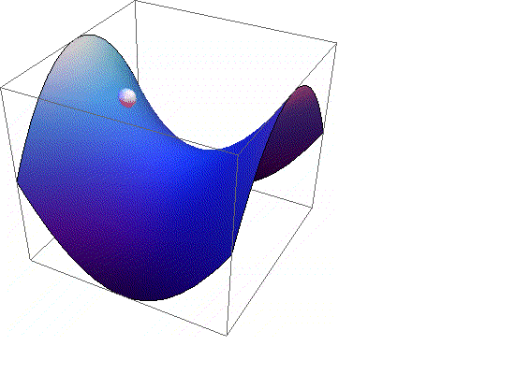
Single Trapped Ion Optical-ν Standard

Slide 14

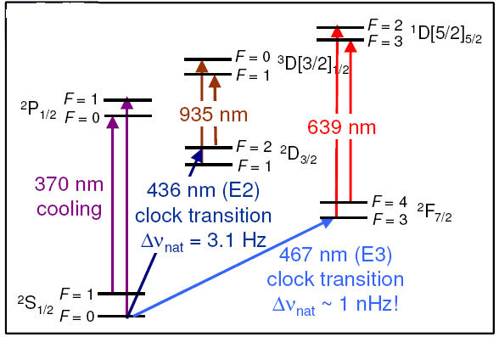
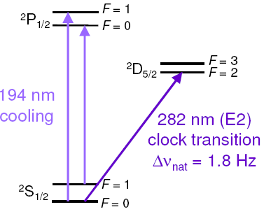
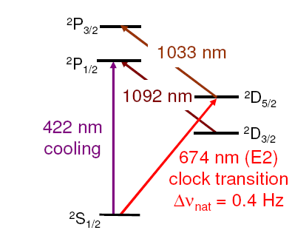
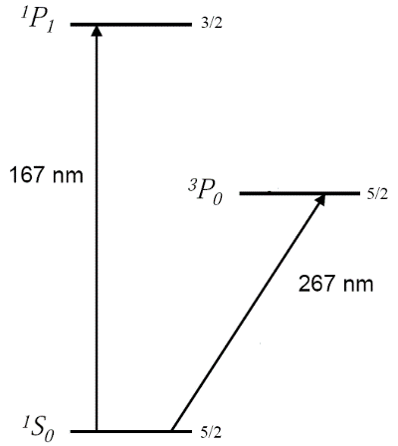
World wide Trapped Ion Optical Frequency Standards
Why Ytterbium ?
CIPM has endorsed the 6s ²S_{1/2}(F=0, m_{F}=0) – 4f¹³6s² ²F_{7/2}(F=3, m_{F}=0) transition as a secondary frequency standards.
First order Zeeman insensitive clock transitions.
Off the shelve lasers.
Yb⁺ chemically reacts with residual H₂ and produces hydride, which photodissociates to Yb⁺ in the presence of cooling laser and that gets retrapped.
Potential candidate for probing fundament science: violation of the local Lorentz symmetry, temporal constancy of the fundamental constant.
¹⁷¹Yb⁺
¹⁹⁹Hg⁺
Ion | λ [nm] | Transition | Laboratories
²²³Ra⁺ | 828 | ²S_{1/2} – ²D_{3/2} (E2) | KVI Netherlands
¹⁹⁹Hg⁺ | 282 | ²S_{1/2} – ²D_{5/2} (E2) | NIST USA
¹⁷¹Yb⁺ | 435 | ²S_{1/2} – ²D_{3/2} (E2) | PTB Germany
¹⁷¹Yb⁺ | 467 | ²S_{1/2} – ²F_{5/2} (E3) | NPL UK, PTB Germany,
¹¹⁵In⁺ | 236 | ²S₀ – ³P₀ (HIT) | MPQ Germany, U. Washington
⁸⁸Sr⁺ | 674 | ²S_{1/2} – ²D_{5/2} (E2) | NPL UK, NRC Canada
⁴³Ca⁺ | 729 | ²S_{1/2} – ²D_{5/2} (E2) | Uibk Innsbruck, CRL Japan, CAS China
²⁷Al⁺ | 267 | ¹S₀ – ³P₀ (HIT) | NIST USA, VU Netherlands
N. Huntemann, et. al., PRL 108, 090801 (2012).
S. A. Diddams, et. al., Science 293, 825 (2001).
⁸⁸Sr⁺
²⁷Al⁺
CSIR-NPL
167 nm
267 nm (HIT)
Δν_{nat}=0.5 mHz
H. S. Margolis, et. al., Science 306, 1355 (2004).
T. Rosenband, et. al., PRL 98, 220801 (2007).

Slide 15
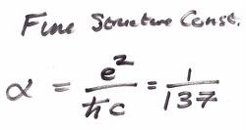
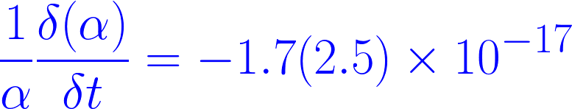
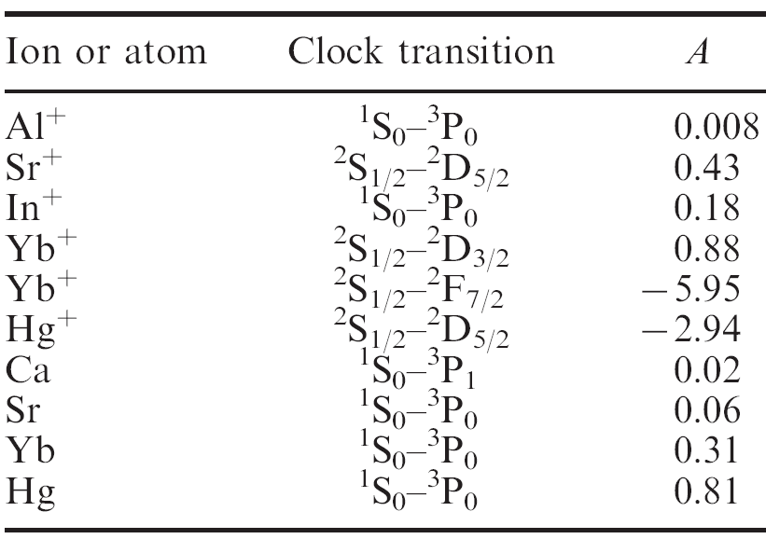
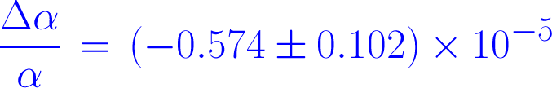
Probing Temporal Constancy of
Fundamental Constants
Fundamental Physics: 10⁻¹⁹ s or better clock accuracy is required
Is it really a constant?
NO !
year ⁻¹
Comparing Hg⁺ & Al⁺ transitions
Ref. T. Rosenband,et. al., Science 319, 1808 (2009) .
Sensitivity
Inter-comparison of Yb⁺ with Sr optical clocks
Sr-atom
Yb⁺
time
Table is adapted from - H. S. Margolis, Contemporary phys. 51, 37 (2010).

Slide 16

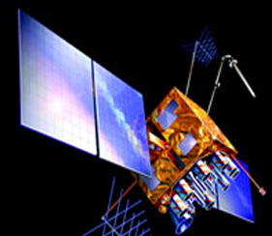
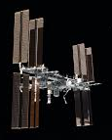
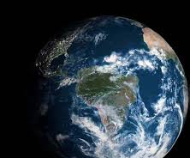



Probing the Local Lorenz Invariance (LLI) violation with Yb-ion
On board clock
R. Bluhm, et. al., Phys. Rev. Lett. 88, 090801 (2002)
Master clock
Estimated sensitivity of LLI-violation
satellite
ISS
clock 1
clock 2
Table is adapted from – V. A. Dzuba, et. al., Nature Phys. doi: 10.1038/nphys3610 (2016).
Energy level shift of the state:
Local position invariance (LPI)
Local Lorenz invariance (LLI)

Slide 17
Single Trapped ion Optical-ν Standards
Electrodynamic (Paul) Trap
Energy levels of ¹⁷¹Yb⁺
|2>
4f¹³5d6s ¹D[3/2]_{3/2}
|1>
|0>
4f¹³5d6s ³D[3/2]_{1/2}
|1>
4f¹⁴6p ²P_{1/2}
|1>
repump 2
|0>
repump 1
atom → ion
935.2 nm
760 nm (quadrupole)
cooling & detection
optical pumping
Continuum
hyperfine repump
|2>
4f¹⁴5d ²D_{3/2}
|1>
369.5 nm
|4>
6s²4f¹³ ²F_{7/2}
4f¹⁴6s6p ¹P₁
|3>
369.5 nm
|1>
467 nm (E3-octupole)
399 nm
4f¹⁴6s ²S_{1/2}
4f¹⁴6s² ¹S₀
|0>

Slide 18
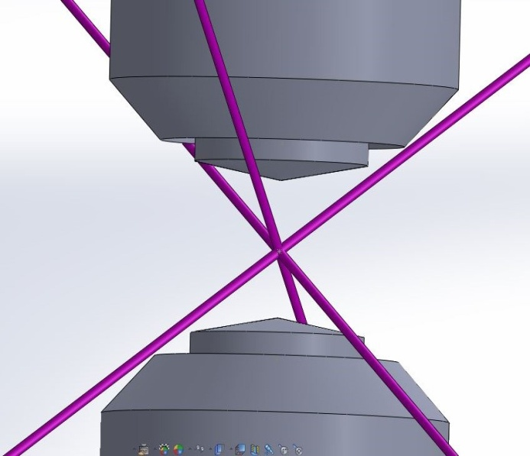
Compensation electrodes design & fabrication
Imaging & Detection of single ion
Systematic shifts cancellation
Computer controlled DC power supply
Ion Trap: designed, in Fabrication stage
UHV: Chamber designed & Fabricated
Frequency Comb for inter-comparison
Building blocks require indigenous development of the instruments
Ultra Stable narrow
linewidth Clock @ 467 nm
Automated Control & Acquisition: developing
Atomic Oven: designed, in testing stage
Optics design & fabrication: Partly done
Frequency Stabilization
AOM & EOM drivers: in testing stage
RF Resonator:
Ready to use
Trapping ions and studying dynamics
Characterization of trap
Helmholtz coil
& Stable
current source
Cooling cycle: 369.5 nm, 760 nm & 935 nm

Slide 19
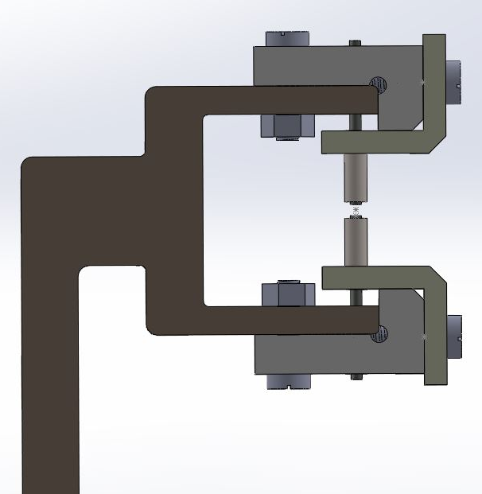
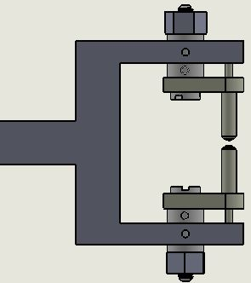
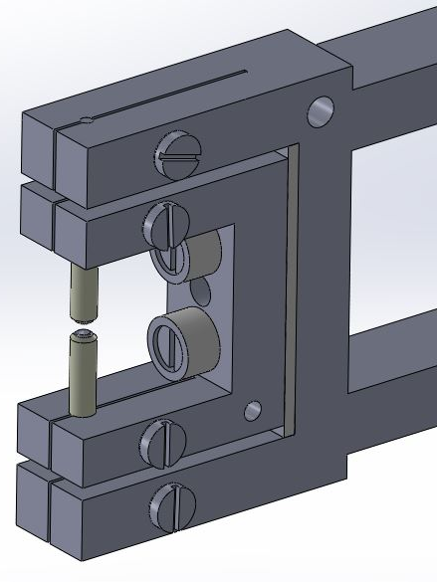
1
2
3
Drawbacks:
More degrees of rotations due to multiple fitting screws
Mutual misalignment
Tight fitting of the electrodes at desired precision failed always
Bulky Macor insulator
Blocking of the lights due to overall bulky structure
Drawbacks:
Relative misalignment resulting from single screw assembly
Difficult assemble the electrodes by tight fitting
Advantages:
NO obstruction of lights coming at the desired angles
NO relative rotation
Easy electrode assembly
TWO legs for mounting with the feedthrough gives better stability
Mounting hole for Pt100
‘Design of the Ion Trap and Vacuum System for ¹⁷¹Yb-ion Optical Frequency Standard’- A. Rastogi et. al., MAPAN-J. Metrol. Soc. India 30, 169 (2015).

Slide 20
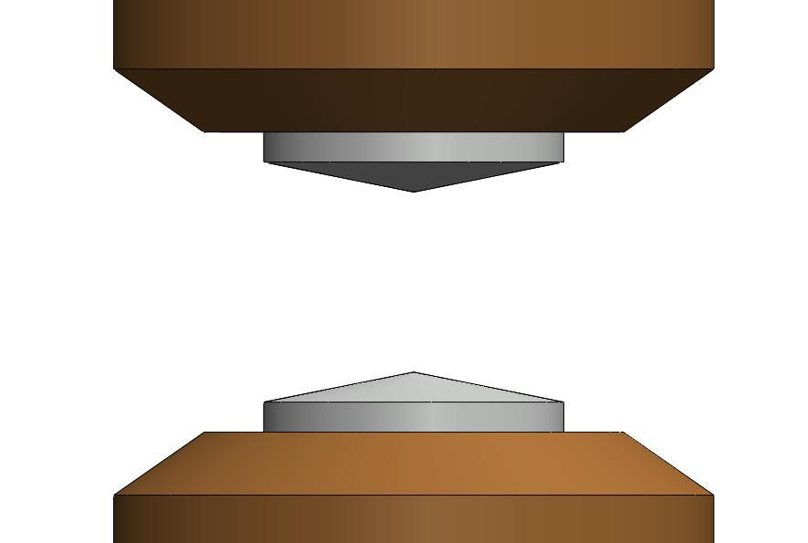
Trap Geometry has influence on
Nature of the confining potential
(desired is quadrupole)
Trajectory of the ions
(micromotions)
Systematic uncertainty
(Electric quadupole shift)

Slide 21
Identifying The Suitable Trap Geometry
Anharmonicity | Schrama (1993) | Beaty (1986) | Beaty (1986) | Stein (2010) | NPL India
|a₄₀ / a₂₀| | 0.004975 | 0.00232 | 0.003529 | 0.01365 | 0.0024
|a₆₀ / a₂₀| | 0.088382 | 0.00014 | 0.000816 | 0.00505 | 0.0092
|a₈₀ / a₂₀| | 0.0065468 | 0.013859 | 0.00132 | 0 | 0.0042
|a₁₀ ₀ / a₂₀| | --- | --- | --- | --- | 0.0023

Slide 22






Motion of ion in the potential
Trajectory
z
z
x
x
y
y
Micromotions - not curable by laser cooling
Micromotion measurement in- D. J. Berkeland, et. al., J. App. Phys. 83, 5025 (1998).
J. Keller, et. al., arXiv:1505.05907v1 (2015).

Slide 23
2r_{o} = 1 mm,
θ_{i} = 10º,
θ_{o} = 45º
2r_{o} = 1 mm,
θ_{i} = 11º,
θ_{o} = 45º
2r_{o} = 0.5 mm,
θ_{i} = 0º,
θ_{o} = 45º
2r_{o} = 1 mm,
2z_{o} = 0.6 mm,
θ_{i}
2z_{o}
θ_{o}
2z_{o} = 0.6 mm,
θ_{i} = 0º,
θ_{o} = 45º
2r_{o}

Slide 24
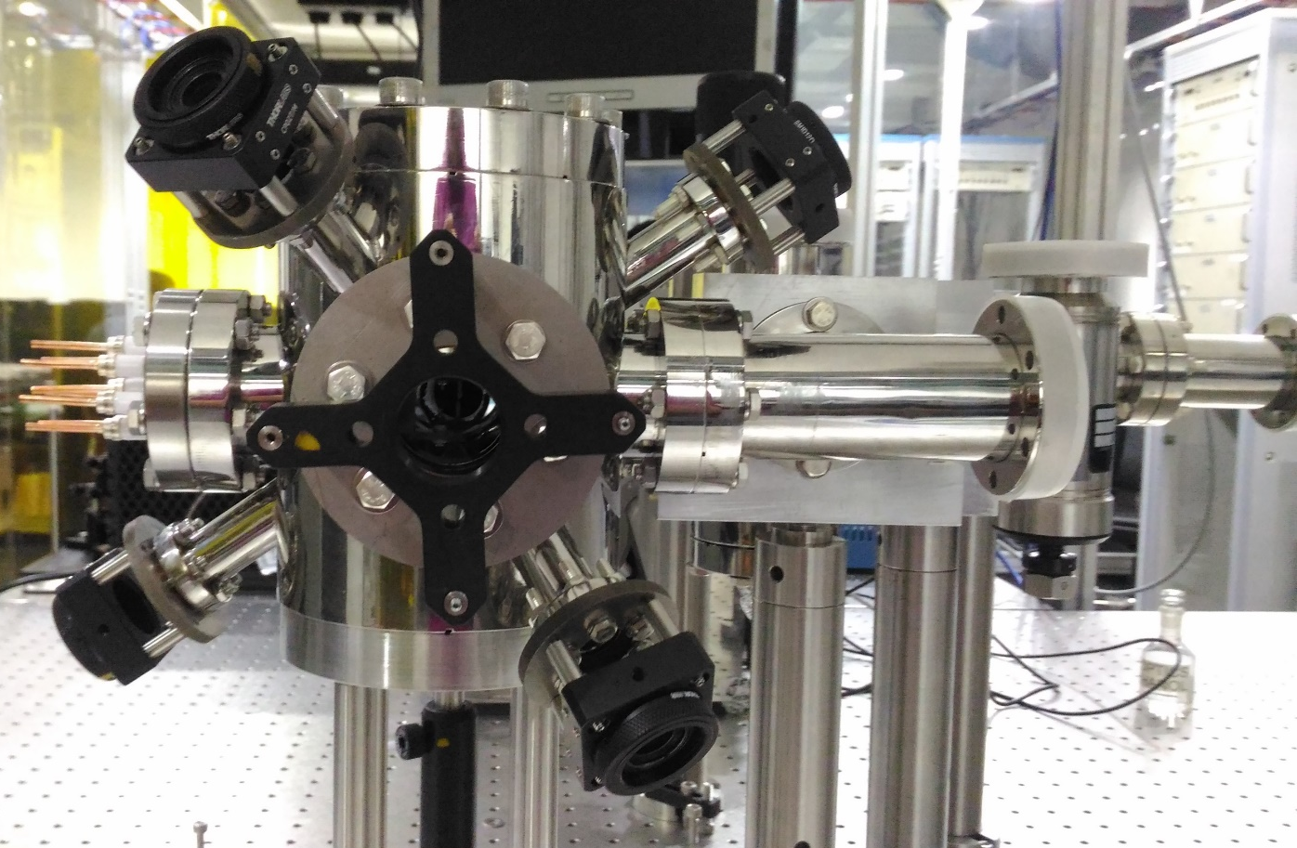
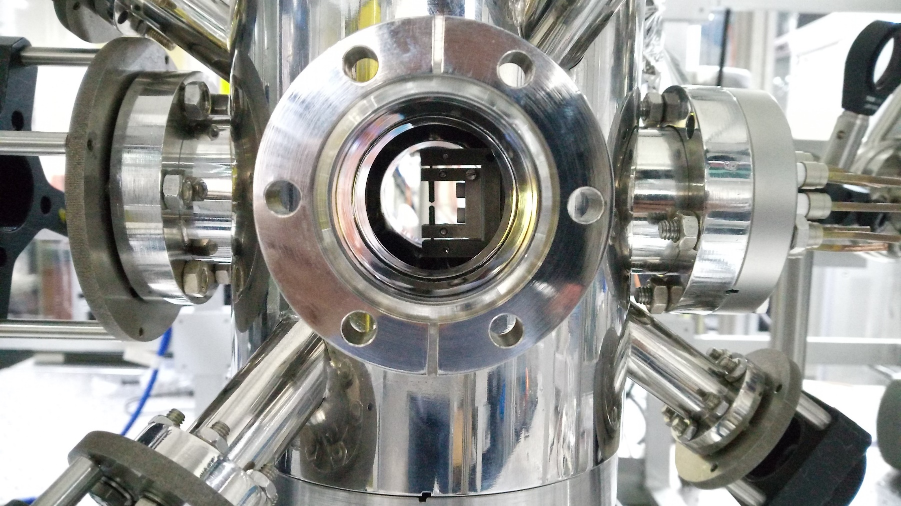

Slide 25
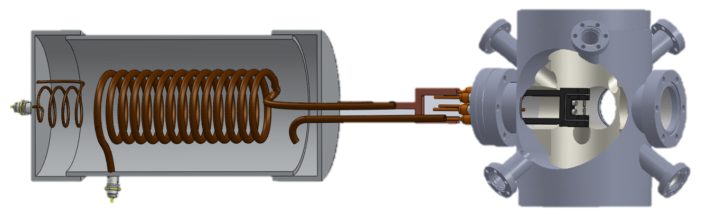
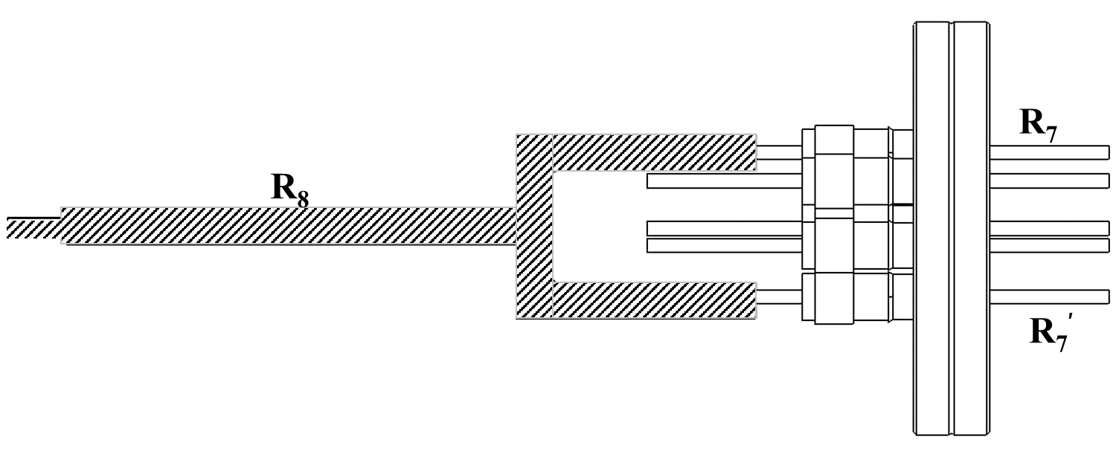
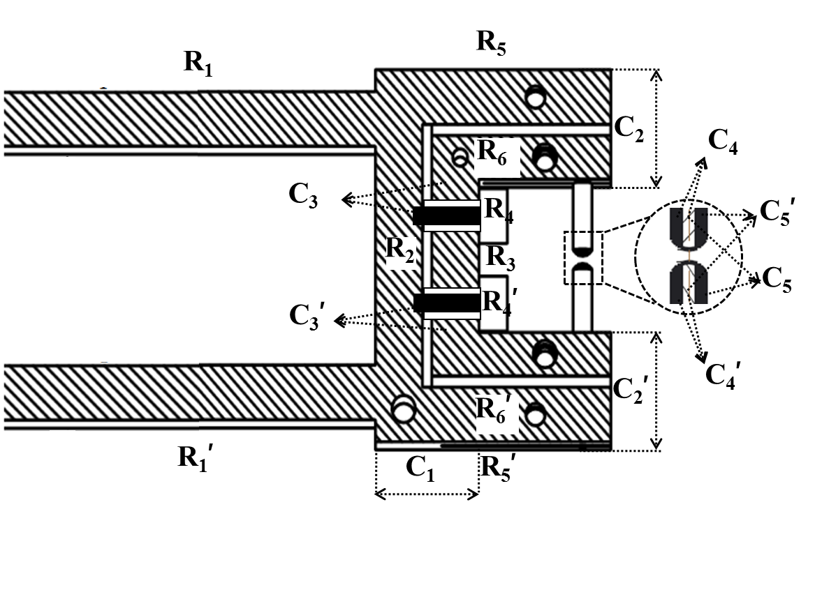
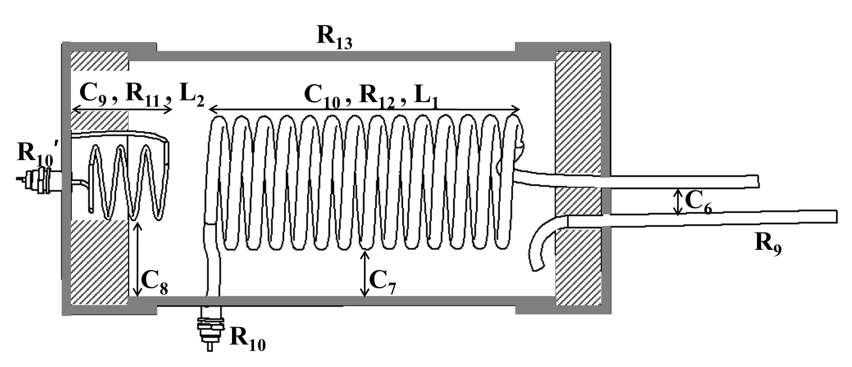
rf
B
Connector
A
C
Helical resonator
Trap

Slide 26
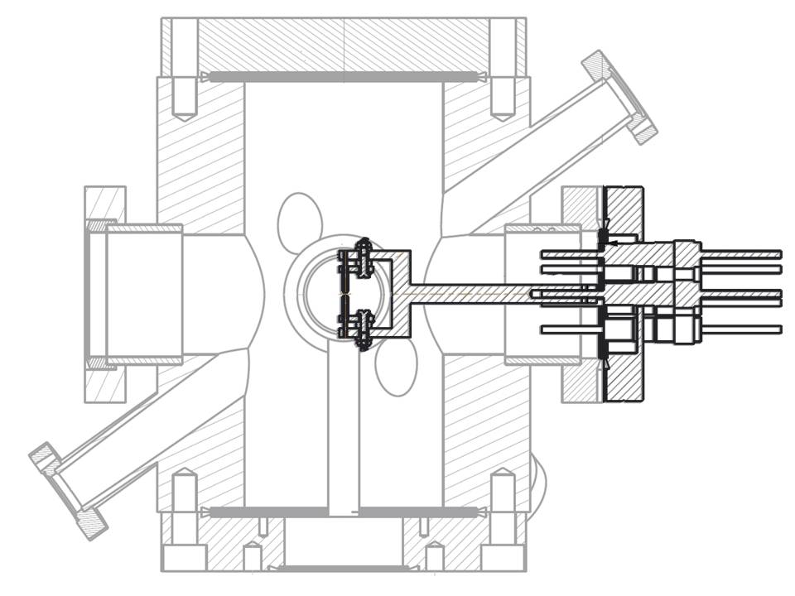
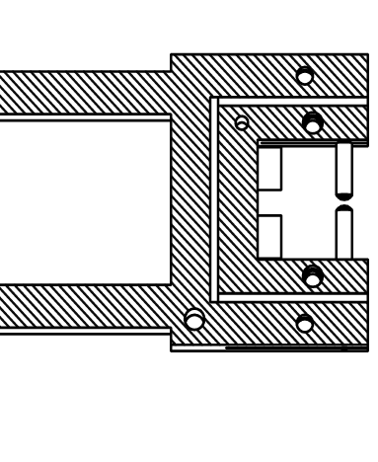


Loads Resulting from the Trap
UHV Chamber
Trap
R₅
R₁
R₇
C₅
R₆
C₆
C₃
R₄
C₁
R₂
R₃
C₈
C₄
C₇
C’₃
R’₄
C₉
R’₁
C’₆
R’₇
C’₅
R’₆
C₂
R’₅
R_{i} and C_{i} indicate resistances and capacitances:
Estimated analytically and through numerical analysis (COMSOL Multiphysics)

Slide 27
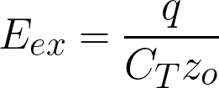
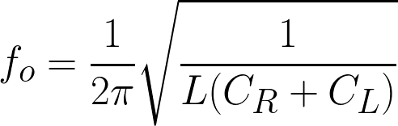
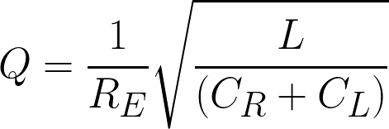
Effect of the Loads Resulting from the Trap
Extra
Micromotions
C_{T}
Variation of resonance frequency and quality factor
C_{R}
R_{E}
C_{R}

Slide 28
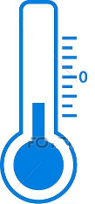
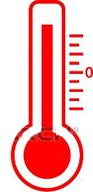
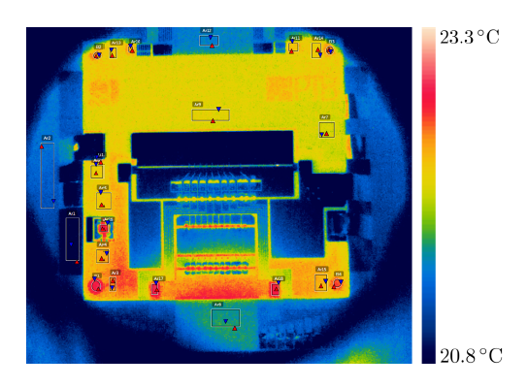
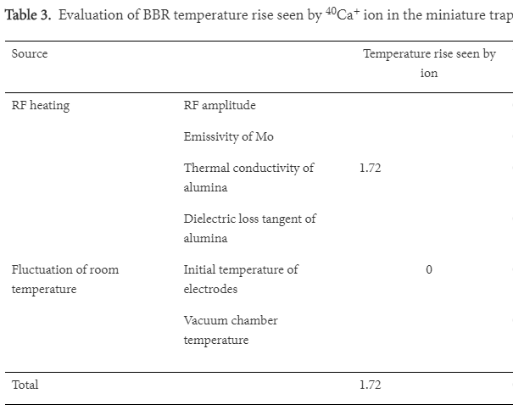
Absorption of the RF and resulting heating of the Ion-trap
AC current
Energy transfer
Skin depth
Heating of the material due to energy dissipation
AC flowing through a conductor
References:
[1] Doležal, M. et al., Metrologia 52, 842 (2015).
[2] Keller, J. et al., J. Phys. Conf. Ser. 723, 012027 (2016).
[3] Zhang, P. et al., J. Appl. Phys. B 50, 015002 (2016).
Thermal image showing temperature increase at U_{AC} = 1 kV, ω_{rf} = 2π x 15.4 MHz. In-ion heats up by 1.0 K resulting to BBR shift of 2 x 10⁻¹⁹
(J. Keller et. al.)
1.72 K temperature increase of Ca-ion results to BBR shift of 5.4 x 10⁻¹⁸ (P. Zang et. al.)

Slide 29




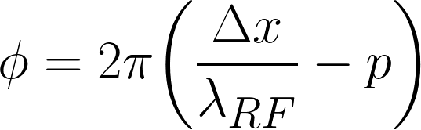
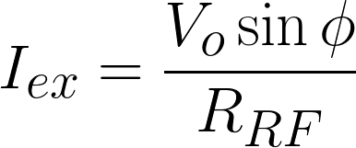
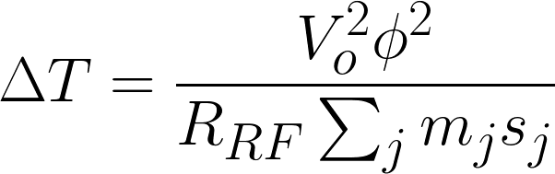
Heating of the Ion-trap Due to Phase Difference in RF
V_{o}
t
AC
AC
t
Equal path lengths on both sides
Equal path lengths on both sides
t
t
Relative phase shift results to
Potential difference V_{o}
Analogous to a Capacitor
D. J. Berkeland et. al., J. Appl. Phys. 83, 503 (1998)
Phase difference of the RF at opposite ends
Total resistance of the RF path
Resulting current flow
Increase of temperature

Slide 30
Loads Resulting from the Trap
R₇
R₁
R₅
C₅
R₆
C₆
C₃
R₃
R₄
C₄
C₇
C₈
C₈’
C₉
C₁
R₂
C₂
R₄’
C₃’
C₆’
R₆ ’
R₇’
R₁’
C₅’
R₅’

Slide 31
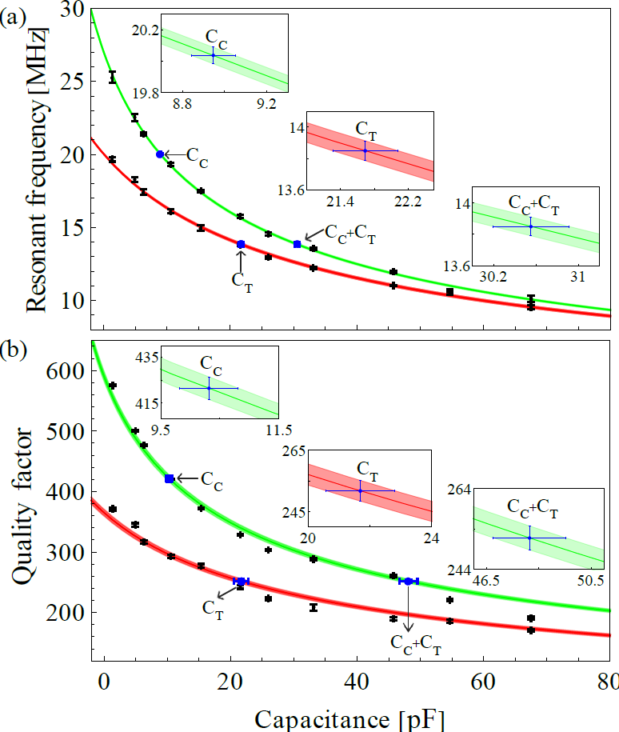
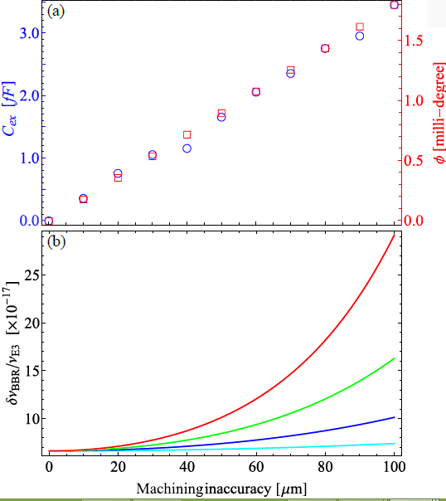




At 1 kV, 15 MHz RF and with ±10µm machining inaccuracy will result to ±0.42 K heating of the trap. This results to 43 mHz shift for the Yb ion E3-clock transition that corresponds to fractional frequency
un-certainty 6.6x10⁻¹⁷
due to the BBR effect.
(a) resonant frequency and (b) quality factor with capacitance for the resonator itself and for the resonator + connector without the ion-trap. The experimental data (black) and the measured capacitance (blue).
(a) Excess capacitance (C_{ex}) phase di-
erence and (b) the BBR shift at RF amplitudes 250 V, 500 V, 750 V and 1000 V resulting from the machining inaccuracy are shown.
Lakhi Sharma et. al., Sci. Reports 8, 16884 (2018).

Slide 32










DC Power supply
Camera multiplexor
Photodiode amplifier and readout
Computer controlled dc voltage source
AOM/ EOM drivers
Indigenously Developed Electronics
Data acquisition system
Shutter drivers
All-digital locking electronics
Computer controlled current source
1. N. Batra, et. al., IEEE Conf. Proc of 2nd International conference on control, instrumentation, energy and communication, Kolkata, 78 (2016). Doi: 10.1109/CIEC.2016.7513823.
2. A. Acharya et. al, Measurements 61, 16 (2015).
3. A. Roy et. al., Metrology Soc. of India Mapan (2017)

Slide 33






PID SERVO and Lock-in
Digital control and software implementation for
Synthesizer
Filters
Phase sensitive detection
PID
Salient features
Compact
Less insensitive to noise pickup
Computer controlled
Low cost
Oscilloscope
PID Servo Controller
Function Generator
FPGA
Lock-in amplifier

Slide 34








Laser frequency stabilization at CSIR-NPL
PD voltage
Piezo voltage
2.0
1.5
Error signal
1.0
Voltage ( × 100 mV )
0.5
0.0
-0.5
0.30
0.35
0.40
0.45
0.50
0.55
0.60
0.65
Wavelength meter reading
Time (ms)
0.9
0.8
0.7
Wavelength change (pm)
0.6
0.5
0.4
24
22
Temperature (C)
20
18
10:30
14:30
18:30
22:30
02:30
06:30
10:30
Day 1
Time
Day 2

Slide 35





Laser frequency stabilization at CSIR-NPL
Auger electron spectroscopy at CSIR-NPL
Low coherence optical interferometry
at BARC Vizag
2.0
1.5
1.0
Voltage ( × 100 mV )
0.5
0.0
-0.5
0.30
0.35
0.40
0.45
0.50
0.55
0.60
0.65
Time (ms)
0.9
0.8
0.7
Wavelength change (pm)
0.6
0.5
0.4
24
22
Temperature (C)
20
18
10:30
14:30
18:30
22:30
02:30
06:30
10:30
Day 1
Time
Day 2

Slide 36
Conclusion
(1) Sci. Reports 8, 16884 (2018).
(2) J. Phys. B:At. Mol. Opt. Phys. 50 205201 (2017).
(3) Mapan-J. Metrol. Soc. India, DOI 10.1007/s12647-017-0241-5 (2017).
(4) MAPAN-J. Metrol. Soc. India, DOI 10.1007/s12647-017-0209-5 (2017).
(5) Chin. Phys. B 25, 113703 (2016).
(6) IEEE Conf. Proc of 2nd International conference on control, instrumentation, energy and communication (2016).
(7) MAPAN-J. Metrol. Soc. India 30, 169 (2015).
(8) Rev. Sci. Instrum. 86, 056104 (2015).
(9) arXiv:1405.5399 (2015).
(10) Int. J. Mod. Phys. B 29, 1550051 (2015).
(11) Measurements 61 16 (2015).
(12) Current Science 106 1348 (2014).
(13) Appl. Phys. B: lasers and optics 114 527 (2014).
Ion trap design
Ultra high Vacuum
Ytterbium oven
Lasers and optics
Frequency stabilization
Necessary electronics
RF resonator
Imaging/ detection
Automation/control system
Production of
ions
Ion trapping
Laser cooling
Trapping and laser cooling
Work is in progress
Ultra stable cavity
Frequency comb
Probing the clock transition
In the planning phase
Time keeping
Generation of UTC(NPLI)
GPS link with BIPM
TWSTFT with NIMs
already exist at CSIR-NPL

Slide 37














T
Single Trapped ion Optical-ν Standard
Present members
H
Kavita Kumari
Lakhi Sharma
Harish
Rathor
Atish Roy
Neelam
Subhasis Panja
A
N
Former members
Amitava Sengupta
Anindya Rastogi
Sathi Chakraborty
K
Sankar Majhi
V N Ojha
Neha Batra
S
Collaborators:
Aranya Bhattachariya, JNU
Bindiya Arora, GNDU
Bijoy K Sahoo, PRL
S R Mishra, RRCAT
Jeroen Koelmeij, VU
Funds:

