Slide 1
Towards a Universal Count of Resources Used in a General Measurement
Saikat Ghosh
Department of Physics
IIT- Kanpur

Slide 2
How precisely can one measure a single parameter?
Spectroscopy, time standards
Detecting new physics: LIGO, variations in constants

Slide 3
Measurement Models
Probe
Measurement
System
Estimator:
Error:
Estimate from a measurement is between
V. Giovannetti, S. Lloyd and L. Moaccone, Nature Photonics, 5, 222 (2011)

Slide 4
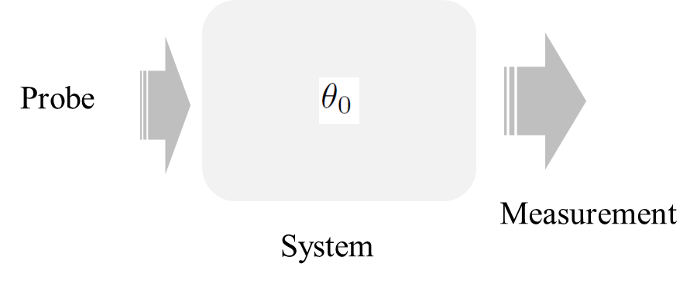
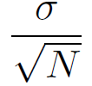
Classical Measurement and Standard Quantum Limit
N probes
N repetitions
The error scales down to : Standard Quantum Limit
Resource used : N
V. Giovannetti, S. Lloyd and L. Moaccone, Nature Photonics, 5, 222 (2011)

Slide 5
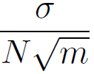
Quantum Resource and Heisenberg Limit
For quantum mechanically N probes, the error scales as:
Resource used: N
m repetitions yield:
Resource used: N*m
V. Giovannetti, S. Lloyd and L. Moaccone, Nature Photonics, 5, 222 (2011)

Slide 6
An example: Phase Measurement
Measure:
Error:
Error:
m repetitions yield:
Resource used: N*m
V. Giovannetti, S. Lloyd and L. Moaccone, Nature Photonics, 5, 222 (2011)

Slide 7
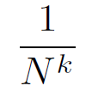
Scaling beyond Heisenberg Limit and Resource Count
For non-linear interactions, scaling beyond HL:
For example.:
S. Boixo et. al. PRL, 98, 094901(2007), M. Napolitano et. al. Nature,471,486 (2011)
However, counting resources becomes non-trivial:
Number of times the probe interacts with the system
For example: V. Giovannetti et. Al. PRL 108, 260405(2012)
M. Zwierz et. al. PRA 85, 042112 (2012), ibid PRL 105 (2010)

Slide 8
What can we say about resources from the output statistics?

Slide 9
Fisher Information
Fisher information quantifies the amount of information carried by the variable X about the unknown parameter.

Slide 10
Cramer-Rao Bound
For an unbiased estimator for the unknown parameter, Cramer-Rao bound sets a lower bound on the error in estimating the parameter.
Note: the Cramer-Rao bound says nothing about the probability distribution or even if it exists.
Notes:
Note: More Fisher Information physically means that the particular probability distribution is sharply peaked around the true value and is therefore, physically, has less error than that with less information.

Slide 11
Outline
Can one explicitly construct a probability distribution that minimizes the error?

Slide 12
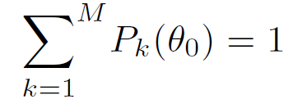
Definition of the problem
For a measurement model with M+1 discrete outcomes and a probability mass function
with the constraints:
is there a that minimizes the root-mean-square-error:

Slide 13
Minimum-Error Distribution (MED)
There is a distribution that indeed minimizes the error and can be constructed in the following way:

Slide 14
Minimum-Error Distribution (MED)
The probability distribution:
J. P. Perdew et. al. PRL. 49, 1691 (1982), D. P. Bestsekas, Nonlinear Programming (1999).

Slide 15
Proof: Minimum-Error Distribution (MED)
The proof follows Cauchy-Schwartz inequality:

Slide 16
Proof: Minimum-Error Distribution (MED)
The proof follows Cauchy-Schwartz inequality:
Any other distribution with different weights will necessarily have a larger error: The distribution is unique

Slide 17
Minimum Error Distribution(MED)
Any experimental model with M+1 discrete set of outcomes that has the least error will have to follow the MED, independent of the strategy.
What is the bound on the error of MED?

Slide 18
What is the bound on the error?
-1
+1
Without loss of generality, one can scale the values between -1 to +1
This implies the expected or true value ranges from -1 and +1

Slide 19
Estimation of the bound on the error
Maximum at the midpoint:

Slide 20
Estimation of the bound on the error
So to find the bound on the MED, we need to find the worst error estimate over any value of . For one of the intervals interval this is

Slide 21
Estimation of the bound on the error of MED
For the entire range: The maximum is larger than the average, and the equality holds when all s are equally spaced.

Slide 22
Can one understand this scaling better?
-1
+1

Slide 23
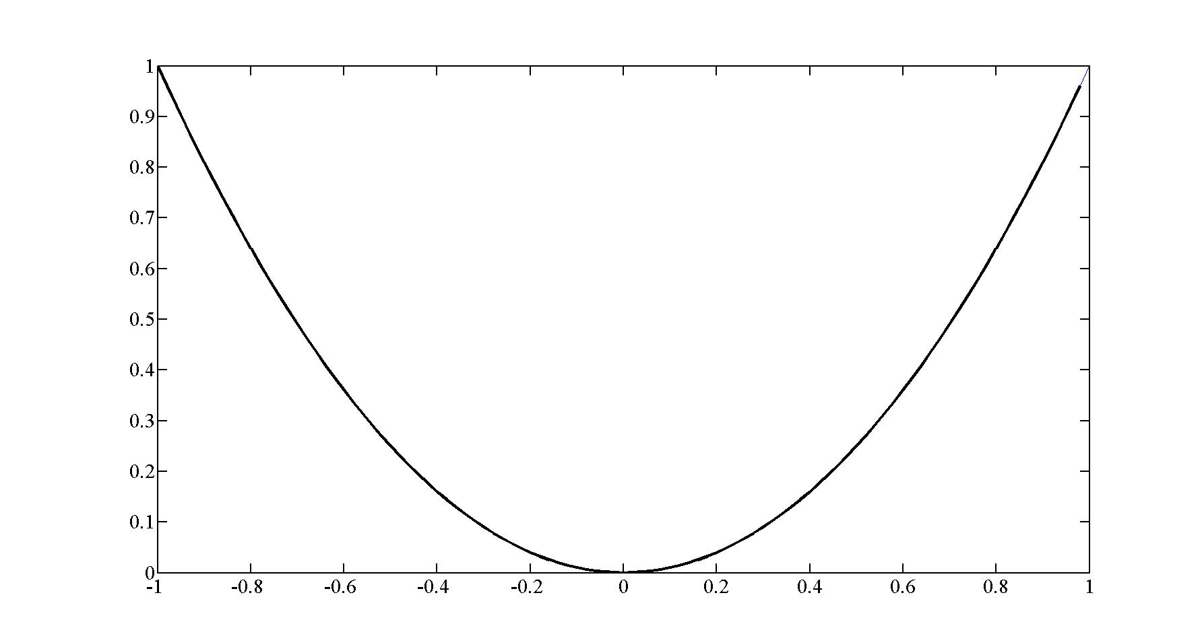
A graphical representation
Plot: with
Here, zero error
corresponds to

Slide 24
A graphical representation

Slide 25
A graphical representation
Not allowed
Not allowed

Slide 26
A graphical representation: visualizing MED
M=1
M=2
M=3
M=4
Not allowed
Not allowed

Slide 27
A graphical representation: visualizing MED
M=4
Not allowed
Not allowed

Slide 28
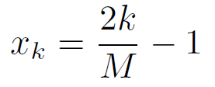
A class of measurement(with M+1 outputs)
M repetitions: values of which M+1 are distinct
The values are equi-spaced:
We take the error in the form:

Slide 29
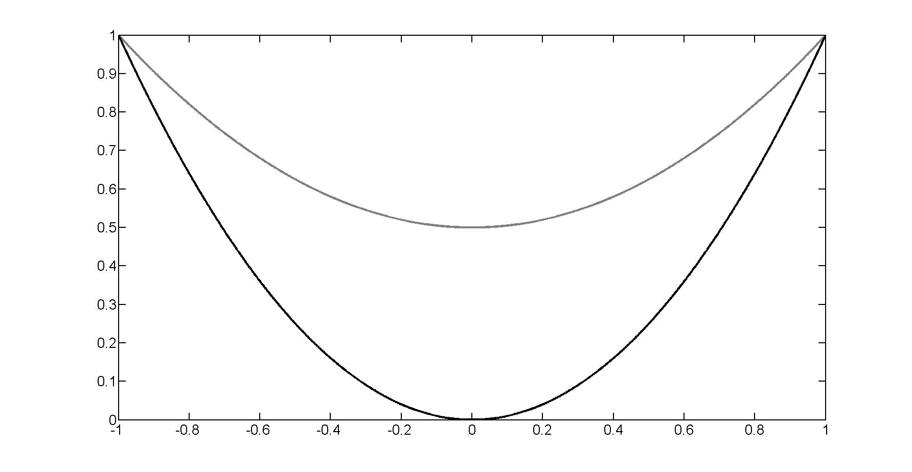
A class of measurements
For a specific M, what is the minimum ?

Slide 30
A class of measurements
For a specific M, what is the minimum ?
For a given M, there is a curve such that the MED for that M is tangent to it.
M=2
M=3
M=4
Notes:
They all meet at

Slide 31
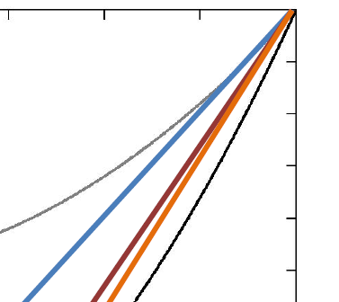
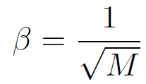
A class of measurements

Slide 32
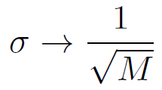
A class of measurements
The extremal curve corresponds to
M=2
M=3
M=4
Notes:
They all meet at

Slide 33
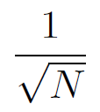
A class (classical) of measurements
The extremal curve corresponds to
N repetitions yields N+1 distinct values with
the error scaling as the SQL:
Notes:
They all meet at

Slide 34
Ansatz: N(resource) = M

Slide 35
Ansatz: N(resource) = M
Quantum mechanical cases:
For a state with N-spins, the Hilbert space is dimensional
with N+1 distinct values.
Classical case:
For N repetitions of a measurement with two outcomes, there are again N+1 distinct outcomes.
A measurement with P outcomes can always be constructed from P-1 repetitions from the two-outcome box.

Slide 36
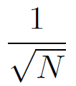
Ansatz: N(resource) = M
Classical case:
The error scales as
Minimum Error Distribution:
The error scales as
Heisenberg Limit:
The error scales as
M. Tsang, PRL, 108,230401(2012), M. Zwierz et. Al. PRA, 85,042112(2012),
V. Giovannetti et.al. PRL, 108,21040(2012) and PRL, 108, 260405(2012)

Slide 37
Universal resource count
A functional definition of resource used in a measurement:
For a classical, quantum (linear or non-linear model) resource used is equal to the number of possible outcomes the model predicts (-1).

Slide 38
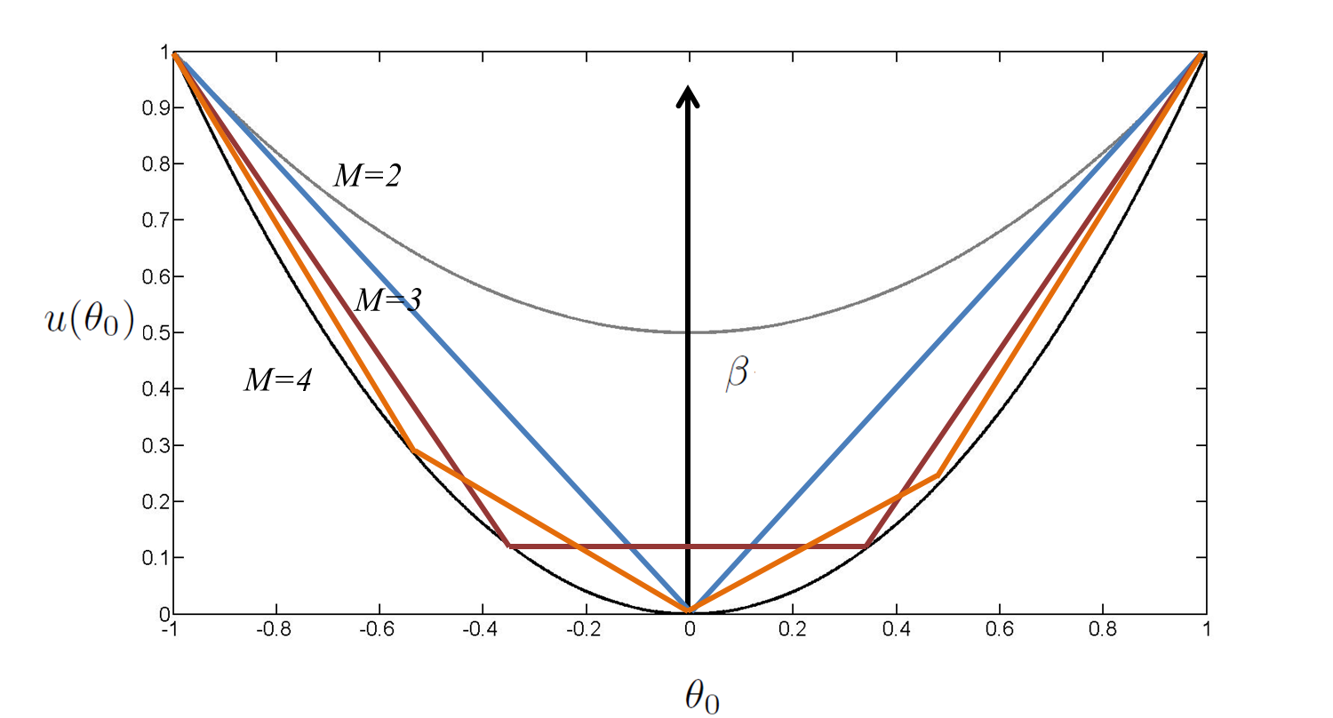
Can one realize the Minimum Error Distribution (MED)?
To achieve this, some amount of prior knowledge is required about the
expected or true value of the parameter.
How well does one need to know the value?

Slide 39
Can one realize the Minimum Error Distribution (MED)?
The MED is achieved for equally spaced outputs, with each bin of size
One needs a prior knowledge of with a precision:
But the precision in the measurement of is of the same order
Therefore the measurement is not going to add any further value

Slide 40
Can one realize the Minimum Error Distribution (MED)?
The MED is not attainable !!

Slide 41
Estimating an arbitrary phase using entangled states (NOON states)
With a proper choice of POVM the output is
So the possible estimates are:
One needs to adopt a strategy to choose the right value.
M. J.W. Hall et. al. PRA, 85, 041802 (R) (2012)

Slide 42
Can there be a strategy to achieve the limit?
The N values are uniformly placed, with a spacing of over an interval [0,2$π).$
To identify the phase, the distribution will have to be the MED, since it is unique,
with an error
But the MED is not attainable.
So no such strategy exists and NOON-like states cannot hit the 1/N limit !

Slide 43
Conclusion
For any experimental model with M+1 discrete set of outcomes that has the least error the corresponding probability mass function is explicitly constructed.
The error corresponding to the distribution scales as 1/M
A simple ansatz is proposed : Resources = Number of discrete outcomes
It is found that the distribution(or the Heisenberg Limit) is not achievable in practice.
H. M. Bharath and Saikat Ghosh (in review) arxiv:1308.3833

Slide 44
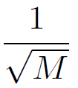
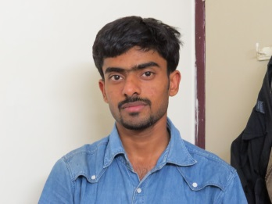
Conclusion
Classical Correlations
In between
H. M. Bharath and Saikat Ghosh (in review) arxiv:1308.3833

Slide 45
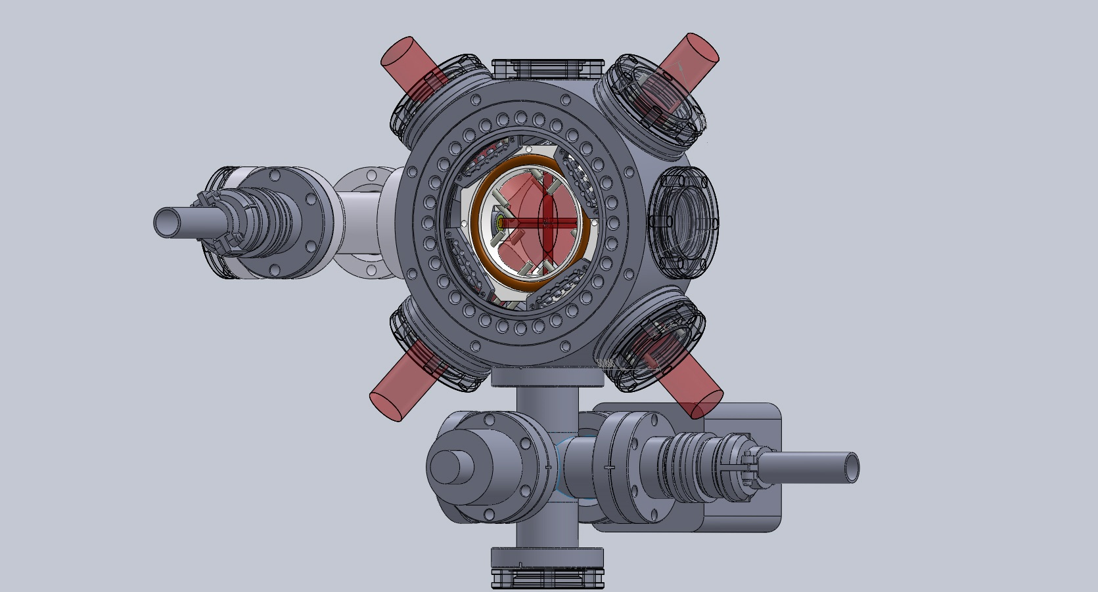
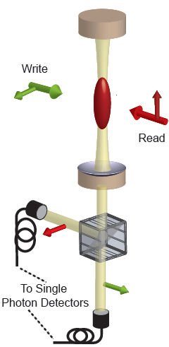
At IIT-Kanpur
Under Construction:
Quantum and Nano-photonics Group

Slide 46
At IIT-Kanpur
Students and post-docs:
PhD Students: Post-Doctoral Fellow:
Rajan Singh Dr. Niharika Singh
Arif Warsi
Anwesha Dutta
Under-graduates: H. M. Bharath(Now at Georgia-Tech), Gaurav Gautam, Prateek Gujrati
Quantum Optics and Atomic Physics
Prof. Anand Jha Prof. Harshwardhan Wanare Prof. V. Subhramaniyam
Visitors and students are most welcome to spend some time with us!

