Slide 1
Ancilla-Assisted
Quantum Information Processing
T. S. Mahesh
Indian Institute of Science Education and Research, Pune

Slide 2
Acknowledgements
Abhishek Shukla
Swathi Hegde
Hemant Katiyar
Koteswara Rao
Manvendra Sharma
Ravi Shankar
Prof. Anil Kumar
Dr. Vikram Athalye
Prof. Usha Devi
Prof. A. K. Rajagopal
PhD students
Collaborators
MS students

Slide 3
Dictionary meaning:
Ancillary staff: Provide necessary support to the primary activities
or operation of an organization, system, etc.
ancilla
ancilla
system
system

Slide 4
Outline
Spin-Systems and NMR
Measurements
Extracting expectation values
Extracting probabilities
Noninvasive measurements
Ancilla Assisted State-Tomography
Ancilla Assisted Process-Tomography
Quantum Simulations
Particle in a potential
Introducing quantum noise
Phase Encoding (Quantum Sensors)
Diffusion in liquids
Mapping-out electromagnetic fields
Summary

Slide 5
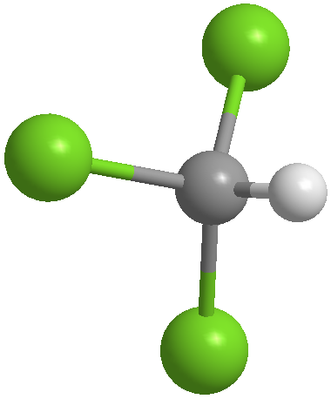
Nuclear Spin and Magnetic Resonance
B₀
Spin ½
(qubit)
|1⟩
¹H
|0⟩
EM energy
(Radio waves)
Chloroform

Slide 6
Nuclear Spin and
Magnetic Resonance
B₀
|1⟩
|0⟩
EM energy
(Radio waves)

Slide 7
Nuclear Spin and Magnetic Resonance
NMR Signal
⟨σ_{x}⟩ = Tr[ ρ σ_{x} ]
σ_{x}
Net transverse magnetization
Procedure:
Prepare ρ
σ_{x}
t

Slide 8
Ancilla assisted measurement:
¹³C
¹H
Unitary observable
System
qubit
System
qubit
Prepare ρ
Prepare ρ
A₁
A₂
A_{m}
A
⋅⋅⋅
Ancilla
qubit
σ_{x}
σ_{x}
Ancilla
qubit
Prepare
|+⟩
Prepare
|+⟩
⟨σ_{x}⟩ = ⟨A⟩_{ρ}
⟨σ_{x}⟩ = ⟨A₁ A₂ ⋅⋅⋅ A_{m}⟩_{ρ}
O. Moussa et al, PRL,104, 160501 (2010)

Slide 9
Example: Evaluating Leggett-Garg inequality
A. J. Leggett and A. Garg,
PRL-1985
Hamiltonian : H = ½ ωσ_{z}
Johannes Kofler,
PhD Thesis, 2004
ρ₀
σ_{x}↗
σ_{x}↗
⟨σ_{x}(0)⋅σ_{x}(Δt)⟩ = C₁₂
ρ₀
σ_{x}↗
σ_{x}↗
⟨σ_{x}(Δt)⋅σ_{x}(2Δt)⟩ = C₂₃
Macrorealistic: K₃ = C₁₂ + C₂₃ − C₁₃ ≤ 1
For spin ½ : K₃ = 2cos(ωΔt) − cos(2ωΔt)
(-3 ≤ K₃ ≤ -1.5)
ρ₀
σ_{x}↗
σ_{x}↗
⟨σ_{x}(0)⋅σ_{x}(2Δt)⟩ = C₁₃
t = 0
Δt
2Δt
time
¹³C
¹H
ωΔt
Athalye, S. S. Roy, TSM, PRL-2011

Slide 10
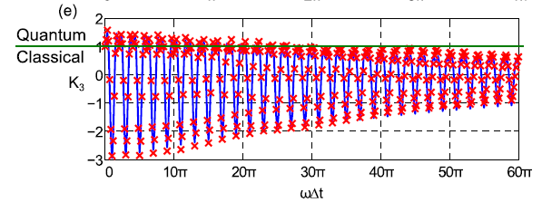
Example: Evaluating Leggett-Garg inequality
A. J. Leggett and A. Garg,
PRL-1985
Hamiltonian : H = ½ ωσ_{z}
Johannes Kofler,
PhD Thesis, 2004
ρ₀
σ_{x}↗
σ_{x}↗
⟨σ_{x}(0)⋅σ_{x}(Δt)⟩ = C₁₂
ρ₀
σ_{x}↗
σ_{x}↗
⟨σ_{x}(Δt)⋅σ_{x}(2Δt)⟩ = C₂₃
Macrorealistic: K₃ = C₁₂ + C₂₃ − C₁₃ ≤ 1
For spin ½ : K₃ = 2cos(ωΔt) − cos(2ωΔt)
(-3 ≤ K₃ ≤ -1.5)
ρ₀
σ_{x}↗
σ_{x}↗
⟨σ_{x}(0)⋅σ_{x}(2Δt)⟩ = C₁₃
t = 0
Δt
2Δt
time
¹³C
¹H
Athalye, S. S. Roy, TSM, PRL-2011

Slide 11
Extracting probabilities (in computational basis)
Arbitrary 1q
density matrix
Diagonal
density matrix
Single quantum
density matrix
crusher
convert
measure
incoherence
U
(dephasing channel)
Prepare ρ
U
σ_{x}
t

Slide 12
Extracting joint probabilities
Suppose Q be an observable, with eigenvalues q = 0 or 1
t
t+Δt
System
qubit
ρ
p( q(t),q(t+ Δt) ) ?
q(t)
q(t+ Δt)
System
qubit
Prepare ρ
U(t)
U(Δt)
σ_{x}
Ancilla
qubit
Prepare |0⟩
σ_{x}

Slide 13
Extracting joint probabilities: Noninvasive method (Negative Result)
Suppose Q be an observable, with eigenvalues q = 0 or 1
t
t+Δt
System
qubit
p( q(t),q(t+ Δt) ) ?
q(t)
q(t+ Δt)
System
qubit
Prepare ρ
U(t)
U(Δt)
σ_{x}
Discord q = 1
---------------------
p(0,0) & p(0,1)
Ancilla
qubit
Prepare |0⟩
σ_{x}
System
qubit
Prepare ρ
U(t)
U(Δt)
σ_{x}
Discord q = 0
---------------------
P(1,0) & p(1,1)
Ancilla
qubit
Prepare |0⟩
σ_{x}

Slide 14
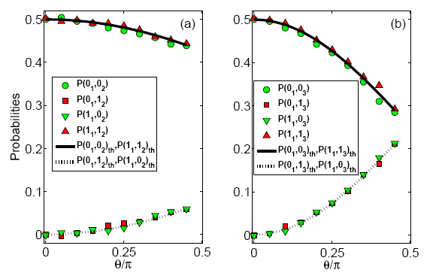
Extracting joint probabilities
Q₁
Q₂
Q₃
t₁
t₂
t₃
time
ancilla
system
H
C
p(q₁,q₂)
p(q₁,q₃)
Hemant, Abhishek, Koteswar, TSM, PRA-2013

Slide 15
Entropic Leggett-Garg Inequality
A. R. Usha Devi, H. S. Karthik, Sudha, and
A. K. Rajagopal, PRA-2013
System state: 1/2
Q₁
Q₂
Q₃
. . .
Dynamical observable : S_{z}(t) = U_{t} S_{z} U_{t}†
time
t₁
t₂
t₃
. . .
Time Evolution: U_{t} = exp(iωS_{x}t)
Information
Deficit:
ancilla
system
H
C
Hemant, Abhishek, Koteswar, TSM, PRA-2013

Slide 16
Reason for LGI violation:
A. R. Usha Devi, H. S. Karthik, Sudha, and
A. K. Rajagopal, PRA-2013
Classical Probability Theory:
Marginals
Grand
P(q₁,q₂)
=
∑
P’(q₁,q₂) = P(q₁,q₂,q₃)
q₃
P(q₁,q₃)
=
∑
P’(q₁,q₃) = P(q₁,q₂,q₃)
q₂
P(q₂,q₃)
=
∑
P’(q₂,q₃) = P(q₁,q₂,q₃)
q₁
Quantum systems do not obey this rule !!

Slide 17
Extracting GRAND probabilities:
Suppose Q be an observable, with eigenvalues q = 0 or 1
p(q(0),q(Δt),⋅⋅⋅,q(nΔt)) ?
System
qubit
0
Δt
(n-1)Δt
nΔt
Q(0)
q(Δt)
q((n-1)Δt)
Q(nΔt)
System
qubit
Prepare ρ
U(Δt)
U(Δt)
U(Δt)
U(Δt)
σ_{x}
Prepare |0⟩
σ_{x}
n
ancilla
qubits
Prepare |0⟩
Prepare |0⟩

Slide 18
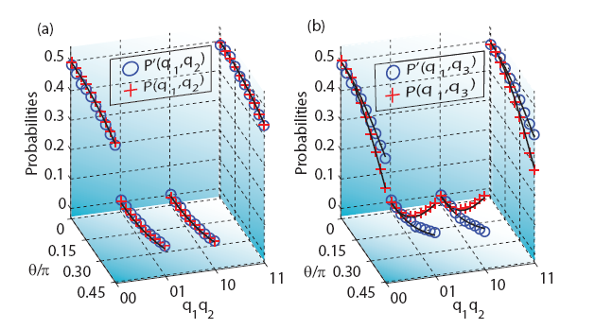
Illegitimate Joint Probability
Hemant, Abhishek, Koteswar, TSM,
PRA-2013
P(q₁,q₂,q₃)
is illegitimate !!
Violation of
Entropic LGI

Slide 19
Quantum State Tomography
Tomography:

Slide 20
Quantum State Tomography
Complete characterization of complex density matrix
Requires a series of measurements all starting from same initial condition
=
+
3-unknowns
Obtained by
measuring
σ_{z}
Obtained by
measuring
σ_{x} and σ_{y}
Measure: σ_{x}⁽¹⁾ ⊗ |0⟩⟨0|,
σ_{x}⁽¹⁾ ⊗ |1⟩⟨1|,
|0⟩⟨0| ⊗ σ_{x}⁽²⁾,
|1⟩⟨1| ⊗ σ_{x}⁽²⁾,
Complex
signal of
Two-qubits
9 different
experiments
carried out
After rotations:
II, XI, YI, IX, IY, XX, XY, YX, YY
15-unknowns

Slide 21
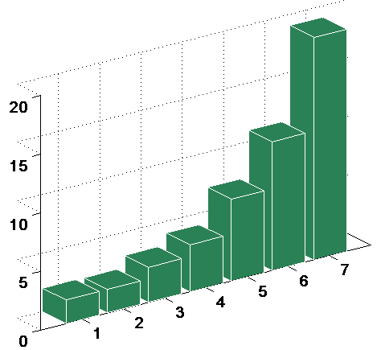
Quantum State Tomography: Scaling
Number unknowns in the density matrix
n-qubit system:
2^{2n}
2^{n}
Number of experiments
~
=
n 2^{n}
n
Observables per experiment
number of
experiments
19
11
7
4
3
2
2
2^{n} x 2^{n} density matrix
n-qubits

Slide 22
Ancilla Assisted Quantum State Tomography:
Nieuwenhuizen & coworkers, PRL-2004
System qubits
|00…0⟩
U_{comp}
System qubits
ρ
System qubits
U_{tomo}
σ_{x}
ancilla qubits
ancilla qubits
ancilla qubits
|00…0⟩
Number unknowns in the density matrix
(n+a)-qubit system:
2^{2n}
2^{n - a}
Number of experiments
~
=
n 2^{(n+a)}
n
Observables per experiment

Slide 23
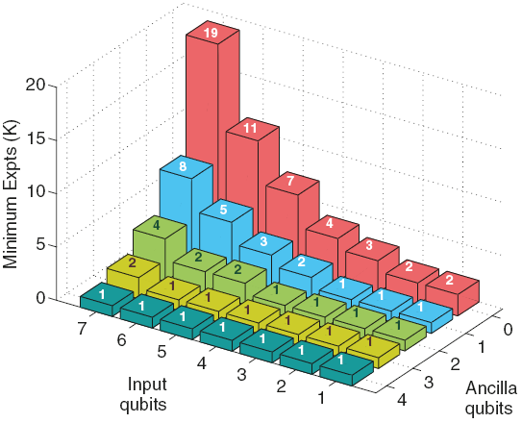
Ancilla Assisted Quantum State Tomography: Scaling
2^{n - a}
n
(n)
(a)
Abhishek, Koteswar, TSM, PRA-2013

Slide 24
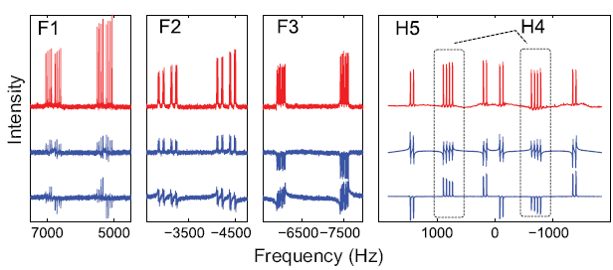
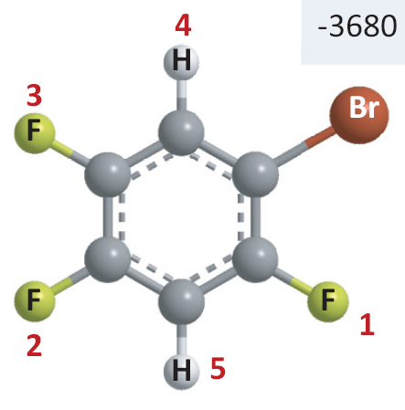
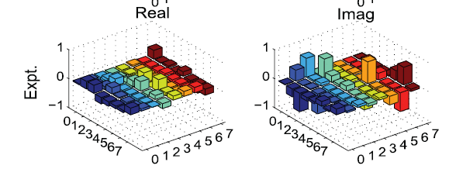
Ancilla Assisted Quantum State Tomography:
3-system qubits, 2-ancilla qubits
Fidelity: 0.95
Abhishek, Koteswar, TSM, PRA-2013

Slide 25
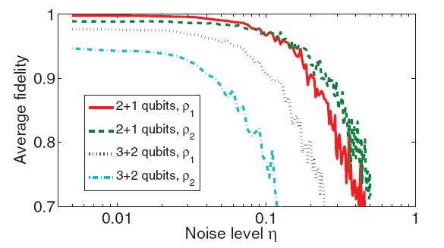
Ancilla Assisted Quantum State Tomography: Noisy Measurements
Abhishek, Koteswar, TSM, PRA-2013

Slide 26
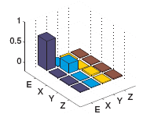
Quantum Process Tomography:
- Characterizes the process (unitary or nonunitary)
Standard method:
1
ε
tomo
b₁
χ matrix
1
ε
tomo
b₂
ε
tomo
b₃
1
Σ
ε(ρ) = χ_{mn} E_{m}ρE_{n}†
ε
tomo
mn
b₄
1

Slide 27
Ancilla Assisted Process Tomography:
Altepeter et al, PRL-2003
- Characterizes the process (unitary or nonunitary)
Using a single ancilla qubit
χ matrix
1
1
ε
(on system)
tomo
1
1
Σ
ε(ρ) = χ_{mn} E_{m}ρE_{n}†
mn

Slide 28
Single-Shot Process Tomography:
- Characterizes the process (unitary or nonunitary)
Using two ancilla qubits
χ matrix
1
1
process
(on system)
σ_{x}
1
1
Σ
ε(ρ) = χ_{mn} E_{m}ρE_{n}†
mn

Slide 29
Quantum Simulation: Particle in a potential (1D)
Schrodinger equation:
iħ (d/dt) |ψ(t)⟩ = H |ψ(0)⟩
|ψ(t)⟩ = exp(-iHt)|ψ(0)⟩
H = T + V
Potential
Kinetic
P²/2m
Do not commute
Trotter approximation:
exp(-i H dt) ≈ exp(-i V/2 dt) . exp(-i T dt) . exp(-i V/2 dt)

Slide 30
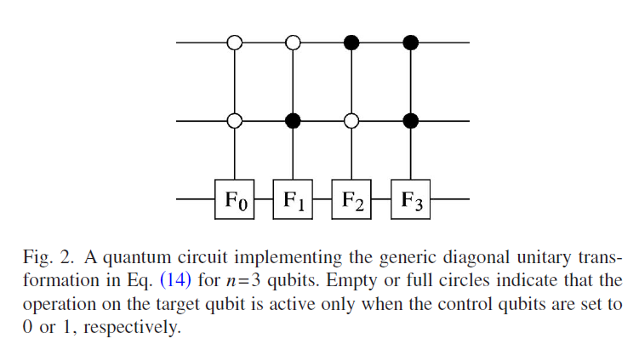
Quantum Simulation: Particle in a potential (1D)
(with spin-1/2 nuclei)
position
x
|111⟩ |110⟩ |101⟩ |100⟩ |011⟩ |010⟩ |001⟩ |000⟩
Trotter form:
exp(-i H dt) ≈ exp(-i V/2 dt) . exp(-i T dt) . exp(-i V/2 dt)
exp(-i H dt) ≈ exp(-i V/2 dt) .U_{iqft}. exp(-i T’ dt) . U_{qft} . exp(-i V/2 dt)
Circuit for Diagonal Unitary

Slide 31
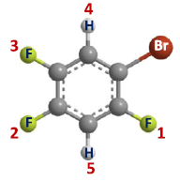
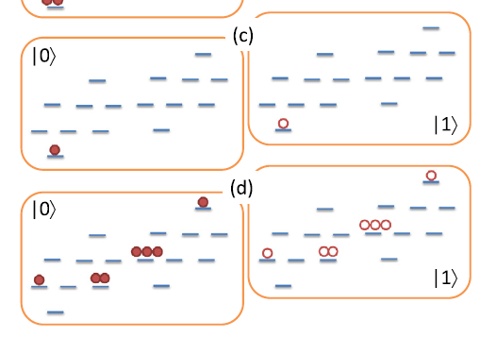
Ancilla Assited Quantum Simulation:
Initial state
Final state
(after
Simulation)
Ravi Shankar, Swathi Hegde, TSM, PLA-2013

Slide 32
Ancilla Assited Quantum Simulation:
Ravi Shankar, Swathi Hegde,
TSM, PLA-2013
Experiments
Theory

Slide 33
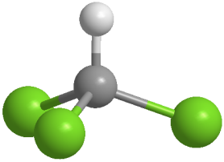
Simulating quantum noise:
Cory & coworkers
PRA, 2003
¹H (system)
¹³C (ancilla: environment)
chloroform
System
System
Time
Time
Ancilla
Ancilla
kicks

Slide 34
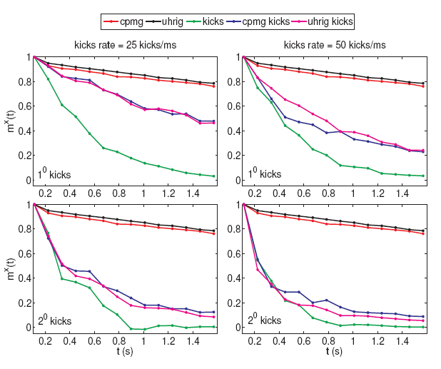
Simulating quantum noise:
¹H (system)
¹³C (environment)
chloroform
Has applications in optimizing dynamical decoupling sequences
Swathi & TSM (on-going work)

Slide 35
Measuring diffusion
|0⟩+|1⟩
|0⟩+e^{iφ}|1⟩
B₀
Price, Concepts in NMR-1997

Slide 36
Measuring diffusion
|0⟩+|1⟩
|0⟩+e^{iφ}|1⟩
B₀
Price, Concepts in NMR-1997

Slide 37
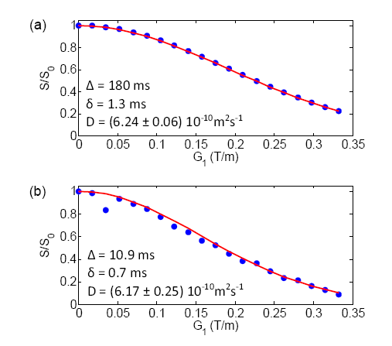
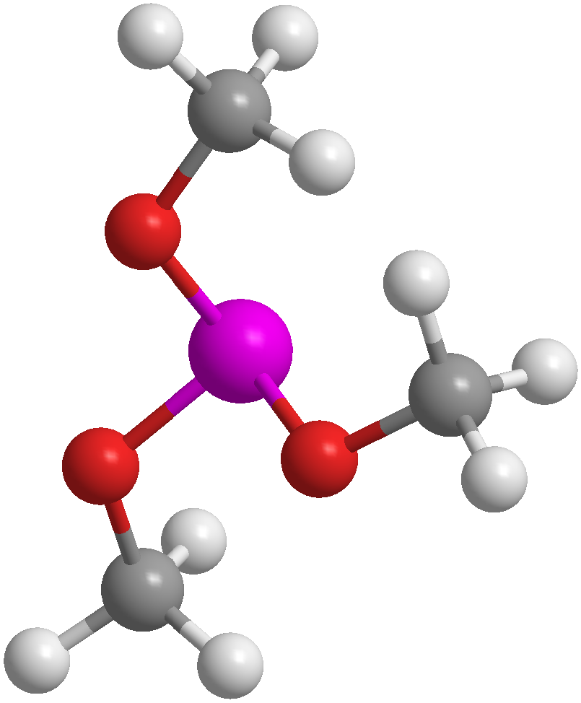
Measuring diffusion
³¹P
Trimethylphosphite
(300 K, DMSO, fixed conc.)
Abhishek, Manvendra, TSM, CPL-2013

Slide 38
Measuring diffusion: NOON states
|0…0⟩+|1…1⟩
|0…0⟩+e^{inφ}|1…1⟩
B₀
³¹P
Preparing
NOON
states
Converting to
single-quantum
states
10-qubits
Trimethylphosphite
(300 K, DMSO, fixed conc.)
Abhishek, Manvendra, TSM, CPL-2013

Slide 39
Measuring diffusion: NOON states
³¹P
Trimethylphosphite
(300 K, DMSO, fixed conc.)
Abhishek, Manvendra, TSM, CPL-2013

Slide 40
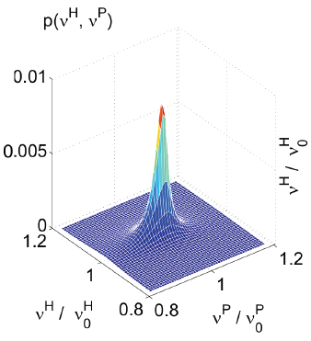
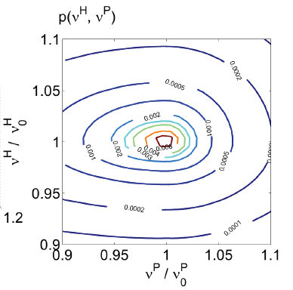
Mapping RF Intensity with NOON states:
³¹P
Abhishek, Manvendra, TSM, CPL-2013

Slide 41
Summary:
Ancilla qubits play an important role in practical quantum processors
Provide efficient ways to measure expectation values and joint probabilities
Assist in Quantum State Tomography and Quantum Process Tomography
Assist in direct read-out of probabilities in quantum simulation
Can induce controlled quantum noise on the system qubits
Can participate in preparing large NOON states – have applications in quantum sensors

