Slide 1


Quantum information perspective
of the Bose Hubbard Model in ion trap
Manas Mukherjee
CQT-NUS, Singapore
QIPA- 2013, HRI Allahabad
Notes:
Blank template

Slide 2
Quantum information perspective
of the Bose Hubbard Model in ion trap
Ion trap – an introduction
Bose Hubbard Model (BHM) for ion trap “Coulomb crystal”
Dynamics of the Hamiltonian
  Sudden quench
  Ramp
Importance to ion trap QC
Towards experimental realization
Notes:
Blank template

Slide 3
Quantum information perspective
of the Bose Hubbard Model in ion trap
Ion trap – an introduction
Bose Hubbard Model (BHM) for ion trap “Coulomb crystal”
Dynamics of the Hamiltonian
  Sudden quench
  Ramp
Importance to ion trap QC
Towards experimental realization
Notes:
Blank template

Slide 4
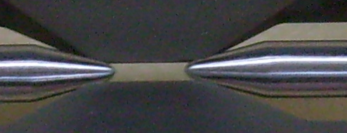
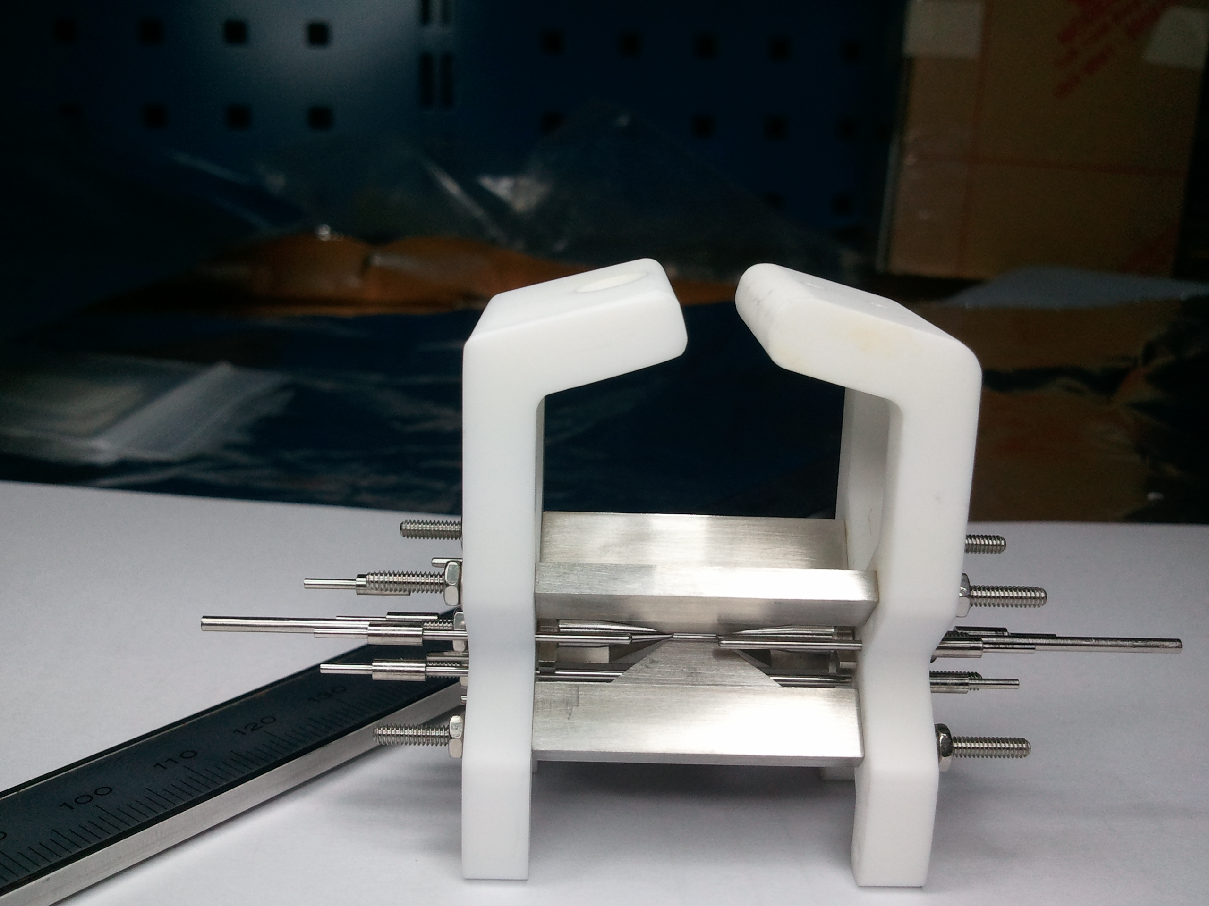
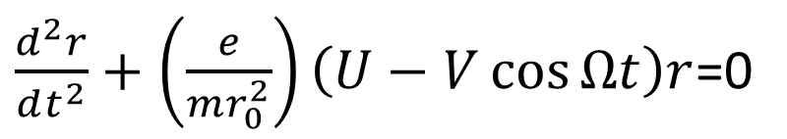
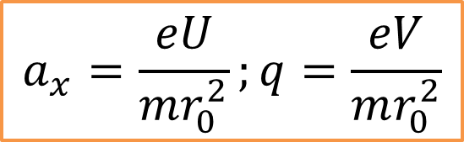

Introduction to ion trap
r_0 = 0.7 mm
Z_0 = 2.2 mm
V cos Ωt
For 2D:
$$Φ_{pot}=αr^{2},r^{2}=x^{2}+y^{2}$$
Equation of motion
Trap parameters
$\frac{d^{2}r}{dt^{2}}+\left(\frac{e}{mr_{0}^{2}}\right)\left(U−V\cos{Ωt}\right)r$=0
$$a_{x}=\frac{eU}{mr_{0}^{2}};q=\frac{eV}{mr_{0}^{2}}$$
Notes:
Blank template

Slide 5
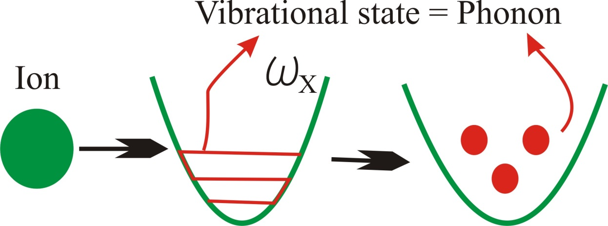

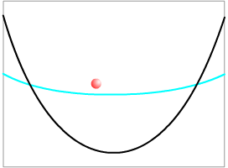
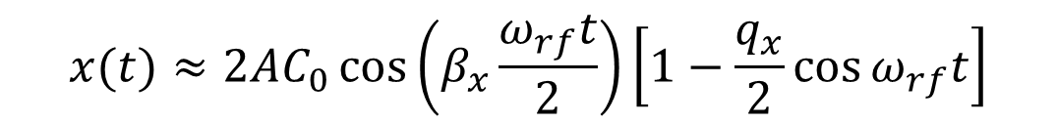
Introduction to ion trap
$$β_{x}≈\sqrt{a_{x}^{2}+q_{x}^{2}/2}$$
$$x(t)≈2AC_{0}\cos\left(β_{x}\frac{ω_{rf}t}{2}\right)\left[1−\frac{q_{x}}{2}\cos{ω_{rf}t}\right]$$
Secular / macro motion
micro motion
Notes:
Blank template

Slide 6
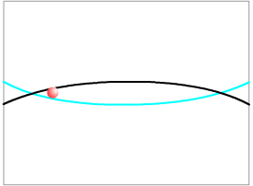
Introduction to ion trap
Salient features of an ion trap
Two radial frequencies (can be degenerate) and one axial frequency
N number of normal modes of motion for N ion chain
For a linear trap radial frequencies are higher than axial frequency
Notes:
Blank template

Slide 7
Quantum information perspective
of the Bose Hubbard Model in ion trap
Ion trap – an introduction
Bose Hubbard Model (BHM) for ion trap “Coulomb crystal”
Dynamics of the Hamiltonian
  Sudden quench
  Ramp
Importance to ion trap QC
Towards experimental realization
Notes:
Blank template

Slide 8
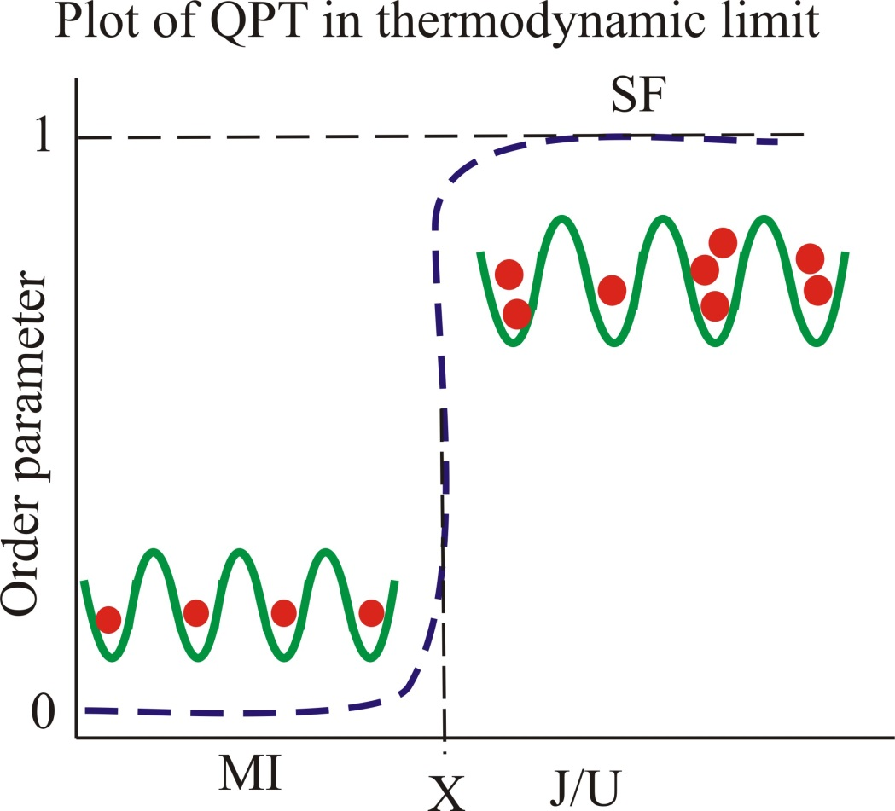
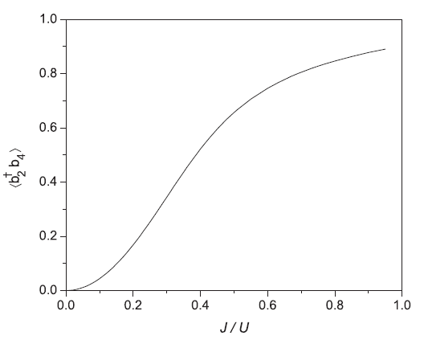
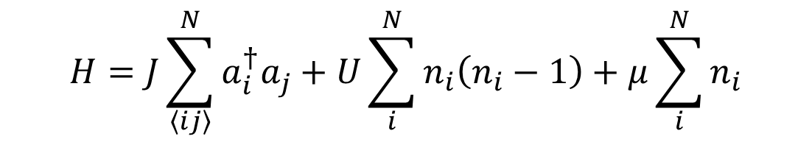
Bose Hubbard Model and
quantum phases
$$H=J\sum_{\left\langle ij\right\rangle }^{N}{a_{i}^{†}a_{j}^{ }}+U\sum_{i}^{N}{n_{i}\left(n_{i}−1\right)}+μ\sum_{i}^{N}{n_{i}}$$
Finite size cross-over
Notes:
Blank template

Slide 9
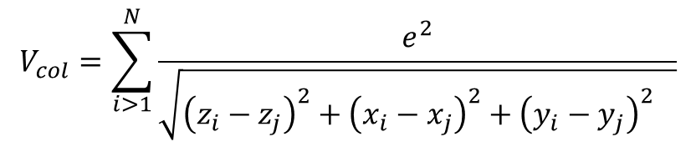
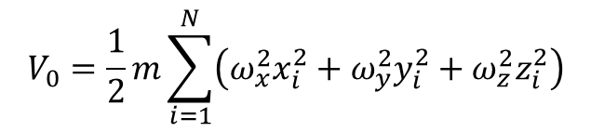
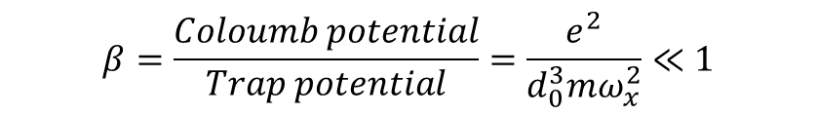
Hamiltonian of trapped ion chain
$$V_{0}=\frac{1}{2}m\sum_{i=1}^{N}{\left(ω_{x}^{2}x_{i}^{2}+ω_{y}^{2}y_{i}^{2}+ω_{z}^{2}z_{i}^{2}\right)}$$
$$V_{col}=\sum_{i>1}^{N}{\frac{e^{2}}{\sqrt{{\left(z_{i}−z_{j}\right)}^{2}+{{\left(x_{i}−x_{j}\right)}^{2}+{\left(y_{i}−y_{j}\right)}^{2}}^{}}}}$$
+
+
z
Assumptions:
Tight confinement in radial direction but weak confinement axially
β parameter small (strong confinement as compared to Col.)
$$β=\frac{Coloumb potential}{Trap potential}=\frac{e^{2}}{d_{0}^{3}mω_{x}^{2}}≪1$$
-Porras and Cirac PRL 96, 250501 (2006)
Notes:
Blank template

Slide 10
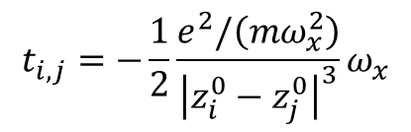
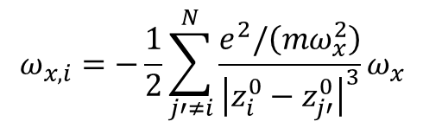
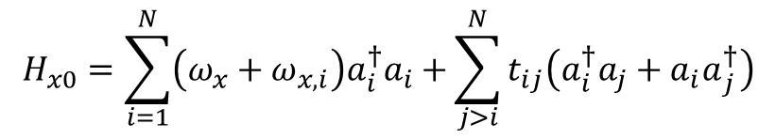
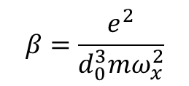
Phonon tunneling in ion trap
$$H_{x0}=\sum_{i=1}^{N}{\left(ω_{x}+ω_{x,i}\right)a_{i}^{†}a_{i}+}\sum_{j>i}^{N}{t_{ij}\left(a_{i}^{†}a_{j}+{a_{i}a}_{j}^{†}\right)}$$
$$ω_{x,i}=−\frac{1}{2}\sum_{j′≠i}^{N}{\frac{e^{2}/\left(mω_{x}^{2}\right)}{{\left|z_{i}^{0}−z_{j′}^{0}\right|}^{3}}ω_{x}}$$
$$β=\frac{e^{2}}{d_{0}^{3}mω_{x}^{2}}$$
$$t_{i,j}=−\frac{1}{2}\frac{e^{2}/\left(mω_{x}^{2}\right)}{{\left|z_{i}^{0}−z_{j}^{0}\right|}^{3}}ω_{x}$$
Assumptions:
Tight confinement in radial direction
β parameter small (strong confinement as compared to Col.)
-Porras and Cirac PRL 96, 250501 (2006)
Notes:
Blank template

Slide 11
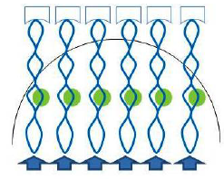
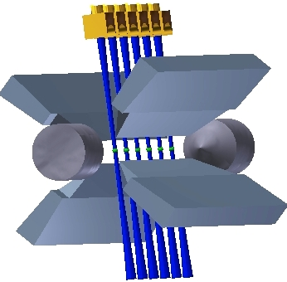
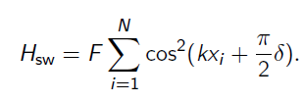
On-site interaction of
phonons in ion trap
Any anharmonicity generates on-site interaction via the quartic term in “x”
x
y
z
Notes:
Blank template

Slide 12

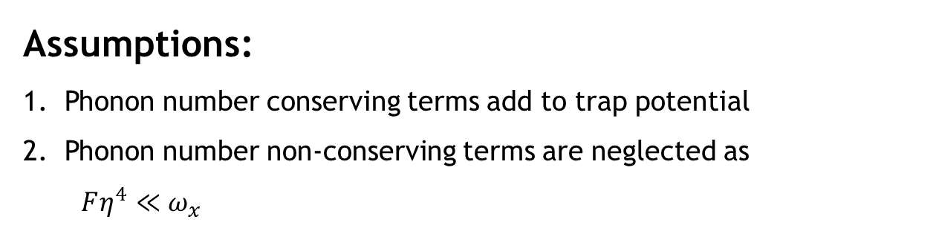
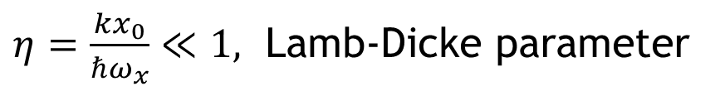
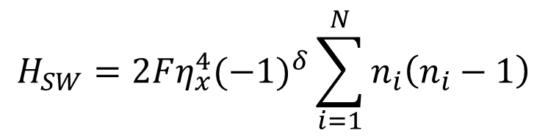
On-site interaction of
phonons in ion trap
Assumptions:
Phonon number conserving terms add to trap potential
Phonon number non-conserving terms are neglected as
$Fη^{4}≪ω_{x}$
$η=\frac{kx_{0}}{ℏω_{x}}≪1,$ Lamb-Dicke parameter
$$H_{SW}=2F{η_{x}^{4}(−1)}^{δ}\sum_{i=1}^{N}{n_{i}\left(n_{i}−1\right)}$$
Notes:
Blank template

Slide 13
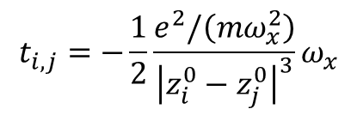
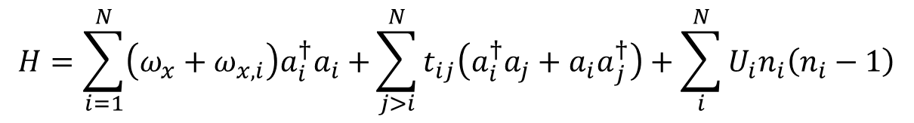


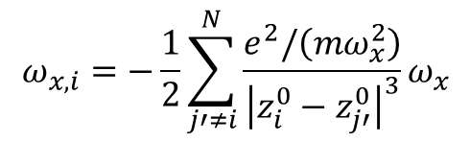
BHM of phonons in ion trap
$$H=H_{x0}+H_{SW}$$
$$H=\sum_{i=1}^{N}{\left(ω_{x}+ω_{x,i}\right)a_{i}^{†}a_{i}+}\sum_{j>i}^{N}{t_{ij}\left(a_{i}^{†}a_{j}+{a_{i}a}_{j}^{†}\right)}+\sum_{i}^{N}{U_{i}n_{i}\left(n_{i}−1\right)}$$
$$ω_{x,i}=−\frac{1}{2}\sum_{j′≠i}^{N}{\frac{e^{2}/\left(mω_{x}^{2}\right)}{{\left|z_{i}^{0}−z_{j′}^{0}\right|}^{3}}ω_{x}}$$
$$t_{i,j}=−\frac{1}{2}\frac{e^{2}/\left(mω_{x}^{2}\right)}{{\left|z_{i}^{0}−z_{j}^{0}\right|}^{3}}ω_{x}$$
$$U_{i}=2F{η_{x}^{4}(−1)}^{δ}$$
can be positive or negative
Notes:
Blank template

Slide 14
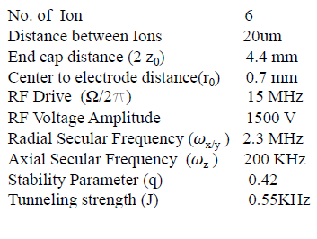
Assumption and reality: ion trap
BP rods
RF rods
Notes:
Blank template

Slide 15
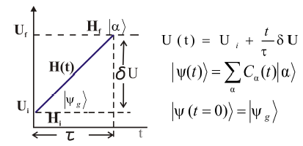

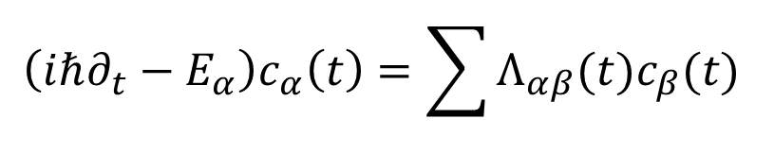
Ramp protocol of BHM in ion trap
Time dependent Hamiltonian
$$\left(iℏ∂_{t}−E_{α}\right)c_{α}\left(t\right)=\sum{Λ_{αβ}(t)c_{β}(t) }$$
$$Λ_{αβ}=\left\langle β | ΔH(t) | α\right\rangle$$
Notes:
Blank template

Slide 16
Alternative ground state cooling
Before
After
T. Dutta, MM, K. Sengupta, PRL 111, 170406 (2013)
Notes:
Blank template

Slide 17
Ramp protocol
for entanglement generation
Before
After
T. Dutta, MM, K. Sengupta, PRL 111, 170406 (2013)
Notes:
Blank template

Slide 18
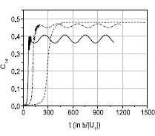
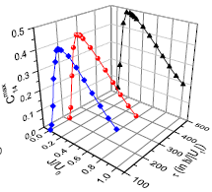
Optimization: Ramp protocol
for entanglement generation
T. Dutta, MM, K. Sengupta, PRL 111, 170406 (2013)
Notes:
Blank template

Slide 19
Importance in ion trap QC
DiVincenzo Criteria
Scalable physical system with well characterized qubits
Ability to initialize the qubit states to simple state
Long coherence time as compared to gate time
A universal set of gate operations
Possibility to readout specific qubit
Motional states for meta-stable electronic state (qubit)
Motional states for ground electronic state (qubit)
D. P. DiVincenzo “The Physical Implementation of Quantum Computation”, Fortschritte der Physik 48, p. 771 (2000)
arXiv:quant-ph/0002077
Notes:
Blank template

Slide 20
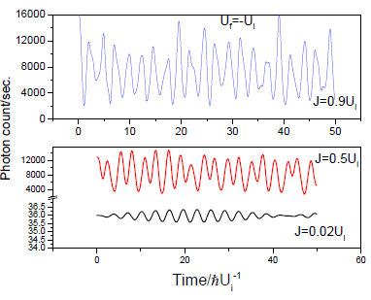
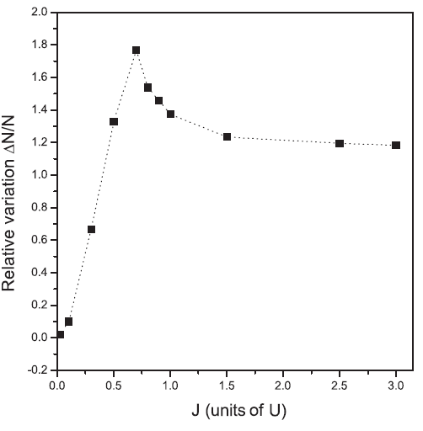
Site specific sudden quench
T. Dutta, MM, K. Sengupta, Phys. Rev. A 85, 063401 (2012)
Notes:
Blank template

Slide 21
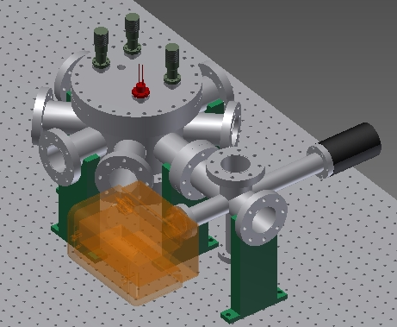
Notes:
Blank template

Slide 22
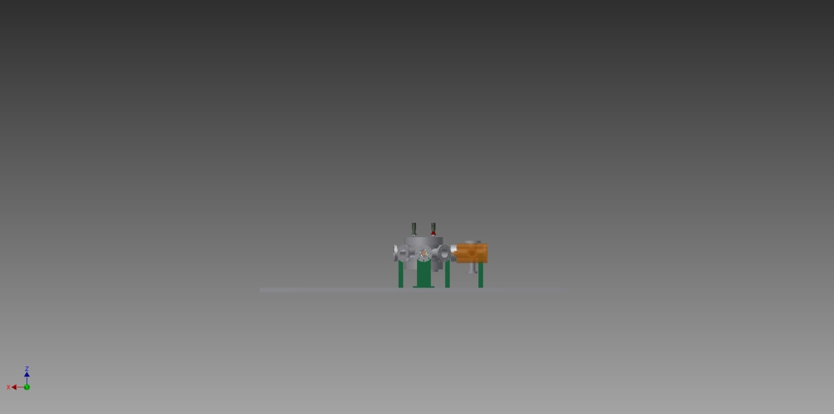
Notes:
Blank template

Slide 23
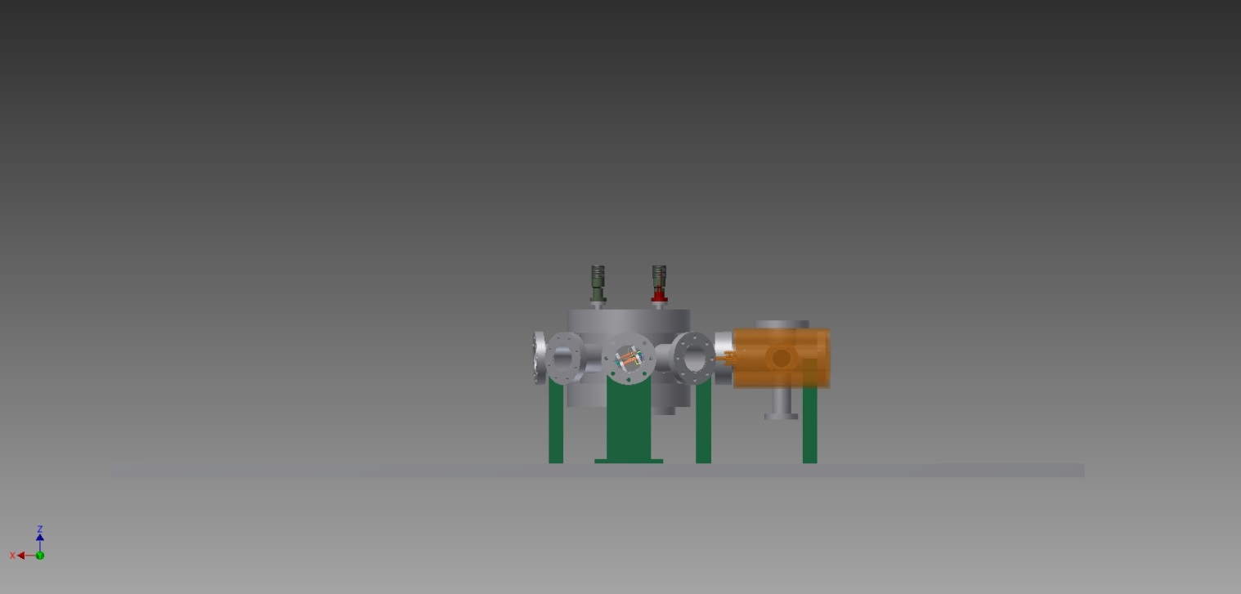
Notes:
Blank template

Slide 24
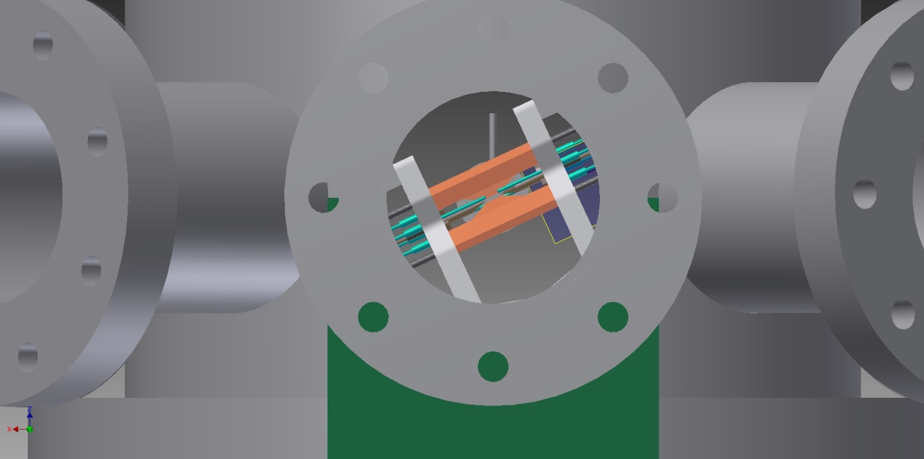
Experimental design
Notes:
Blank template

Slide 25
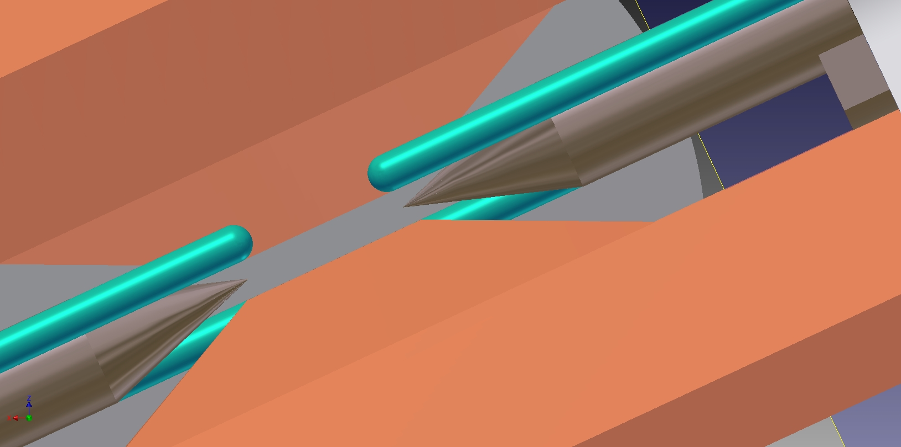
Ion trapping and cooling
Notes:
Blank template

Slide 26
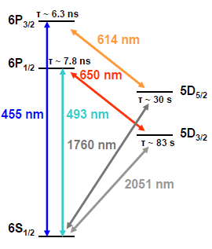
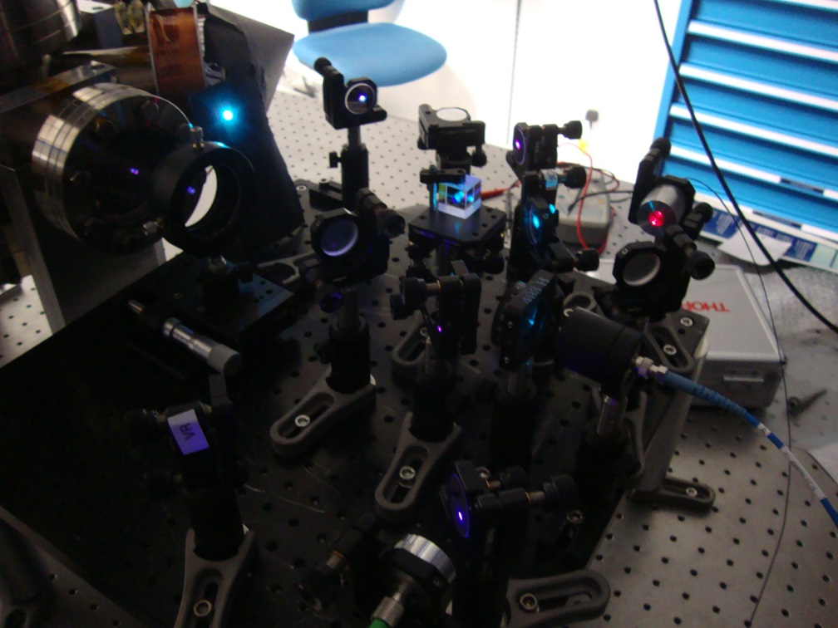
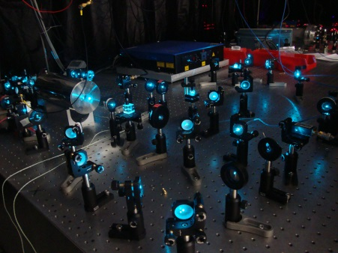
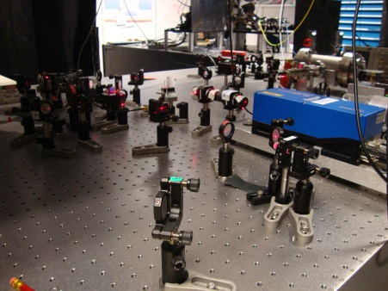
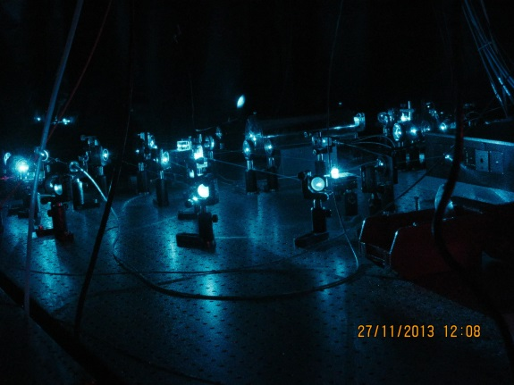
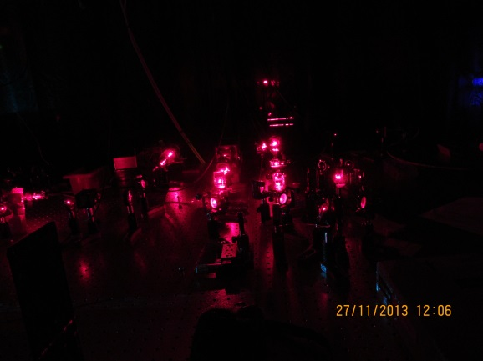
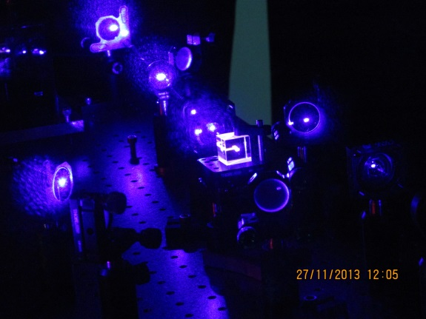
Experimental design
Notes:
Blank template

Slide 27
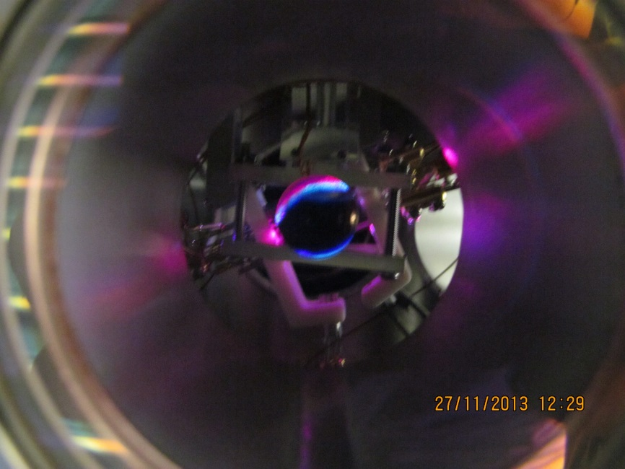
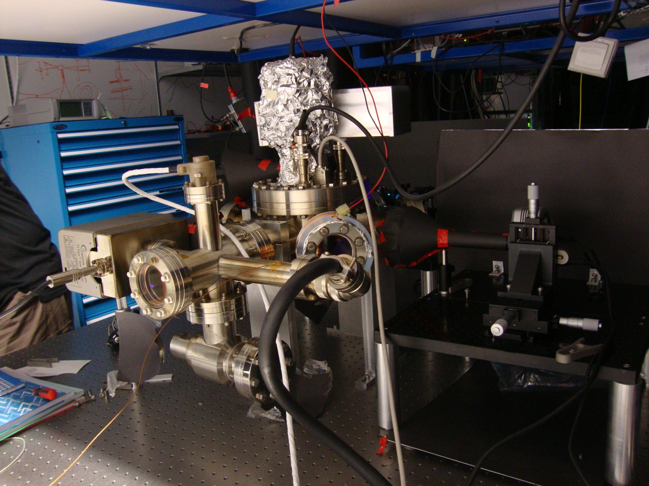
Experimental design
Notes:
Blank template

Slide 28
Observation of cold ions
View quantum jumps
Notes:
Blank template

Slide 29
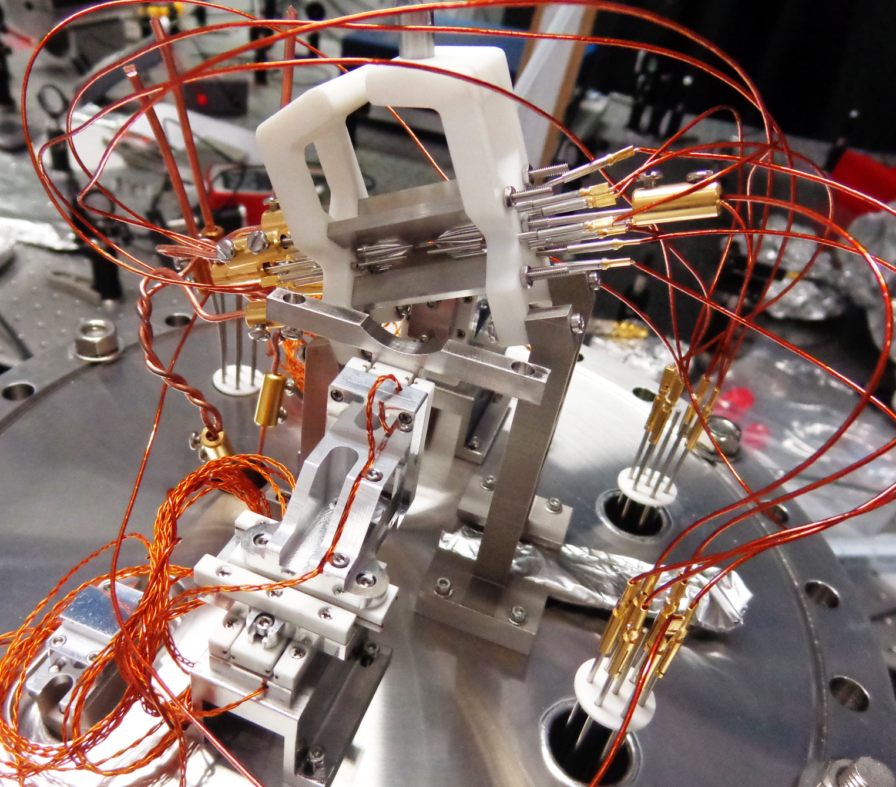
Experimental design
Notes:
Blank template

Slide 30
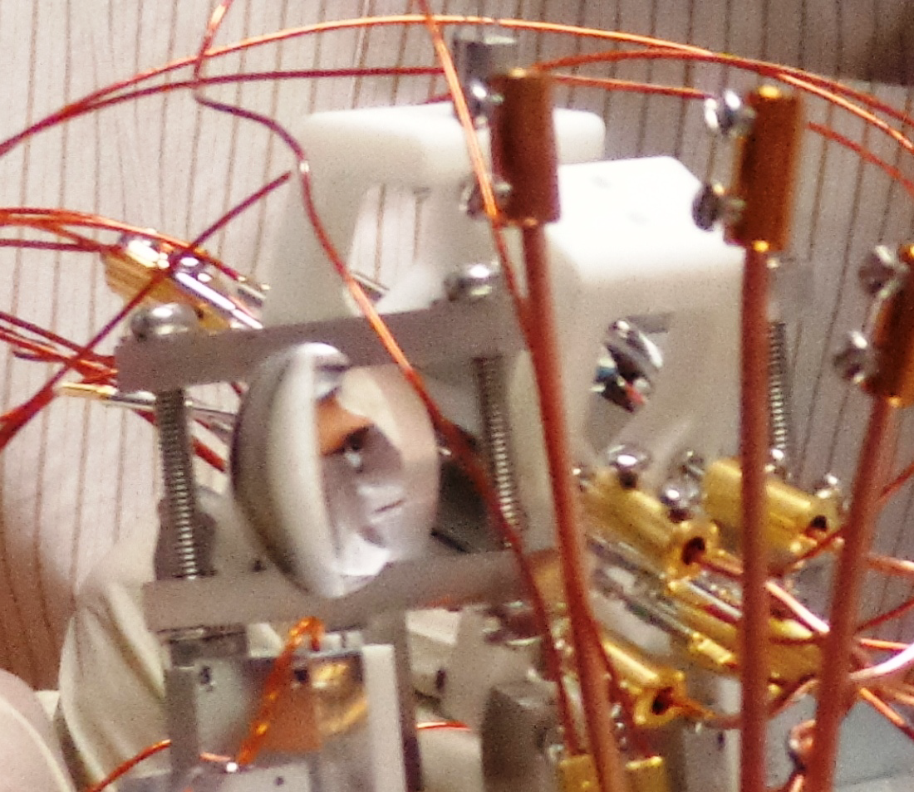
Experimental design
Notes:
Blank template

Slide 31



Acknowledgement
BHM dynamics
Abelian and non-Abelian
phases
Riadh Rebi (postdoc)
Tarun Dutta (Phd student)
Debashis de Munshi (Phd student)
Swarup Das (Phd student)
Tyler Huges (student)
MPI Heidelberg SF6 project
Surface trap project
Notes:
Blank template

