Slide 1
Experimental Quantification of Entanglement and Quantum Discord in Spin Chains
Chiranjib Mitra
IISER-Kolkata
NJP 15, 013047 (2013); Das, Singh, Chakraborty, Gopal, Mitra
NJP 15, 0 113001 (2013); Singh, Chakraborty, Das, Jeevan, Tokiwa, Gegenwart , Mitra
Quantum Information Processing and Applications 2013,
December 2-8, HRI Allahabad

Slide 2
Plan of the Talk
Introduction to Quantum Spin systems and spin qubits
Entanglement in spin chains
Detailed analysis to extract Entanglement from the data – Magnetic susceptibility as an Entanglement witness
Variation of Entanglement with Magnetic Field
Quantum Information Sharing through complementary observables
Quantum Phase Transitions in spin systems
Specific Heat as an entanglement witness.
Measurement of specific heat close to quantum criticality
Quantum Discord in Heisenberg Spin chains
Quantum Discord through Susceptibility and Specific heat

Slide 3
Quantum Magnetic Systems
Low Spin systems (discrete)
Low Dimensional Systems
Spin Chains
Spin Ladders
Models
Ising Model (Classical)
Transverse Ising Model (Quantum)
Heisenberg Model (Quantum)

Slide 4
The ‘DiVincenzo Checklist’
Must be able to
Characterise well-defined set of quantum states to use as qubits
Prepare suitable states within this set
Carry out desired quantum evolution (i.e. the computation)
Avoid decoherence for long enough to compute
Read out the results

Slide 5
Natural entanglement
Entanglement that is present ‘naturally’ in easily accessible states of certain systems (for example, in ground states or in thermal equilibrium)
Natural questions to ask:
How much is there? Can we quantify it?
How is it distributed in space?
Can we use it for anything?
Notes:
Unitary Operations: Entangling Gate

Slide 6
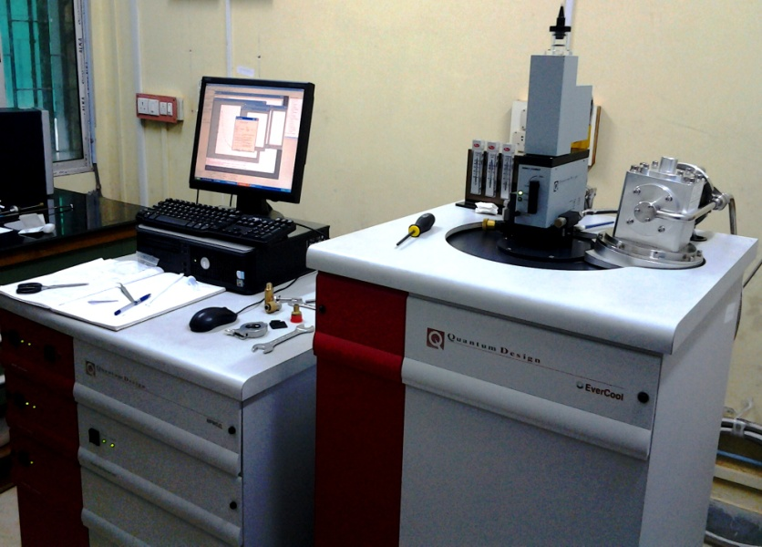
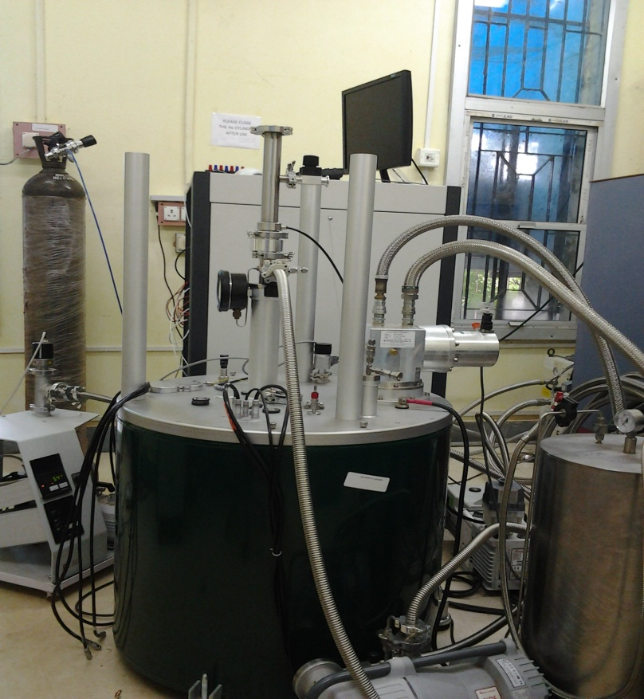
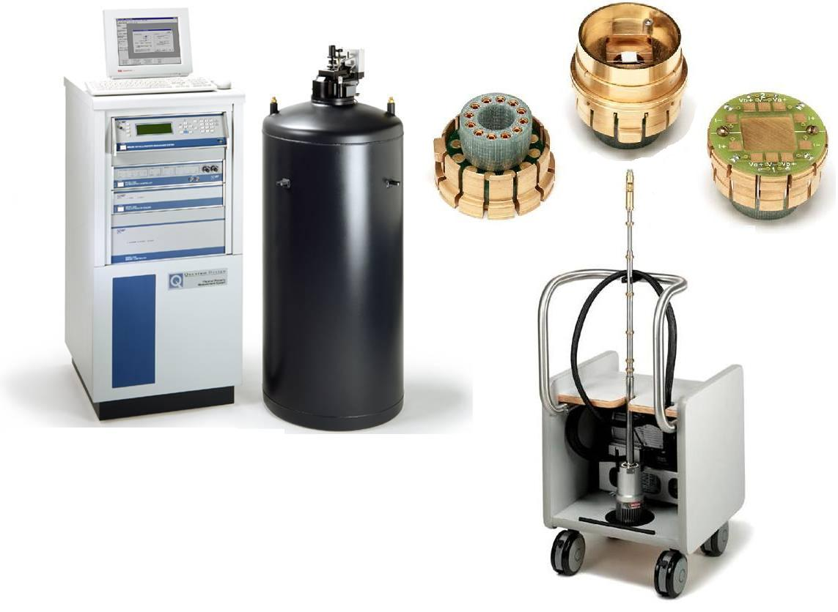
Experimental facilities
Magnetic Property Measurement System
(MPMS)
1.8K- 350K temperature range
0T – 7T magnetic field range
Cryogen free system- Resistivity, Heat capacity
Physical Property Measurement System
(PPMS).
400mK- 300K temperature range
0T – 9T magnetic field range

Slide 7
Macroscopic Quantum Entanglement
Copper Nitrate Cu(NO₃)₂ . 2.5H₂O
Is an Heisenberg antiferromagnet alternating dimer spin chain system with weak inter dimer interaction as compare to intra dimer interaction.
j
J >>j
J
J

Slide 8
Exchange coupled pair model (Dimer)
H = 2 ΣJ_{i} S_{i}•S_{i+1} + g μBH Σ S_{i}
. . . .
Spin S=1/2
E S M_{S}
triplet
H 1 -1
J_{i}
Energy E
0 1 0
singlet
-J_{i} 0 0
H 1 +1
Magnetic Field H

Slide 9
The Hamiltonian for two qubit : (Bipartite systems)

Slide 10
Heisenberg model
triplet
Energy E
J_{i}
singlet
Magnetic Field H
Singlet (AF)
No Entanglement for Ferromagnetic ground state

Slide 11
In the ground state (at low temperatures) the system is in the pure state and is in the state
J/4 (triplet)
Energy E
J
-3J/4 (singlet)
Maximum Mixing

Slide 12
At finite temperatures the system is in a mixed state

Slide 13
At very high temperatures, β 0, the density matrix, Reduces to
Panigrahi and Mitra, Jour Indian Institute of Science, 89, 333-350(2009)

Slide 14
ρ is separable if it can be expressed as a convex sum of tensor product states of the two subsystems
There exists
Hence the system is perfectly separable
(goes to zero, since the Pauli matrices are traceless)

Slide 15
Thermal Entanglement (intermediate temp)

Slide 16
Concurrence
[W.K. Wootters, Phys. Rev. Lett. 80, 2245 (1998)]
In Ferromagnet it is zero
For an Antiferromagnet
O’Connor and Wootters, Phys. Rev. A, 63, 052302 (2001)

Slide 17
Isotropic system
B = 0 limit

Slide 18
Susceptibility as an Entanglement Witness
Wie´sniak M, Vedral V and Brukner C; New J. Phys. 7 258 (2005)

Slide 19
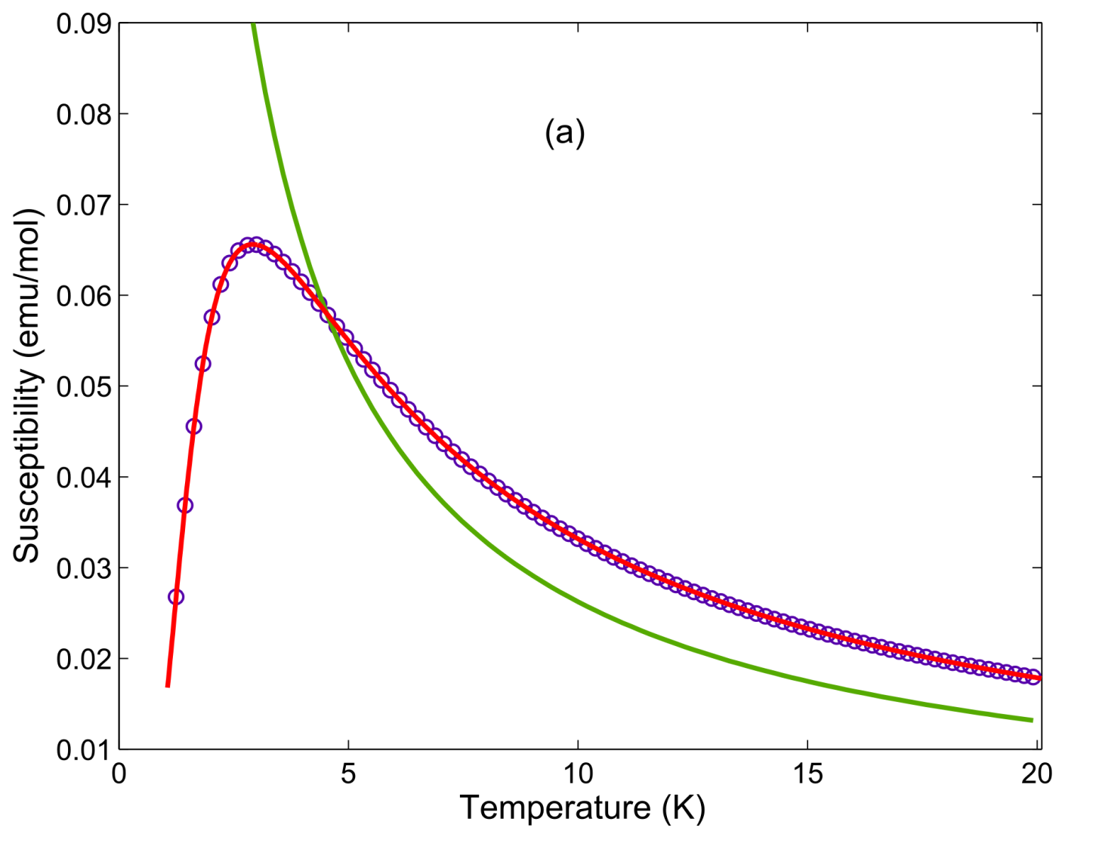
Entangled Region
D. Das, H. Singh, T. Chakraborty, R. K. Gopal and C. Mitra, NJP 15, 013047 (2013)

Slide 20
Concurrence in Copper Nitrate
D. Das, H. Singh, T. Chakraborty, R. K. Gopal and C. Mitra, NJP 15, 013047 (2013)

Slide 21
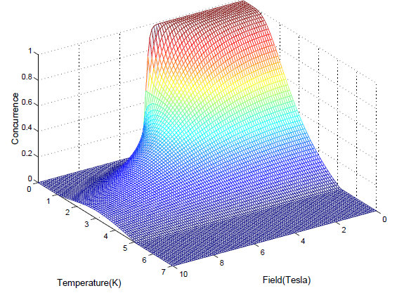
Theoretical Entanglement
Arnesen, Bose, Vedral, PRL 87 017901 (2001)

Slide 22
Experimental Entanglement
NJP 15, 013047 (2013); Das, Singh, Chakraborty, Gopal, Mitra

Slide 23
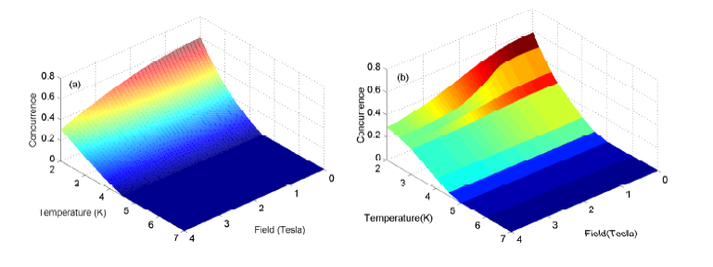

Slide 24
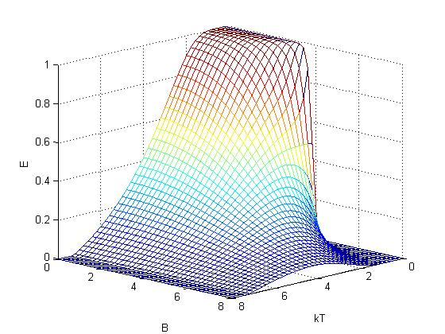
Theoretical Entanglement

Slide 25
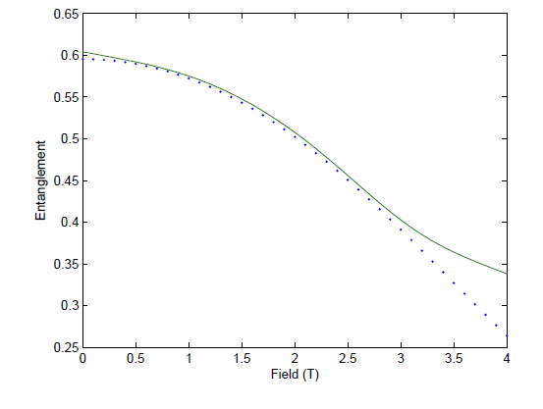
Entanglement vs Field
NJP 15, 013047 (2013); Das, Singh, Chakraborty, Gopal, Mitra

Slide 26
Heisenberg model
Energy E
Magnetic Field H
Singlet (AF)
No Entanglement for Ferromagnetic ground state

Slide 27
Quantum Phase Transition
H(g) = H₀ + g H₁, where H₀ and H₁ commute
Eigenfunctions are independent of g even though the Eigenvalues vary with g
level-crossing where an excited level becomes the ground state at g = g_{c}
Creating a point of non-analyticity of the ground state energy as a function of g
Subir Sachdev, Quantum Phase Transisions, Cambridge Univ Press, 2000

Slide 28
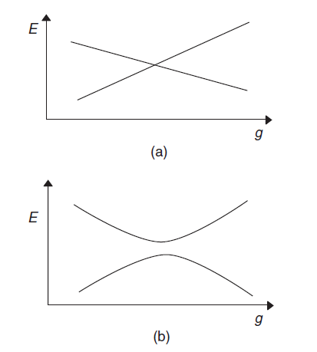
Level Crossing
Δ ∼ J |g − g_{c}|^{zν}
diverging characteristic length scale ξ
ξ⁻¹ ∼ Λ |g − g_{c}|^{ν}

Slide 29
Heisenberg model
Energy E
Magnetic Field H
Singlet (AF)
No Entanglement for Ferromagnetic ground state

Slide 30
Quantum Information Sharing
For Product states
NJP 15, 013047 (2013); Das, Singh, Chakraborty, Gopal, Mitra
Wie´sniak M, Vedral V and Brukner C; New J. Phys. 7 258 (2005)

Slide 31
(Single Qubit)
Q
P
Wiesniak, Vedral and Brukner; New Jour Phys 7, 258(2005)

Slide 32
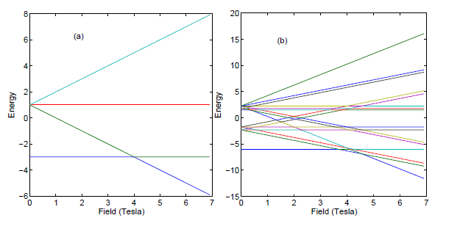

Slide 33
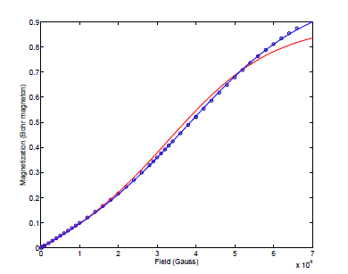
Magnetization
NJP 15, 013047 (2013); Das, Singh, Chakraborty, Gopal, Mitra

Slide 34
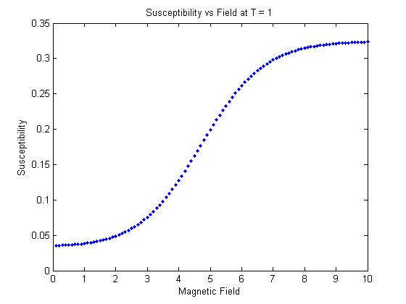
Susceptibility

Slide 35
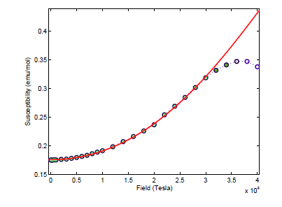
Susceptibility as a function of field
NJP 15, 013047 (2013); Das, Singh, Chakraborty, Gopal, Mitra

Slide 36
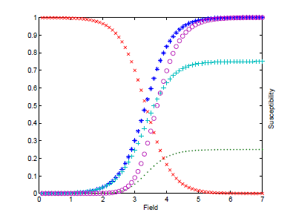
Q
NJP 15, 013047 (2013); Das, Singh, Chakraborty, Gopal, Mitra

Slide 37
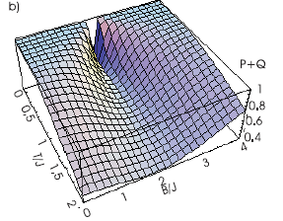
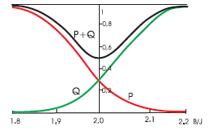
Partial information sharing
Wie´sniak M, Vedral V and Brukner C; New J. Phys. 7 258 (2005)

Slide 38
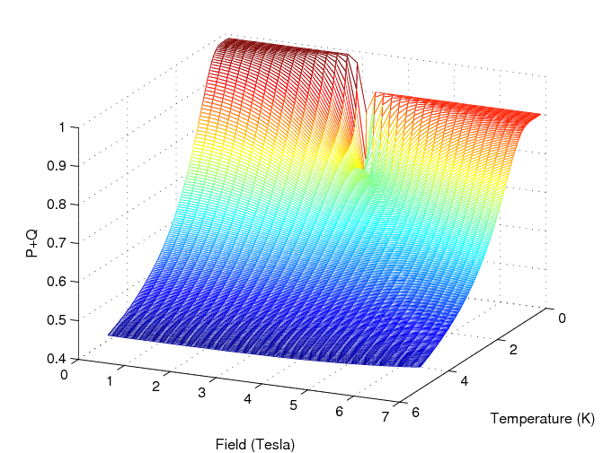
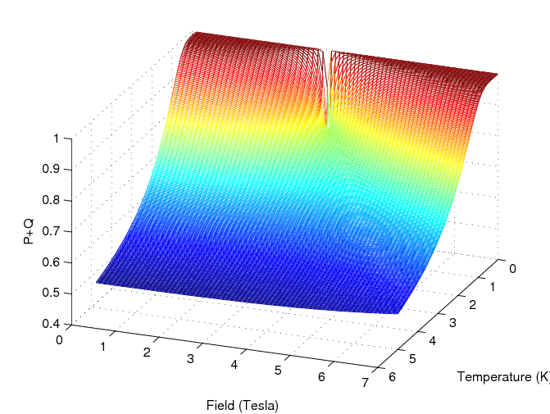
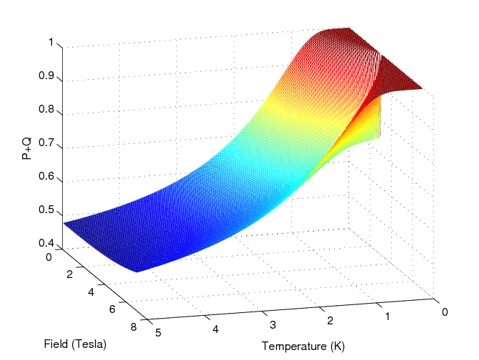

Slide 39
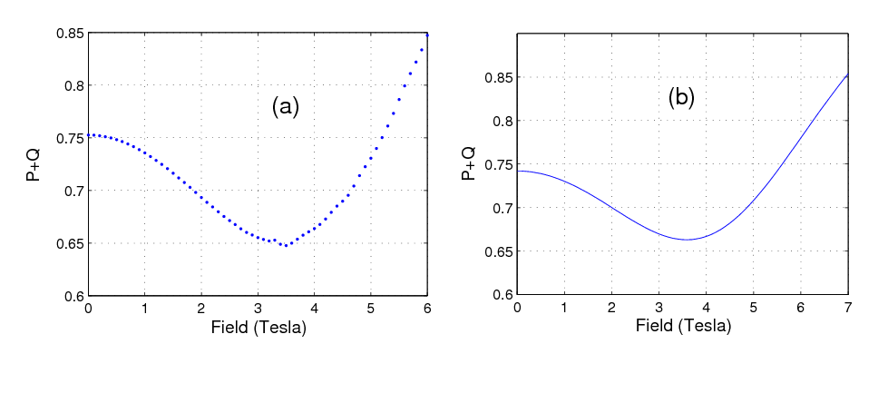
Theoretical and Experimental P+Q at T=1.8
NJP 15, 013047 (2013); Das, Singh, Chakraborty, Gopal, Mitra

Slide 40
Heat Capacity As Entanglement Witness
NJP 15, 0 113001 (2013); Singh, Chakraborty, Das, Jeevan, Tokiwa, Gegenwart , Mitra

Slide 41
Theory
The Hamiltonian is related to heat capacity as
The measure of entanglement is represented by Concurrence C

Slide 42
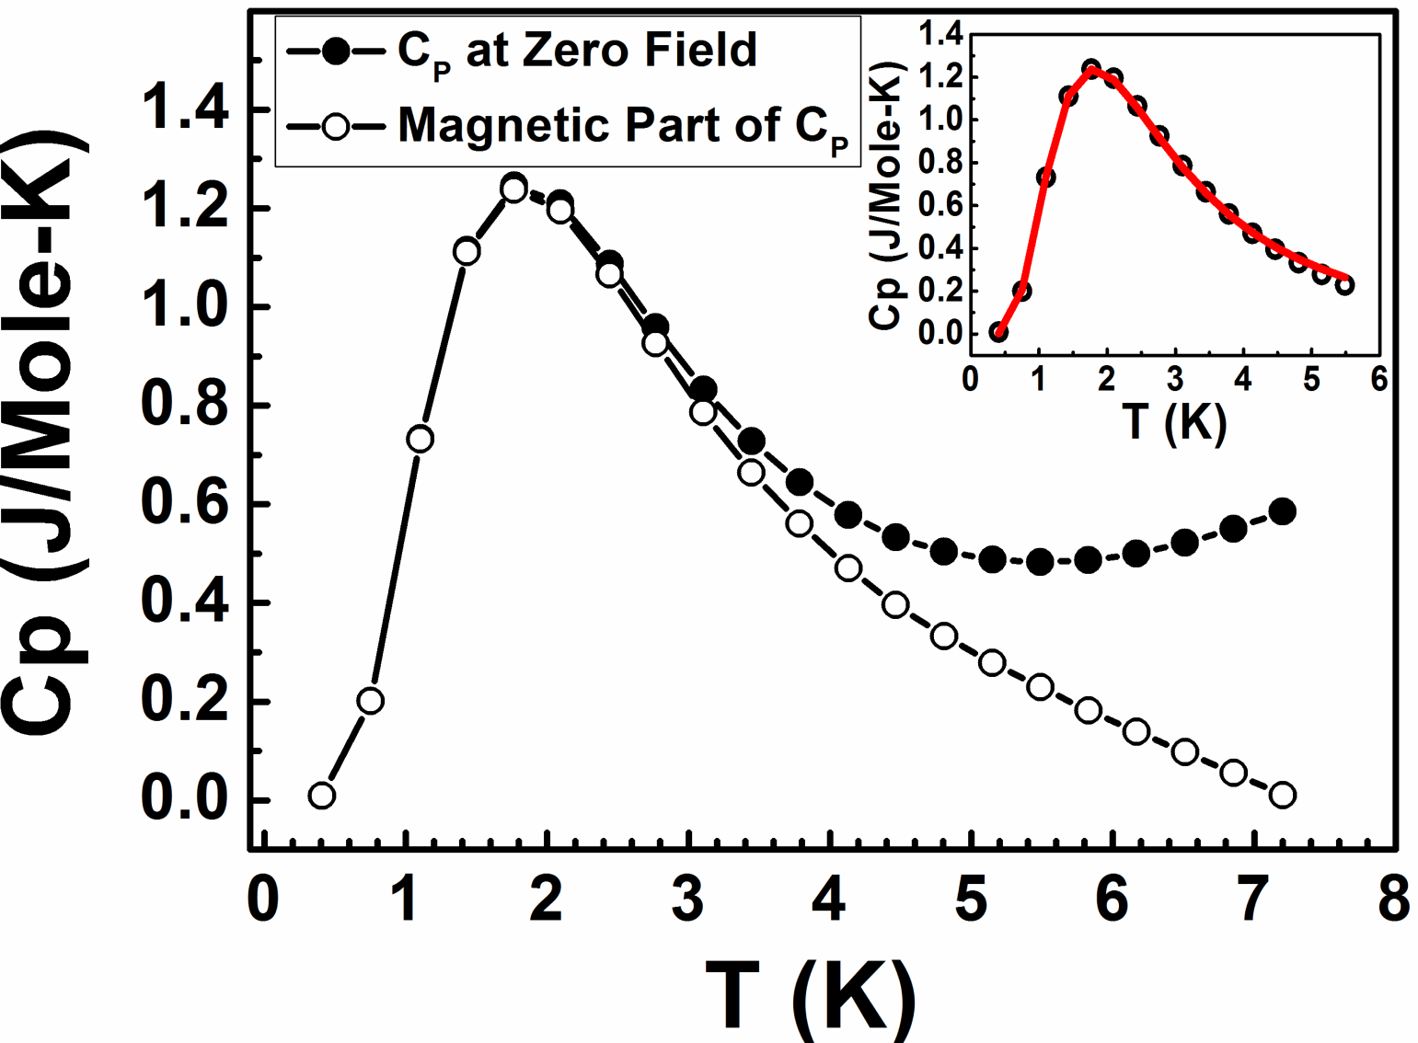
Experimental (heat capacity)
H. Singh, T. Chakraborty, D. Das, H. S. Jeevan, Y. K. Tokiwa, P. Gegenwart and C. Mitra
NJP 15, 0 113001 (2013)

Slide 43
Temperature and Field Dependence

Slide 44
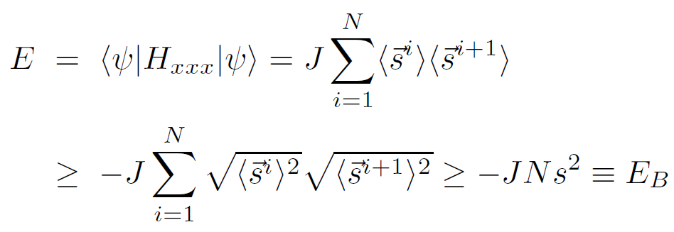
Specific Heat as an entanglement witness
separable region
Entangled
Regime
Wie´s niak M, Vedral V and Brukner C; Phys.Rev.B 78,064108 (2008)

Slide 45
Specific Heat as an entanglement witness
The Hamiltonians and specific heat are related as

Slide 46
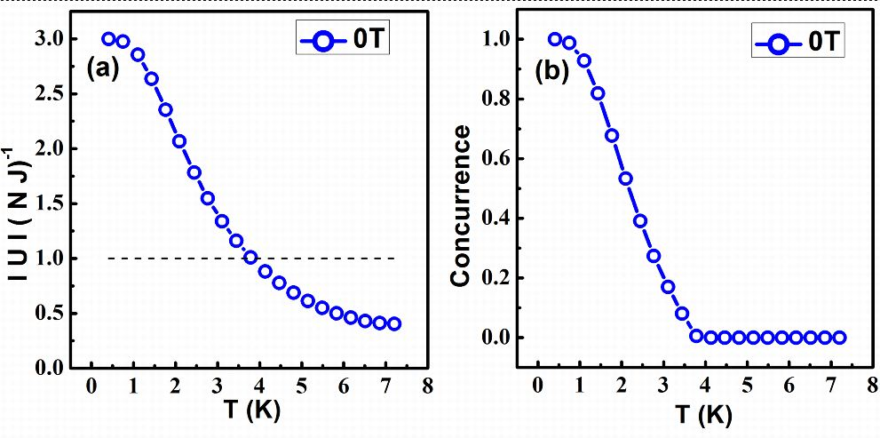
Experimental (heat capacity)…..
U = dC / dT

Slide 47
Theoretical

Slide 48
Temperature and Field Dependence of Internal energy

Slide 49
Entanglement vs. Temperature vs. Field

Slide 50
Specific Heat as a function of field at 0.8 K: QPT
QPT at 0.8K

Slide 51
Heisenberg model
Energy E
Magnetic Field H
Singlet (AF)
No Entanglement for Ferromagnetic ground state

Slide 52
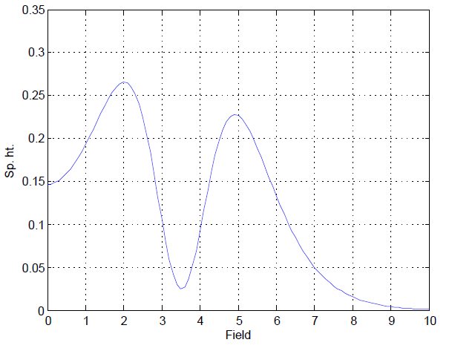
Quantum Phase Transition
Experiment
Theory
QPT at 0.8K

Slide 53
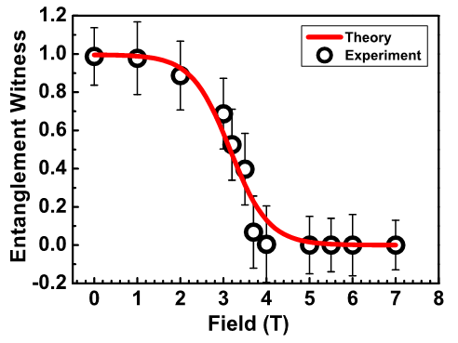
Entanglement across QPT
T=0.8 K

Slide 54
Estimation of Quantum Discord In Copper Nitrate

Slide 55
Classically:
Conditional Entropy : Information about A for a given B (when Y is known or H(Y) is known)
Mutual information : correlation between two random variables(common information of X and Y)
Classical version of mutual information
Quantum Discord

Slide 56
Quantum Versions:
Shanon entropy von Neumann entropy
Conditional Entropy
Mutual information
Classical information
Quantum Discord
Ref: H. Olliver and W. H. Zurek, Phys. Rev. Lett. 88, 017901 (2001).
Ref: A. Datta and A. Shaji, C. Caves Phys. Rev. Lett. 100 , 050502 (2008).

Slide 57
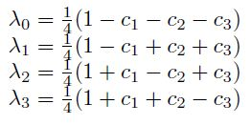
The two particle density matrix is of the form
The eigenvalues of are
classical correlation given by
Mutual information takes the form
Eventually, the mathematical expression for QD can be written as
A K Pal and I Bose J. Phys. B 44 045101 (2011).

Slide 58
considering the standard basis of a two qubit system {|00>, |01>, |10>, |11>}, the density matrix can be defined as,
Where G is defined as the two-site spin-spin correlation function given by,
The analytical relations of quantum mutual information (I) and total classical correlation (C) with G can be written as
Hence, with the given value of G, one can easily obtain the amount of QD present in a certain system at finite temperature using the relation
S Luo 2008 Phys. Rev. A 77 042303.
M A Yurischev Phys. Rev. B 84 024418 (2011).

Slide 62
Conclusion and future directions
AF Ground state of a quantum mechanical spin system is entangled
Magnetic susceptibility can be used as a macroscopic entangled witness
Using quantum mechanical uncertainty principle for macroscopic observables, it is possible to throw light on quantum correlations close to QPT.
Specific heat measurements at low temperatures explicitly capture the QPT.
Specific Heat is an Entanglement Witness
Quantum Discord can be quantified using magnetic susceptibility and heat capacity data.
Quantum Discord to be used to capture QPT in spin systems.

Slide 63
Collaborators
Tanmoy Chakraborty
Harkirat Singh
Diptaranjan Das
Sourabh Singh
Radha Krishna Gopal
Philipp Gegenwart

