Slide 1
Measurements of the UVB using the proximity effect at z > 5
ALEX CALVERLEY
In collaboration with George Becker (ioA), Martin Haehnelt (IoA) and Jamie Bolton (University of Melbourne)
Cosmological Reionization
Allahabad, India
16th Feb 2010

Slide 2
INTRODUCTION
What is the Ultraviolet Background (UVB) ?
Measurements of the UVB at z>5
What does it tell us?
Alex Calverley (IoA, Cambridge)
Shape and intensity → sources of UV
Redshift evolution → changes in emissivity, or in λ_{mfp} (observational evidence for end of EoR?)

Slide 3
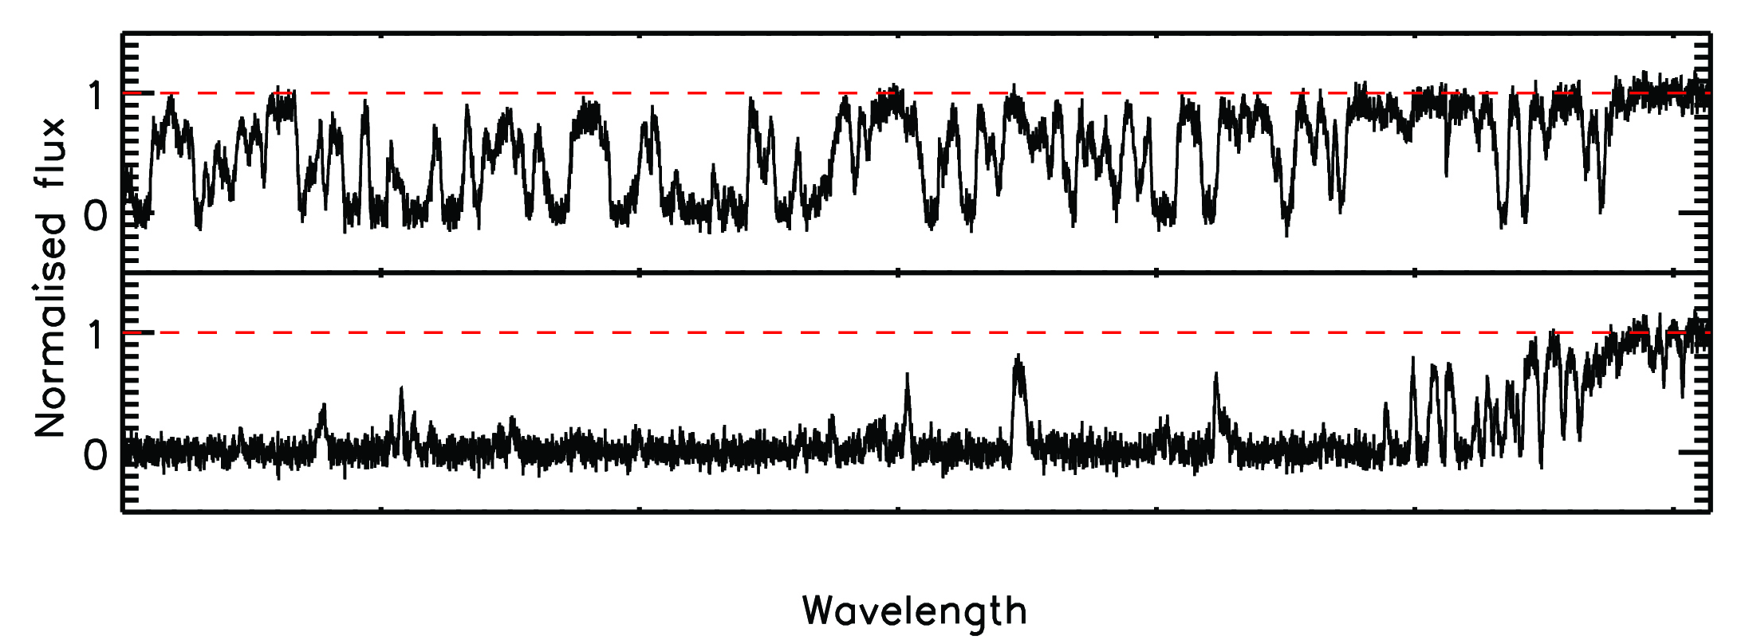
INTRODUCTION
Two main methods to measure UVB:
Flux Decrement
Proximity Effect
Measurements of the UVB at z>5
Alex Calverley (IoA, Cambridge)
z = 4
z = 6

Slide 4
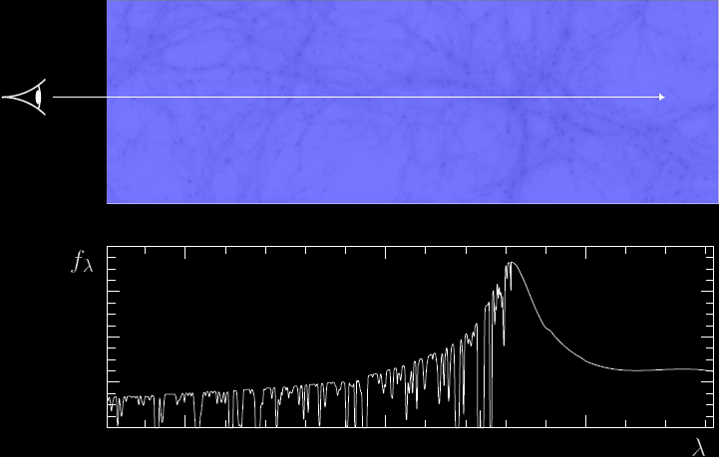
PROXIMITY EFFECT
Measurements of the UVB at z>5
Alex Calverley (IoA, Cambridge)
Credit: Lutz Wisotzki

Slide 5
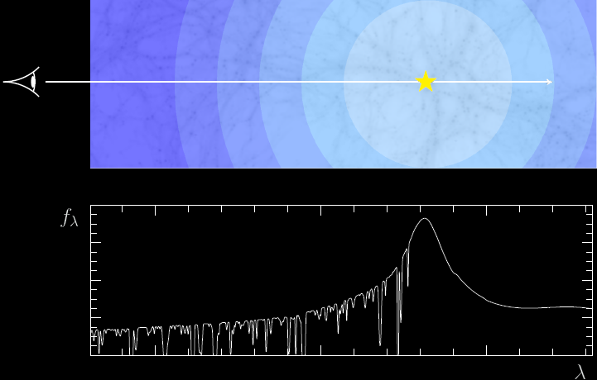
PROXIMITY EFFECT
Measurements of the UVB at z>5
Alex Calverley (IoA, Cambridge)
Credit: Lutz Wisotzki

Slide 6
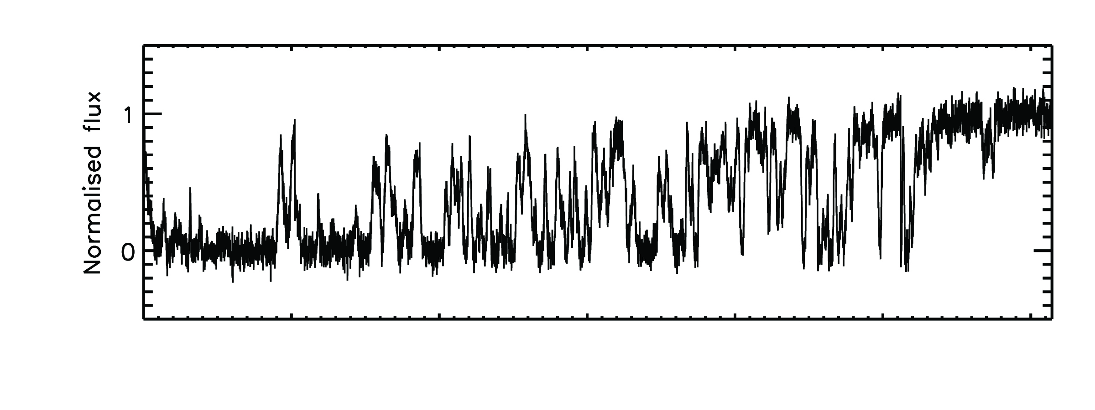
PROXIMITY EFFECT
Two ways of measuring the proximity effect
1. Line Counting
(Bajtlik, Duncan & Ostriker 1988; Scott et al 2000, 2002)
Many strong lines (~7)
Few strong lines (~2)
Measurements of the UVB at z>5
Alex Calverley (IoA, Cambridge)
z = 5

Slide 7
PROXIMITY EFFECT
Two ways of measuring the proximity effect
2. Flux Transmission
(Liske & Williger 2001; Becker et al 2007; Dall’Aglio et al 2008, 2009)
Average flux ~0.5
Average flux ~0.9
Measurements of the UVB at z>5
Alex Calverley (IoA, Cambridge)
z = 5

Slide 8
INTRODUCTION
Two main methods to measure UVB:
Flux Decrement
Proximity Effect
Measurements of the UVB at z>5
Alex Calverley (IoA, Cambridge)
z = 4
z = 6

Slide 9
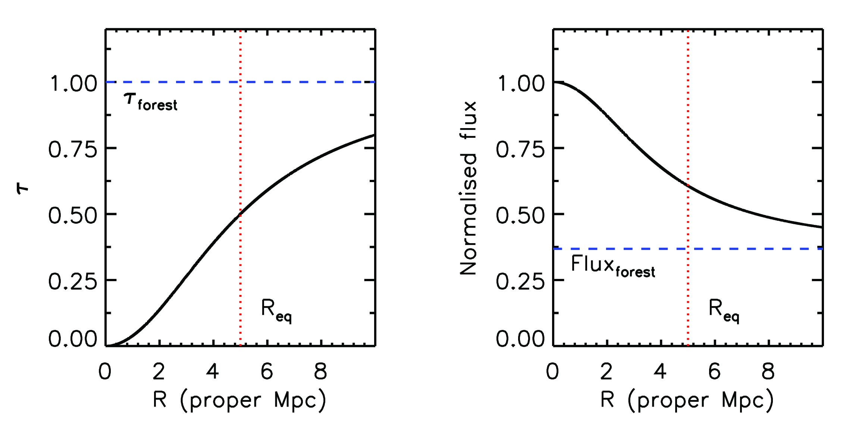
METHOD
Measurements of the UVB at z>5
Alex Calverley (IoA, Cambridge)
Define R_{eq} as (LoS) distance where photoionization rate from quasar equals that of the background

Slide 10
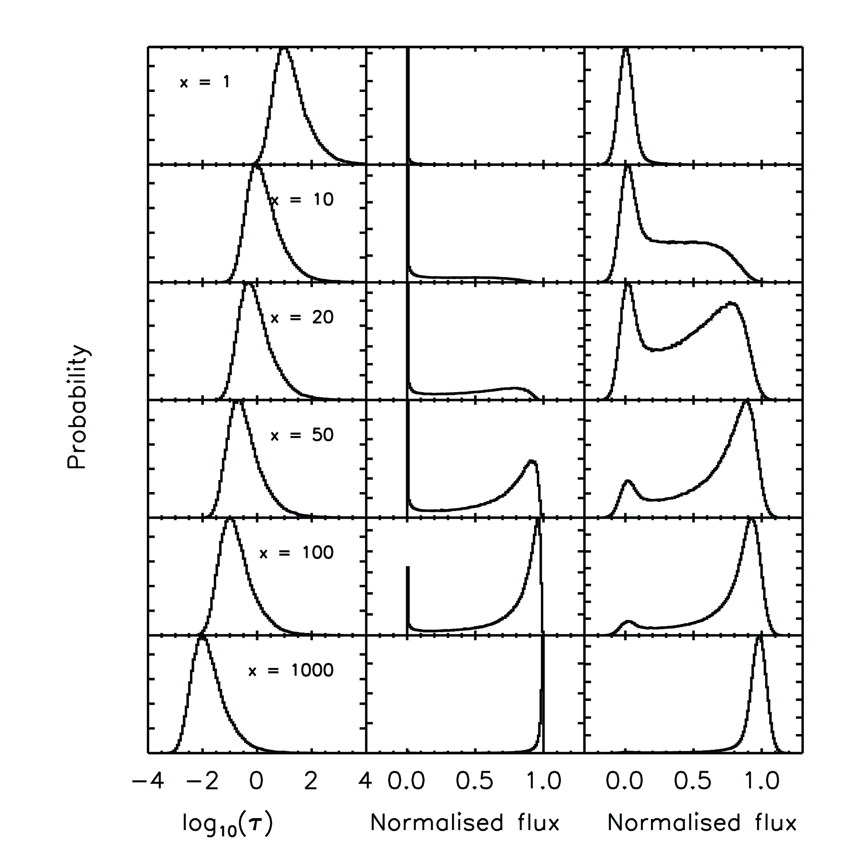
METHOD
x =
For a trial R_{eq} can get a probability for measuring the flux of each pixel in a spectrum
Measurements of the UVB at z>5
Alex Calverley (IoA, Cambridge)

Slide 11
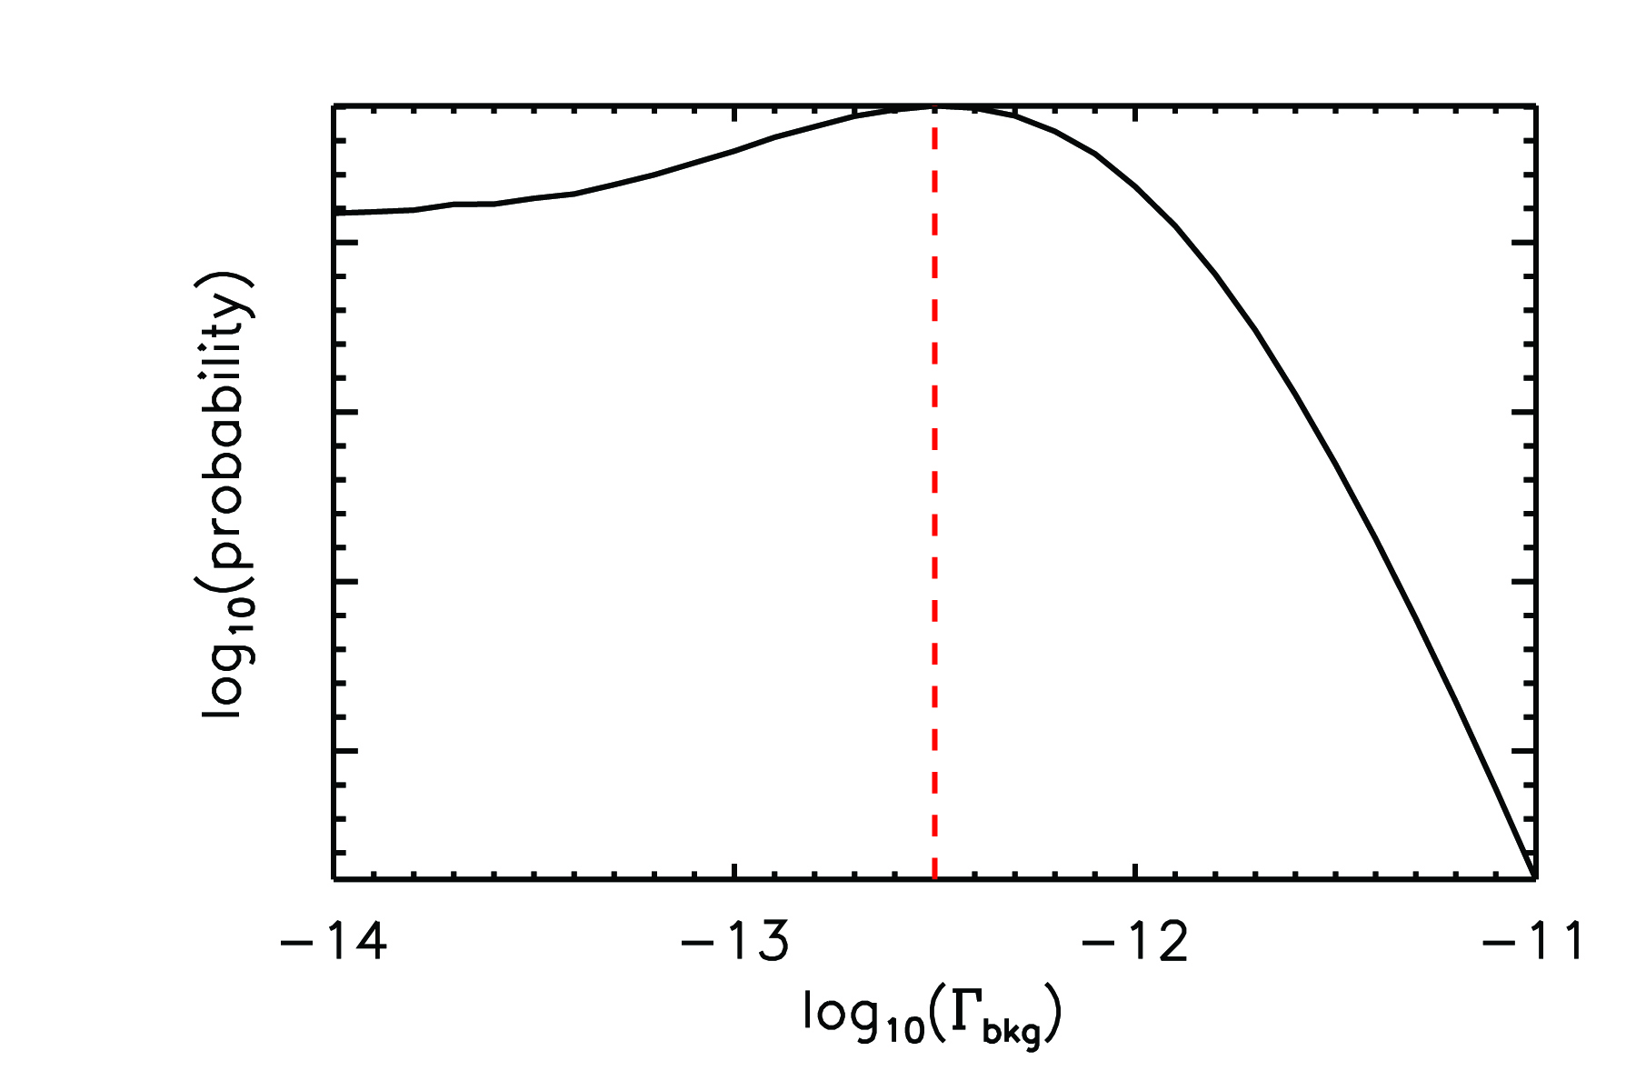
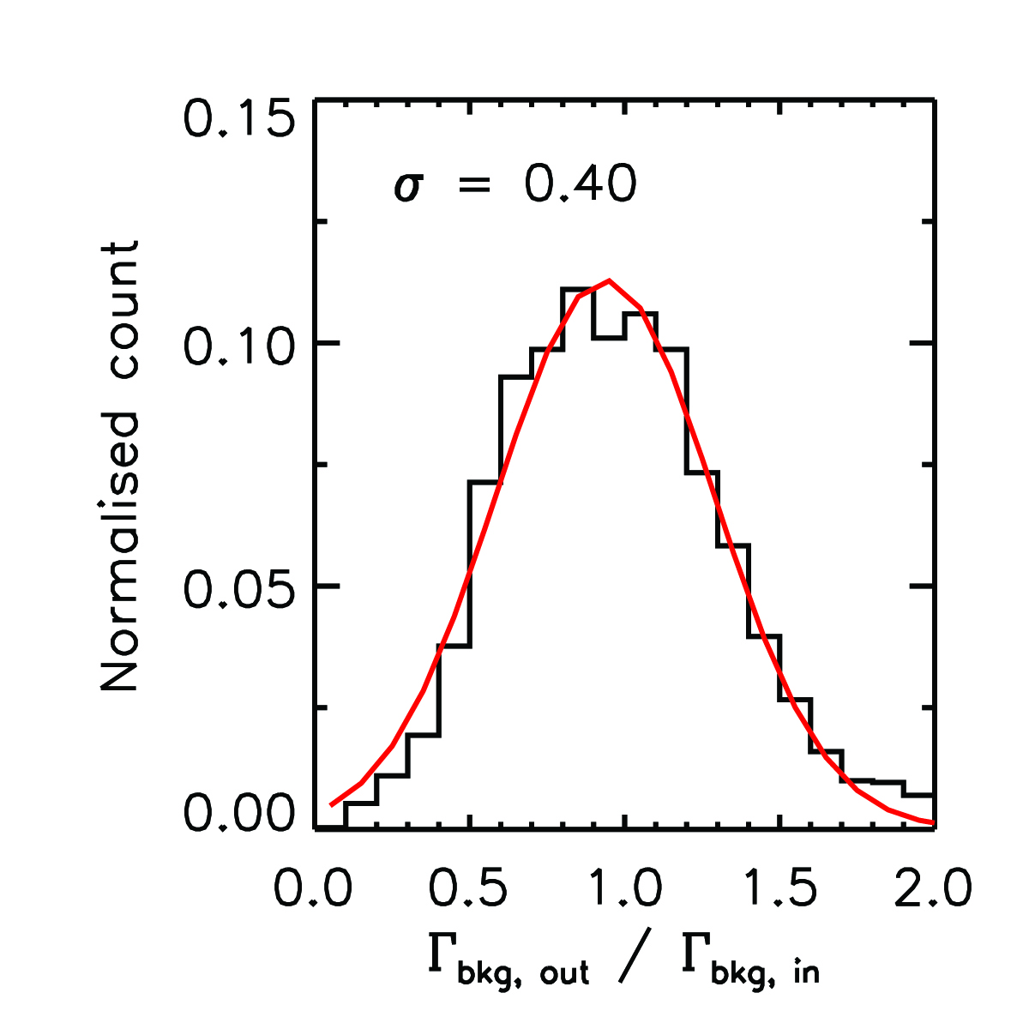
METHOD
Γ_{bkg} = Γ_{Q}(R_{eq}) ∝ Luminosity × (R_{eq})⁻²
Trial Γ_{bkg} + known L
Trial R_{eq}
Use a Maximum Likelihood method to find the best fitting value of Γ_{bkg}
Measurements of the UVB at z>5
Alex Calverley (IoA, Cambridge)

Slide 12
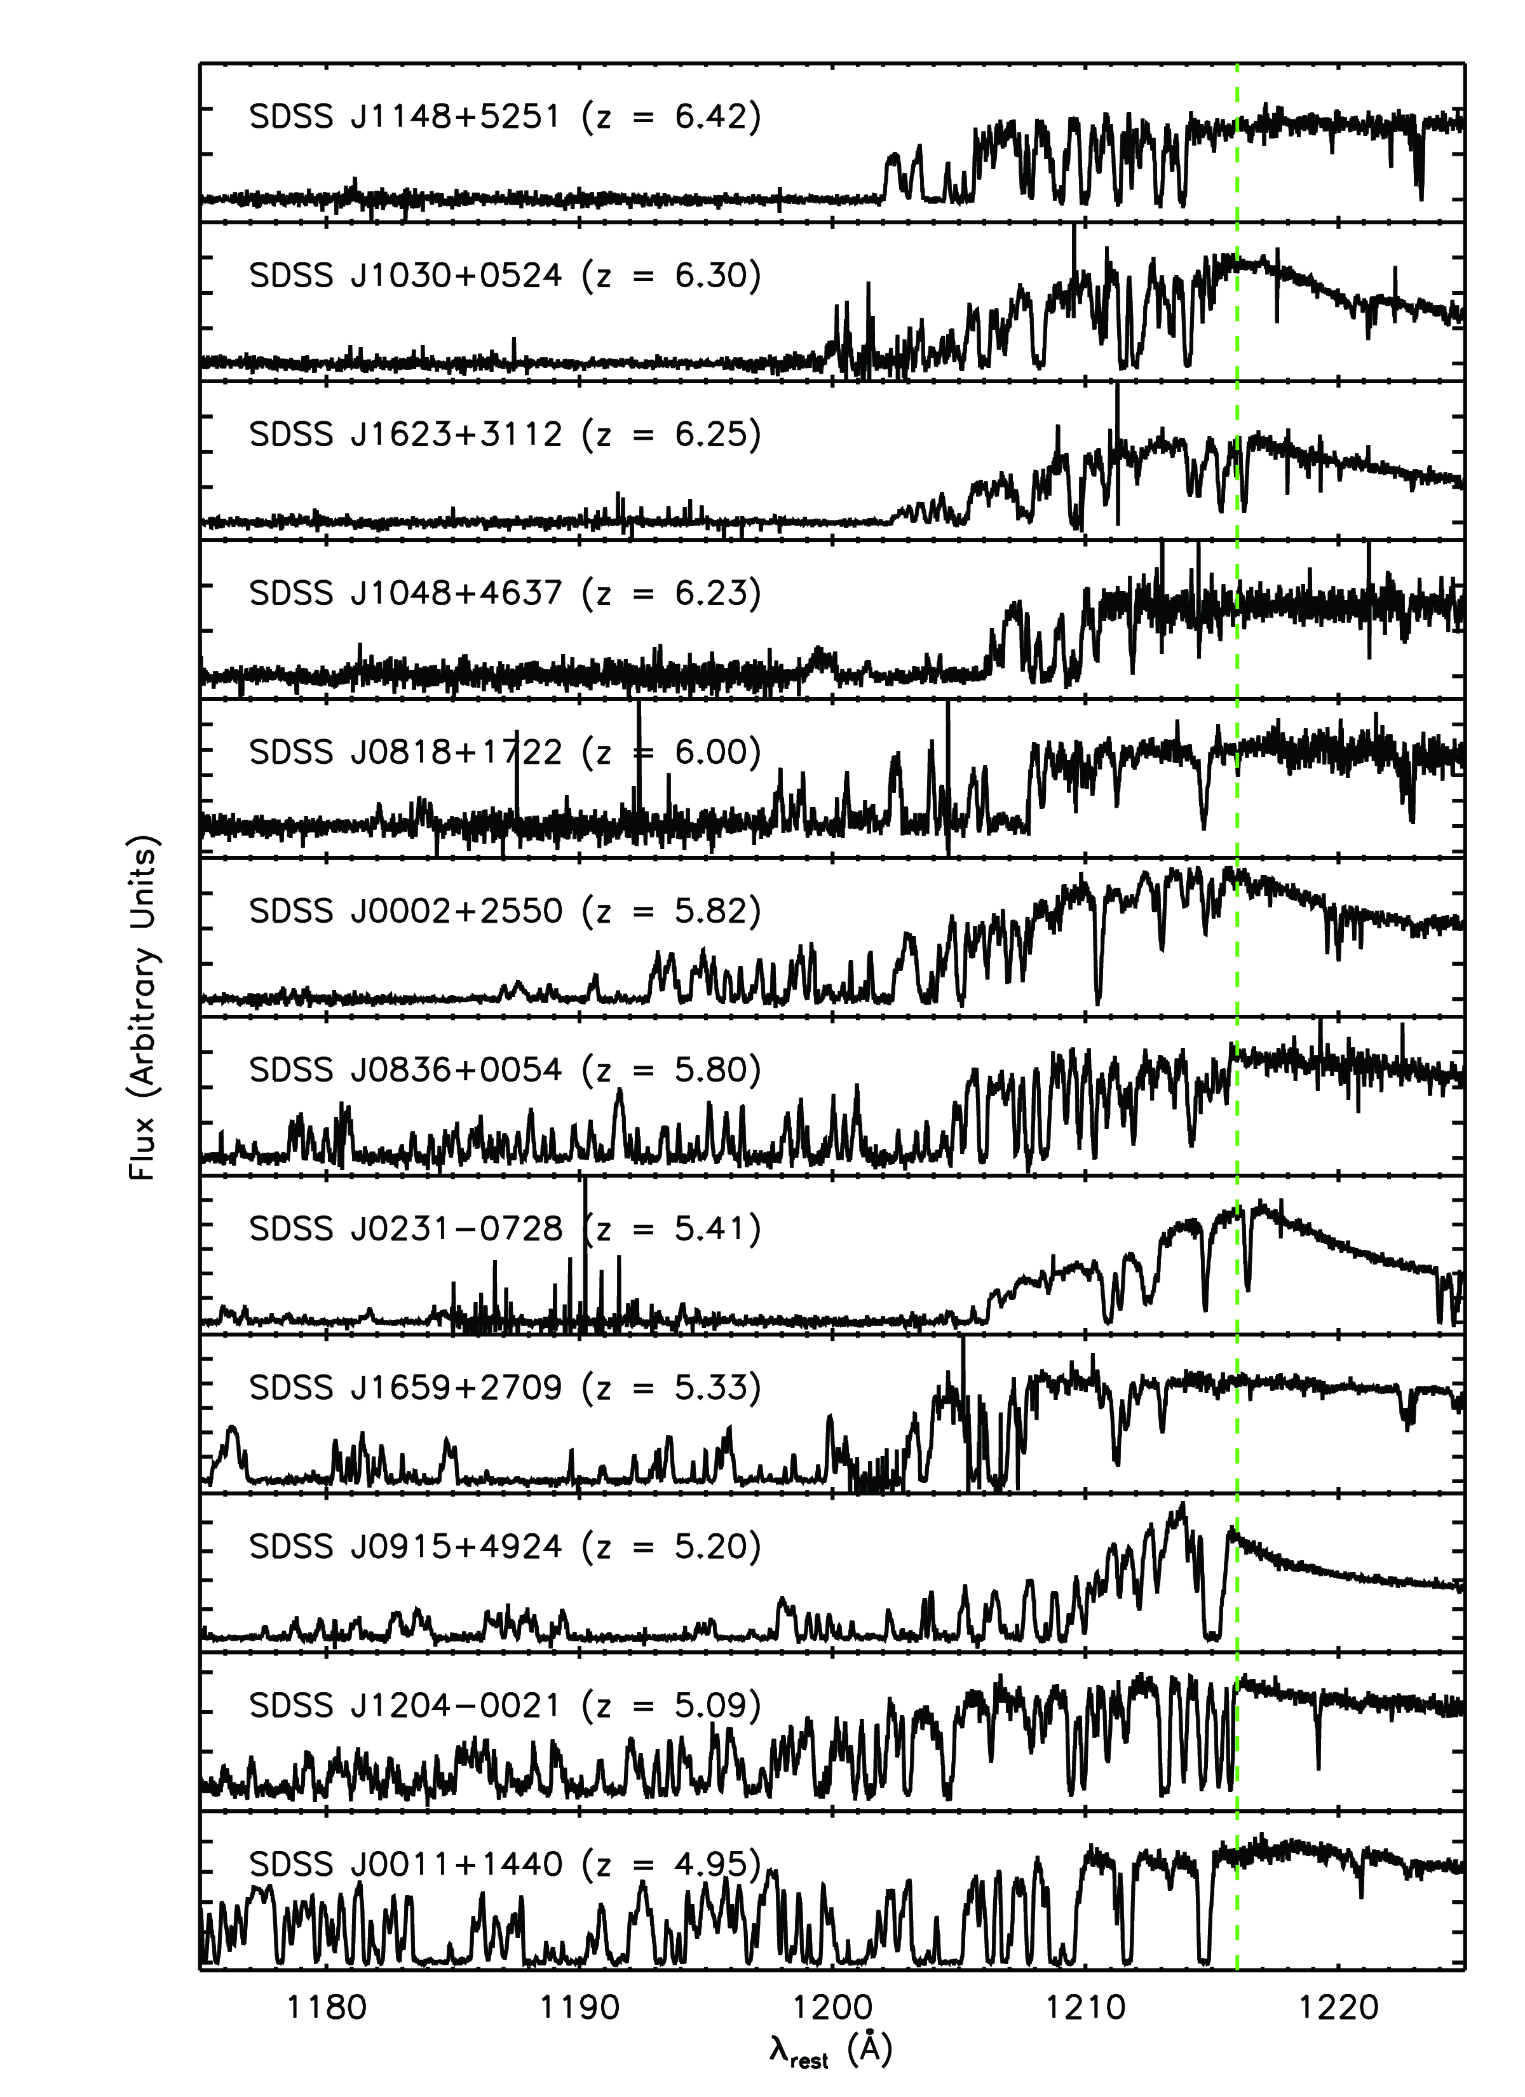
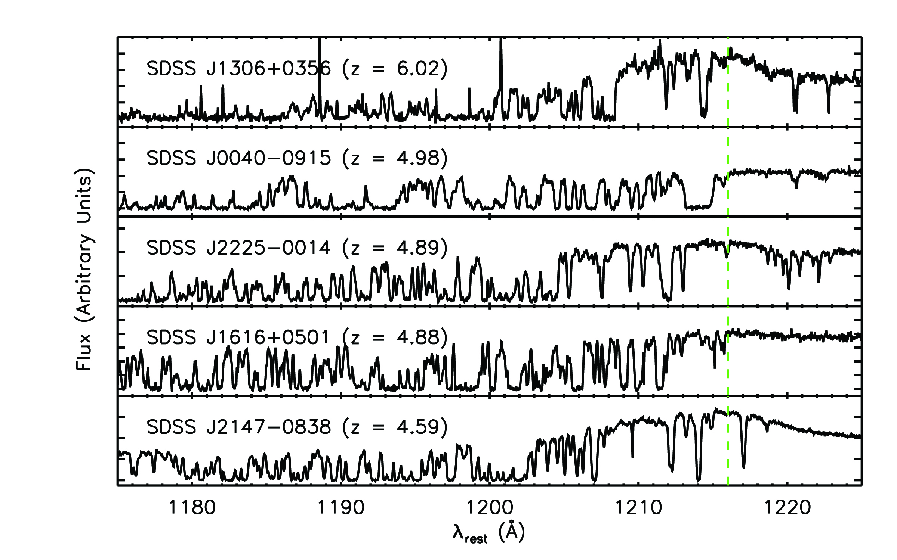
DATA
Measurements of the UVB at z>5
Alex Calverley (IoA, Cambridge)
5 spectra from MIKE on MAGELLAN
12 spectra from HIRES on KECK
Continuum fit using a power law and B-spline fit

Slide 13
SIMULATIONS
From Bolton & Becker (2009)
Smoothed particle hydrodynamics
20 comoving Mpc box
2 × 400³ particles
Output at z = 2, 3, 4, 5 and 6
1024 sightlines, 1024 pixels long
Measurements of the UVB at z>5
Alex Calverley (IoA, Cambridge)
Credit: Joerg Colberg, Virgo Consortium
USED FOR FOREST OPTICAL DEPTH DISTRIBUTION

Slide 14
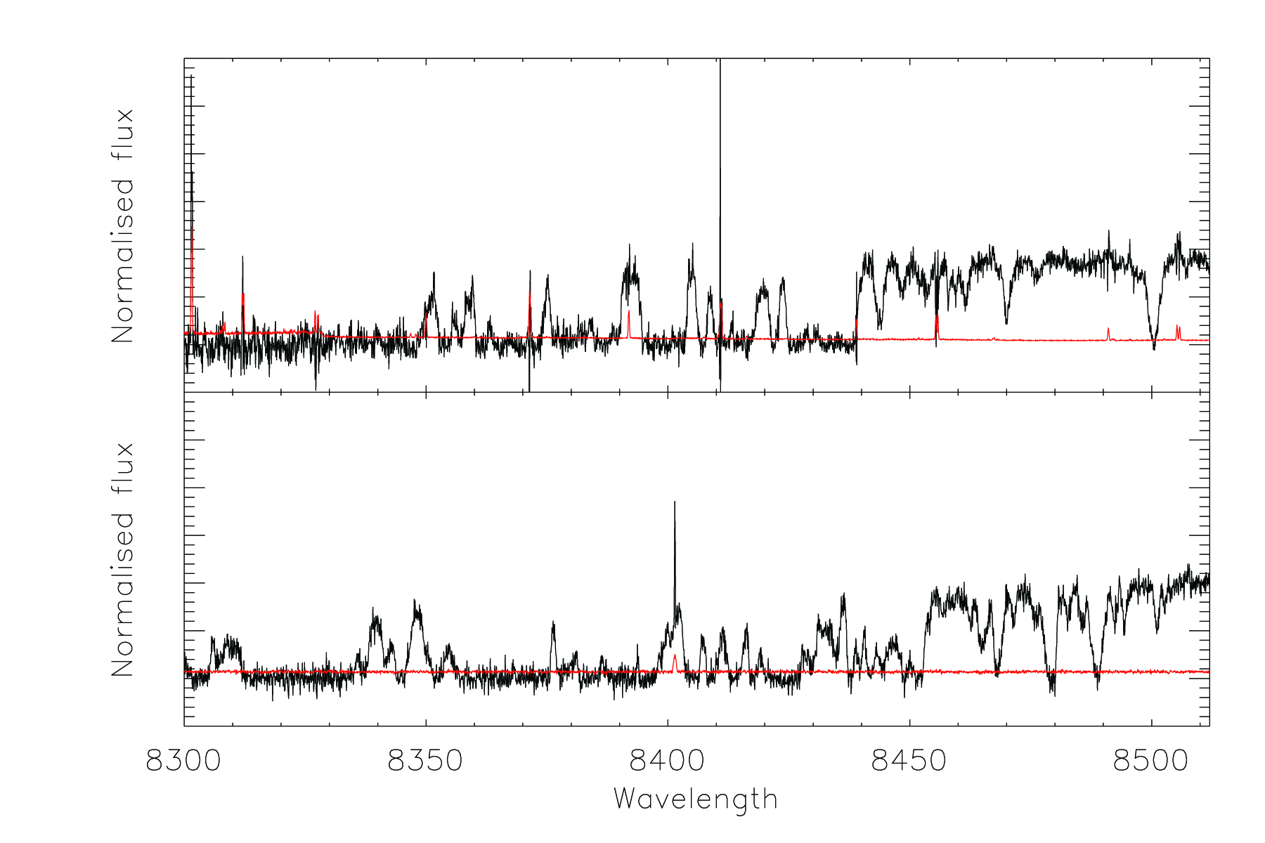
COMPARISON
REAL
Measurements of the UVB at z>5
SIMULATED
Alex Calverley (IoA, Cambridge)

Slide 15
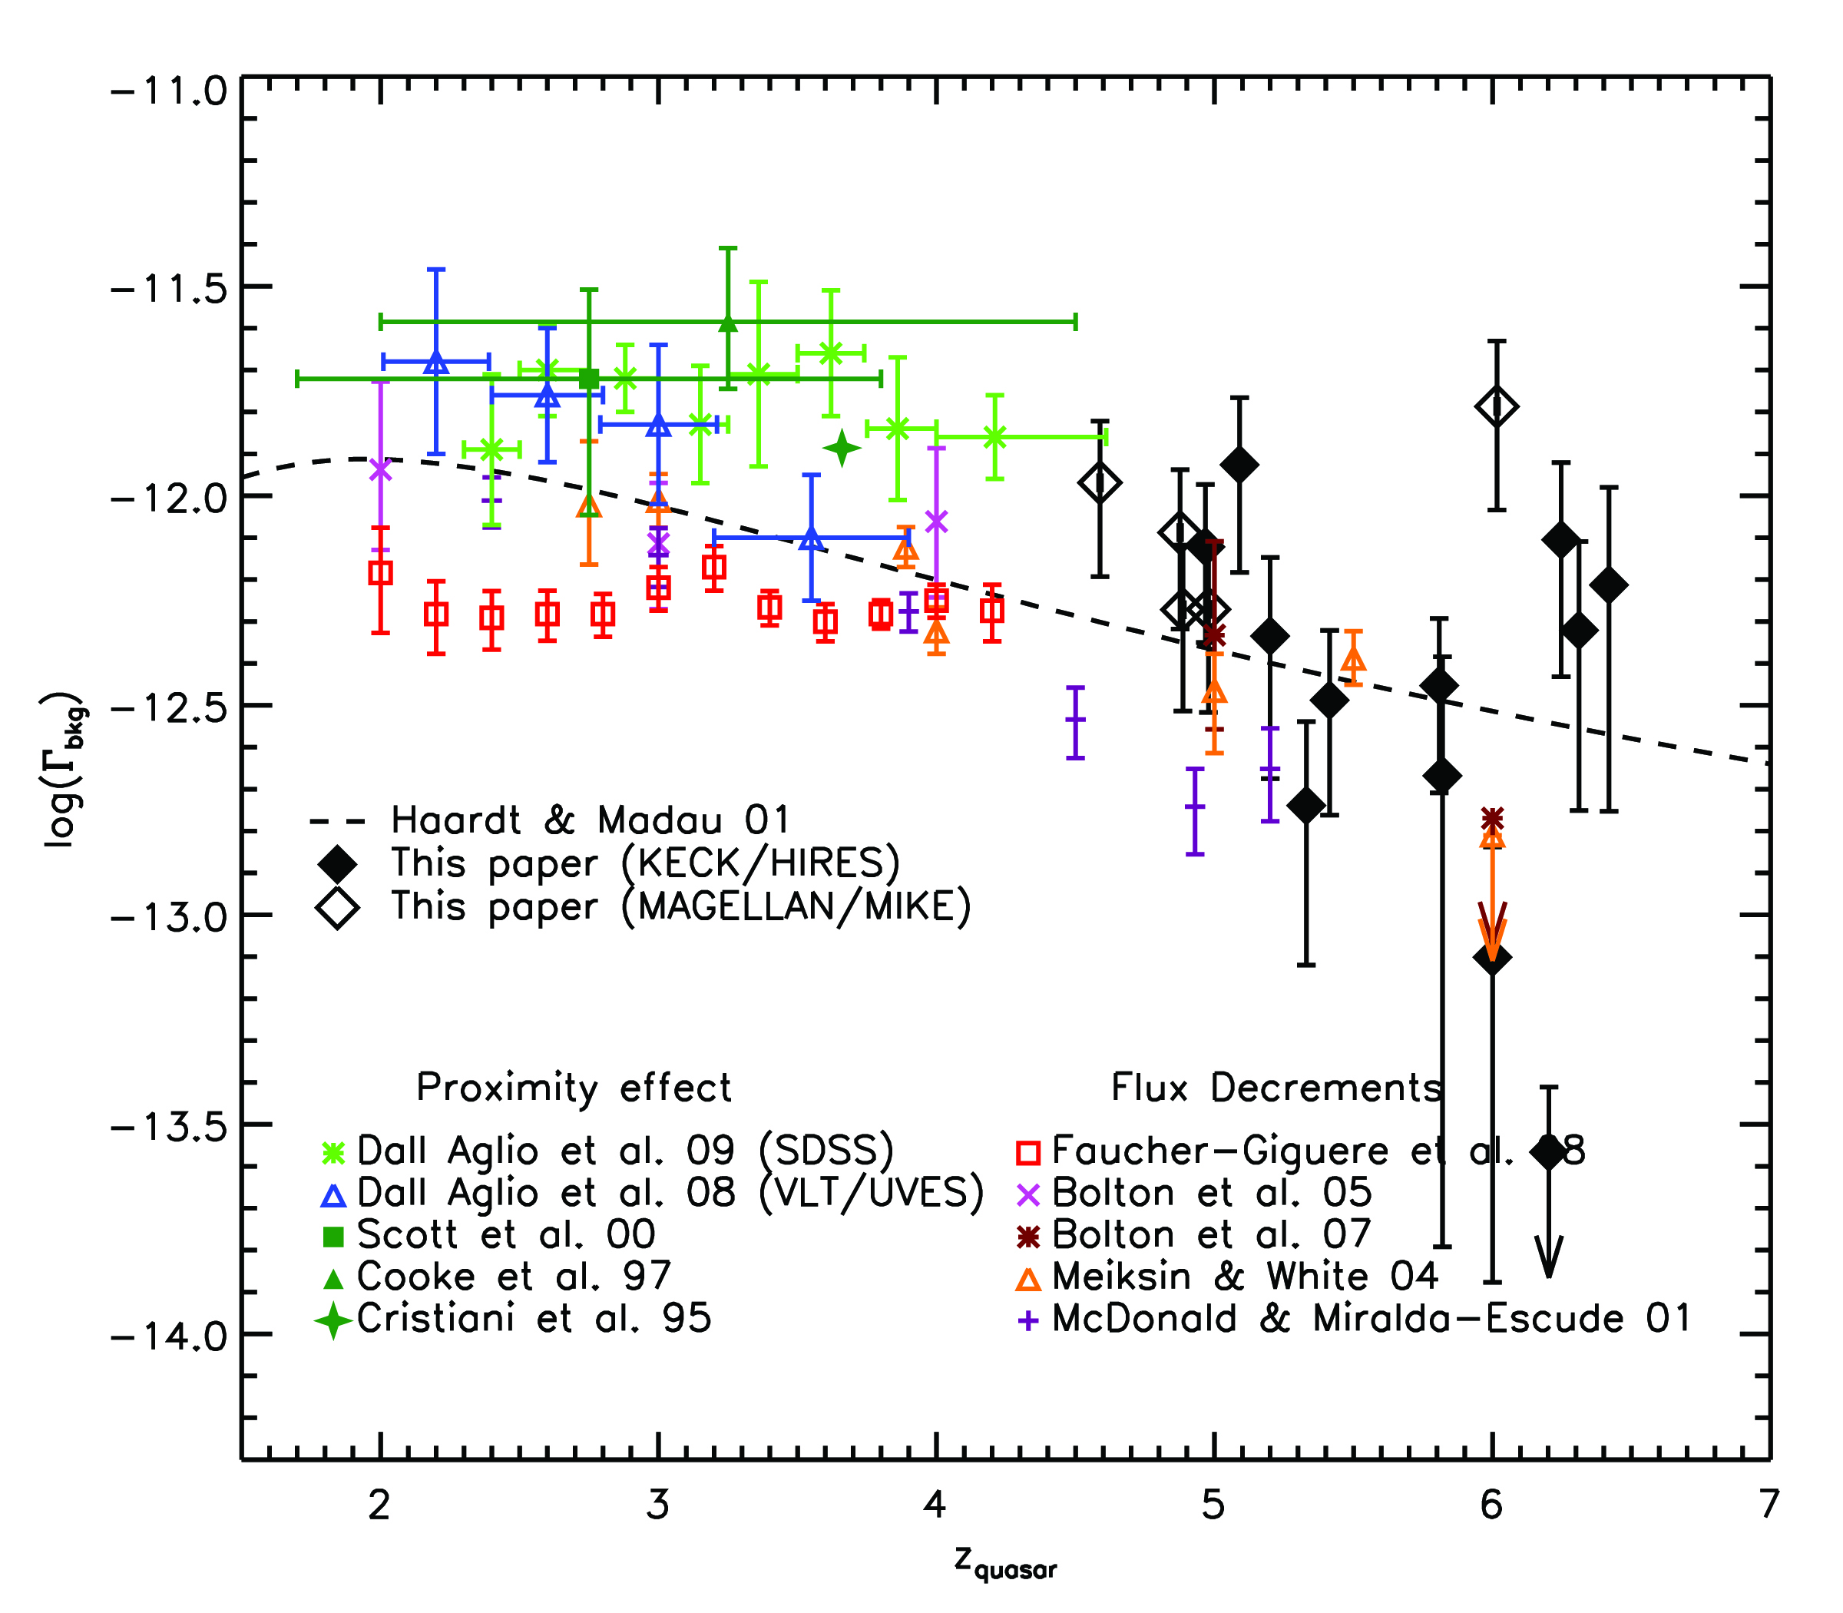
RESULTS
INDIVIDUAL QUASARS
Measurements of the UVB at z>5
Alex Calverley (IoA, Cambridge)
1 σ errors

Slide 16
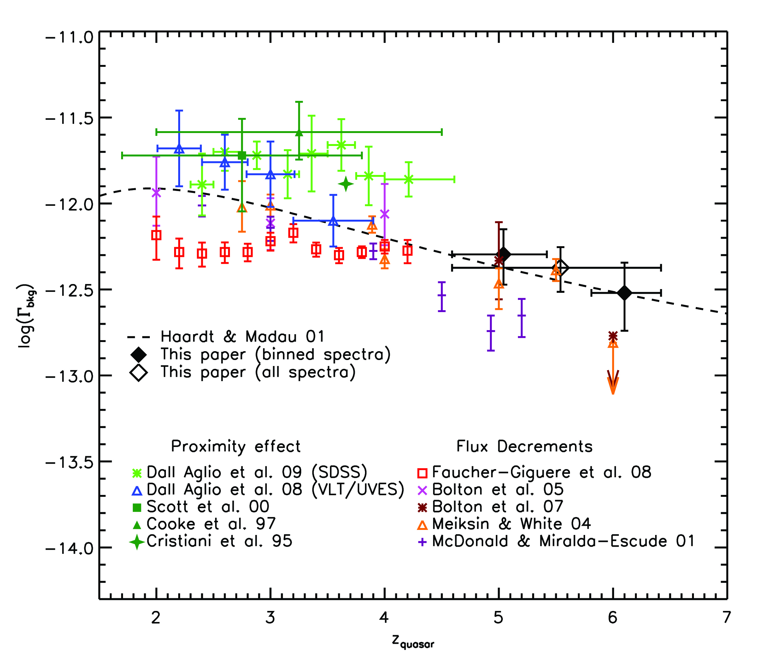
RESULTS
BINNED WITH CONSTANT UVB
Measurements of the UVB at z>5
Alex Calverley (IoA, Cambridge)
2 σ errors

Slide 17
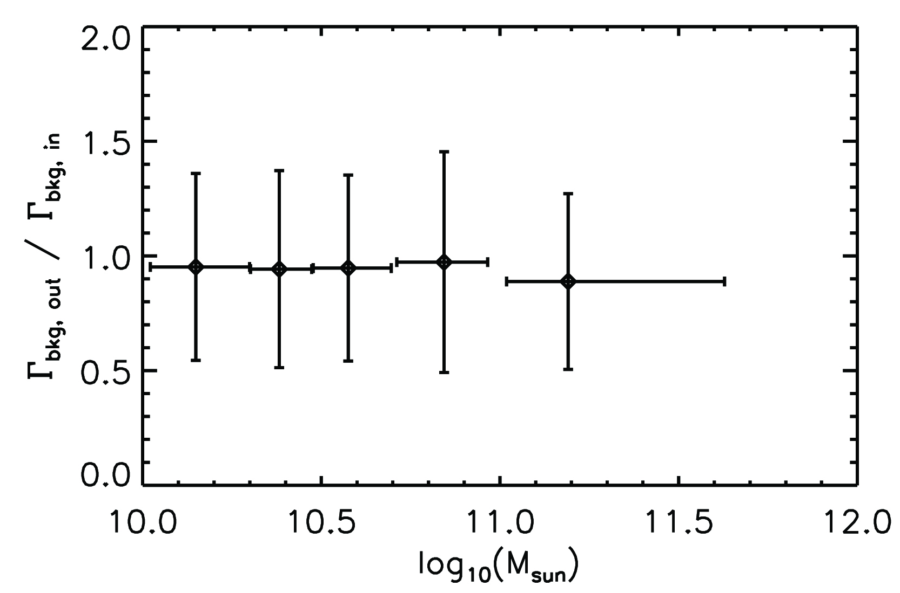
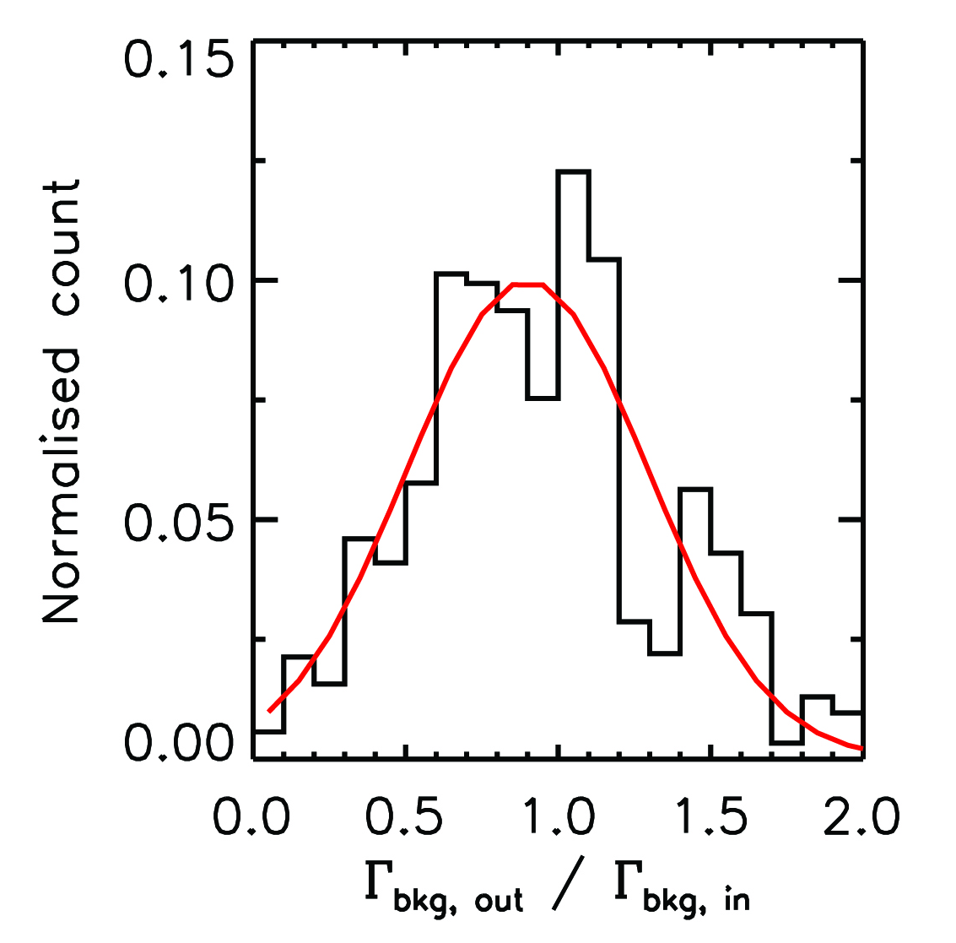
RESULTS
Effect of quasars lying in overdensities?
Sightlines drawn in the x, y and z directions through the 500 most massive (by total mass) haloes in the simulation box
Measurements of the UVB at z>5
Alex Calverley (IoA, Cambridge)
No apparent mass dependence at z=6!

Slide 18
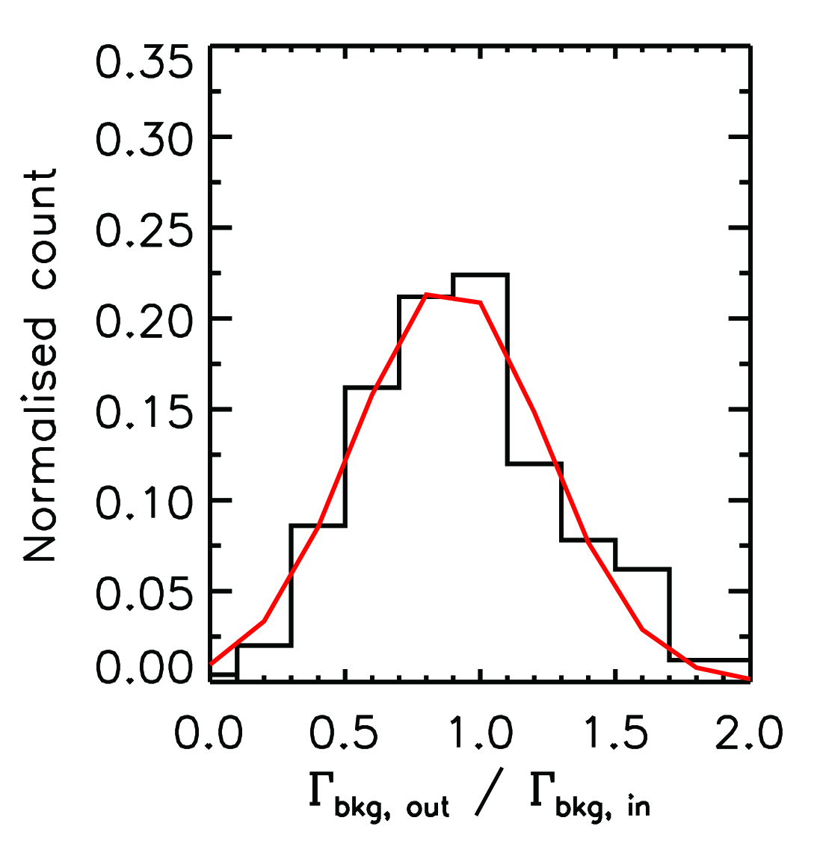
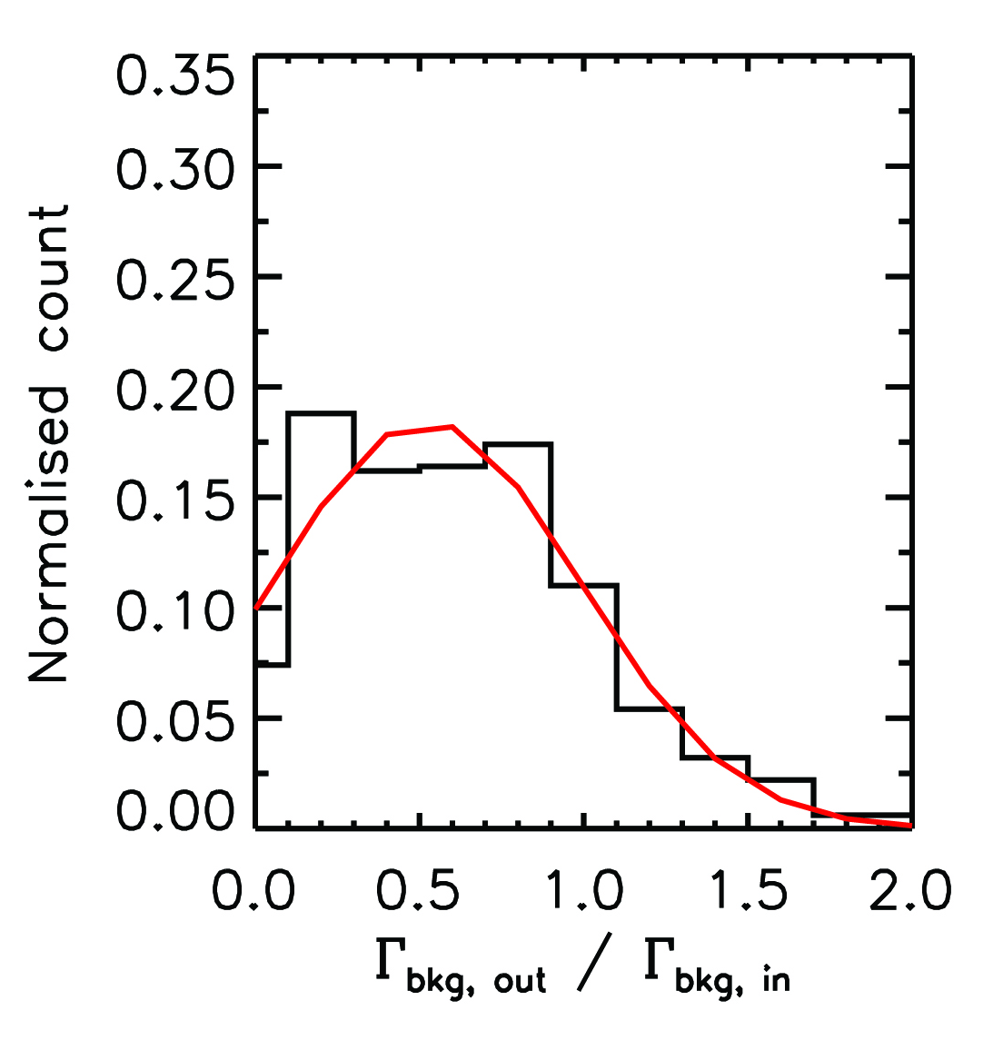
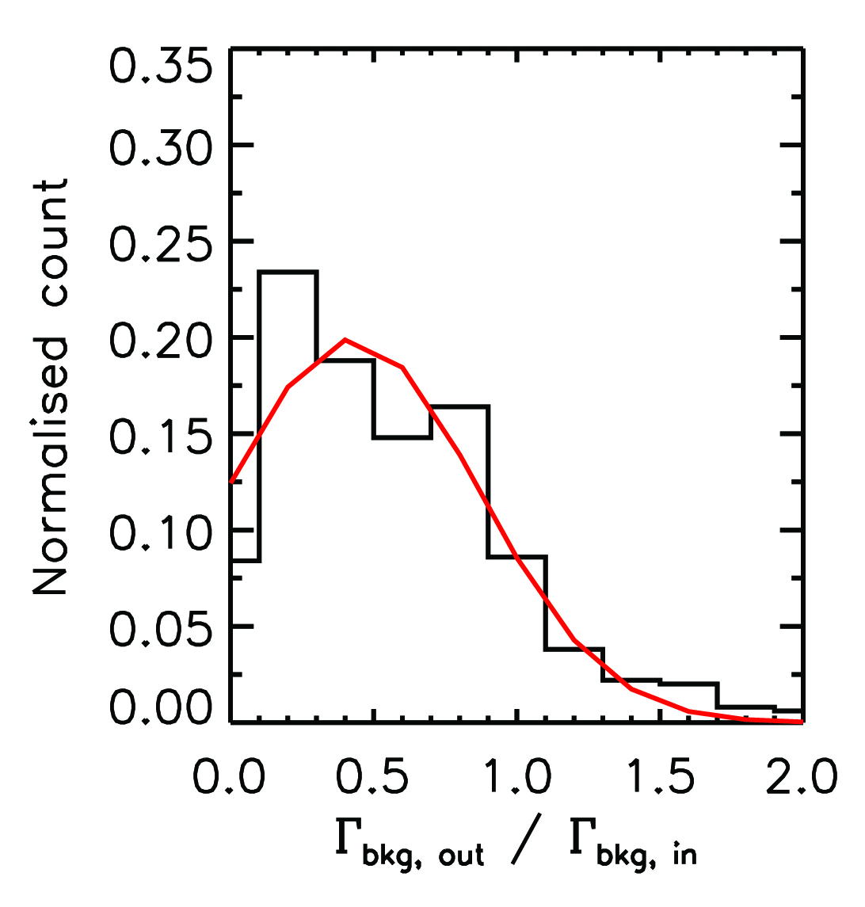
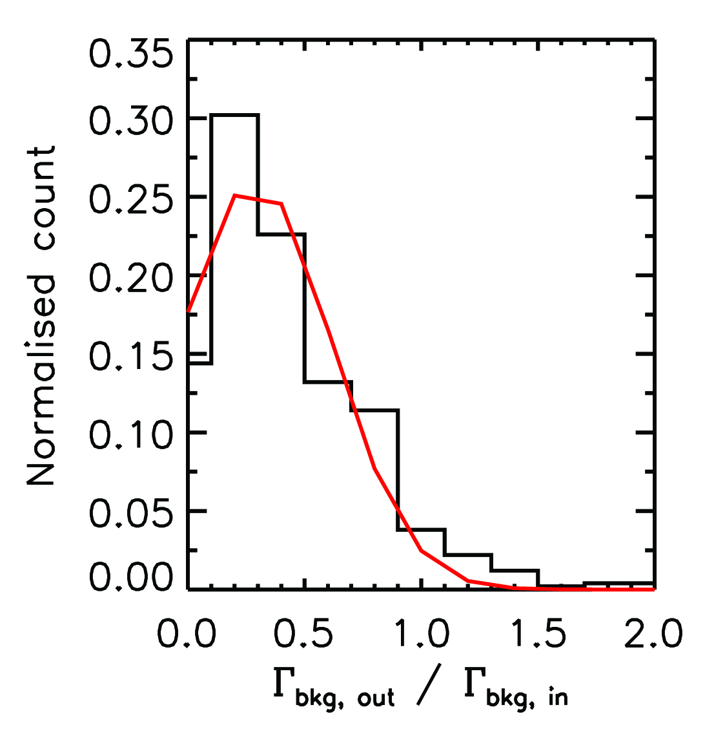
RESULTS
Effect of Lyman Limit Systems?
Number of LLS per simulated sightline calculated using both the formulas of Storrie-Lombardi et al. 1994 and Péroux et al. 2003
Put in to the simulated spectra using the method of Bolton & Haehnelt 2007
Measurements of the UVB at z>5
Alex Calverley (IoA, Cambridge)
No LLS
SL94
P03
P03 1σ UL
Worst case: 60% underestimate in Γ -> Move of 0.4 on a log plot

Slide 19
CONCLUSIONS
The Ultraviolet Background was measured using the proximity effect observed in 17 quasars
They are the first proximity effect measurements of Γ_{bkg} at z > 5
A maximum likelihood method based on SPH simulations was used to find the best fitting values of Γ_{bkg}
Little redshift evolution over the entire range probed
Overdensities and Lyman Limit Systems unlikely to change this result
Measurements of the UVB at z>5
Alex Calverley (IoA, Cambridge)

