Slide 1
Helium, dust and frequencies
Recent improvements in SimpleX2
Chael Kruip
Jan-Pieter Paardekooper
Vincent Icke

Slide 2
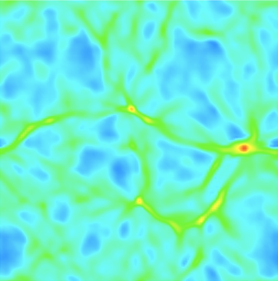
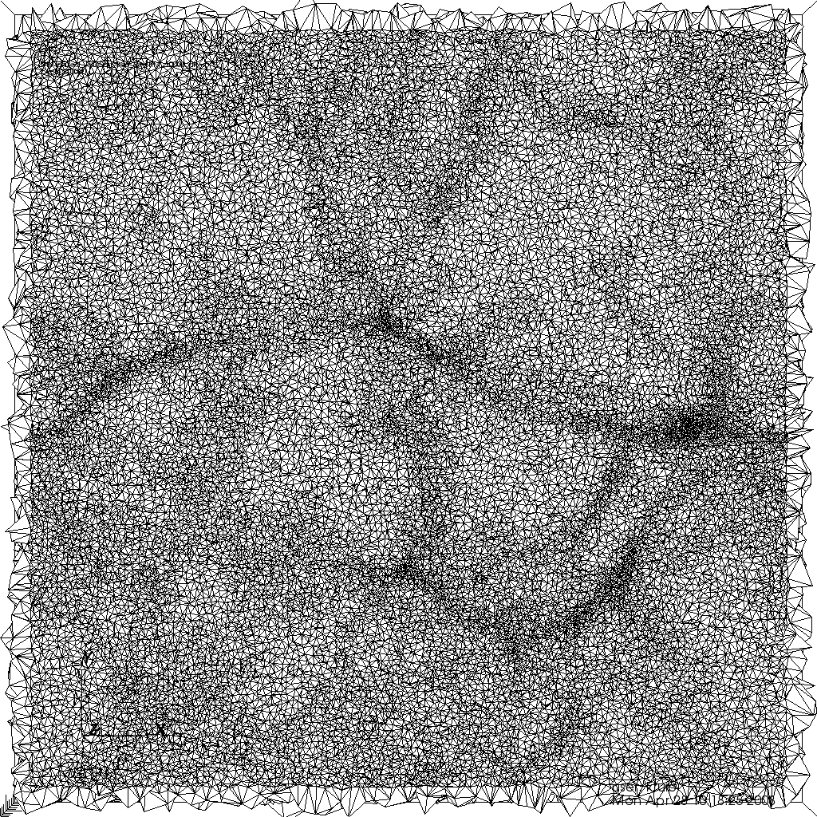
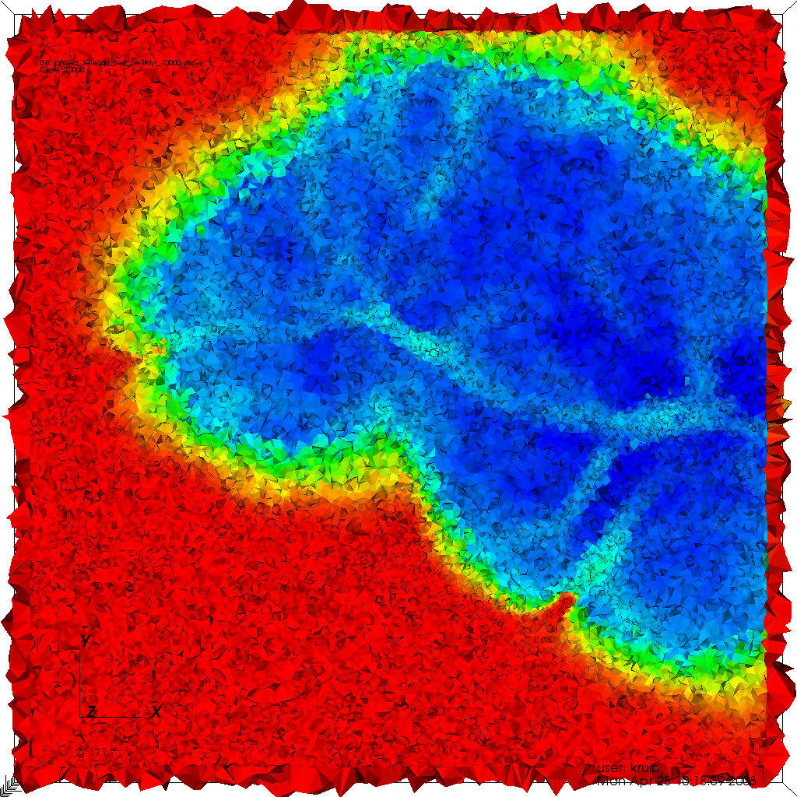
Introduction to SimpleX2
Unstructured (adaptive) Voronoi-Delaunay grid
Point density scales with opacity of the medium
Point-to-point distance is a function of the mean free path
Density field taken from Test 4 in Iliev et al. (2006)
Notes:
We have put considerable effort in the translation between a density field and a point density distribution that generates a suitable grid but I won’t talk about that today.

Slide 3
Introduction to SimpleX2
Radiation travels between nuclei
Diffuse Ballistic Direction conserving

Slide 4
Coupling to hydro-codes
The AMUSE project [Simon Portegies Zwart & Co-workers]
Codes (N-body, stellar evolution, hydro) coupled as modules
First test-bed for SimpleX2-based Radiation-hydro
Need for heating/cooling in SimpleX2

Slide 5
Uncertainties
Rates in literature can differ significantly
Larger uncertainties for He than H.
[Iliev et al. (2006)]

Slide 6
Cross sections
Discrepancies lead to errors of 3(10)% for the effective intensity weighted total cross section for a BB spectrum of 1e4(1e5)K.

Slide 7
HeII recombination cooling

Slide 8
Physical values and rates
Not a canonical set of values:

Slide 9
H & He
Comparison with CLOUDY
Using a 1D code to eliminate possible RT effects
Constant temperature (1e4 K)
nH = 1e-3 cm⁻³ , nHeI = 0.1 nH
1e5 K BB-source with 5e48 ionizing photons per second
500 Myr evolution

Slide 10
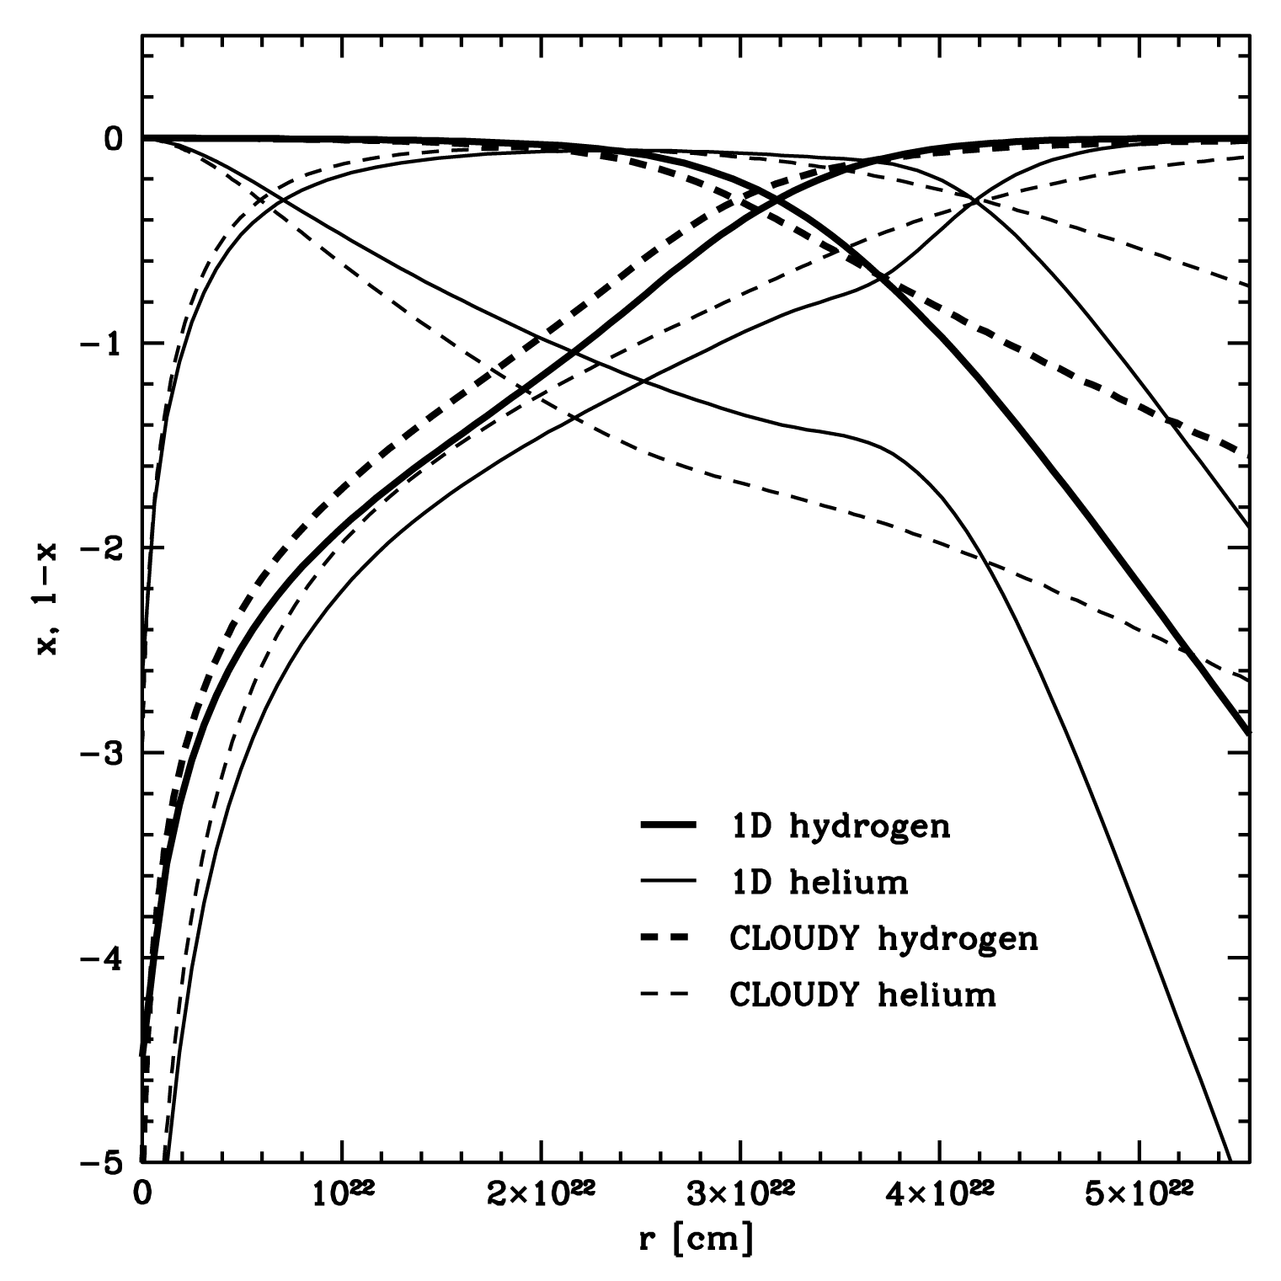
H & He

Slide 11
H & He
More realistic coupling between species by adopting the model from Flower & Perinotto (1980) which incorporates
Ground state recombination photons of HII, HeII and HeIII
Recombinations to excited states of HeI, followed by cascade
HeII Ly-α photons
HeII Balmer continuum photons
Two photon decay from HeII in the 2s ²S state

Slide 12
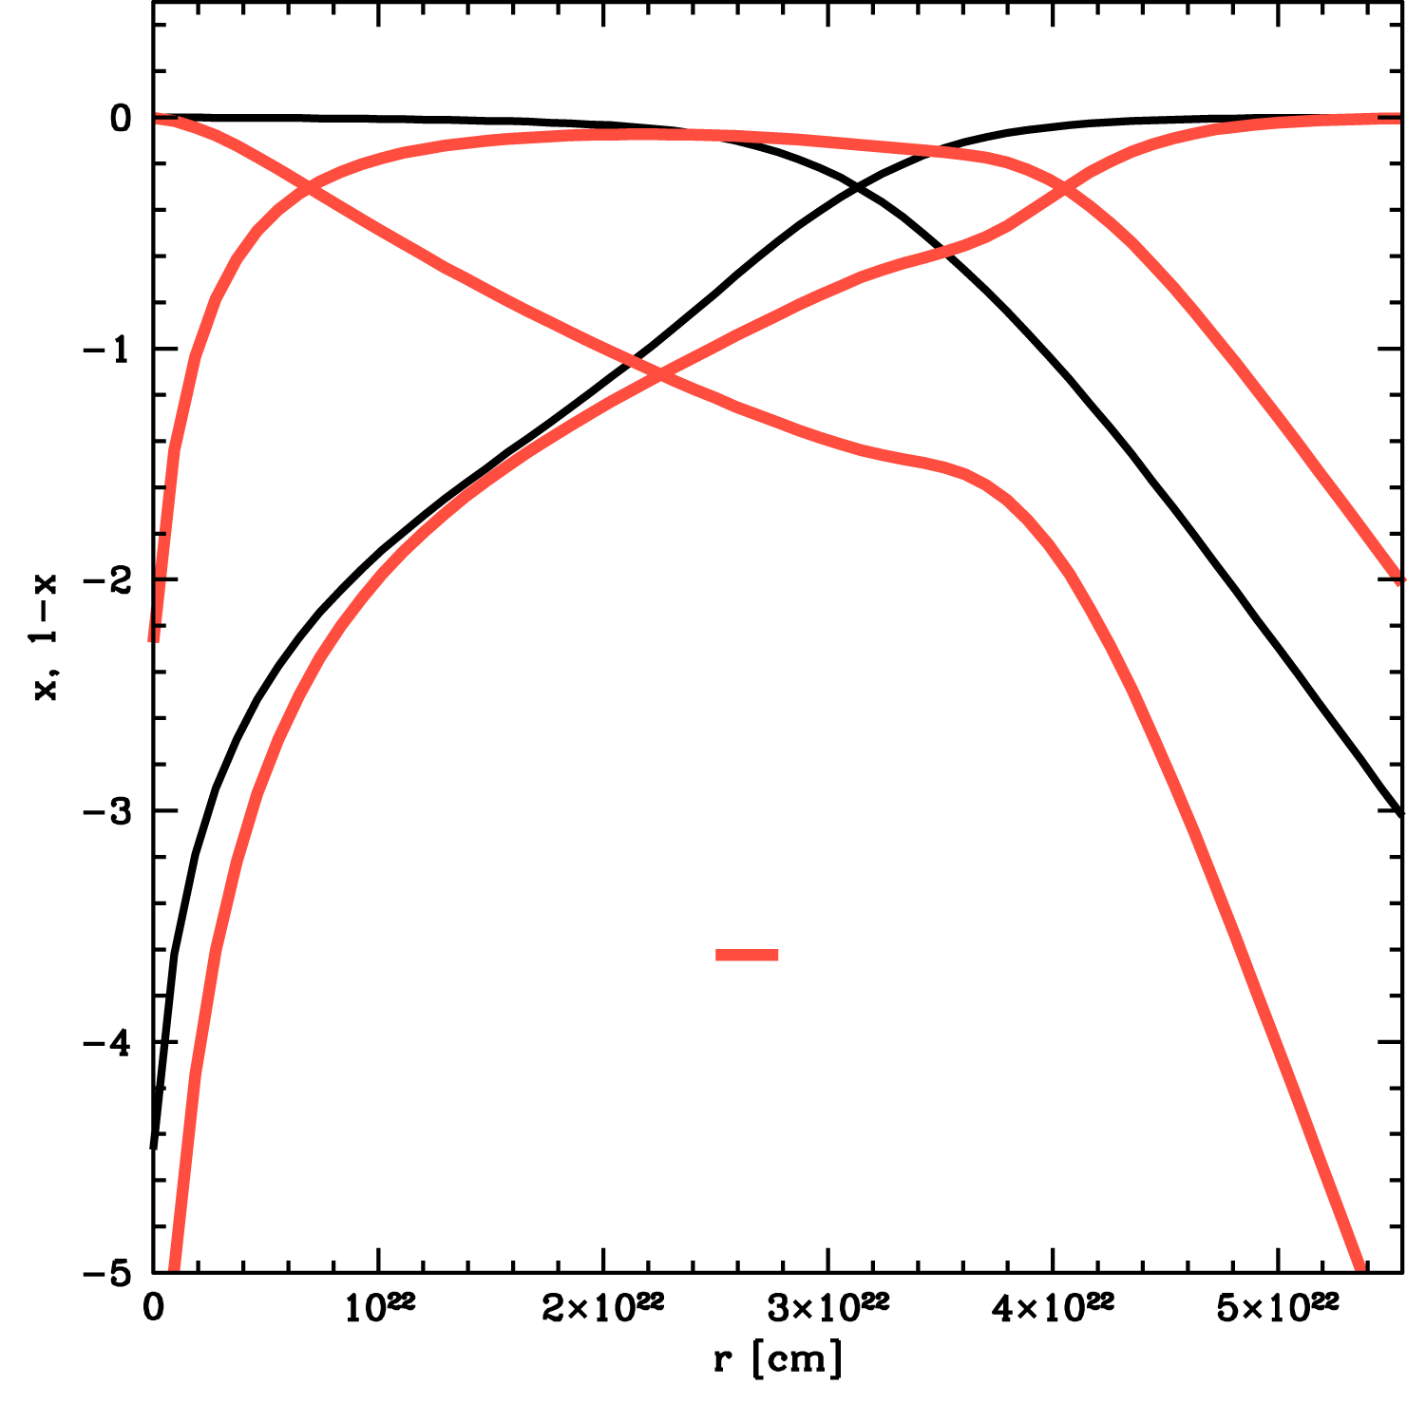
H & He

Slide 13
Adding dust
Recent observational results suggest the possibility of significant effects of dust in z ∼ 6−8 galaxies [e.g. Schaerer & de Barros (2010)]
Using dust description from Gnedin et al. (2008)
Adopt metallicities of SMC, LMC and MW
Differences < 1% level in positions of the Ifront
Might be important for heating/cooling though…

Slide 14
Test 2 (Iliev et al. 2006)
nH = 1e-3 cm⁻³
1e5 K BB-source with 5e48 ionizing photons per second
500 Myr evolution
Initial temperature of 100 K
Heating and cooling
Spectral hardening

Slide 15
Test 2 (Iliev et al. 2006)
No spectral hardening:
-IFront lags behind wrt other codes
With spectral hardening:
-IFront is consistent with other codes
-IFront becomes less steep
-Neutral fraction in inner region becomes lower than other codes find…problem?

Slide 16
Spectral hardening
Spectral hardening implies multiple frequencies
Different MFP for different freqs in SimpleX
Break-down of scaling with point-to-point distance
Two regimes:
R >> 1: almost all photons are absorbed/scattered within 1 step
R << 1: photons can travel multiple steps

Slide 17
Optically thin domain
Transport over multiple edges: Challenging as ballistic transport becomes diffusive after approx. 6 steps
2D example:

Slide 18
Two solutions
De-refine the grid [Paardekooper et al. (2010); submitted]
Use Direction Conserving Transport [Kruip et al. (2010); A&A accepted]
Added computational cost!

Slide 19
Constant cross section per bin
Possible to choose frequency bounds such that
Is constant over bins.
All photons can be transported on the same grid!

Slide 20
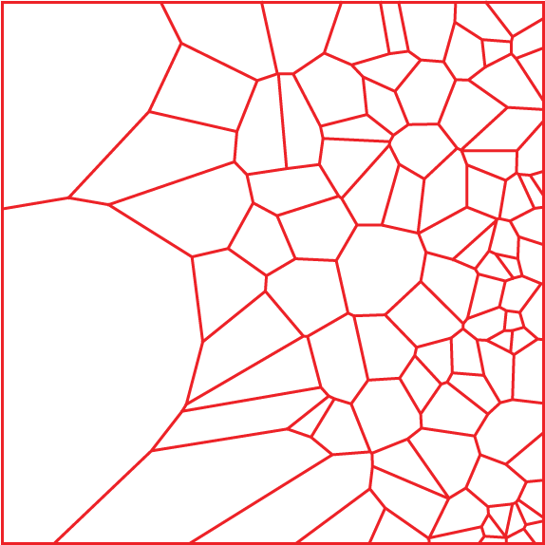
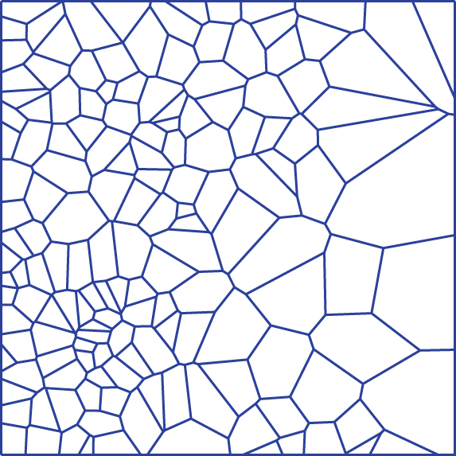
Multiple grids
Multiple grids needed for a more general choice of bins

Slide 21
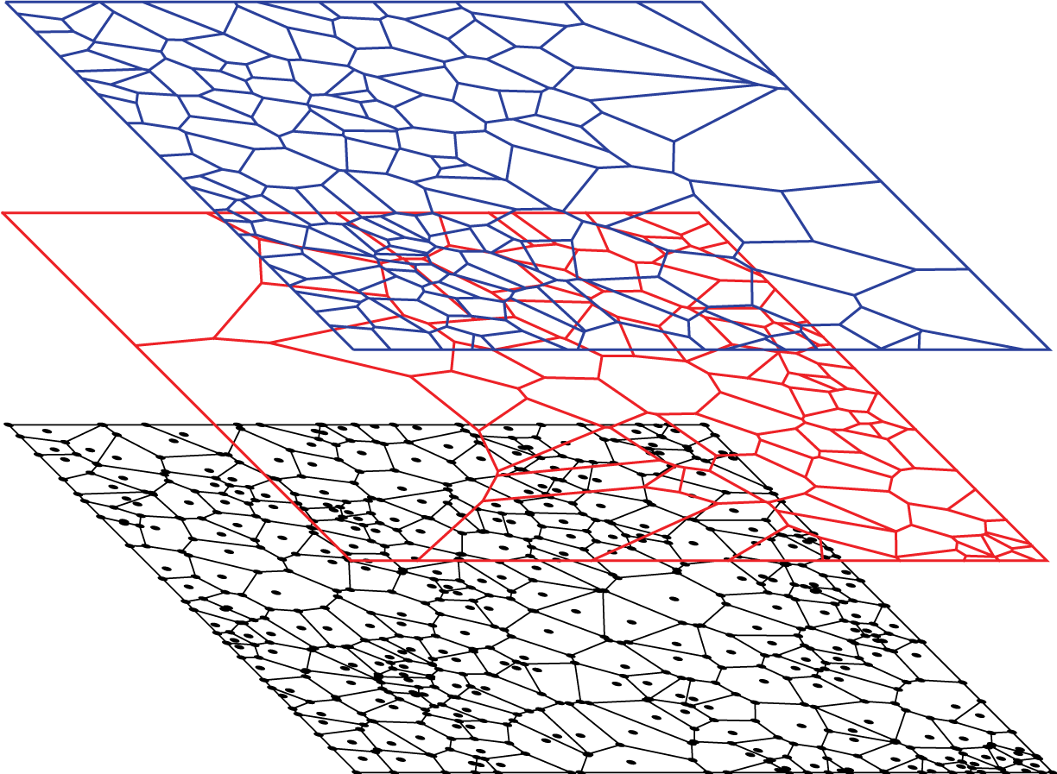
Freq 1
Freq 2
Physics

Slide 22
Communication between grids
Happens on RT timescale
Interpolation implies diffusion of photons
0th order interpolation scheme is best here
Fast association between grids with octree
Testing stage…

Slide 23
Summary
SimpleX2 has overcome the initial diffusion problems
Physics module now contains
Heating/cooling
HI, HII, HeI, HeII and HeIII
Dust absorption
Multiple frequencies
General multi-frequency approach requires multiple grids
Coupling with hydro-codes underway

