Slide 1
Statics and dynamical quantum correlations in an alternating- field XY model
Debasis Sadhukhan
HRI, Allahabad, India

Slide 2
Plan
Overview: Quantum XY model with uniform transverse field
Alternating transverse field XY model:
  Statics
    Zero-temperature study
    Finite temperature study
  Dynamics at short time
Summary

Slide 3
Why
Quantum information processing is advantageous over classical information processing: dense coding, teleportation, QKD, etc.
To achieve the advantage of quantum world, one needs physical systems to implement quantum operation.
Natural choice: quantum spin models.
Simulation of such spin systems in the laboratory is now possible by existing cutting edge technologies with photons, ions, NMR, etc.

Slide 4

QC Measures
Pure state: Von-Neumann Entropy $ℇ{(|ψ⟩}_{AB})=S(ρ_{A})$
Mixed state: $ℇ\left(ρ_{AB}\right)=\min_{ρ_{AB}=∑p_{i}|ψ_{AB}^{i}⟩⟨ψ_{AB}^{i}|}{\sum_{i}{p_{i}S(ρ_{A}^{i})}}=h(\frac{1+\sqrt{1−C^{2}}}{2})$
Entanglement of formation is a monotonic function of concurrence(C).
Wooters, PRL 80, 2245 (1998)
Notes:
For pure state C = 2\sqrt(det(\rho_A))=2\sqrt(la(1-la))

Slide 5
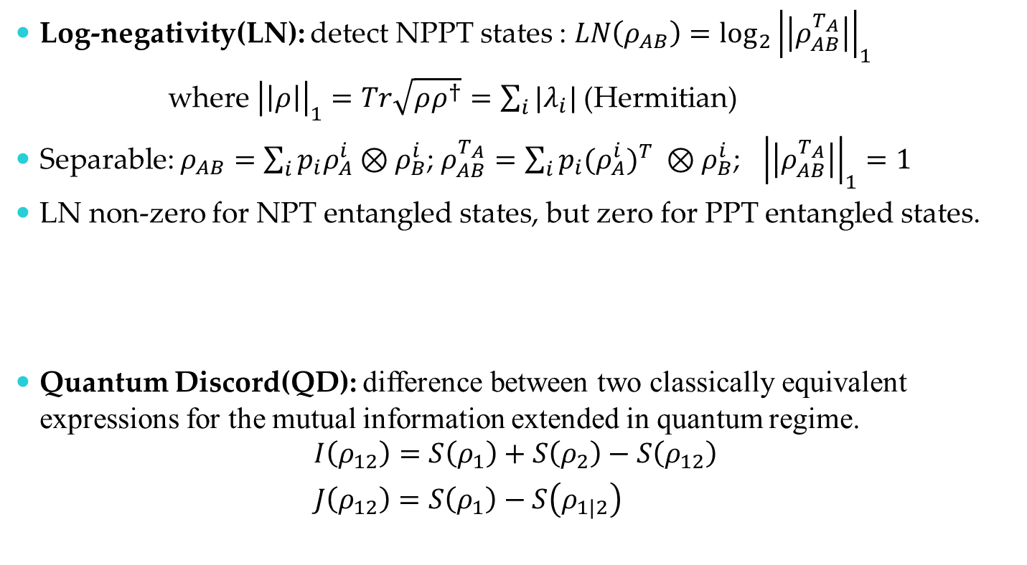
QC Measures
Log-negativity(LN): detect NPPT states : $LN\left(ρ_{AB}\right)={\log_{2}\left|\left|ρ_{AB}^{T_{A}}\right|\right|}_{1}$
where ${\left|\left|ρ\right|\right|}_{1}=Tr\sqrt{ρρ^{†}}=\sum_{i}{|λ_{i}|}$ (Hermitian)
Separable: $ρ_{AB}=\sum_{i}{p_{i}ρ_{A}^{i}⊗ρ_{B}^{i}}$; $ρ_{AB}^{T_{A}}=\sum_{i}{p_{i}{{(ρ}_{A}^{i})}^{T} ⊗ρ_{B}^{i}}$; ${\left|\left|ρ_{AB}^{T_{A}}\right|\right|}_{1}=1$
LN non-zero for NPT entangled states, but zero for PPT entangled states.
Quantum Discord(QD): difference between two classically equivalent expressions for the mutual information extended in quantum regime.
$$I\left(ρ_{12}\right)=S\left(ρ_{1}\right)+S\left(ρ_{2}\right)−S\left(ρ_{12}\right)$$
$J\left(ρ_{12}\right)=S\left(ρ_{1}\right)−S\left(ρ_{1|2}\right)$
Vidal, Werner, PRA 65, 032314 (2002)
Plenio, PRL 95, 090503 (2005)
Henderson, Vedral, J. Phys. A 34, 6899 (2001)
Oliver, Zurek, PRL 88, 017901 (2002)
Notes:
For pure state C = 2\sqrt(det(\rho_A))=2\sqrt(la(1-la))

Slide 6
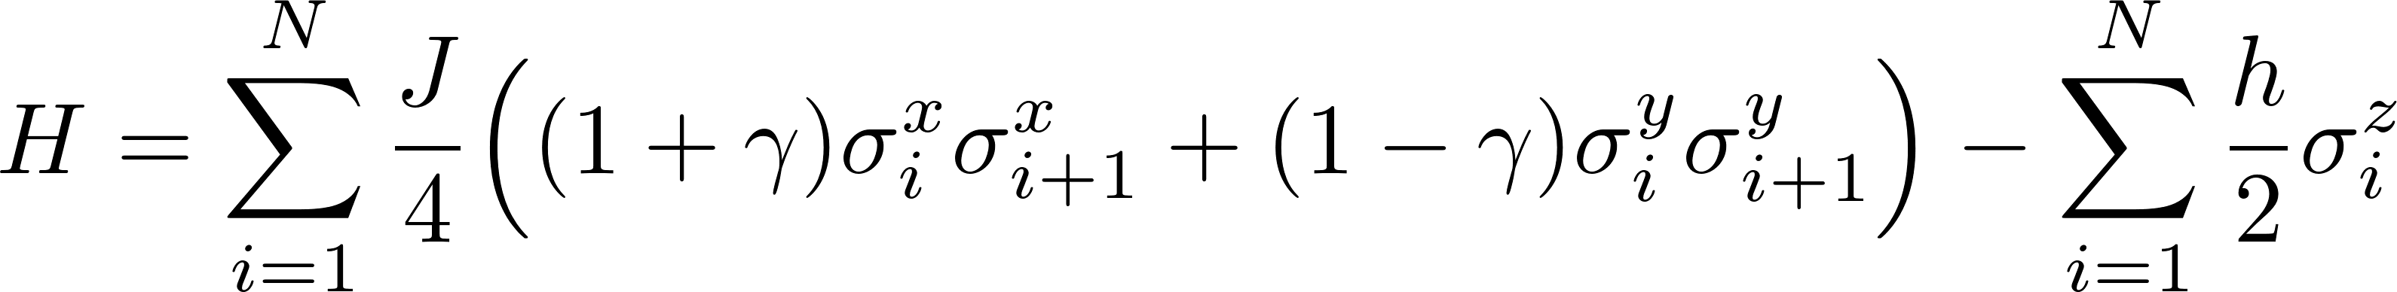
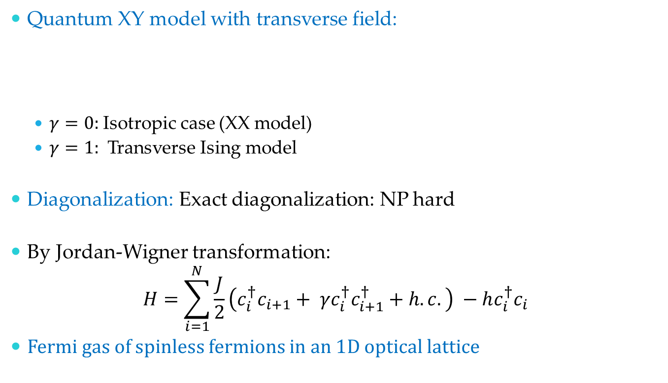
Overview
Quantum XY model with transverse field:
  $γ=0:$Isotropic case (XX model)
  $γ=1:$ Transverse Ising model
Diagonalization: Exact diagonalization: NP hard
By Jordan-Wigner transformation:
$$H=\sum_{i=1}^{N}{\frac{J}{2}\left(c_{i}^{†}c_{i+1}+ γc_{i}^{†}c_{i+1}^{†}+h.c.\right) −hc_{i}^{†}c_{i}}$$
Fermi gas of spinless fermions in an 1D optical lattice
PBC assumed

Slide 7
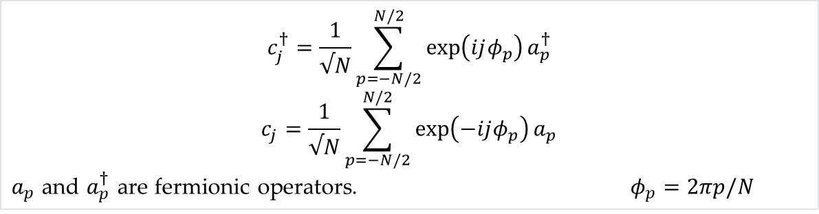

Overview
Quantum XY model with transverse field:
  $γ=0 :$Isotropic case (XX model)
  $γ=1 :$ Transverse Ising model
Exactly solvable : by successive Jordan-Wigner, Fourier and Bogoliubov transformation.
PBC assumed
$$c_{j}^{†}=\frac{1}{√N}\sum_{p=−N/2}^{N/2}{\exp\left(ijφ_{p}\right)a_{p}^{†}}$$
$$c_{j}=\frac{1}{√N}\sum_{p=−N/2}^{N/2}{\exp\left(−ijφ_{p}\right)a_{p}}$$
$a_{p}$ and $a_{p}^{†}$ are fermionic operators. $φ_{p}=2πp/N$

Slide 8
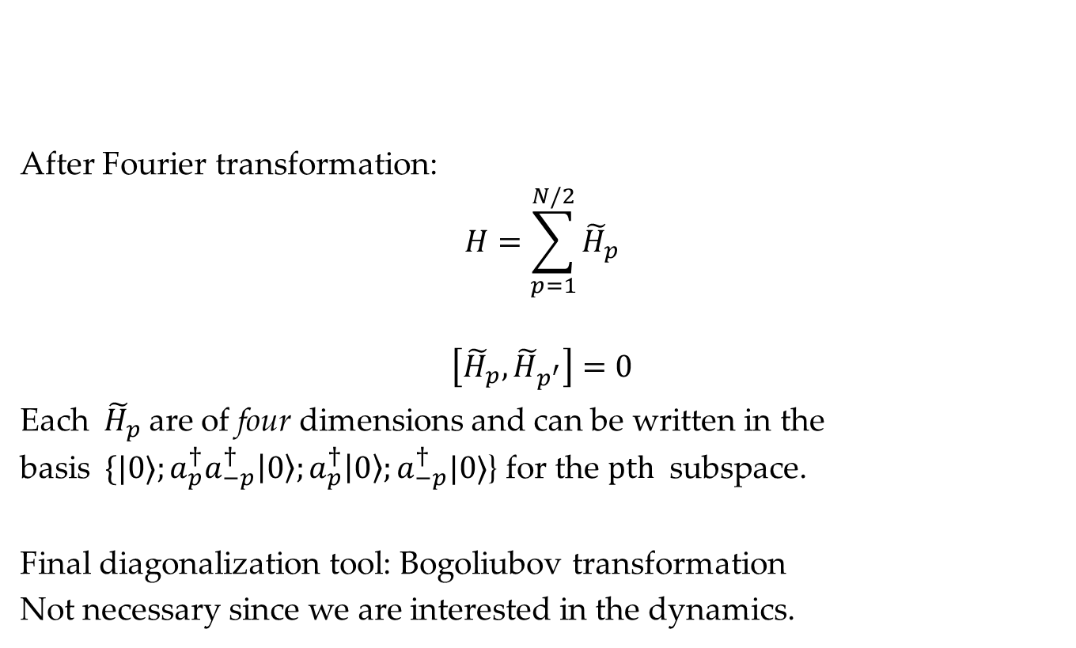
Transverse field XY model
After Fourier transformation:
$$H=\sum_{p=1}^{N/2}{{\tilde{H}}_{p}}$$
$$\left[{\tilde{H}}_{p},{\tilde{H}}_{p^{′}}\right]=0$$
Each${ \tilde{H}}_{p}$ are of four dimensions and can be written in the basis$\{|0⟩;a_{p}^{†}a_{−p}^{†}\left|0\right\rangle ;a_{p}^{†}\left|0\right\rangle ;a_{−p}^{†}|0⟩$} for the $pth$ subspace.
Final diagonalization tool: Bogoliubov transformation
Not necessary since we are interested in the dynamics.

Slide 9
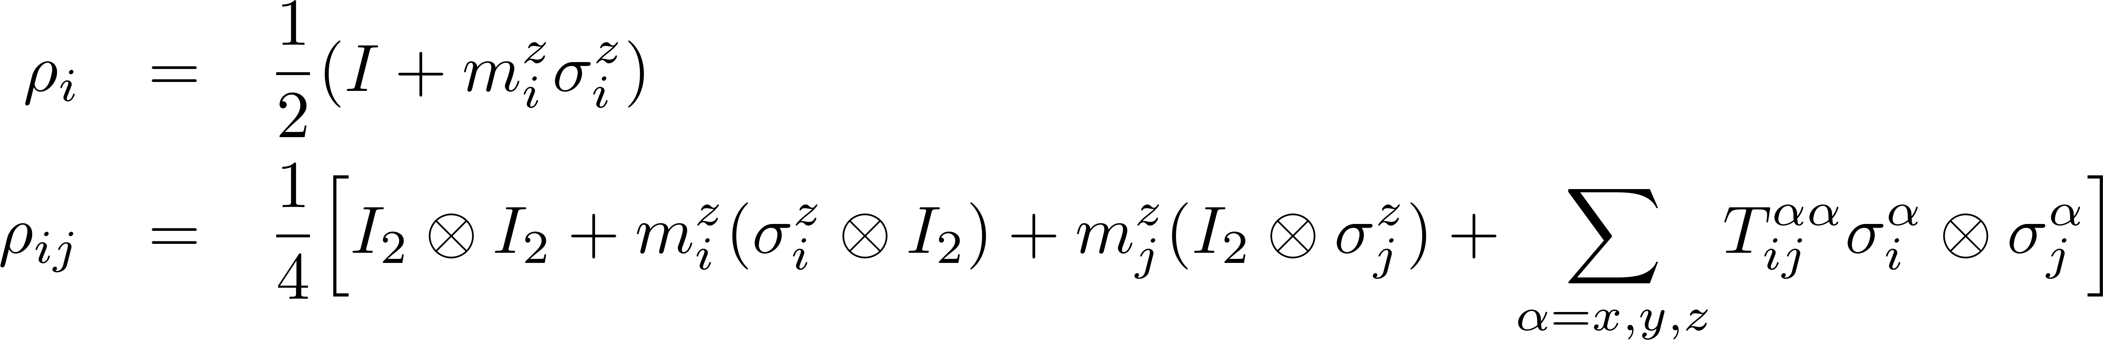

Statics
Global phase-flip symmetry : $\left[H,Π_{i}σ_{i}^{z}\right]=0$
Zero-temperature state (CES) :
$$ρ=\lim_{β→∞}{e^{−βH}/Tr[e^{−βH}]}$$
NOT the symmetry broken state.
Symmetry always reflects in the ground state.
Notes:
Describe the calculation of $ρ_{ij}$ T_xy is zero due to imaginary terms… and then how to calculate QC

Slide 10
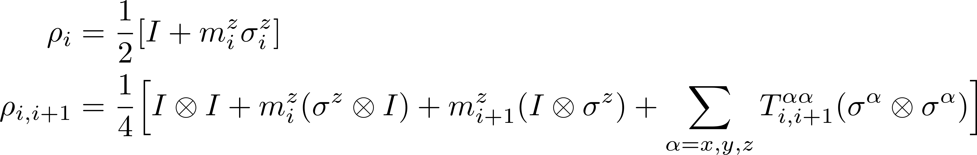
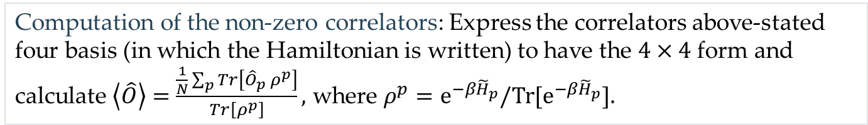

Statics
The global phase flip-symmetry implies
$T_{i,i+1}^{xy}=0$ : vanishes for static case.
Computation of the non-zero correlators: Express the correlators above-stated four basis (in which the Hamiltonian is written) to have the $4×4$ form and calculate $\left\langle \hat{O}\right\rangle =\frac{\frac{1}{N}\sum_{p}{Tr\left[{\hat{O}}_{p} ρ^{p}\right]}}{Tr\left[ρ^{p}\right]},$ where $ρ^{p}=e^{−β{\tilde{H}}_{p}}/Tr[e^{−β{\tilde{H}}_{p}}].$
Notes:
Describe the calculation of $ρ_{ij}$ and then how to calculate QC

Slide 11
QPT captured by entanglement
Transverse Ising: H = -J^{x}_{i}^{x}_{i+1} - h^{z}_{i ,}  = J/h
Concurrence
Osborne, Nielson, PRA 66, 032110 (2002)
Osterloh et. al., Nature 416, 608 (2002)
Notes:
Define Concurrence

Slide 12
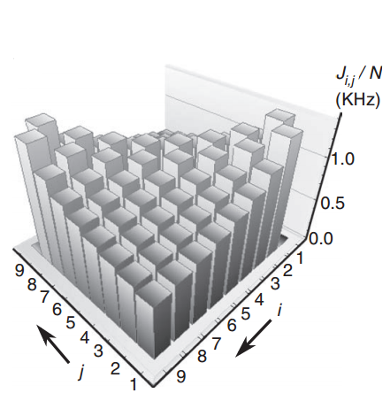
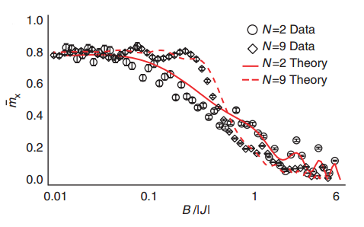
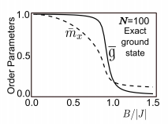
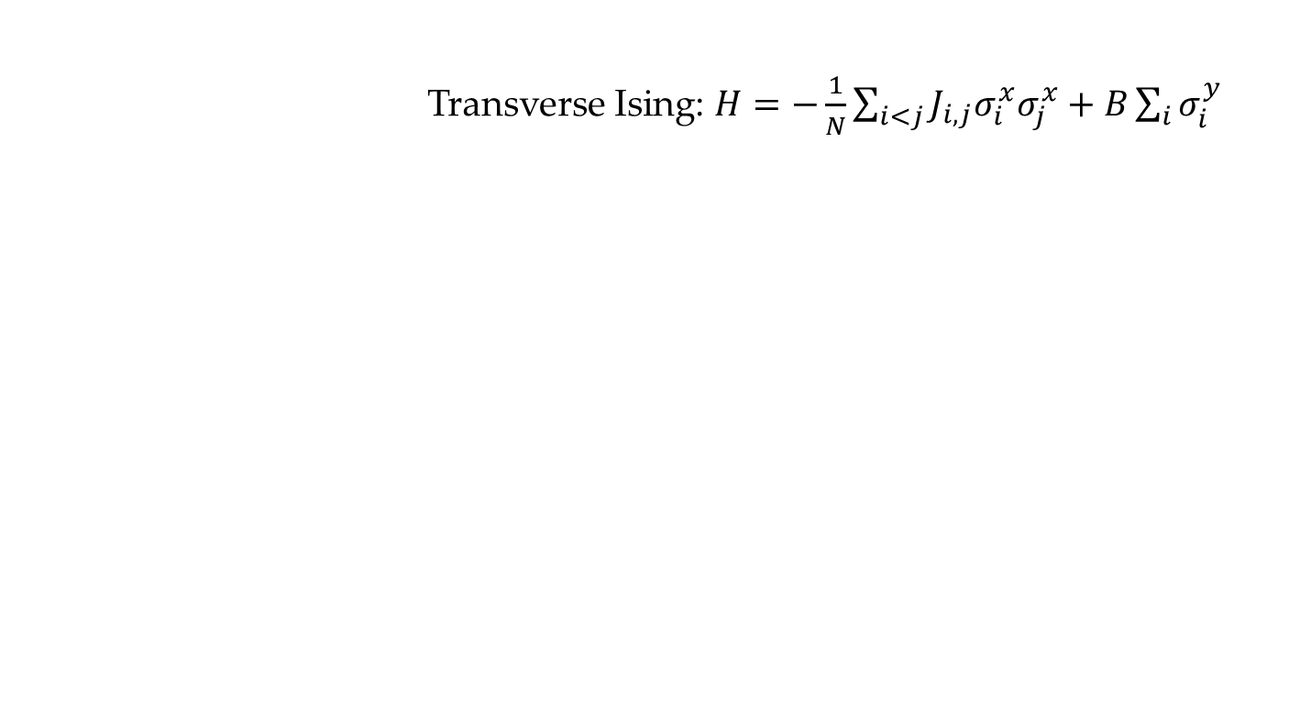
QPT Realization in Finite Size (Ion Trap)
Transverse Ising: $H=−\frac{1}{N}\sum_{i<j}{J_{i,j}σ_{i}^{x}σ_{j}^{x}+B\sum_{i}{σ_{i}^{y}} }$
Islam et. al., Nature Communications 2, 377 (2011)

Slide 13

Dynamics
The magnetic field is switched off at time $t=0.$
$$h\left(t\right)=a, t≤0$$
$$=0, t>0$$
The time-evolved(TES) state is given by:
$$ρ^{p}\left(t\right)=e^{−i{\tilde{H}}_{p}t}ρ^{p}\left(0\right)e^{i{\tilde{H}}_{p}t}$$
Notes:
The Hailtinian symmetry still reflects in the TES

Slide 14
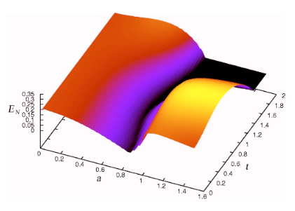


Dynamics of entanglement
ρ₂₃
1 2 3 4 5
$$γ=0.5$$
Log-Negativity
Sen(De), Sen, Lewenstein, PRA 72, 052319 (2005)
Notes:
Define LN

Slide 15
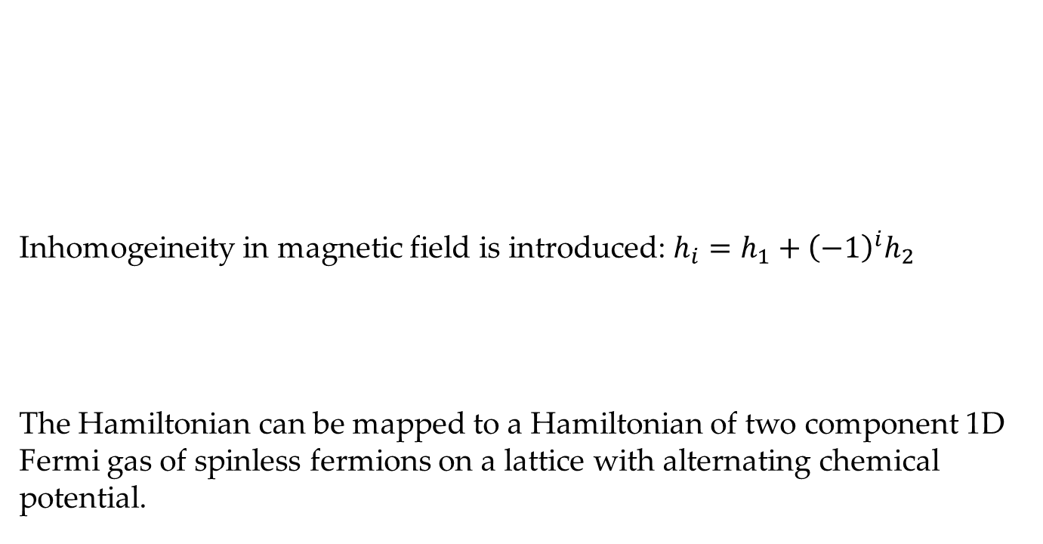
Alternating transverse field
Inhomogeineity in magnetic field is introduced: $h_{i}=h_{1}+{\left(−1\right)}^{i}h_{2}$
The Hamiltonian can be mapped to a Hamiltonian of two component 1D Fermi gas of spinless fermions on a lattice with alternating chemical potential.
1 2 3 4 5

Slide 16
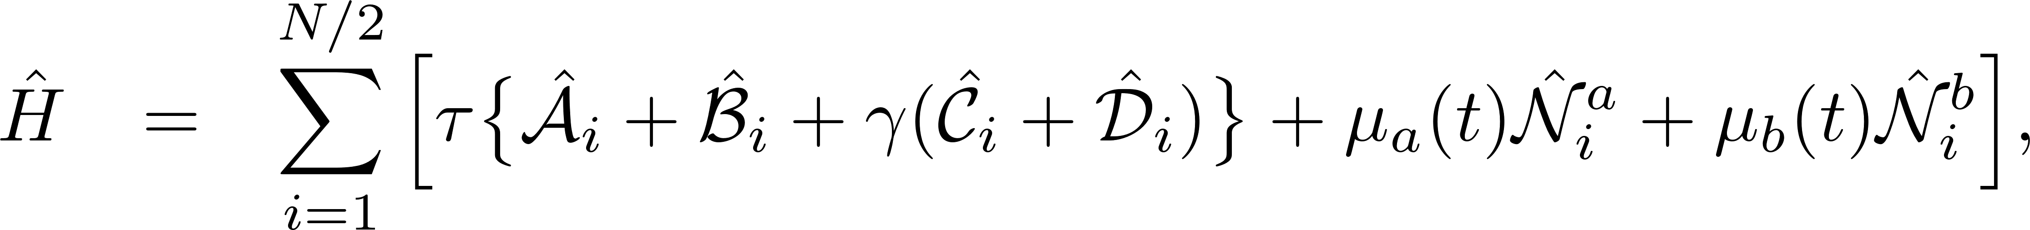
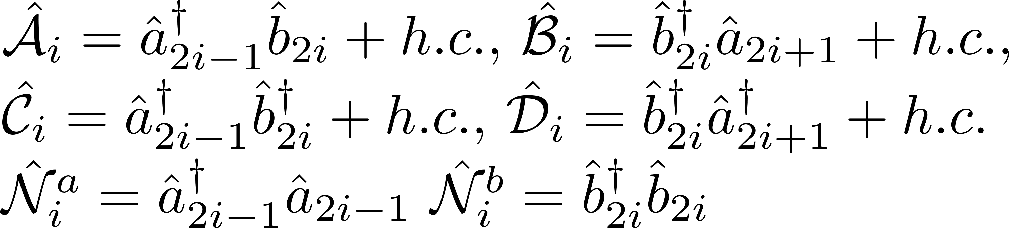
Alternating transverse field
Two component Fermi gas on an 1D lattice with alternating chemical potential:
1 2 3 4 5

Slide 17
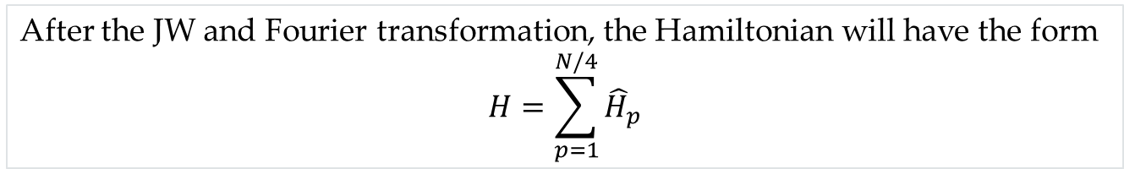
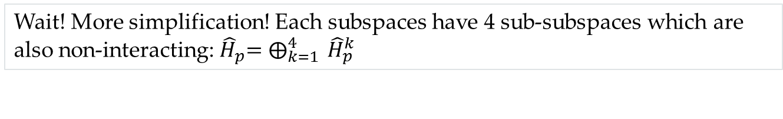

Alternating transverse field
Inhomogeineity in magnetic field is introduced: $h_{i}=h_{1}+{\left(−1\right)}^{i}h_{2}$
1 2 3 4 5
After the JW and Fourier transformation, the Hamiltonian will have the form
$$H=\sum_{p=1}^{N/4}{{\hat{H}}_{p}}$$
Wait! More simplification! Each subspaces have 4 sub-subspaces which are also non-interacting:${ \hat{H}}_{p}=⨁_{k=1}^{4}{ {\hat{H}}_{p}^{k}}$
Again, subspaces are not interacting: $\left[{\hat{H}}_{p},{\hat{H}}_{p′}\right]=0$and each ${\hat{H}}_{p}$ are $16×16.$

Slide 18
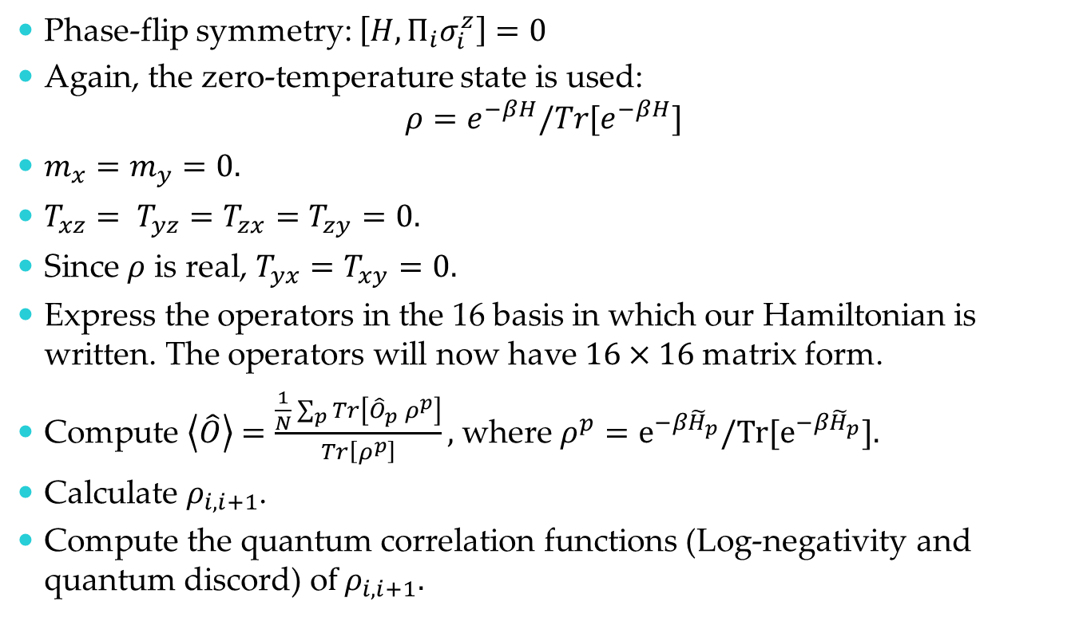
Prescription (Statics)
Phase-flip symmetry: $\left[H,Π_{i}σ_{i}^{z}\right]=0$
Again, the zero-temperature state is used:
$$ρ=e^{−βH}/Tr[e^{−βH}]$$
$m_{x}=m_{y}=0.$
${T_{xz}= T}_{yz}=T_{zx}=T_{zy}=0.$
Since $ρ$ is real, $T_{yx}=T_{xy}=0.$
Express the operators in the 16 basis in which our Hamiltonian is written. The operators will now have $16×16$ matrix form.
Compute $\left\langle \hat{O}\right\rangle =\frac{\frac{1}{N}\sum_{p}{Tr\left[{\hat{O}}_{p} ρ^{p}\right]}}{Tr\left[ρ^{p}\right]},$ where $ρ^{p}=e^{−β{\tilde{H}}_{p}}/Tr[e^{−β{\tilde{H}}_{p}}].$
Calculate $ρ_{i,i+1}$.
Compute the quantum correlation functions (Log-negativity and quantum discord) o$f ρ_{i,i+1}.$

Slide 19


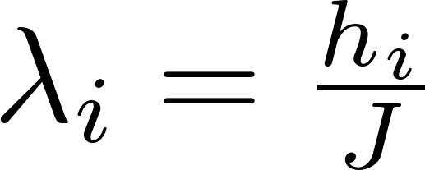


Statics
The alternating field XY model posses an extra dimer phase (DM) in addition to antiferromagnetic (AFM) and paramagnetic phase (PM) of normal XY model.
The phase-boundary:
${ λ}_{1}^{2}=λ_{2}^{2}+1$
${ λ}_{2}^{2}=λ_{1}^{2}+γ^{2}$
The factorization line:
$λ_{1}^{2}=λ_{2}^{2}+(1−γ^{2})$
$$γ=0.8$$

Slide 20
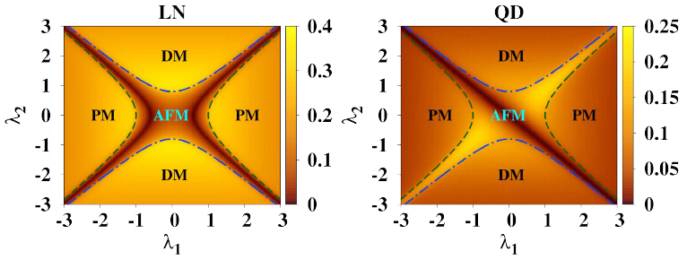

Statics
LN and QD at zero-temperature :
$$N=∞$$
$$γ=0.8$$
Notes:
LN high:DM,PM. Very low: AFM, First Define QD…QD:moderate in PM, High along l1=l2, zero along l1=-l2, situation reversed if measured on A. Asymmetry is captured by QD & Not LN

Slide 21
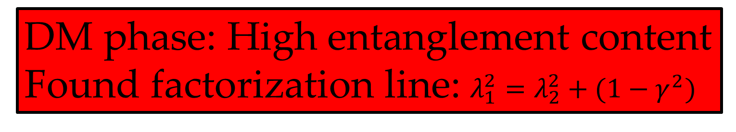
Statics
LN and QD at zero-temparature :
DM phase: High entanglement content
Found factorization line: $λ_{1}^{2}=λ_{2}^{2}+(1−γ^{2})$
$$N=∞$$
$$γ=0.8$$
Notes:
LN high:DM,PM. Very low: AFM, First Define QD…QD:moderate in PM, High along l1=l2, zero along l1=-l2, situation reversed if measured on A. Asymmetry is captured by QD & Not LN

Slide 22
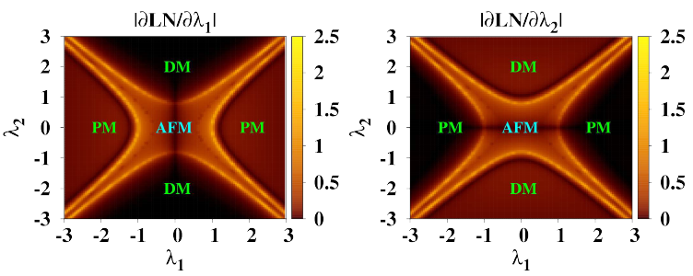
Statics
LN and QD at zero-temparature :
The first derivative of LN captures the QPTs
$$N=∞$$
$$γ=0.8$$
Notes:
J1-J2 bipartite cannot detect QPT. But here LN,QD can detect AFM->DM

Slide 23
Statics
But, now currently available technologies e.g. ion-trap can also simulate the finite size behavior.
Interesting to check how large system size is large enough to mimic the thermodynamic limit behavior.
Notes:
The prev. was for thermodynamic limit

Slide 24
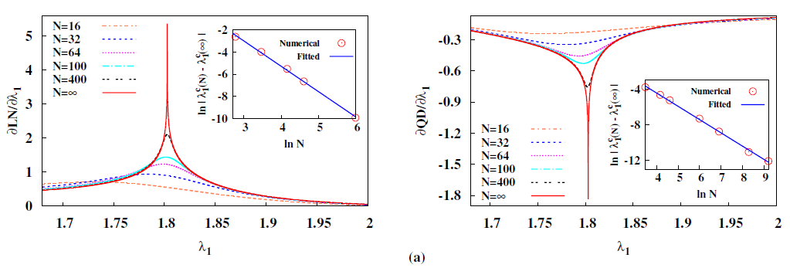



Statics
$$λ_{1}^{c}\left(N\right)=λ_{1}^{c}\left(∞\right)+α_{1}N^{−2.278}$$
Finite size scaling of LN and QD : AFM PM
$$λ_{1}^{c}\left(N\right)=λ_{1}^{c}\left(∞\right)+α_{1}N^{−1.489}$$
Better scaling exponent
$$λ_{2}=1.5,$$
$$γ=0.8$$
Notes:
J1-J2 bipartite cannot detect QPT. But here LN,QD can detect AFM->DM

Slide 25
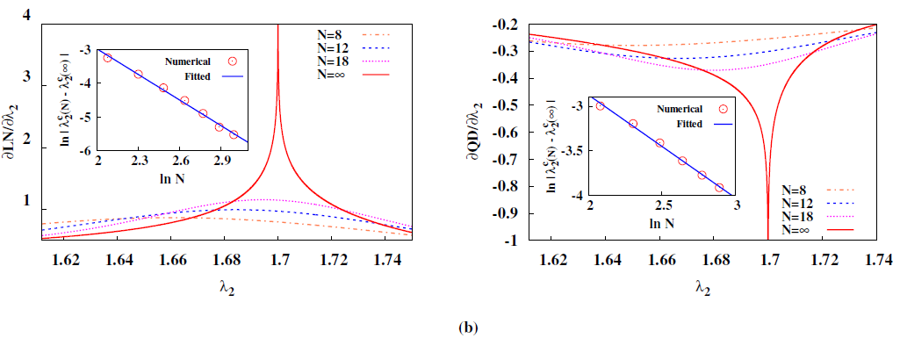



Statics
$$λ_{2}^{c}\left(N\right)=λ_{2}^{c}\left(∞\right)+α_{2}N^{−2.525}$$
Finite size scaling of LN and QD : AFM DM
Lanczos algorithm is used
$$λ_{2}^{c}\left(N\right)=λ_{2}^{c}\left(∞\right)+α_{2}N^{−1.153}$$
Scaling exponent in AFM DM > AFM PM
$$λ_{1}=1.5,$$
$$γ=0.8$$

Slide 26
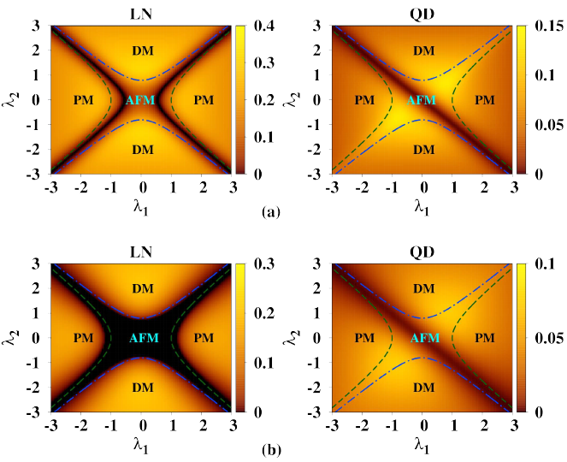


Effects of Temperature
AFM: higher spreading rate
DM: most robust
QD is more robust than LN
Finite-temperature quantum correlation of the CES:
$$βJ=5$$
$$βJ=2$$
$$N=∞$$
$$γ=0.8$$
Notes:
Why finite temperature. LN: from FL->AFM. Most fragile region:AFM…DM entanglement more robust, LN=0 absent at high T. QD is more robust that LN

Slide 27
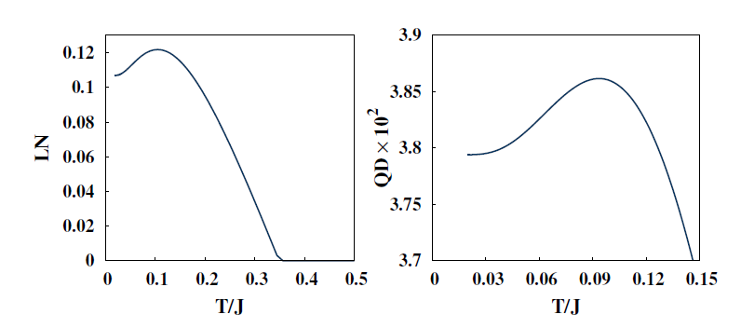


Statics
Counter-intuitive behavior of QC:
Non-monotonicity with Temperature
Surprisingly,
$$λ_{1}=−0.9, λ_{2}=0.25$$
$$λ_{1}=−0.4, λ_{2}=0.7$$
Dimer phase: Entanglement is monotonic
$$N=∞$$
$$γ=0.8$$
Notes:
Potential applicability: realize quantum protocols at high T, yet get high QC

Slide 28
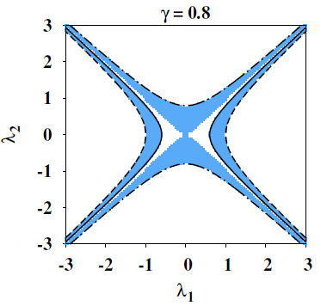
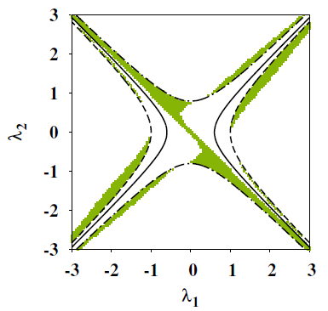
Statics
Non-monotonic regions:
LN
QD
$$N=∞$$
$$γ=0.8$$
Notes:
Potential applicability: realize quantum protocols at high T, yet get high QC

Slide 29
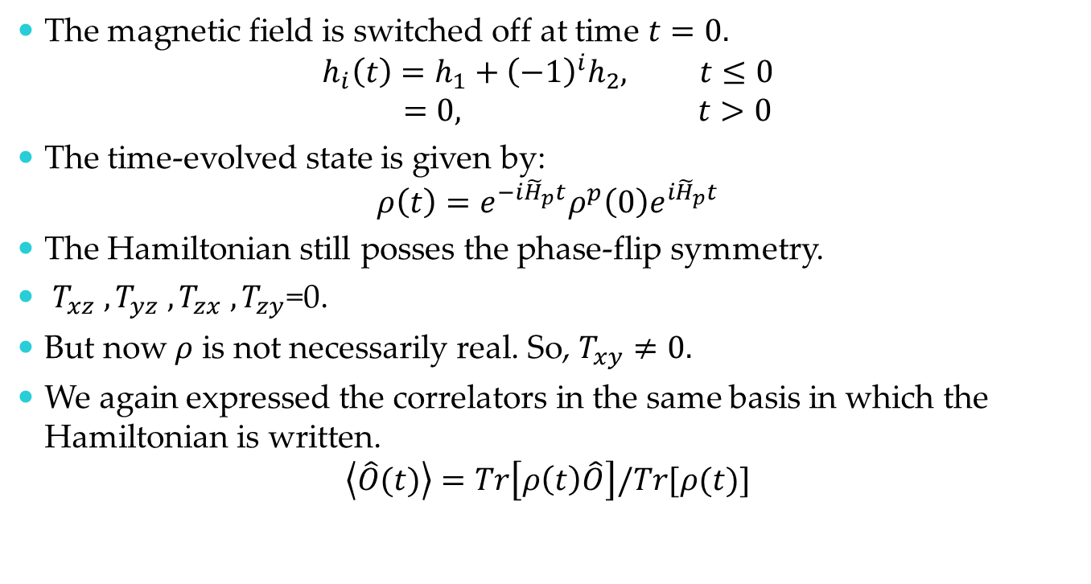
Dynamics
The magnetic field is switched off at time $t=0.$
$$h_{i}\left(t\right)=h_{1}+{\left(−1\right)}^{i}h_{2}, t≤0$$
$$=0, t>0$$
The time-evolved state is given by:
$$ρ\left(t\right)=e^{−{i\tilde{H}}_{p}t}ρ^{p}\left(0\right)e^{i{\tilde{H}}_{p}t}$$
The Hamiltonian still posses the phase-flip symmetry.
$T_{xz} , T_{yz} , T_{zx} , T_{zy}$=0.
But now $ρ$ is not necessarily real. So, $T_{xy}≠0.$
We again expressed the correlators in the same basis in which the Hamiltonian is written.
$$\left\langle \hat{O}(t)\right\rangle =Tr\left[ρ\left(t\right)\hat{O}\right]/Tr[ρ(t)]$$

Slide 30
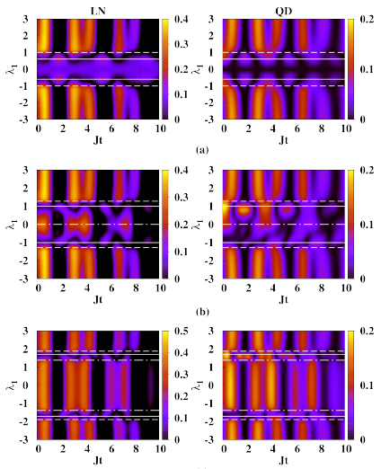




Dynamics
$$λ_{2}=0$$
$λ_{2}$ kept fixed.
$λ_{1}$ varies.
Revival and Collapse
For large-time behavior,
ergodicity, look into:
PRA 94 042310 (2016)
$$λ_{2}=0.8$$
$$λ_{2}=1.6$$
Notes:
Both LN & QD revive and collapse non-periodically. LN posses higher value. But, rise and fall of LN is more frequent than QD.

Slide 31
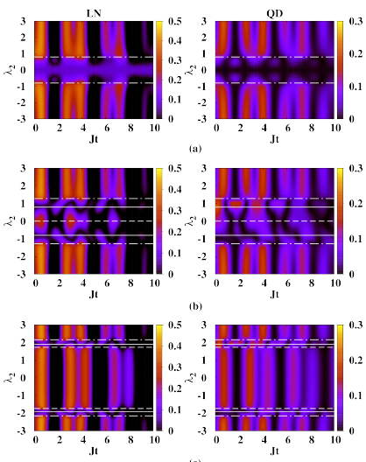




Dynamics
$$λ_{1}=0$$
$λ_{1}$ kept fixed.
$λ_{2}$ varies.
For large time behavior
look into PRA 94 042310 (2016)
$$λ_{1}=0.8$$
$$λ_{1}=1.6$$
Notes:
Both LN & QD revive and collapse non-periodically. LN posses higher value. But, rise and fall of LN is more frequent than QD. Thank collaborators…

Slide 32
Summary
Investigate the effect of an alternating transverse field in 1D XY chain.
Entanglement of ground state is high in DM phase while is very low in AFM phase.
Derivatives of Nearest neighbor QC can detect the QPTs.
With temperature, nonmonotonic variations of entanglement is found. Entanglement is always monotonic with temp in DM phase.
Large-time behavior of entanglement: always ergodic.
T Chanda, T Das, D Sadhukhan, A K Pal, A Sen(De), U Sen PRA 94 042310 (2016)

Slide 33





Thank you
For an open system treatment of this model: listen to the last talk of this conference by Amit K Pal
In collaboration with

