Slide 1

Experimental Quantum Correlations in Condensed Phase: Possibilities of Quantum Information Processing
Debabrata Goswami
CHEMISTRY*CENTER FOR LASERS & PHOTONICS*DESIGN PROGRAM
Indian Institute of Technology Kanpur
Funding:
* Ministry of Information Technology, Govt. of India
* Swarnajayanti Fellowship Program, DST, Govt. of India
* Wellcome Trust International Senior Research Fellowship, UK
* Quantum & Nano-Computing Virtual Center, MHRD, GoI
* Femtosecond Laser Spectroscopy Virtual Lab, MHRD, GoI
* ISRO STC Research Fund, GoI
Students: A. Nag, S.K.K. Kumar, A.K. De, T. Goswami, I. Bhattacharyya, C. Dutta, A. Bose, S. Maurya, A. Kumar, D.K. Das, D. Roy, P. Kumar, D.K. Das, D. Mondal, K. Makhal, S. Dhinda, S. Singhal, S. Bandyopaphyay, G. K. Shaw…

Slide 2
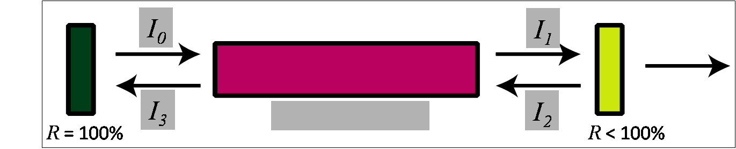
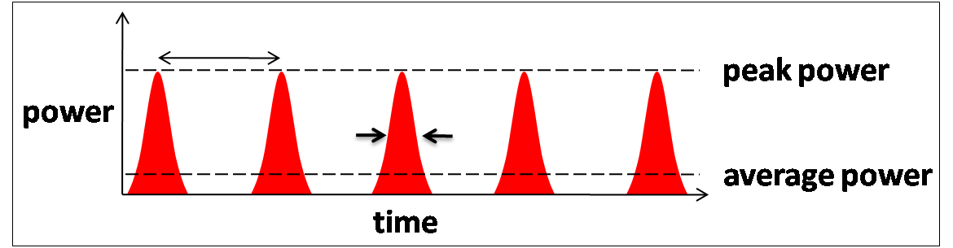
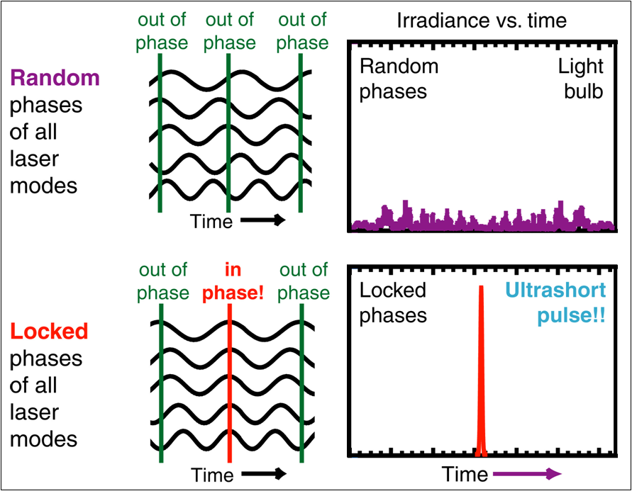
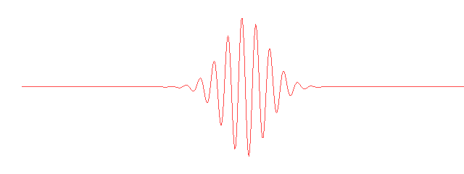



Laser sources and pulse characterization
What is an ultra-short light pulse?
τΔν = constant ~ 0.441 (Gaussian envelope)

Slide 3
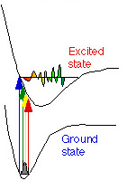
Laser Time-Bandwidth Relationship
For a CW Laser
Delta function
~0.1 nm
time
wavelength
An Ultrafast Laser Pulse
  Coherent superposition of many monochromatic light waves within a range of frequencies that is inversely proportional to the duration of the pulse
Short temporal duration of the ultrafast pulses results in a very broad spectrum quite unlike the notion of monochromatic wavelength property of CW lasers.
e.g.
Commercially
available
Ti:Sapphire
Laser at 800nm
10 fs (FWHM)
94 nm
time
wavelength

Slide 4

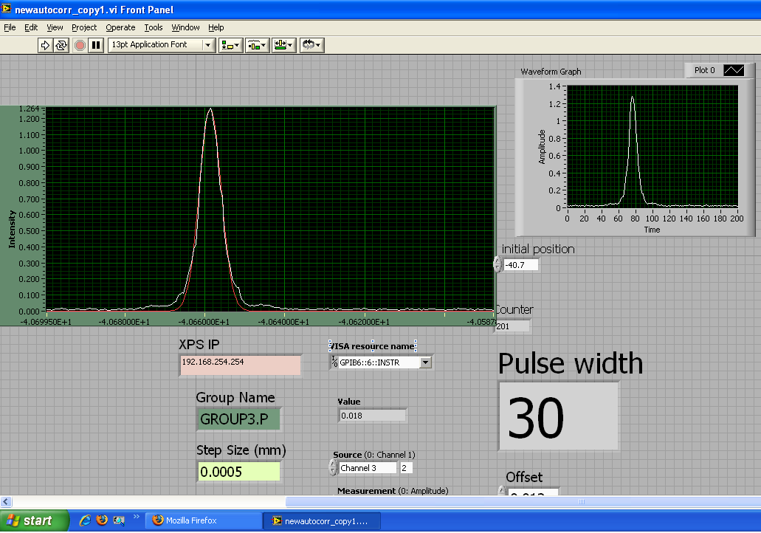
Pulse Characterization: Intensity Autocorrelation
Non-collinear Intensity autocorrelation
SPITFIRE PRO
M1
M1
M1
M1
M1
BS
L
M1
M→ Mirror
L→ Lens
BS→ Beam Splitter
PD→ Photo Diode
BBO
PD
Delay

Slide 5
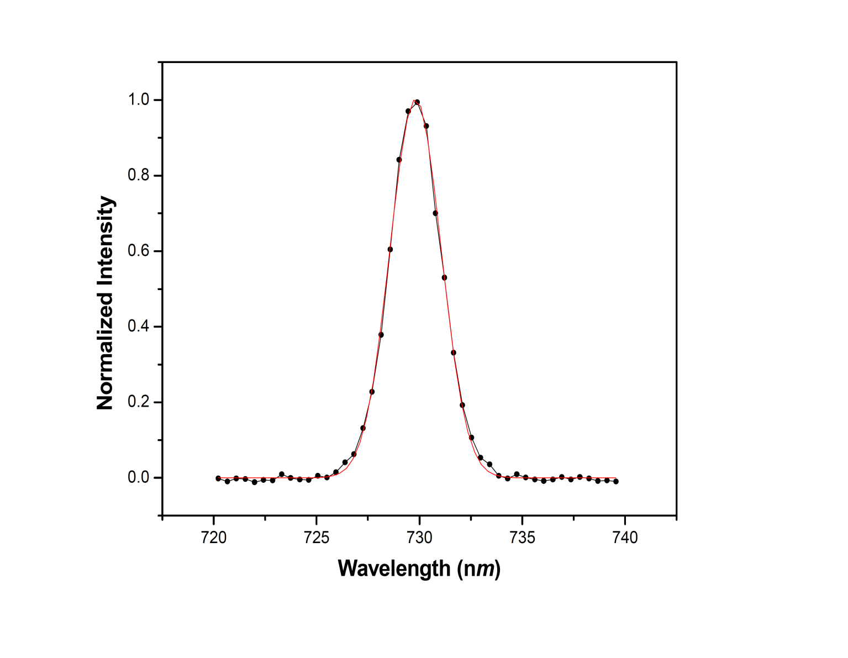
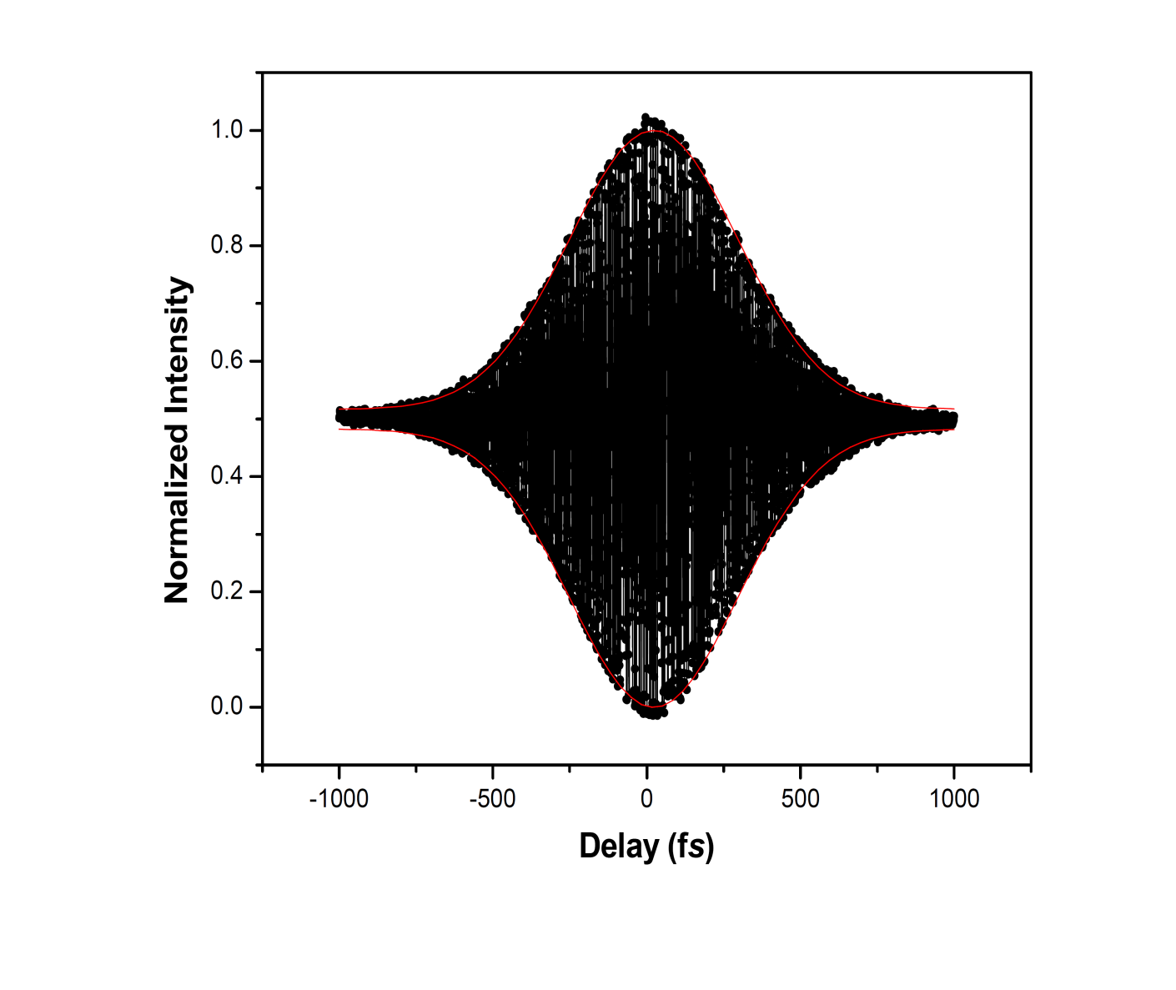
Laser Pulse Profile
Laser central wavelength ~730 nm, Pulse width: ~180 fs

Slide 6
Pulse Characterization Under Different Repetition rate
Laser repetition rate (Hz) | Pulse width (fs)
1000 | 47
500 | 52
333 | 58
250 | 59
200 | 62
100 | 67
50 | 69
25 | 80
20 | 81
10 | 88
5 | 111

Slide 7
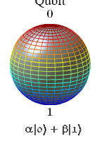
Ideal Two-Level System
Ω₁(t)=k(μ_{eff}.ε(t))^{N}/
Phys. Rep. 374(6), 385-481 (2003)

Slide 8
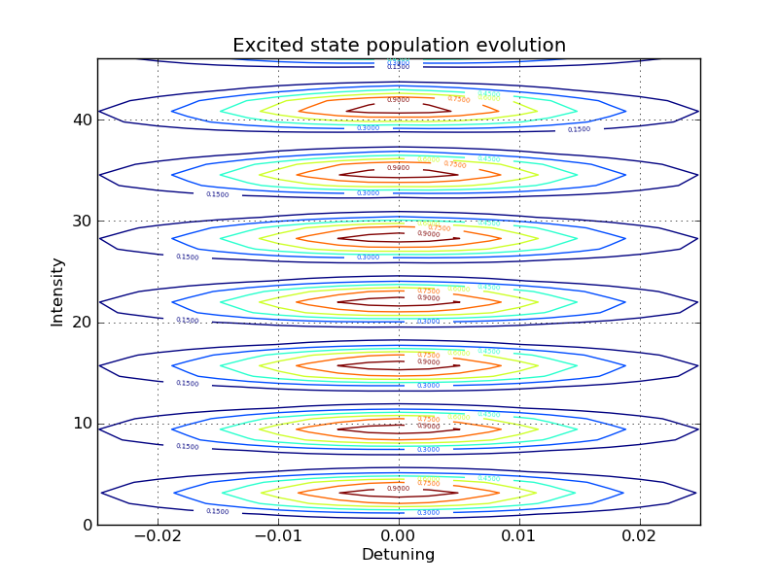
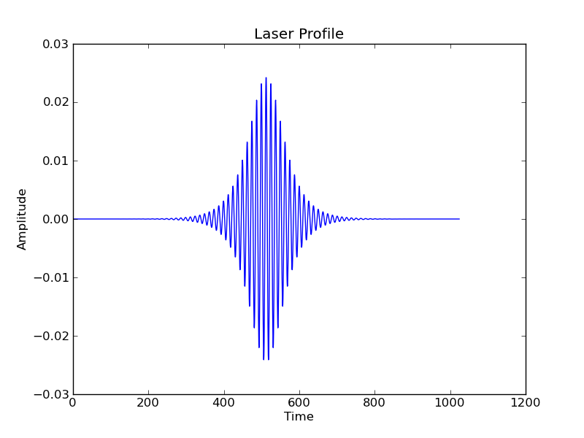
Intensity
Rabi Frequency
Electric Field
Time
Resonance offset (Detuning)

Slide 9
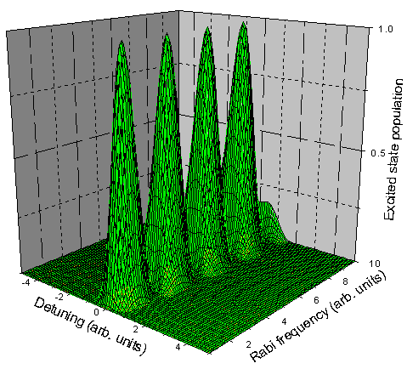
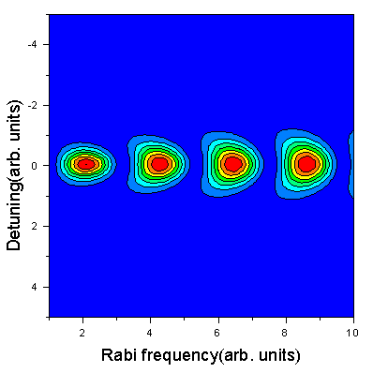
Effect of Transform-limited Guassian Pulse
Excited state population w.r.t Rabi frequency and detuning

Slide 10
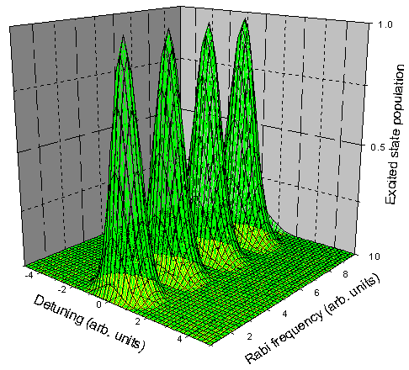
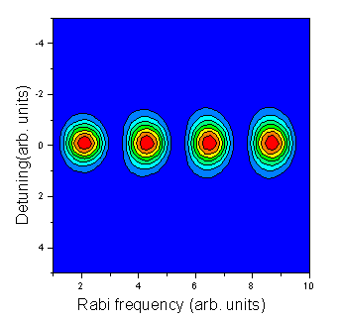
Effect of Transform-limited Hyperbolic Secant Pulse
Excited state population w.r.t Rabi frequency and detuning

Slide 11
Consider a
& let the
be
For Rotating Wave Approximation (RWA) to hold:
Though this may hold for the central part of the spectrum for a very spread-out spectrum (e.g., few-cycle pulses), it would fail for the extremities of the spectral range of the pulse.
To prove this point, lets rewrite the above equation as:
At the spectral extremities
FAILS
RWA
Failure
FAILS

Slide 12
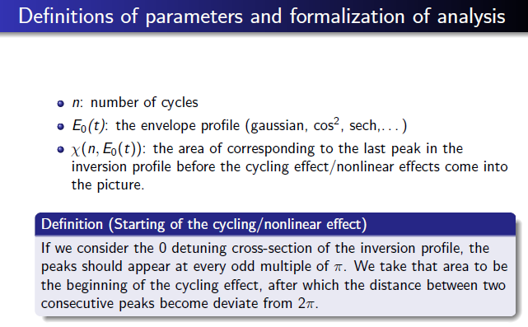
When we go to few cycle pulses, we need to evolve some further issues…
Few cycle limit?

Slide 13
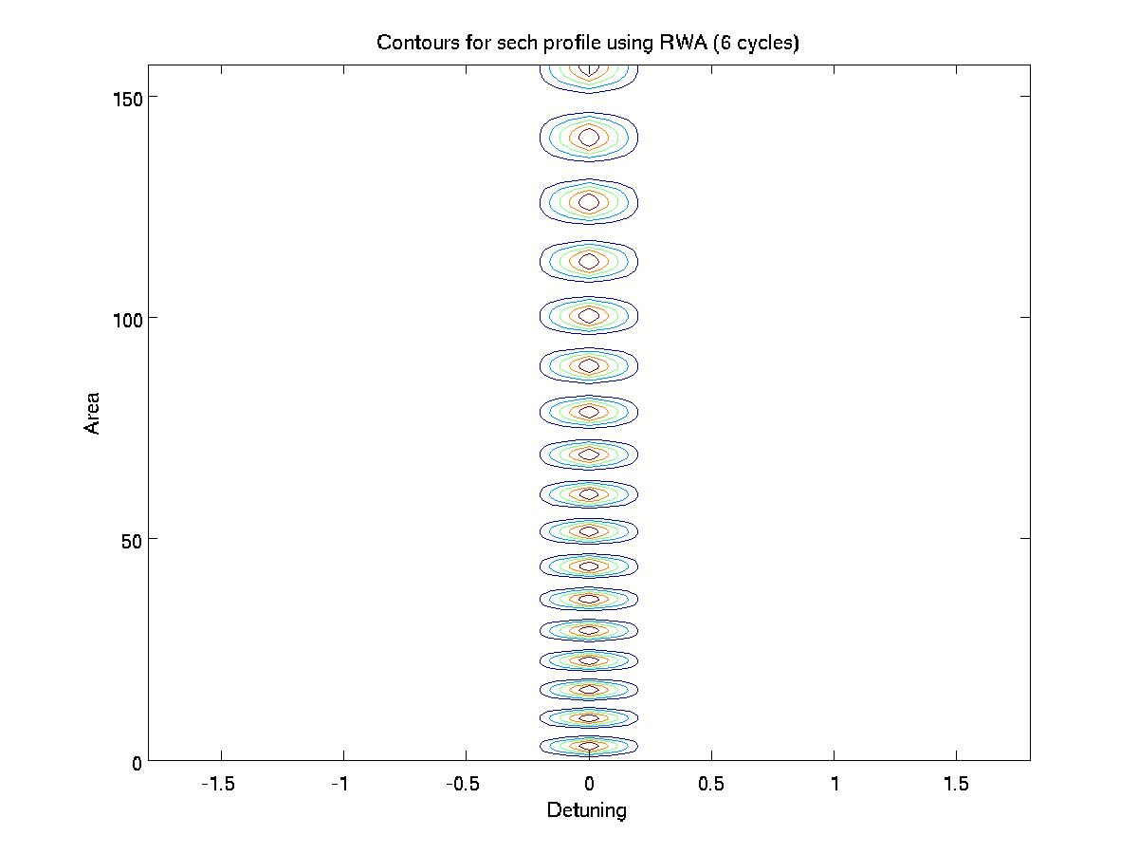
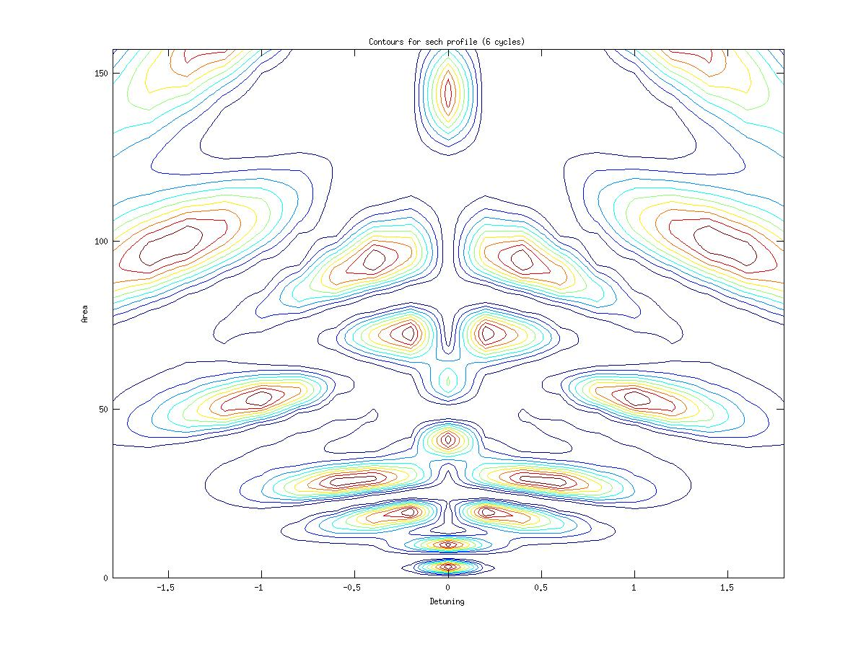
150
150
With RWA
100
Area
100
Without RWA
Area
50
50
0
-1.5
-1.0
-0.5
0
0.5
1.0
1.5
0
Detuning
-1.5
-1.0
-0.5
0
0.5
1.0
1.5
Detuning
Secant Hyperbolic Pulse 6-cycles limit

Slide 14
Observations & Problem Statement…
The constant area theorem for Rabi oscillations, at zero detuning, fail on reaching the higher areas (and hence, intensity).
This is dependent on the number of cycles in each pulse. So, let us define a threshold function for the area, for each type of profile:
where n is the number of cycles, and the minimum is taken over the inversion contours of the corresponding proﬁle.
Study the DEPENDENCE of ‘χ’ on ‘n’ for DIFFERENT pulse envelop profiles

Slide 15
Effect of Six-Cycle Gaussian Pulse

Slide 16
Effect of Eleven-Cycle Gaussian Pulse

Slide 17
Effect of Thirty-six Cycle Gaussian Pulse

Slide 18
χ(n)
χ(n)

Slide 19

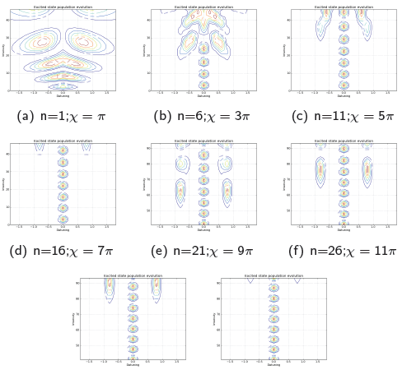

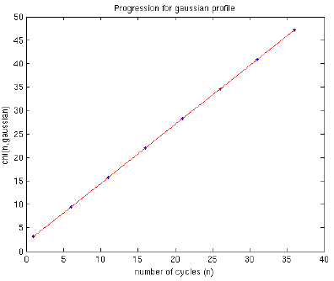


Slide 20
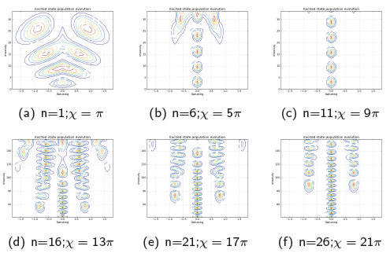

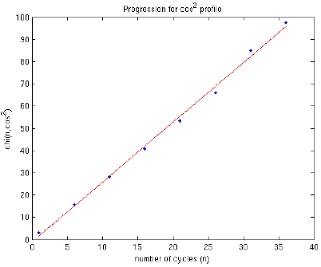
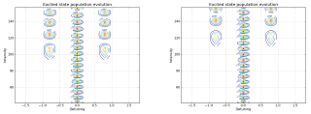

Typical Example: cosine squared

Slide 21

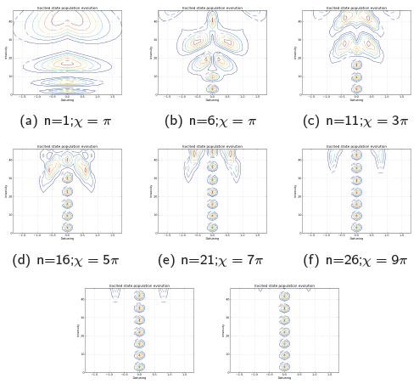

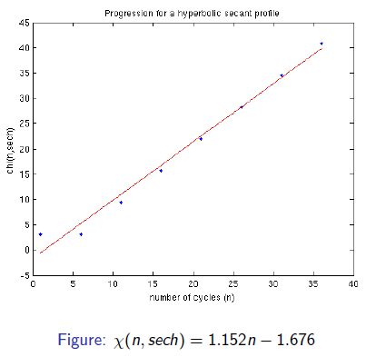

Slide 22
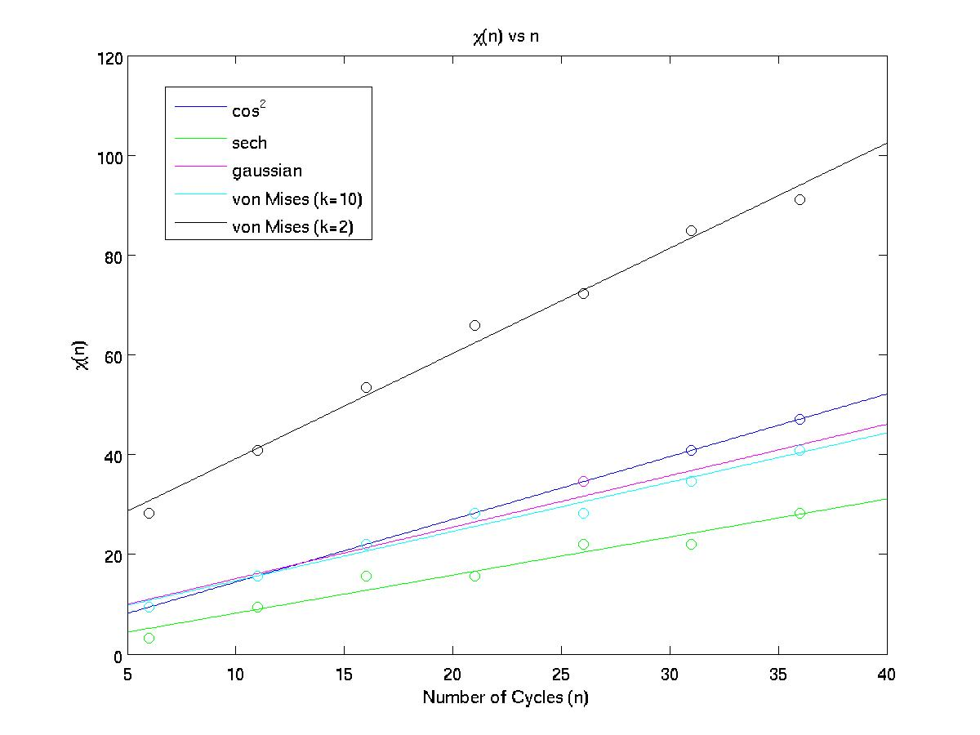

Slide 23
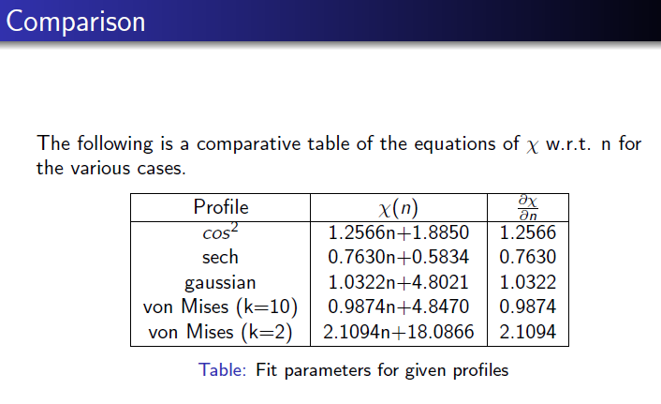
χ(n) characterizes the critical limit of area, after which the cycling effect dominates the envelop profile effect, for few-cycle pulses
This measure is DEPENDENT on the envelop profile under question.

Slide 24
Present Status
Many cycle envelop pulses:
  Area under pulse important
Interestingly,
  Envelop Effect still persists even in the few cycle limit results
Measure of nonlinearity has to be consistent over both the domains…

Slide 26
The plane wave equations for the two photons and the combined wave function is given by:

Slide 27
Hamiltonian.
Thus

Slide 29
This two-photon transition probability is independent of δ, the time
delay between the two photons

Slide 32
Relative Photon delay is immaterial
Virtual state position is also not extremely significant

Slide 33
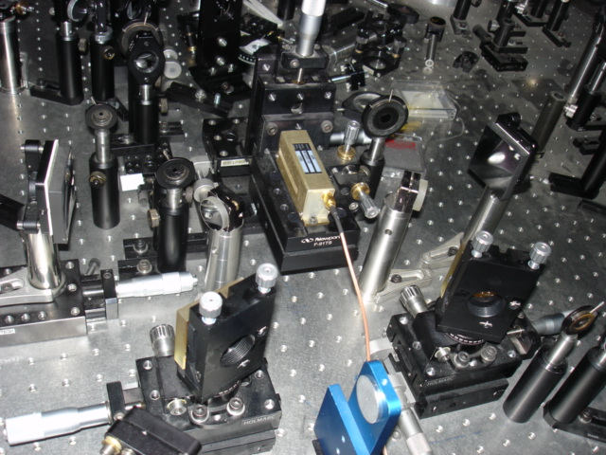
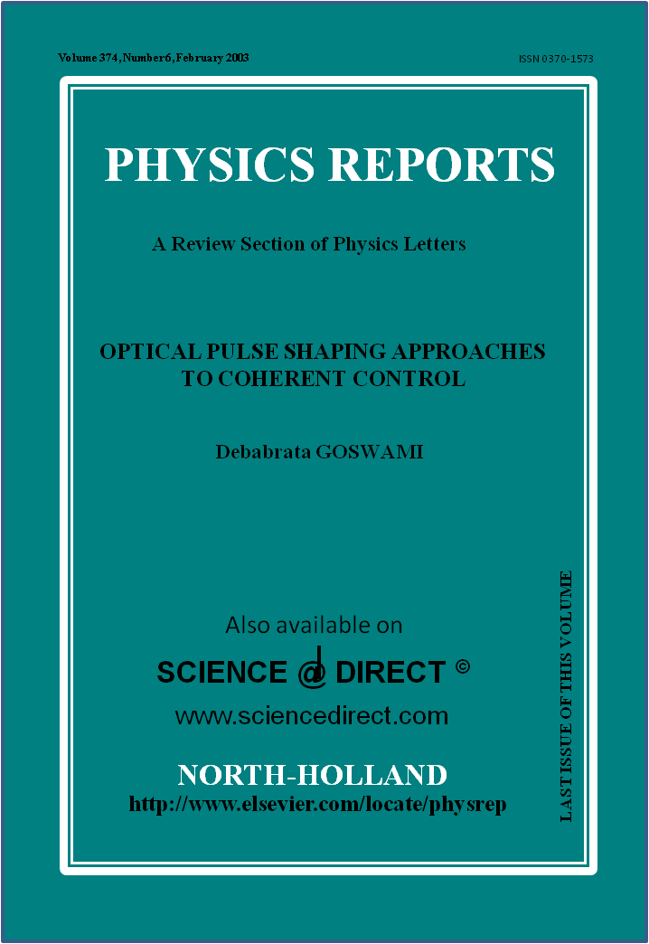

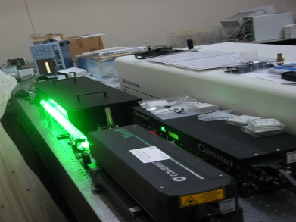
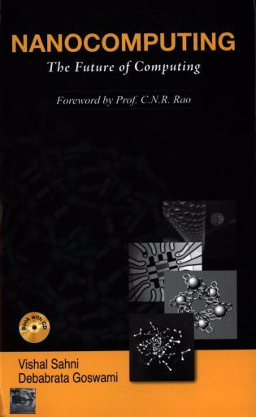
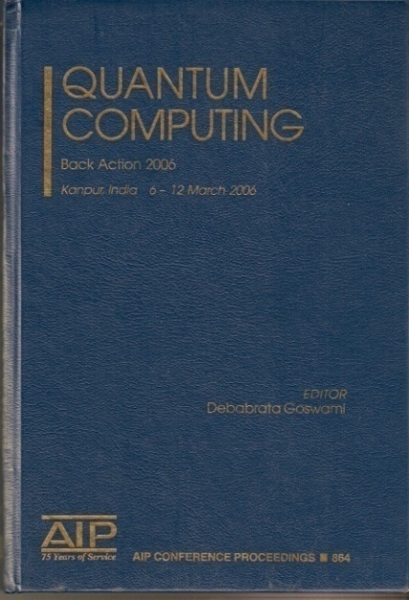
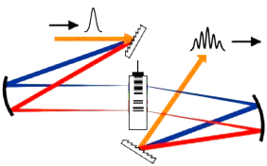
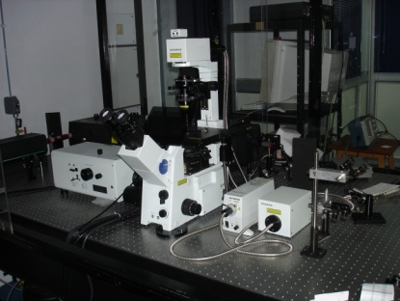
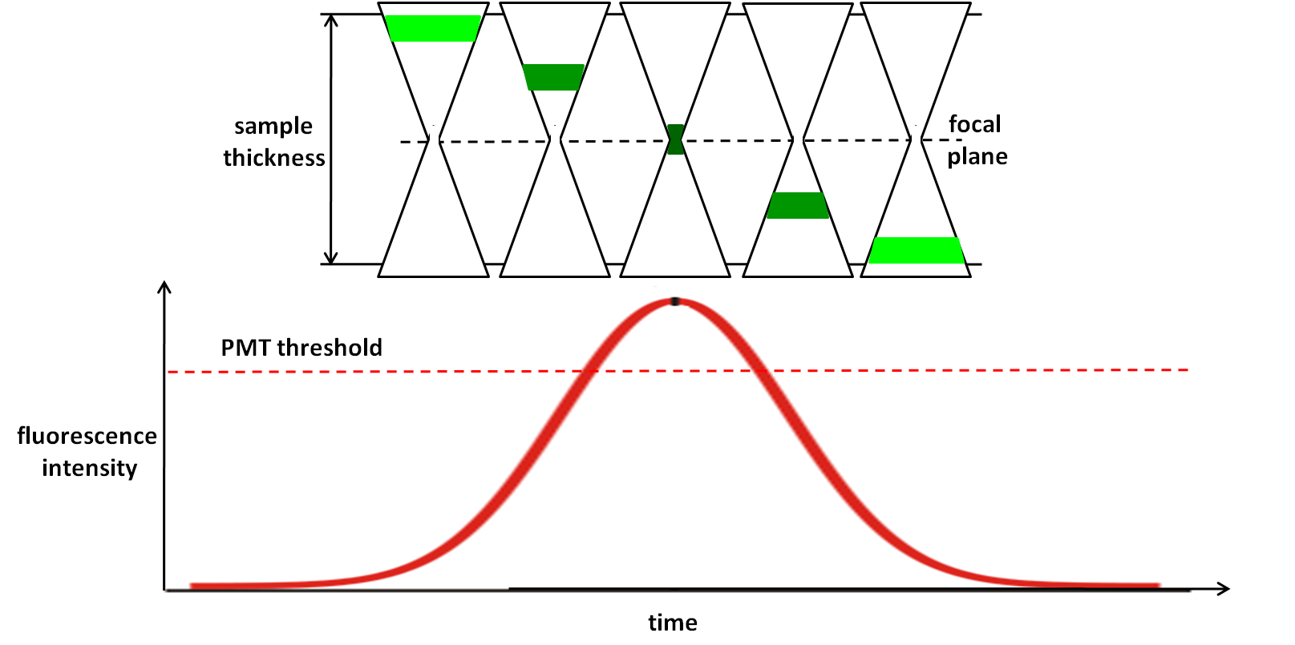
Coherent Control
Bioimaging
  Multiphoton Imaging
  Optical Tweezers
2-D IR Spectroscopy
Thank You
Femtosecond Pulse Shaper
Measurement
of Nonlinearities
For more info please visit
http://home.iitk.ac.in/~dgoswami

